Slide 1
Safeguard for Efficiency
February 2024

Slide 2
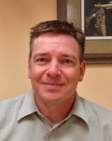
Intro
Hi, I’m Mark Jakobsen
Customer Services Manager
27+ years with IDS

Slide 3
Cybercrime damages is expected to cost the world over 7 Trillion USD in 2024

Slide 4
Today we’re going to discuss what are the actual risks, why they exist in your business, what to do about it..

Slide 5
Risks

Slide 6
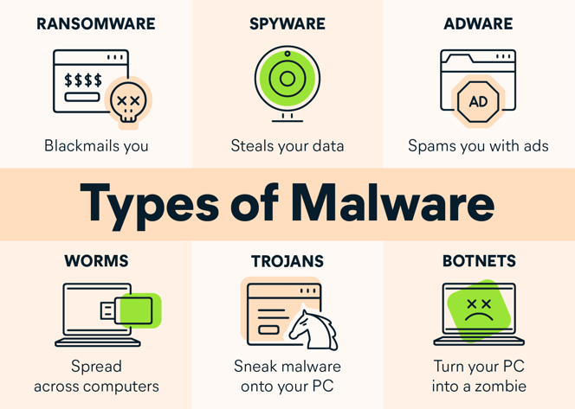
You need security against what?
Notes:
Only 50% that pay ransom actual gets unlocked

Slide 7
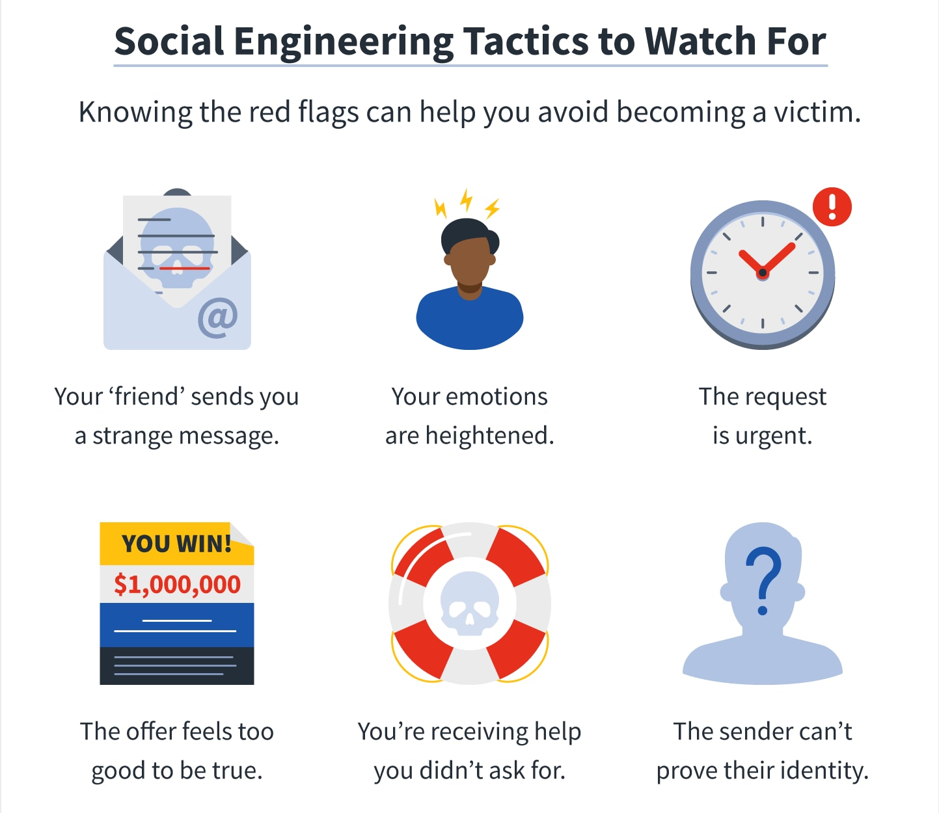
You need security against what?
Notes:
Kidnapping story

Slide 8
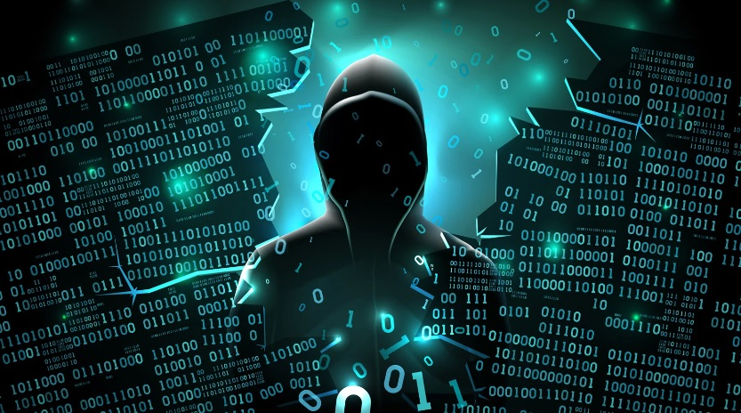
You need security against who?
Notes:
You never know, individuals, organized crime, countries?

Slide 9
Quick Alignment
Notes:
Why me!!! Let’s review what your business is to identify the “who”

Slide 10
Let’s review your business makeup

Slide 11
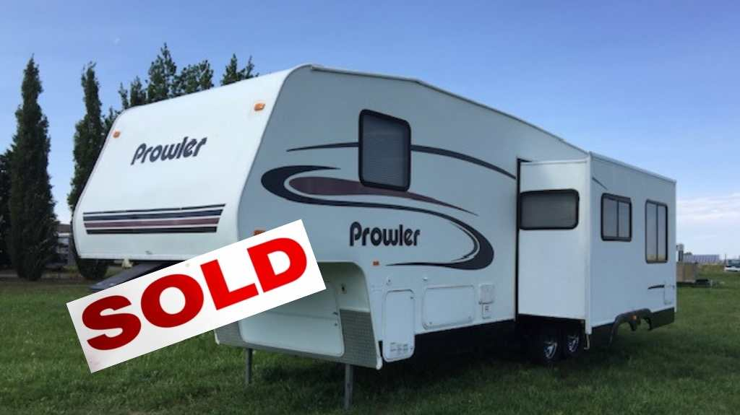
Sales
Possible Data Points

Slide 12
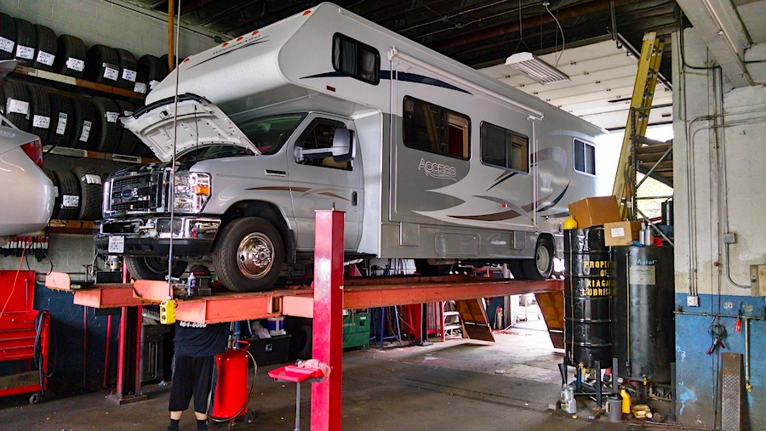
Service
Possible Data Points

Slide 13
Parts
Possible Data Points

Slide 14
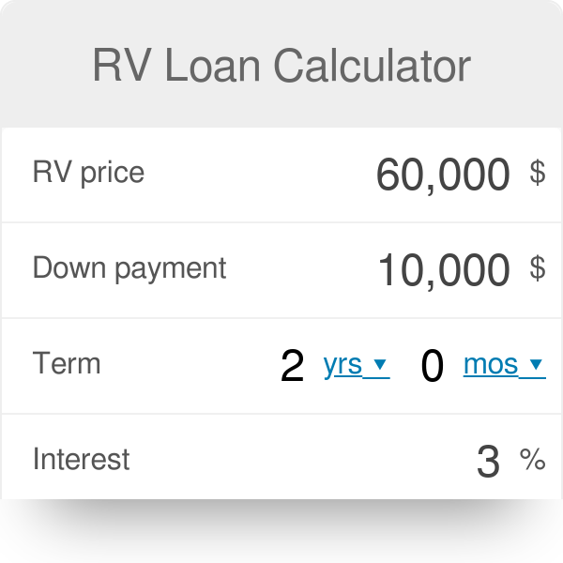
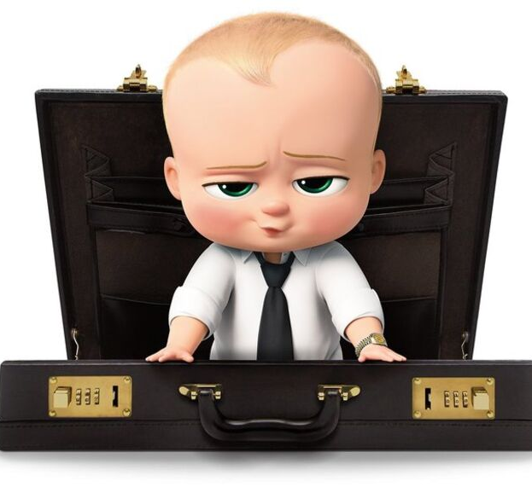
F & I
Possible Data Points

Slide 15
Management

Slide 16
The Net Result = Lots of Information
You use data to target and acquire new customers
You use data to service and sell to specific things to your customers
You use data to retain and possibly increase products and services adopted by your customers

Slide 17
What about security for this data?

Slide 18
Everything is Connected
but information security is often forgotten or minimized because…. It costs money

Slide 19
Your business needs to use mobile phones,

Slide 20
using tablets makes things easier,

Slide 21
And computers are a necessity.

Slide 22
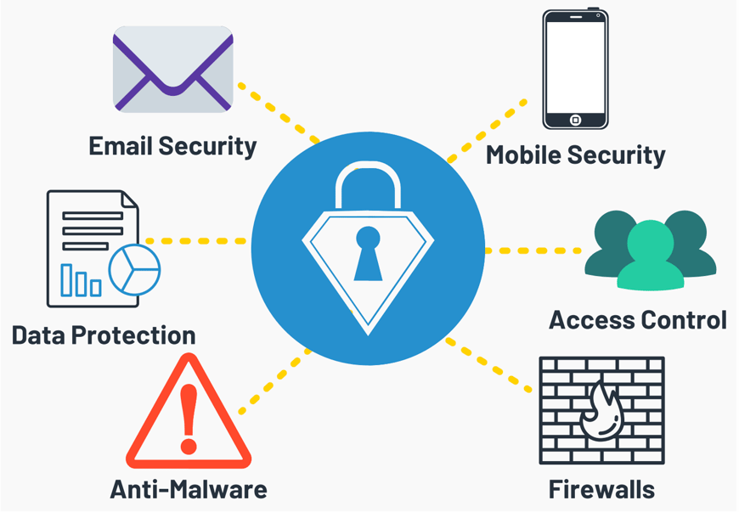
Information Security is a huge gap for most businesses
But have you made the time for security?
FTC

Slide 23
Information security costs time & money, often more than we want to spend. This is why it is being forced upon us.
Notes:
Year ago no body told you when they were hacked, bad for reputation. Bad for consumer so disclosing in now required.

Slide 24
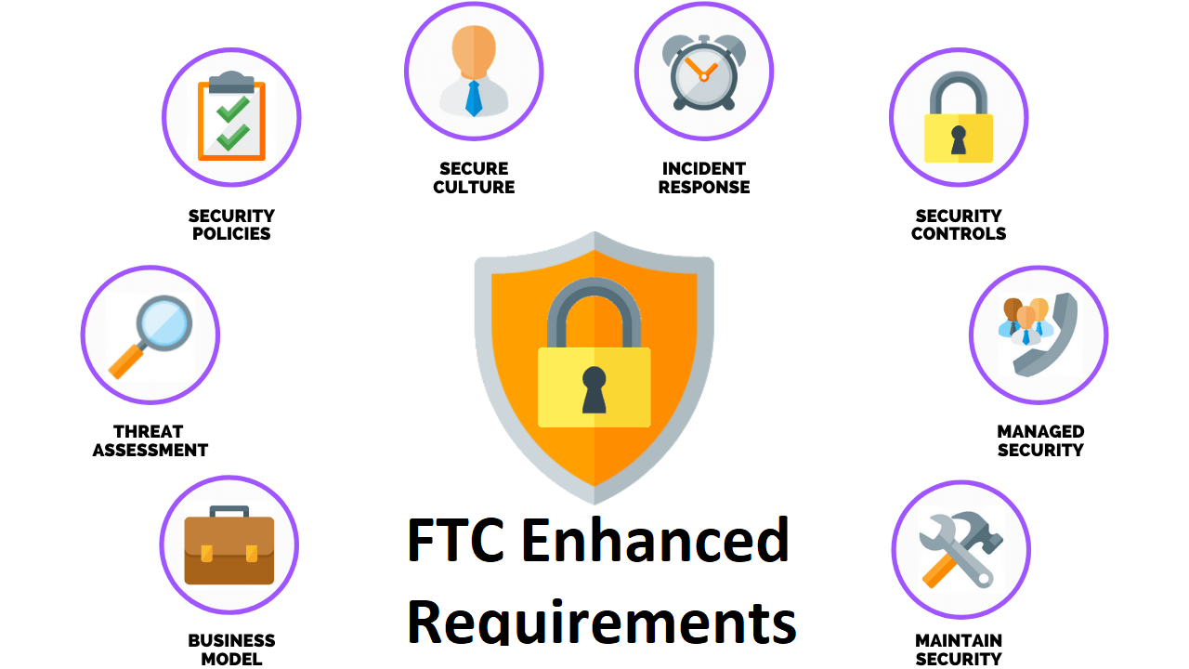
Information Security is a huge gap for most businesses
FTC

Slide 25
FTC Enhanced Requirements
Qualified person to run your infosec program
Have a written plan
Have a risk assessment completed
Penetration test & vulnerability scan
Customer data encrypted in transit and at rest
Vendor oversight
Training program
MFA – Multifactor Authentication
Notes:
MFA – touched on in the road map

Slide 26
Essentials IDS Cloud On Premise
IDS Server Options
Notes:
Essentials already has Transit and Rest covered, IDS Cloud has rest covered but we need to work together to address transit, On Premise, Local IT and will need to involve IDS for both.

Slide 27
Practical Steps
Disaster Recovery
One Backup is not enough
Limited Access
One Purpose Server
Use Available Tools
MS Office Passwords and Encryption
Notes:
Essential/Cloud = 2 backups, 1 within the data center, 1 outside – On Premise? Hackers found a way to delete online backup solution (do not save passwords in browers
Limited Access – Mission critical application, no secondary application, not a file server, the most access points, more risk

Slide 28
MS Outlook Encryption

Slide 29
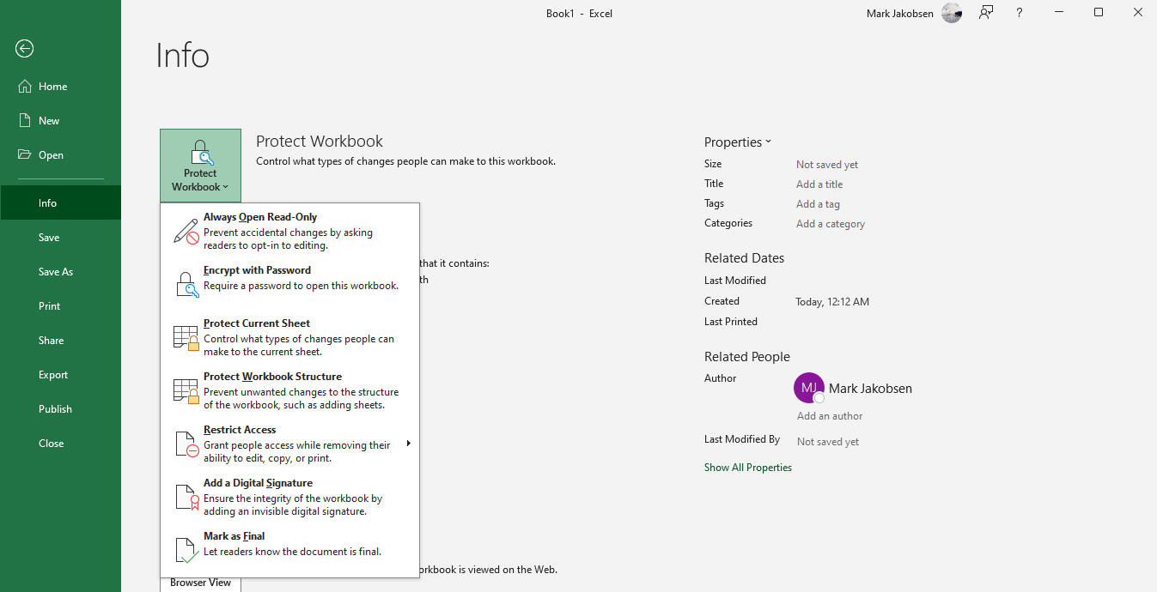
MS Office Protection
Notes:
Under the File tab

Slide 30
Information Security requires a financial commitment

Slide 31
And a shift in corporate culture
The question needs to be “what will it cost if I don’t take action?”

Slide 32
In 2022, 76% of US organizations were targeted by ransomware, of which 64% were actually impacted
Phishing & Ransomware are the top threats to public and private businesses.
Ransomware attacks are growing not only in volume, but also in the financial/reputational costs.
Notes:
What is IT spend – internet, website, apps, computers, phones, tablets, people cost

Slide 33
$4,500,000 USD
$2,700 per employee
10% of your IT budget
Average cost of a data breach
Average cost for cyber security related training annually
Should be spent on cyber security
Notes:
What is IT spend – internet, website, apps, computers, phones, tablets, people cost

Slide 34
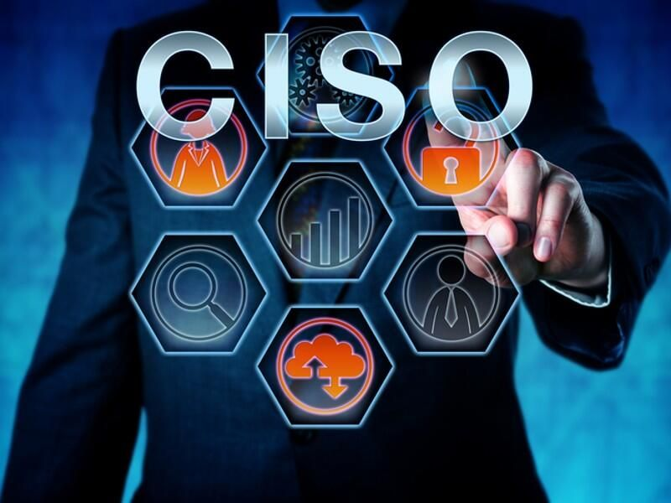
Do you need a CISO?
A Chief Information Security Officer is a skilled professional who would be accountable for the protection of your business’s information
Notes:
Most dealership not large enough for this

Slide 35
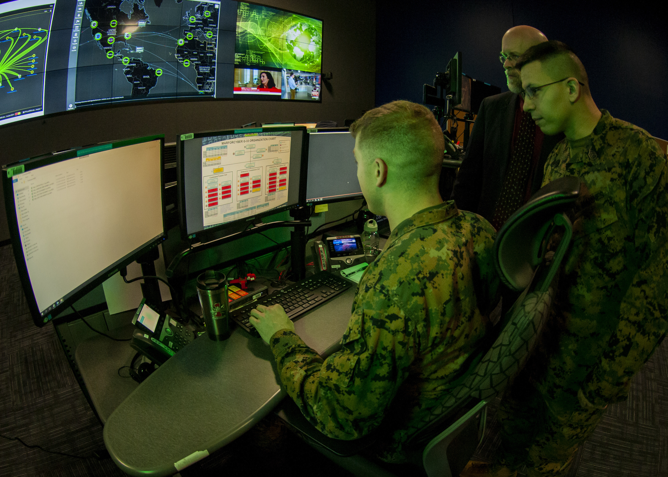
Do you need military grade protection?
Notes:
Probably now but you need to have something…

Slide 36
What you really need is
Someone who owns this role
1
Authority
& Funding
2
Corporate Security Culture
3

Slide 37
So, who’s accountable?

Slide 39
The person who has the power to say “No” is ultimately accountable
Notes:
No that procedure/process is bad and we are not going to do it. Someone has to have the authority/knowledge to make a decision. Not just electronic security, what internal process do you have that store/save PII details. Deal Jackets, sales process DL, personal phones, etc, offsite storage. Risk assessment should help identify these areas.

Slide 40
Action Plan
Name an Individual
Provide Authority And Funding
Build The Plan
1
3
5
2
4
6
Share that this risk is not “IF” but “WHEN”
Complete An Assessment
Execute The Plan

Slide 41
Questions?
Notes:
Mention the PII deletion that we did for Wilkins.

Slide 42
Thank you!

