Slide 1
Unlocking Efficiency Through
AP Automation
IDS User Conference
February 9, 2024

Slide 2
Allison Miller
Sales Engineer
Notes:
A little bit about me. The majority of my career has been in accounting and administration.
After more than a decade in the telecom industry I joined B. Young RV as their Controller
Helped Bruce sell the business and stayed on as GM for Lazydays

Slide 3
Agenda
Who is FormedAI
What is AP Automation
Invoice Processing
Payment Processing
Dealer feedback/discussion

Slide 4
About Formed AI
16+ years in business
Privately held, based out of AZ
175+ integrations
1,800+ Automation Implementations
Custom Implementation for IDS

Slide 5
What is AP Automation
Automates routine steps such as:
Receiving invoices,
GL Coding,
Routing for approval,
Payment and Reconciliation

Slide 6
What is AP Automation
Capture invoices digitally, including handwritten or unstructured
Automatically match invoices to POs and reconcile information
Attach proper GL codes (summary or line item) & GL schedules
Workflows automatically look up payment terms and discounts

Slide 7
What is AP Automation
Route invoices to approvers
Reconcile invoices for multiple locations in one workflow
Optional: Process and issue payment using secure virtual credit card numbers
Instantly view metrics via dashboards and reports

Slide 8
The Entire Data Chain
Data is securely and compliantly stored
Securely upload documents
Auto-routing for approvals
Customized review and approval
Bi-directional sync of data with IDS
Robust reporting
Advanced data extraction
Realize an
80%
reduction in human effort

Slide 9
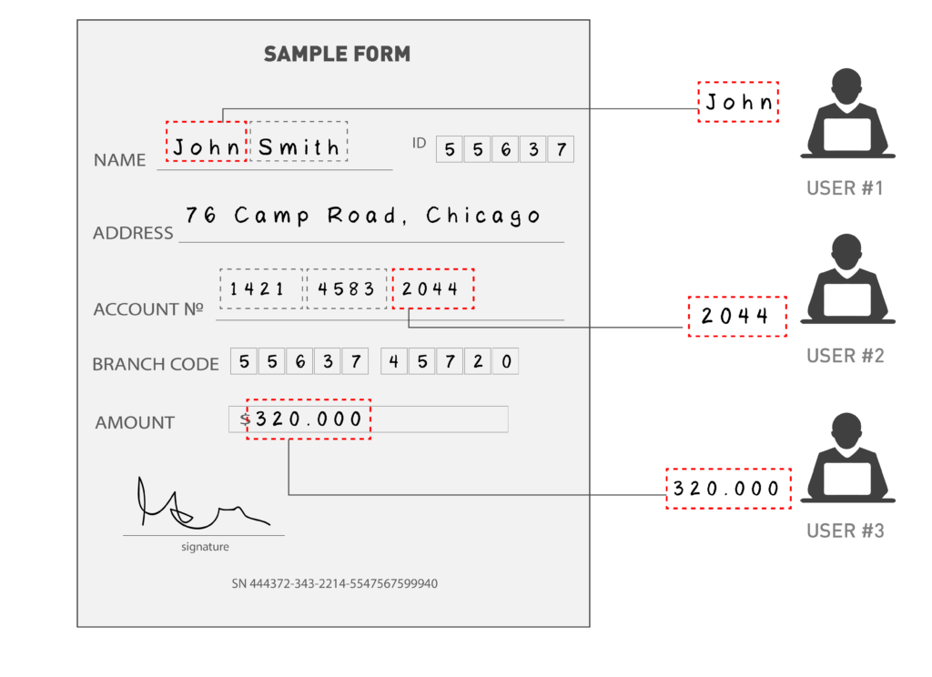
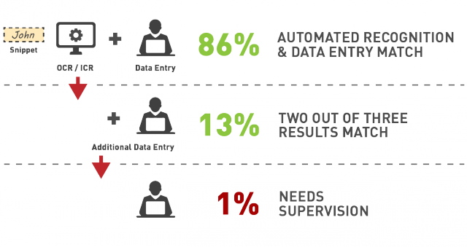
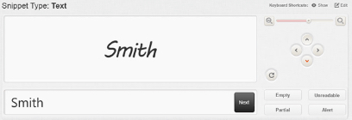
Full-Service, Custom Data Extraction
Day forward outsourced data extraction services
Our outsourced data extraction service is powered by our own DocXtraction software and proprietary process, but it is presented and sold to customers as an outsourced service.
Save over $12,000.00/ 240 hours yr.
Based on 1,000
invoices yr.
99% accuracy rate achieved through human verification

Slide 10
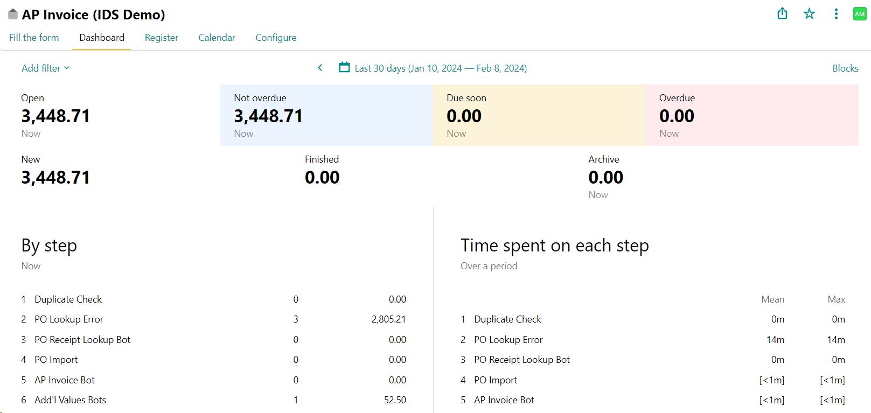
Real-Time Reporting

Slide 11
Lifetime Audit Trail

Slide 12
Access Scanned Invoices from G2

Slide 13
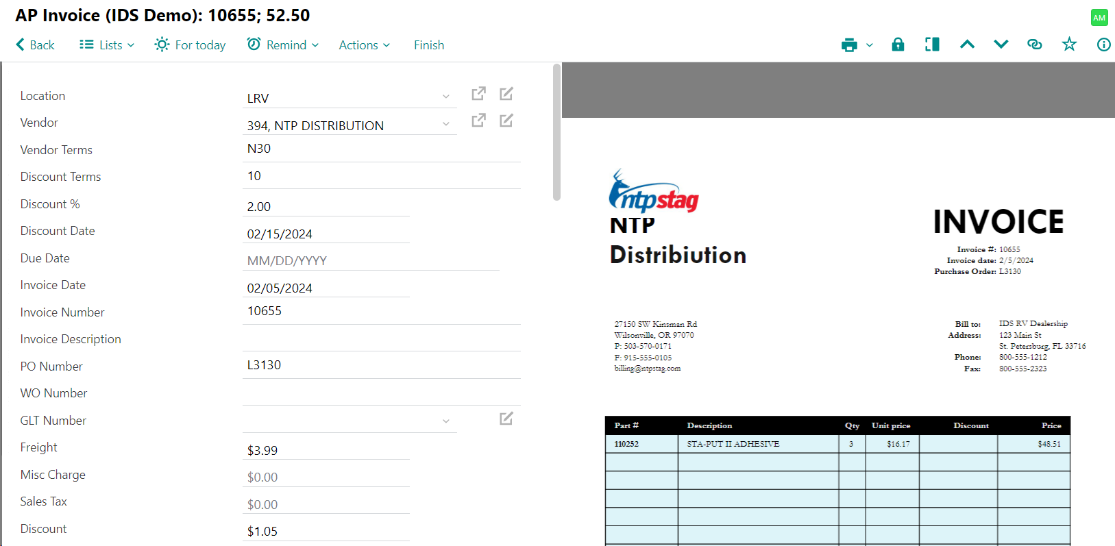
View Invoice Image & Detail in Pyrus

Slide 14
Audit Reviews
Preprocessing: sorting/scanning
Dispute Handling
Printing of emailed invoices
Staff overtime
Searching for misplaced or lost invoices
Vendor inquiry
Manual entry & GL Coding to ERP (keying errors eliminated)
Retrieval
Manual approval
Filing
2/3 way P.O. Match
14

Slide 15
I’m curious to know…
How many FTE process payables?
How could their time be spent if not entering payables?
How much do you think it costs to process a payable?
Time to reconcile, research & post
How much does it cost to issue payment?
Time to pull/review payables, checks & envelopes, bank fees

Slide 16
I’m curious to know…
What % of bills are paid with credit card?
Are you taking advantage of credit card rebates?

Slide 17
How to get more info
Schedule a full demo
Account Managers: Kevin & Wylie

