Slide 1
Leadership Insights
February 2024

Slide 2
Don Miller
Senior Consultant

Slide 3
Leadership Insights
“If you can’t measure it, you can’t manage it.”
“If you can’t track it, you can’t learn from it.”
“Knowledge is power.”

Slide 4
Leadership Insights
Data is “factual information used as a basis for reasoning, discussion, or calculation.”
Data Mining is "the practice of searching through large amounts of data to find useful patterns or trends”
Insight is “the power or act of seeing into a situation”
Source: Merriam-Webster

Slide 5
Leadership Insights
“Data insights are the direct benefits of a profound understanding of an enterprise organization’s information.
The analysis of certain issues and patterns leads to data insights that an organization can use for better decision-making, which can lead to better ROIs, deeper understanding of the market, and increased benefits within both the organization itself and their client base.”
Source: Hewlett Packard
Notes:
Gleaning insights is paramount in today’s market
Your DMS contains a ton of useful data. Getting to it and reviewing it has been challenging. We have been working on improving this with custom dashboards, Vision reporting, and specifically the structure of the databases behind G2 that makes this possible. There has been a lot of work behind the scene to get to this point. I was tasked with providing access to these insights…

Slide 6
Leadership Insights
Provide timely insights
Ability to access from anywhere
Combine all locations
Easy to review and understand
Easy to set up & implement

Slide 7
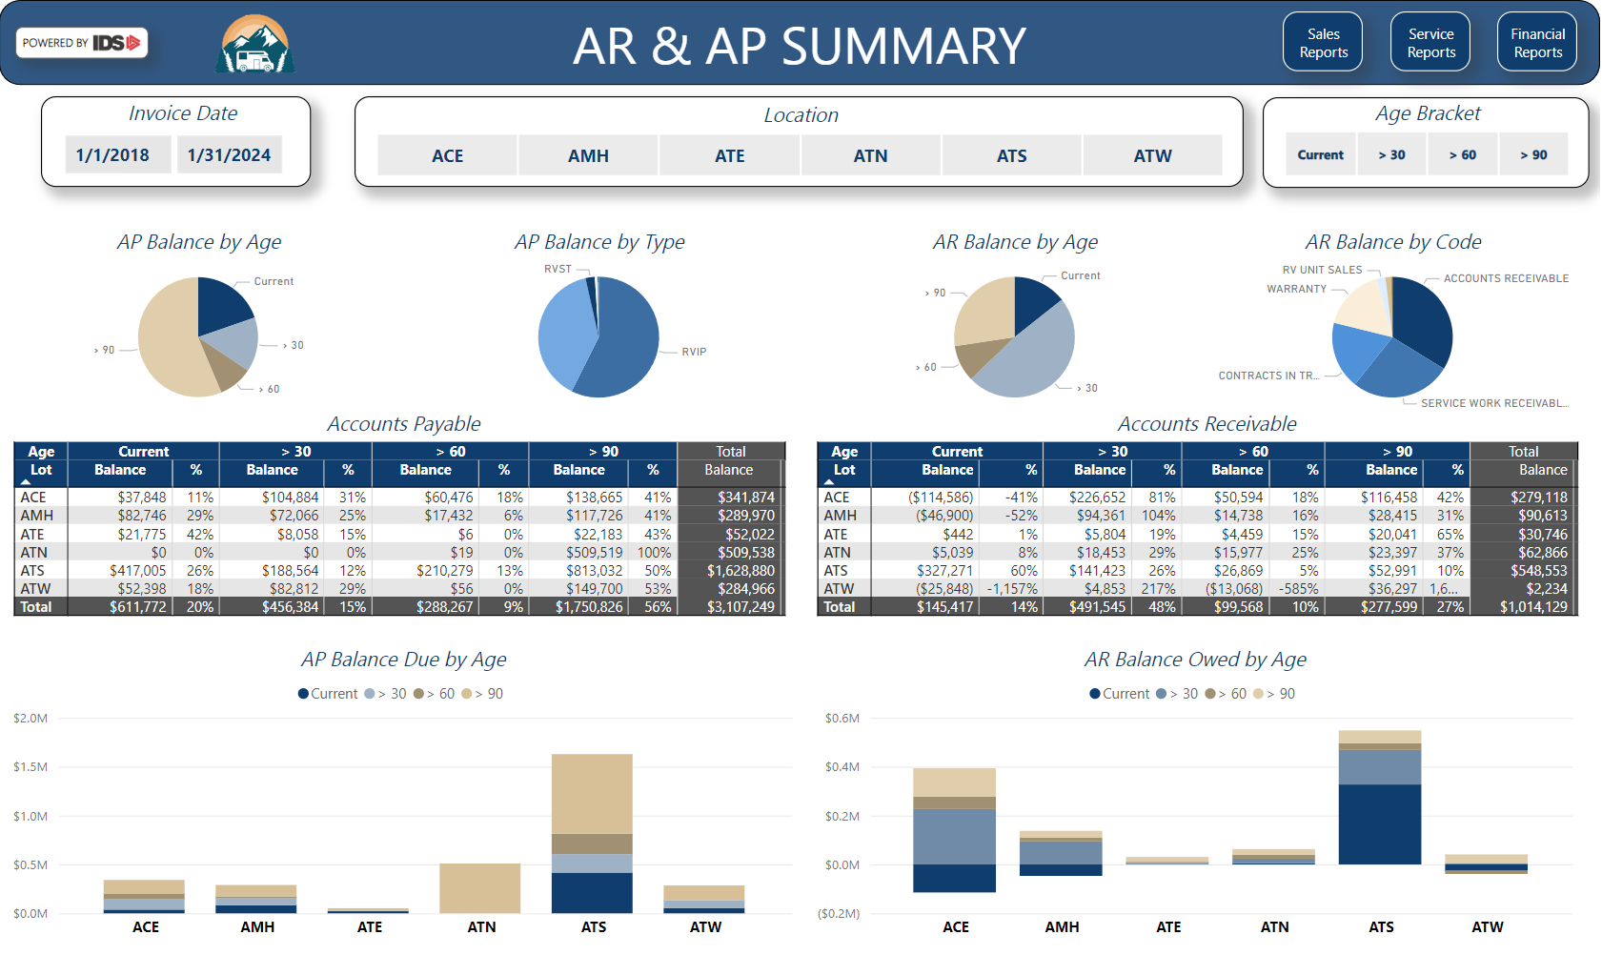
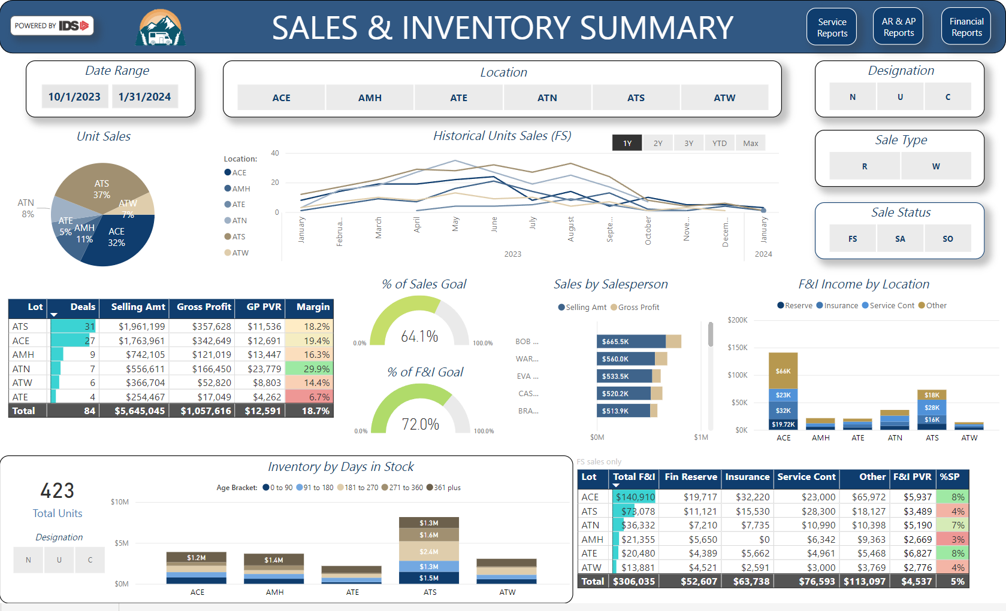
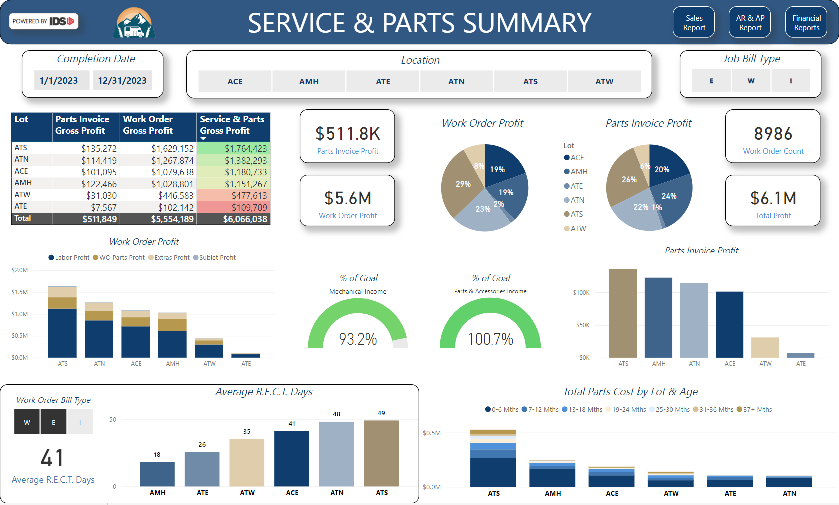
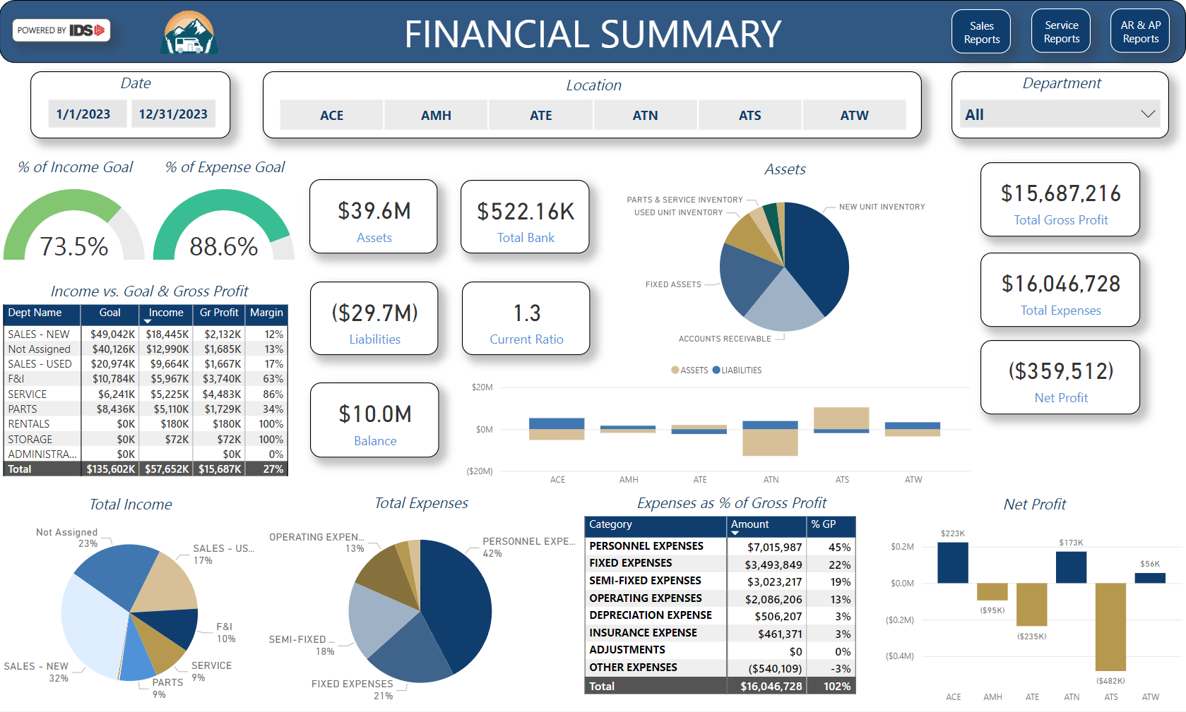
Leadership Insights Standard Reports

Slide 8
Standard Reports – AR & AP
Notes:
Each report opens to a summary page followed by detailed reports

Slide 9
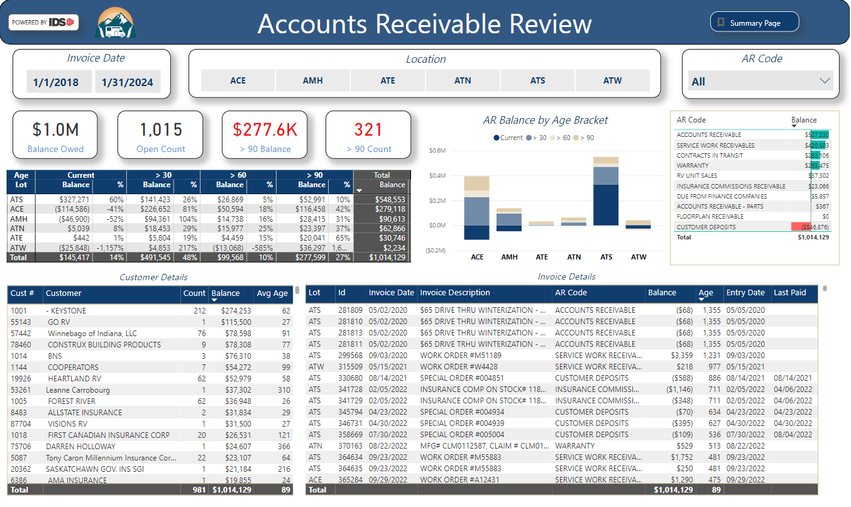
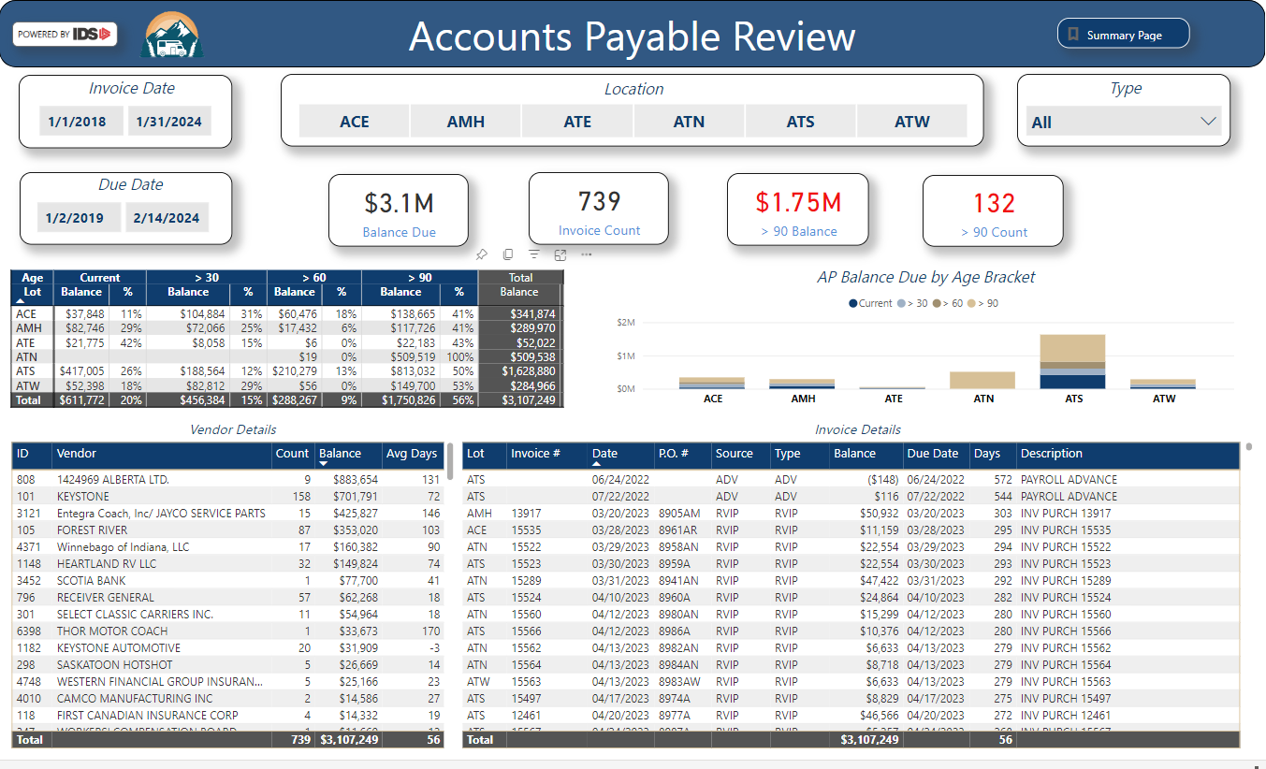
Standard Reports – AR & AP

Slide 10
Standard Reports - Sales & Inventory

Slide 11
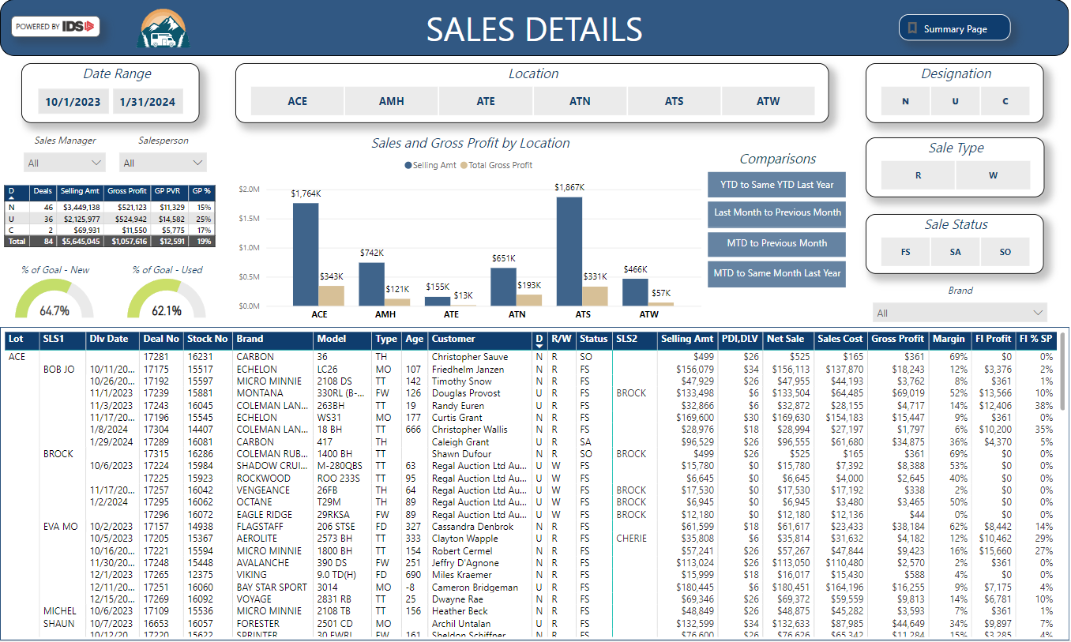
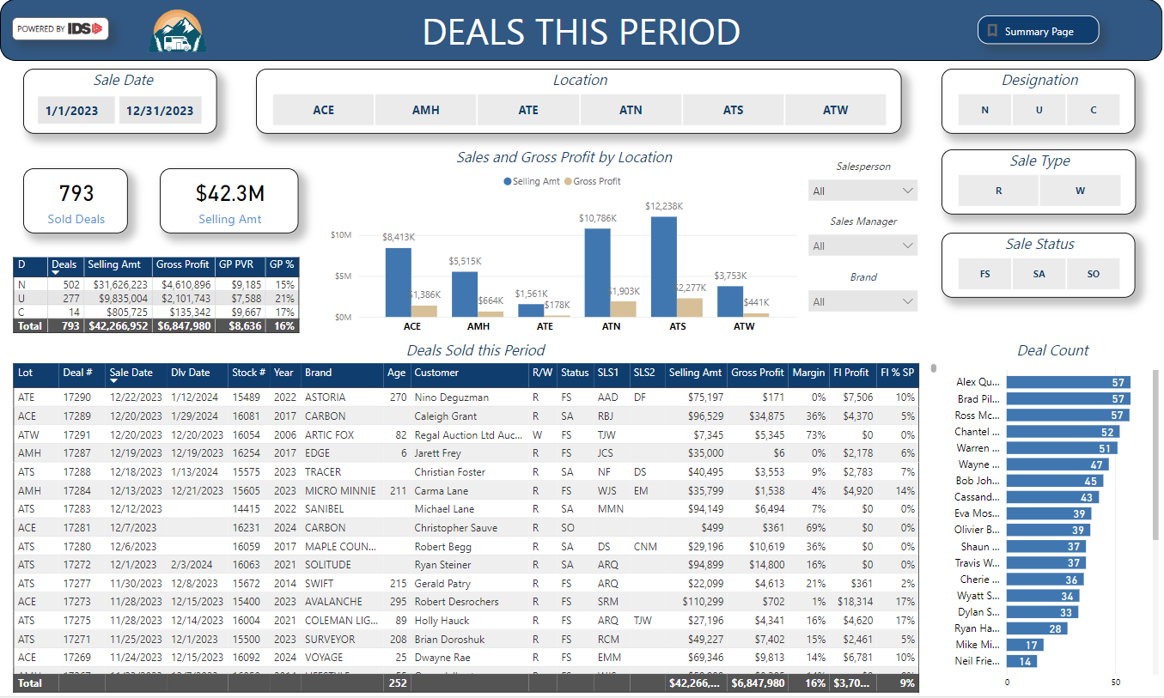
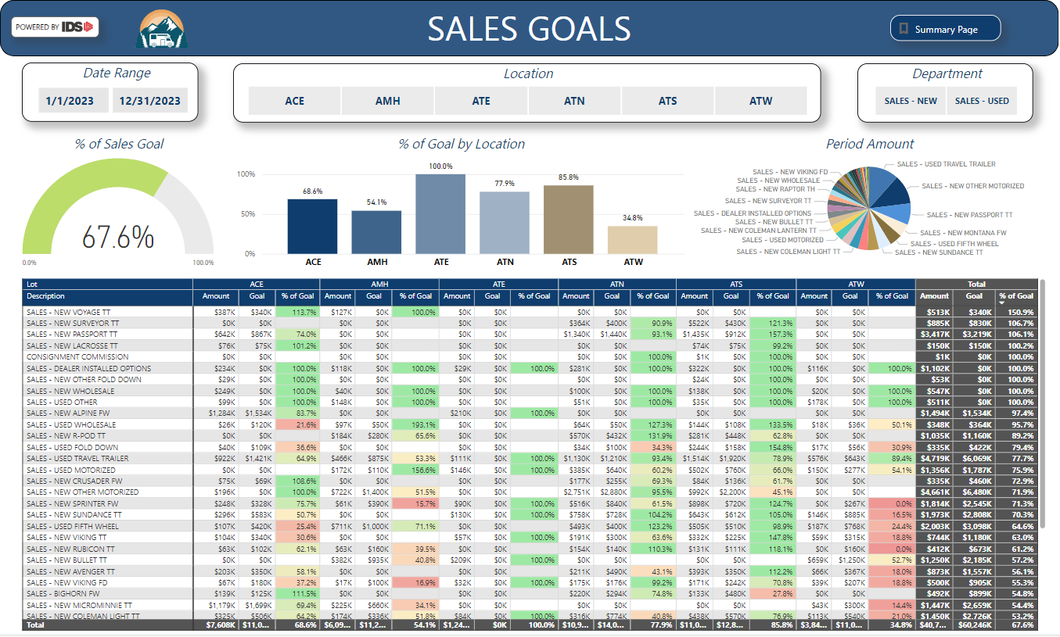
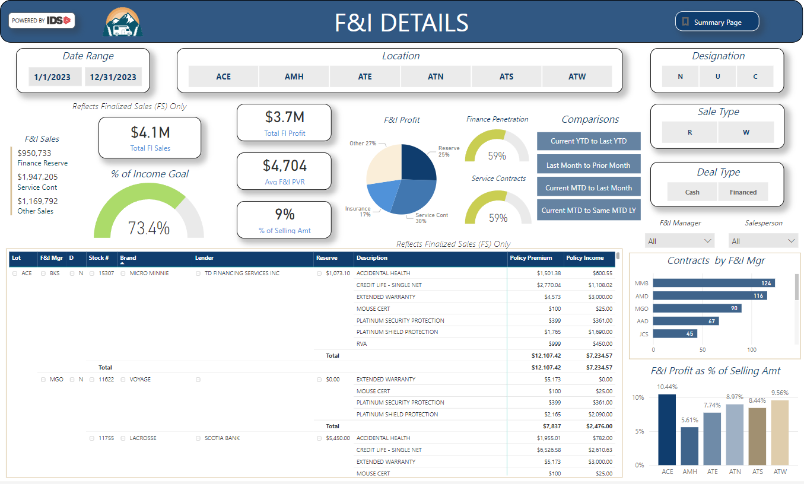
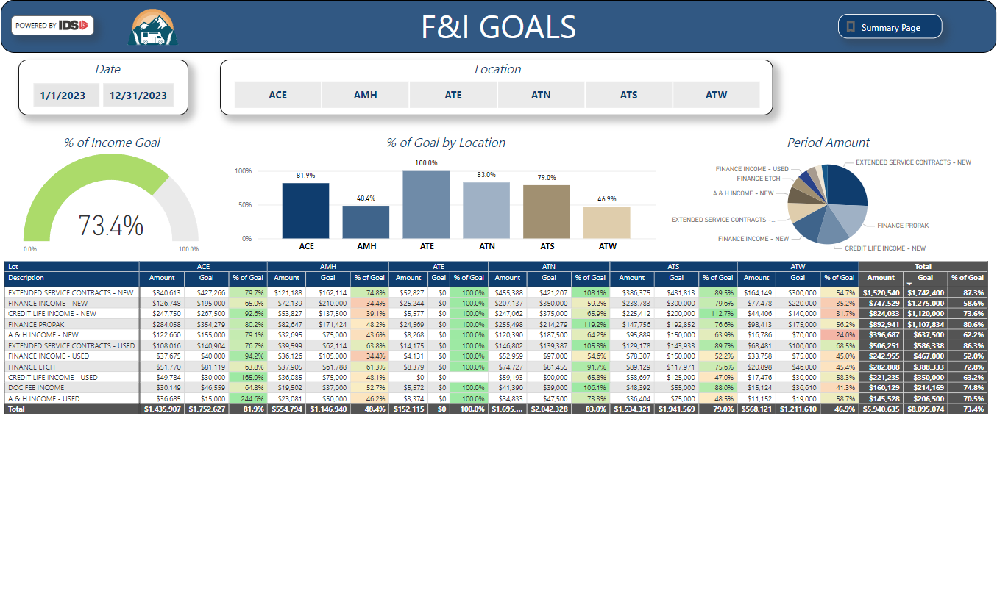
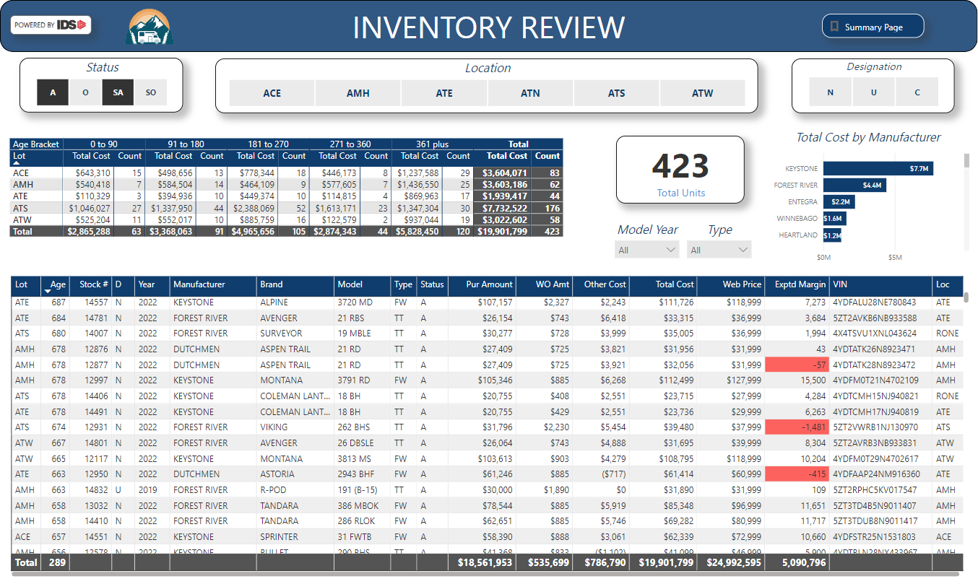
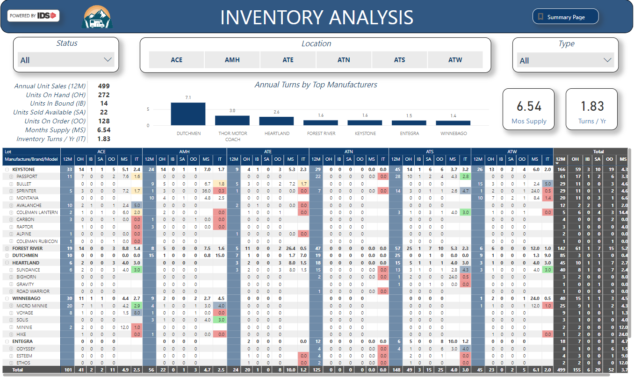
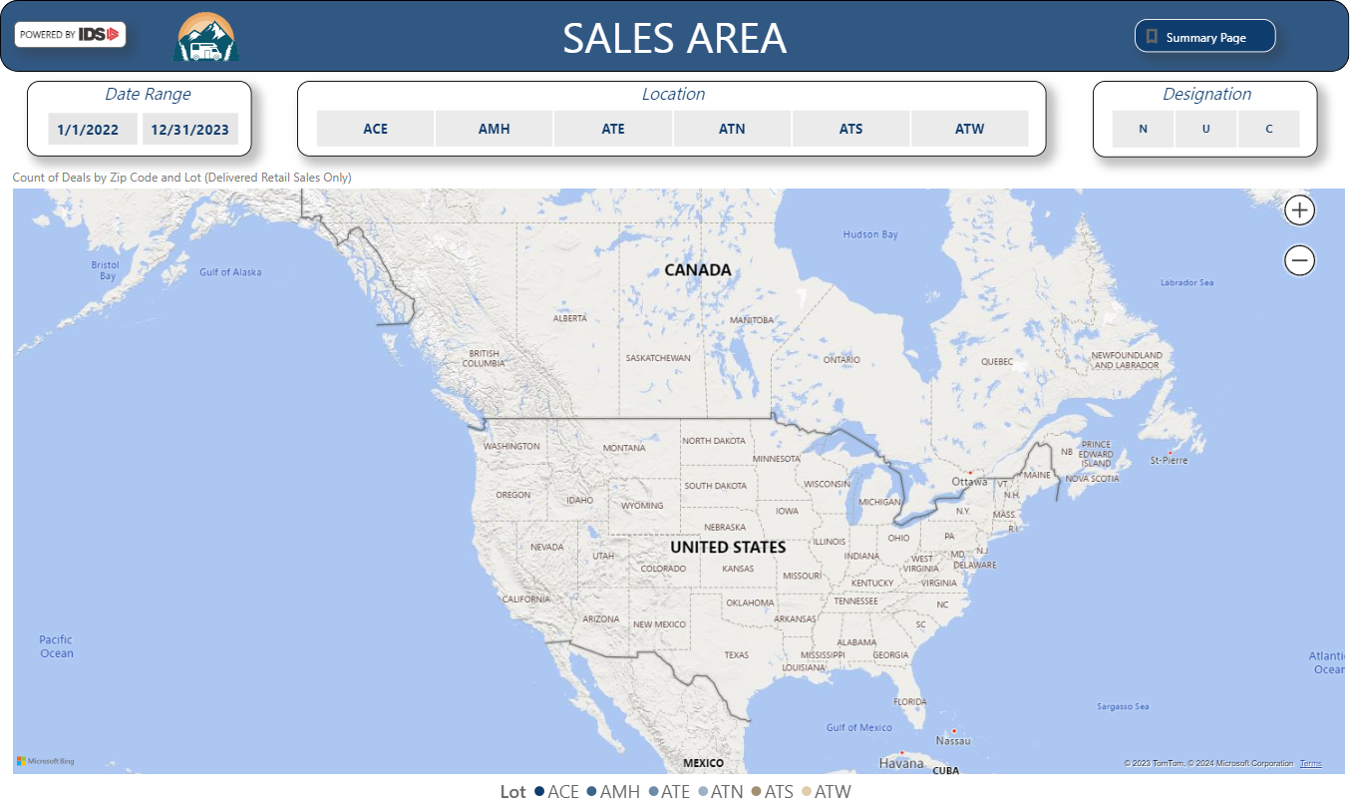
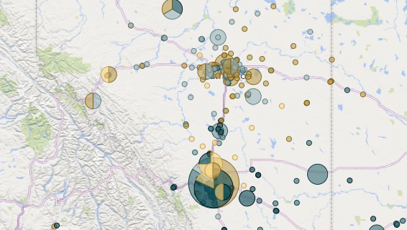
Standard Reports - Sales & Inventory

Slide 12
Standard Reports - Service & Parts

Slide 13
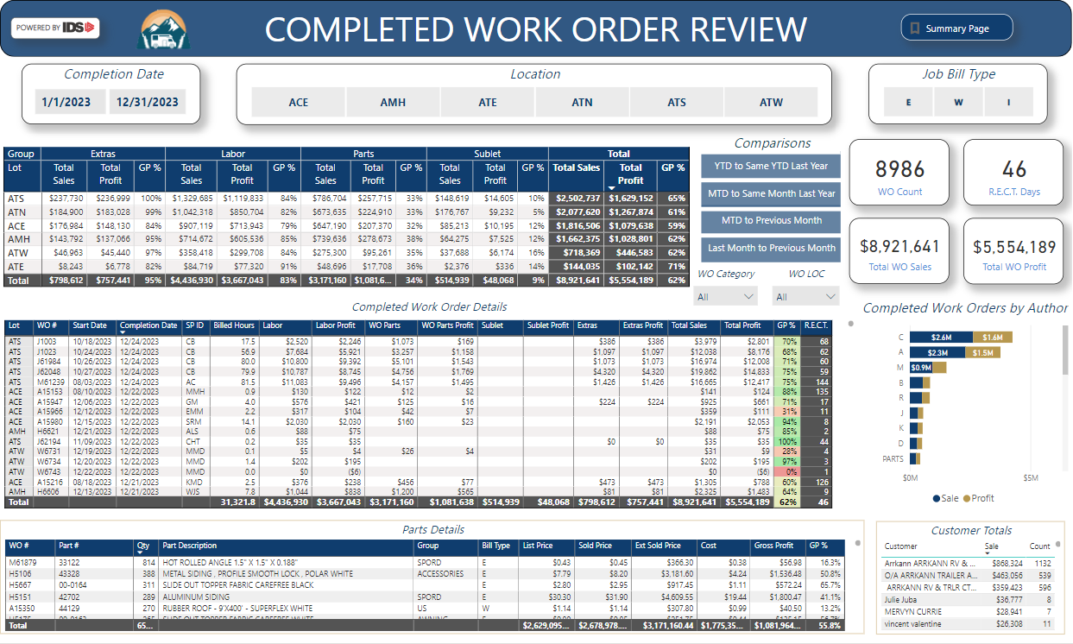
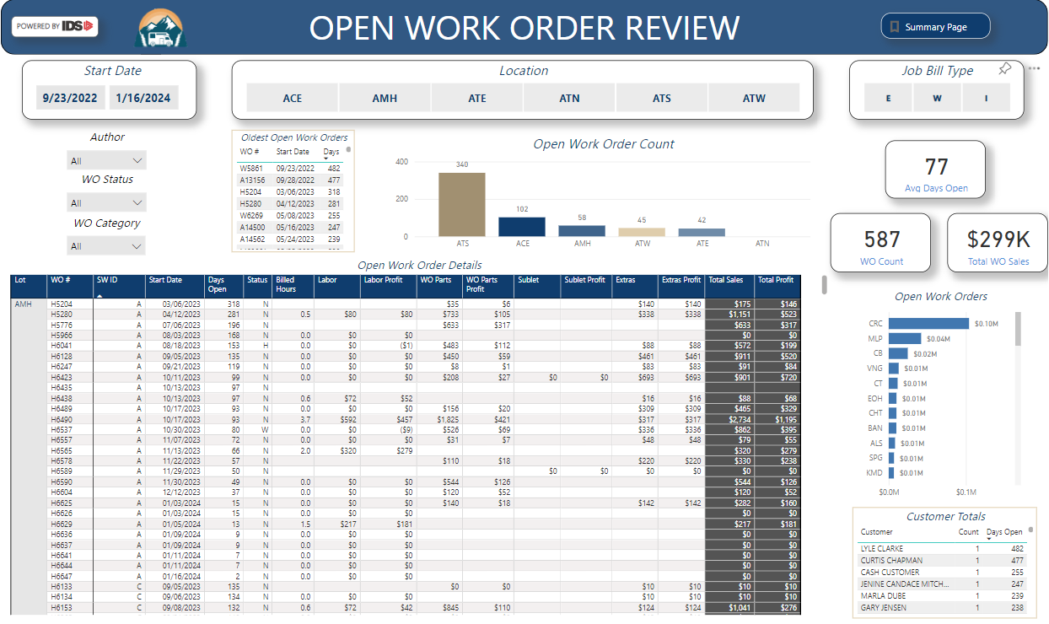
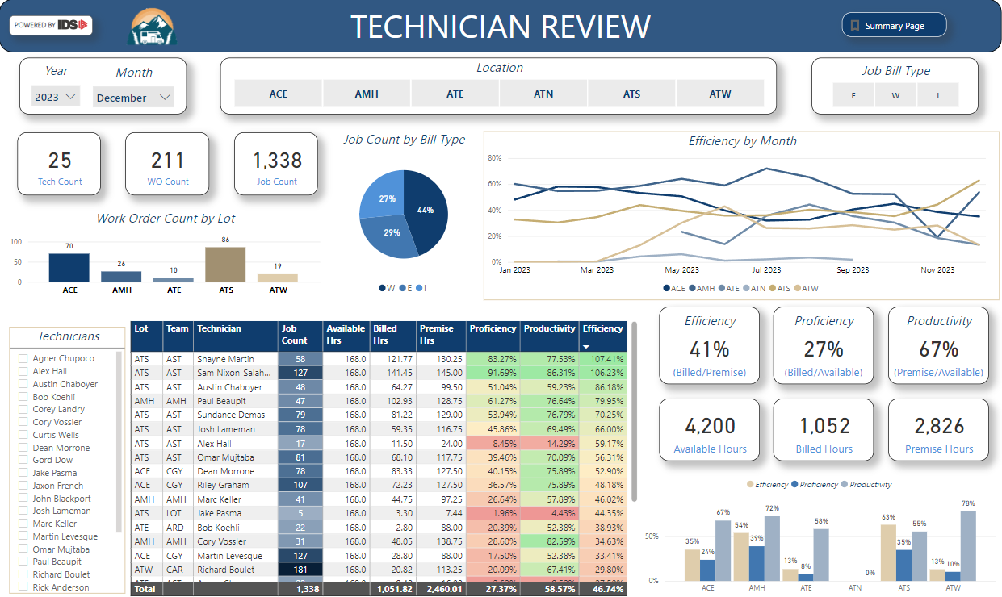
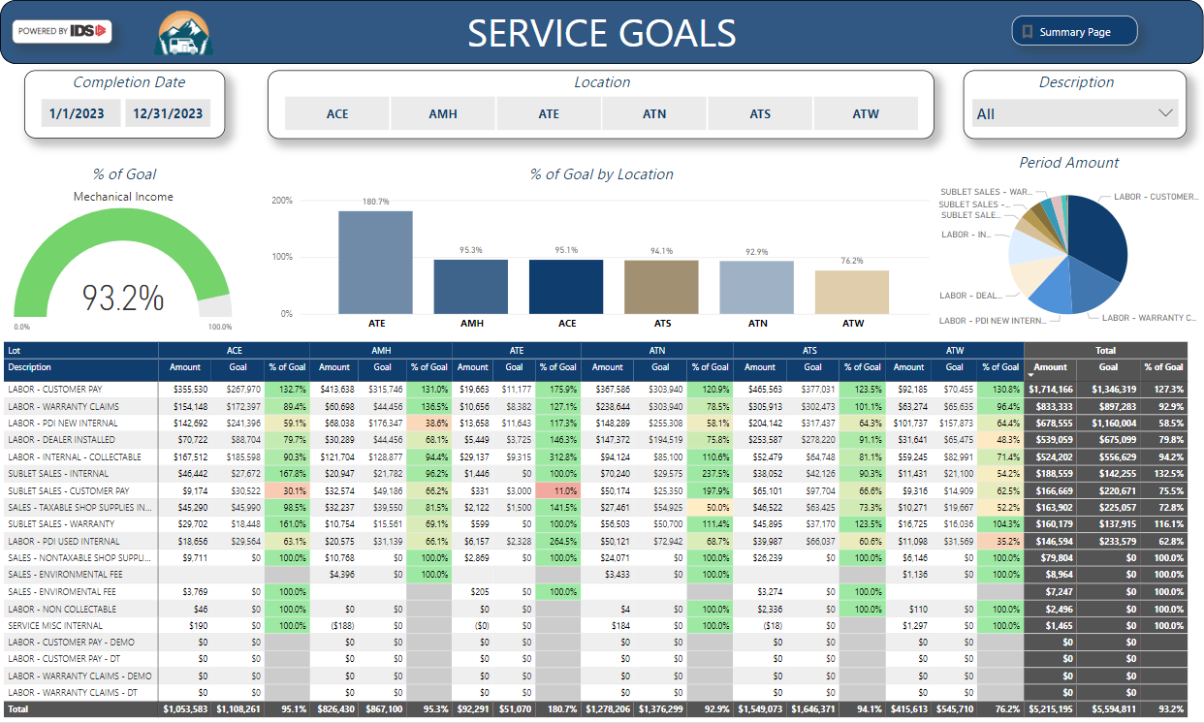
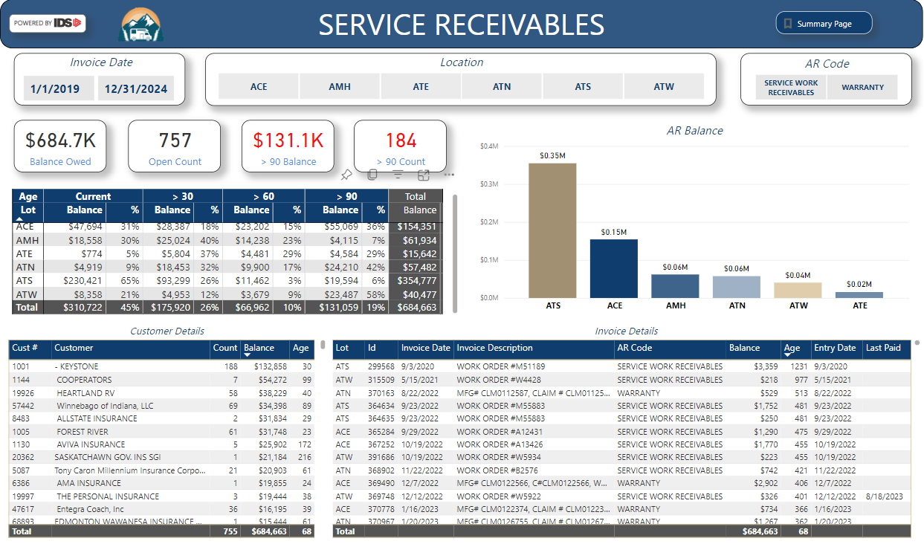
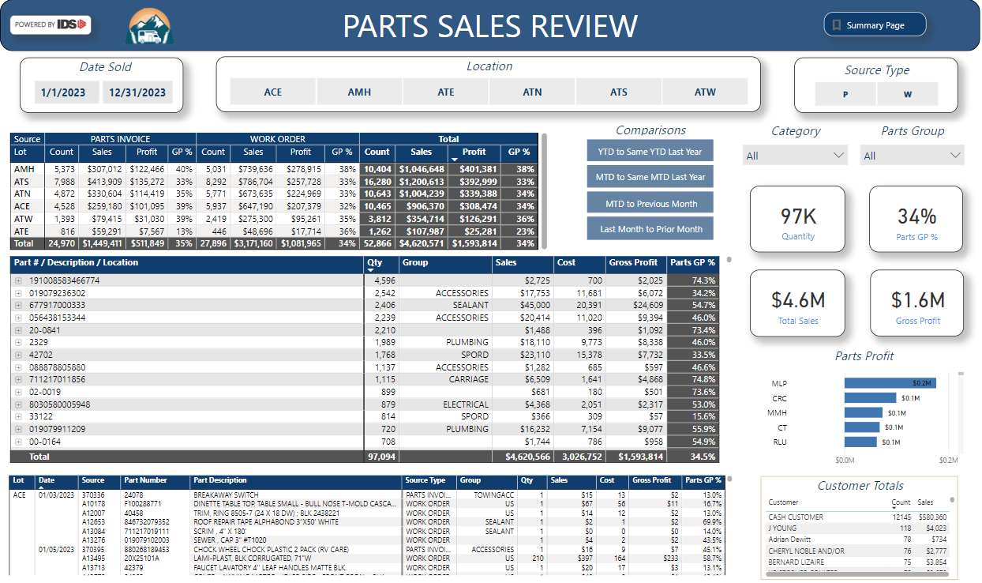
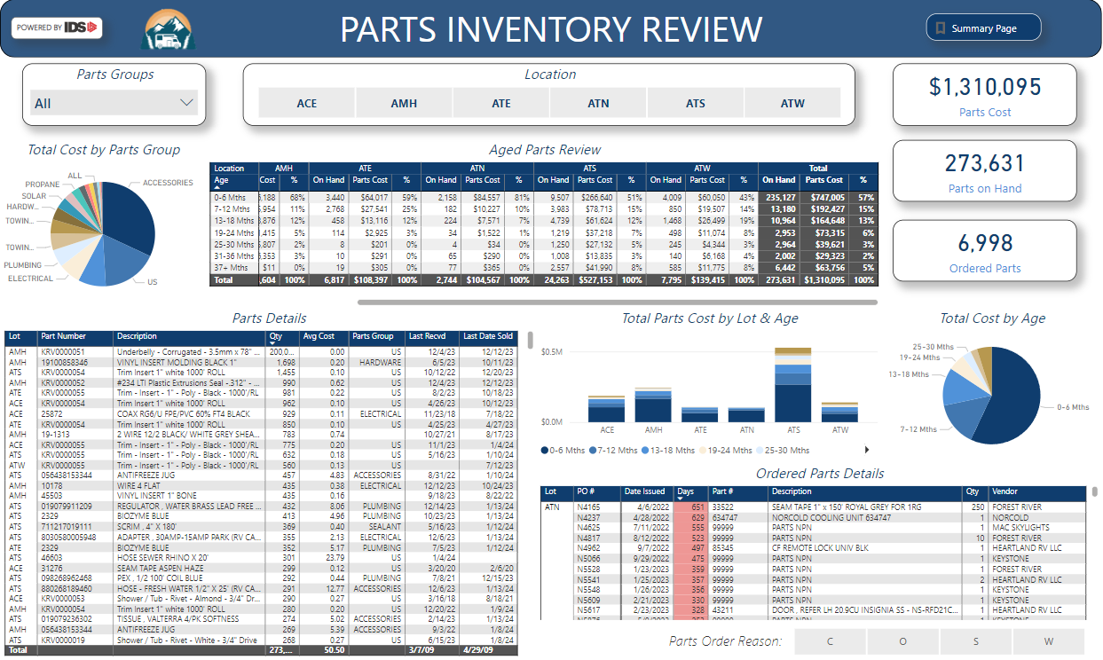
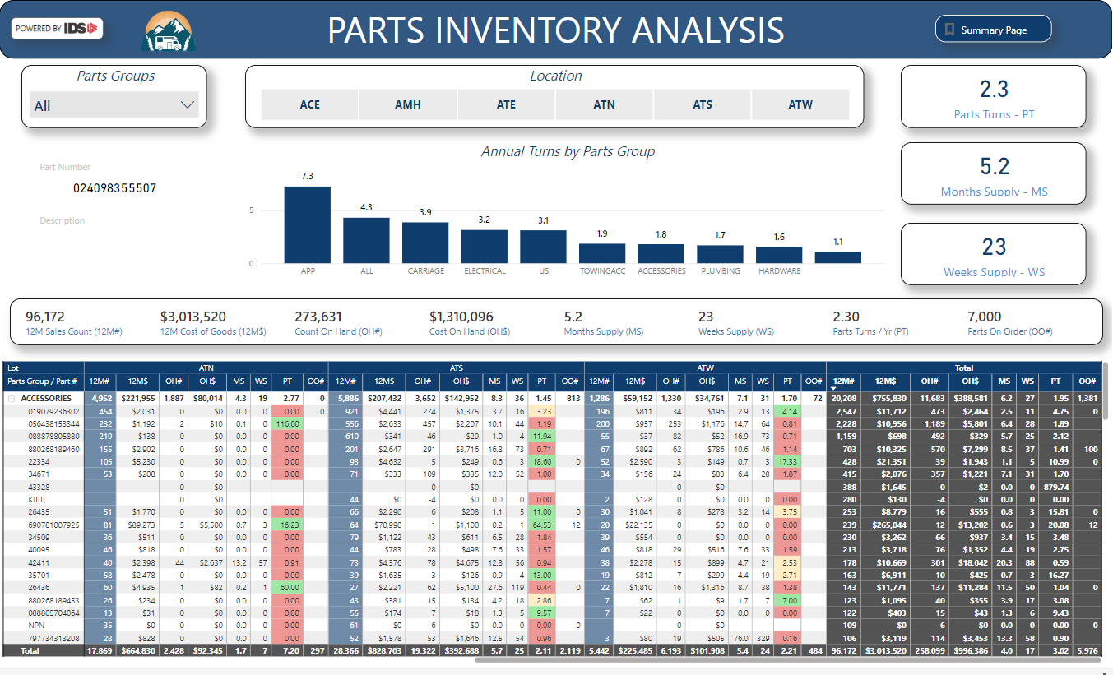
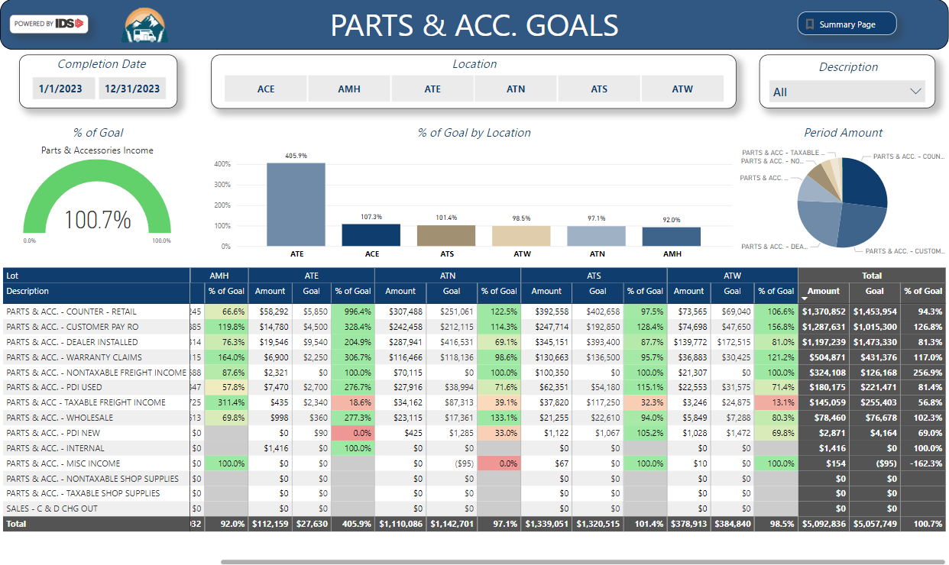
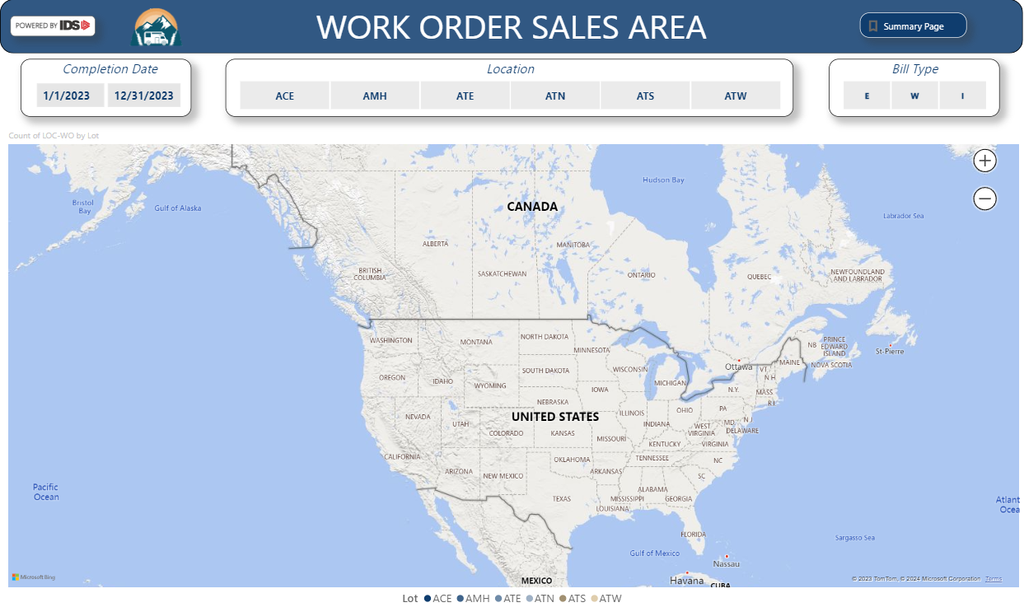
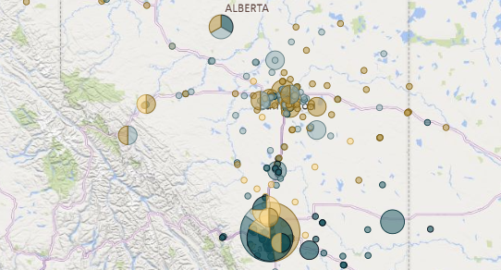
Standard Reports - Service & Parts

Slide 14
Standard Reports - Financial

Slide 15
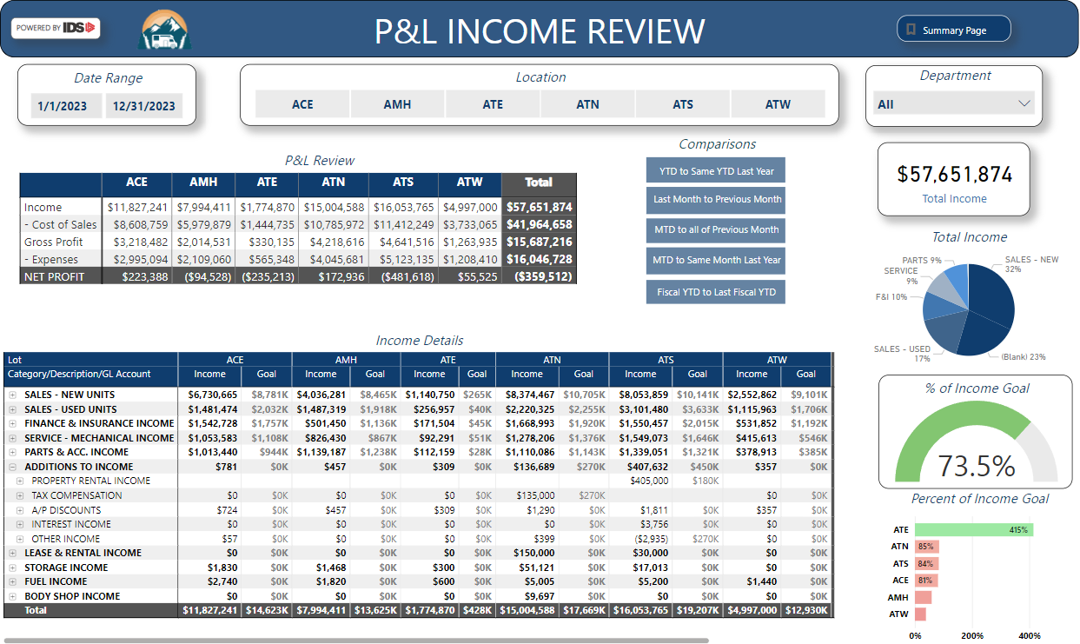
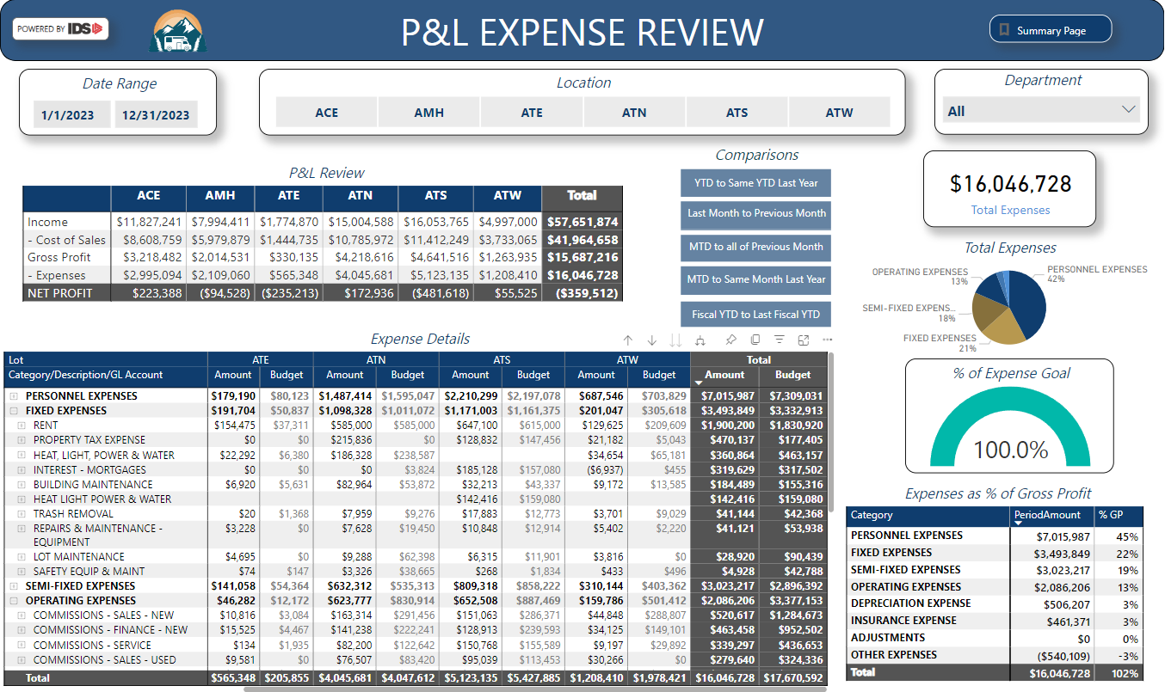
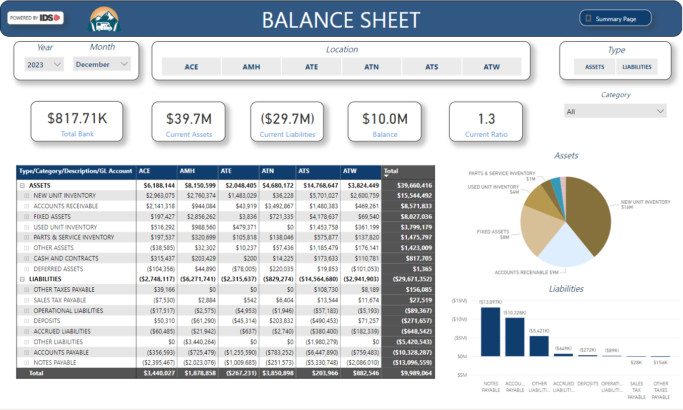
Standard Reports - Financial

Slide 16
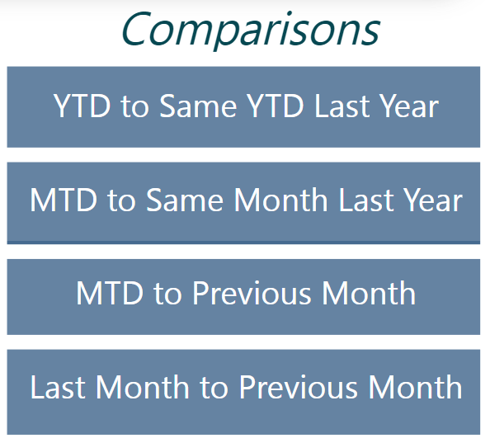
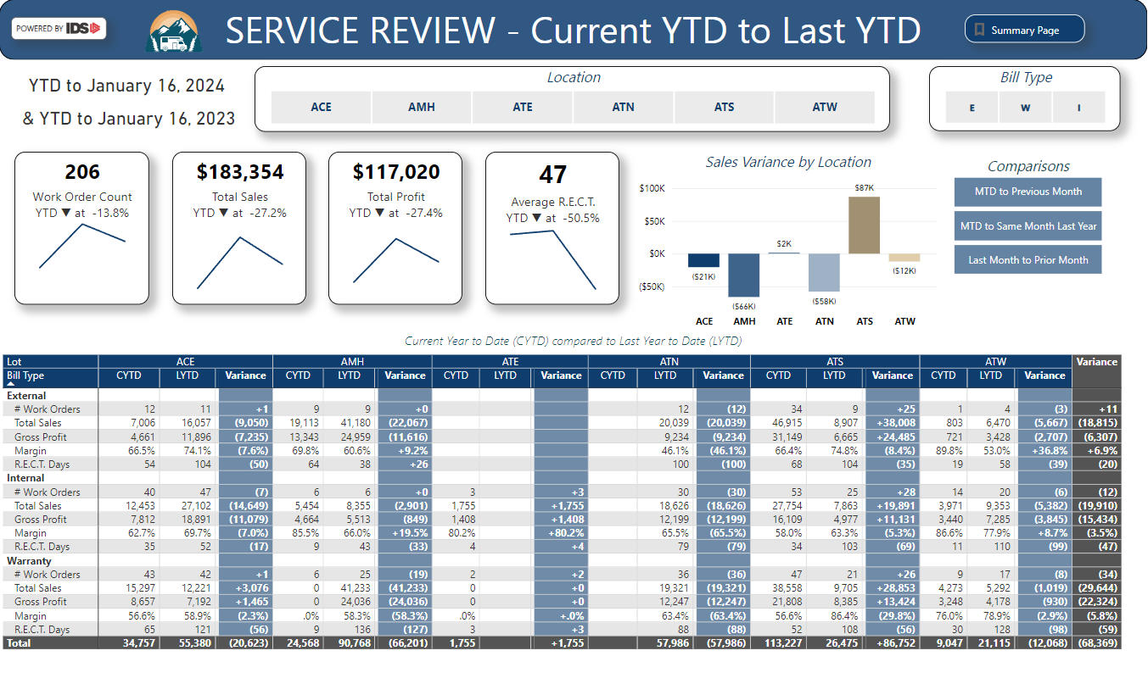
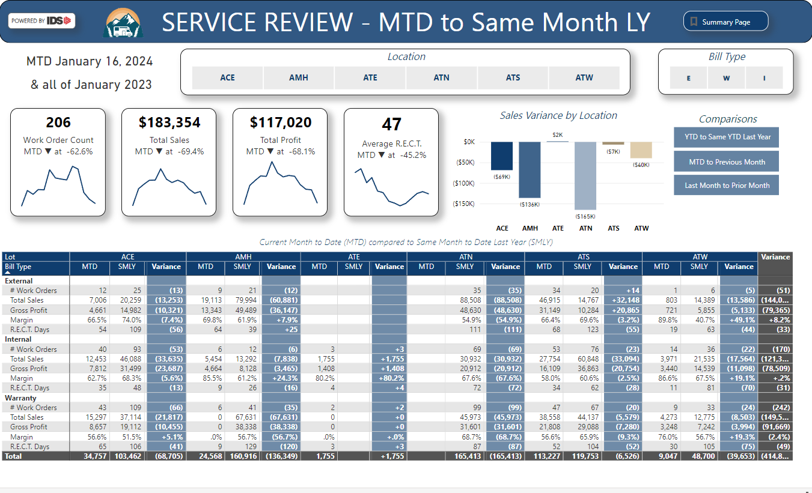
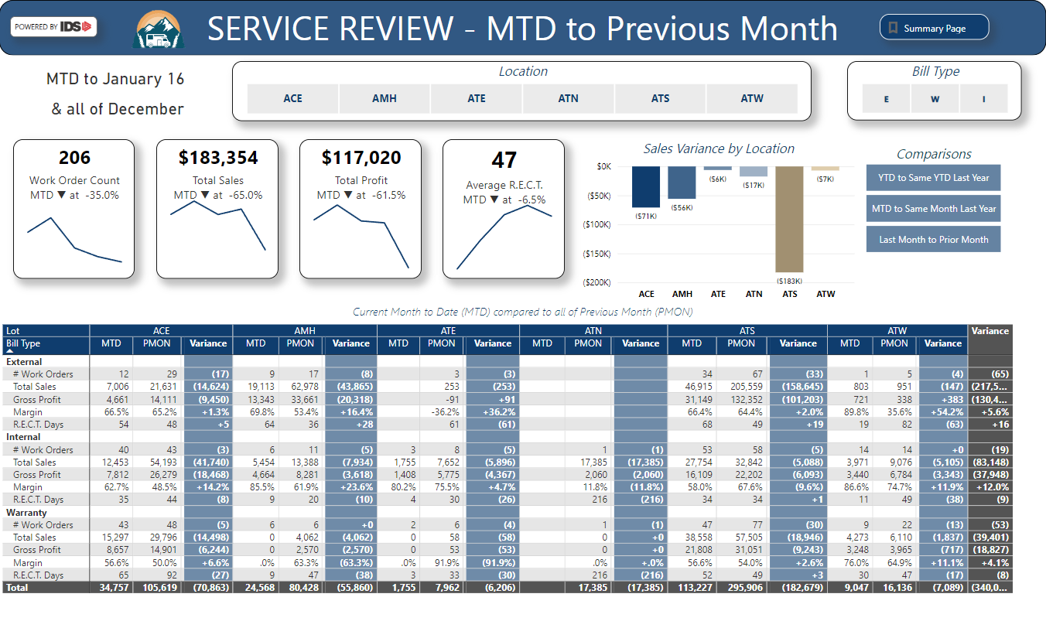
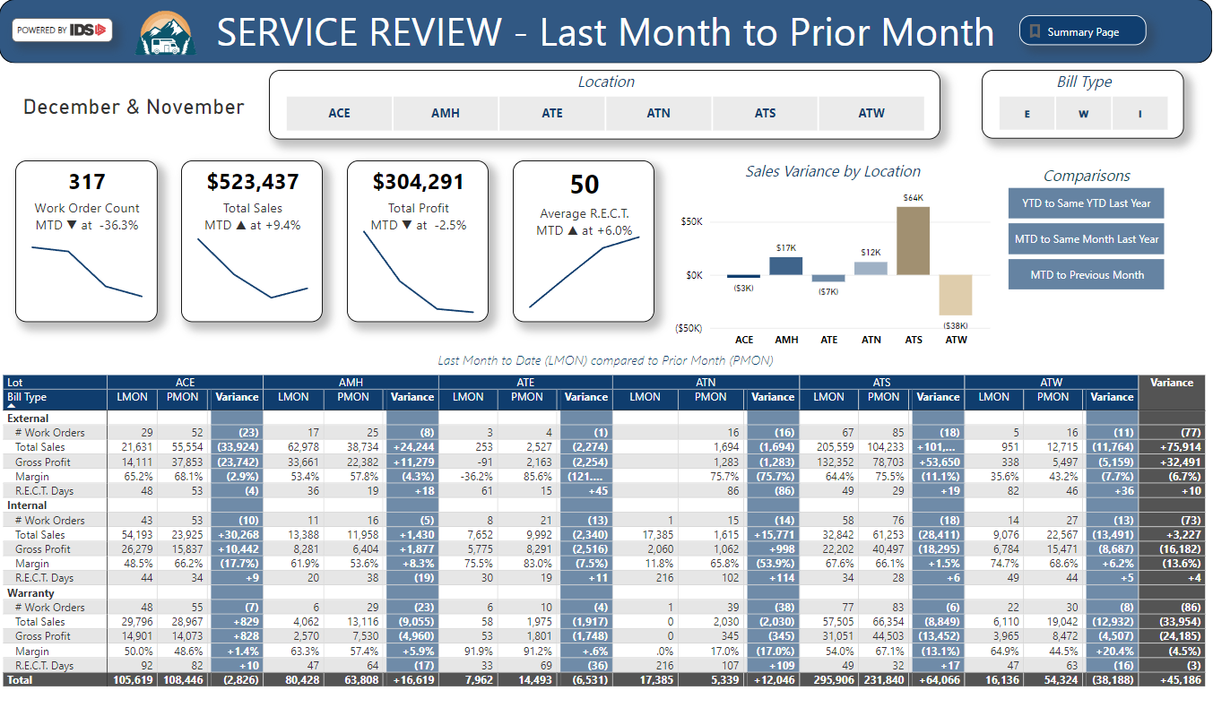
Standard Reports – Comparisons
Notes:
Service & Parts compares # of completed work orders, Total Sales, Gross Profit, Margin and RECT

Slide 17
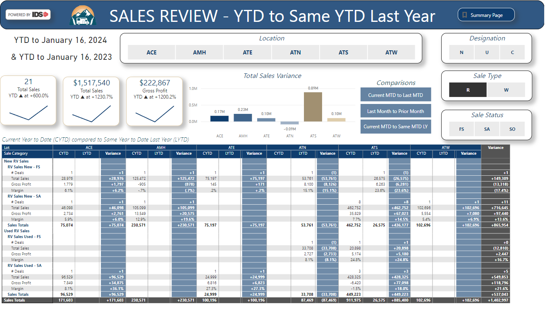
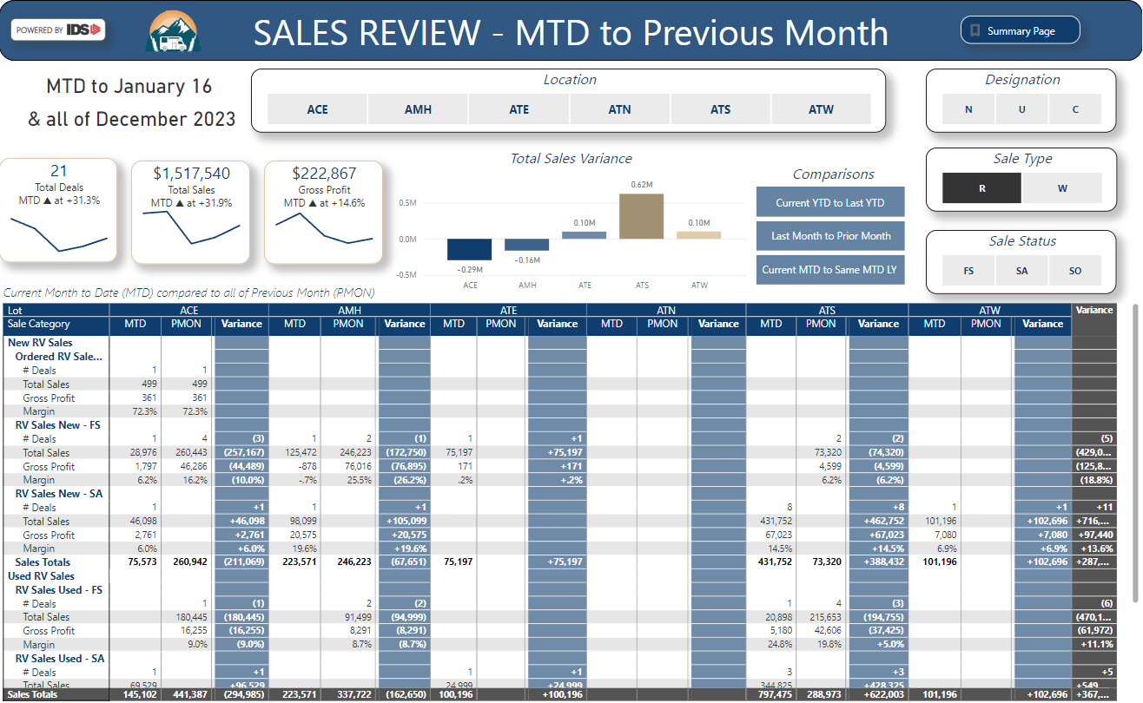
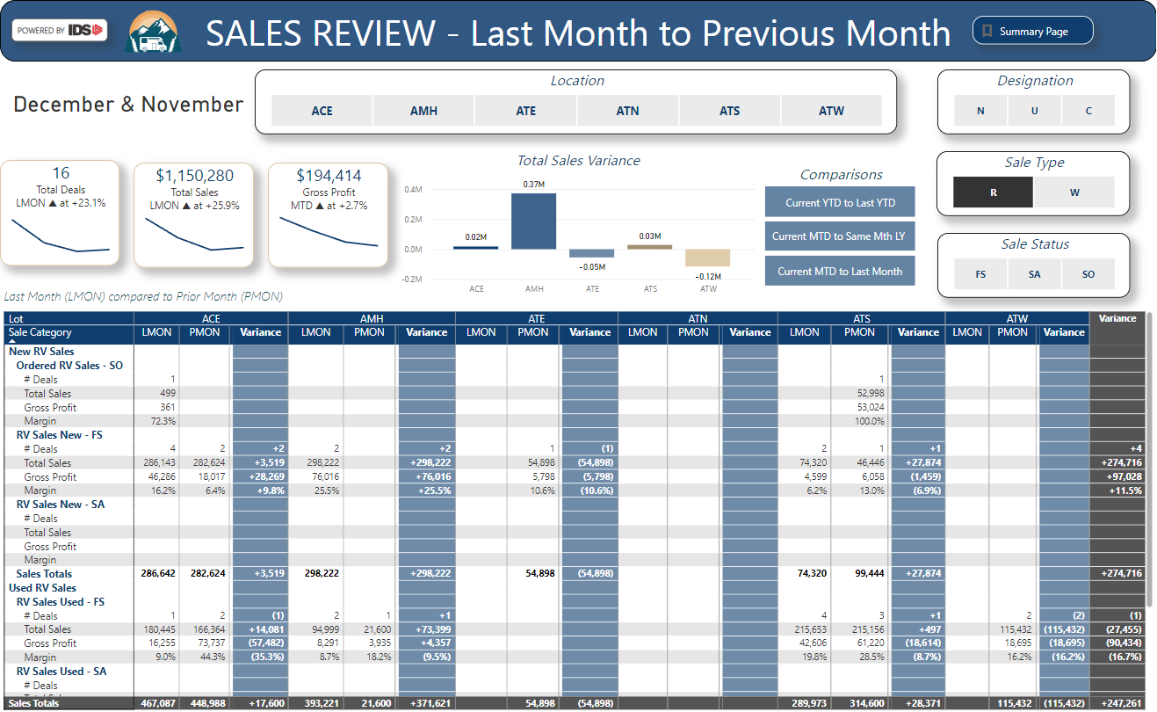
Standard Reports – Comparisons
Notes:
Sales & Inventory compares Number of Deals, Total sales, gross profit and margin

Slide 18
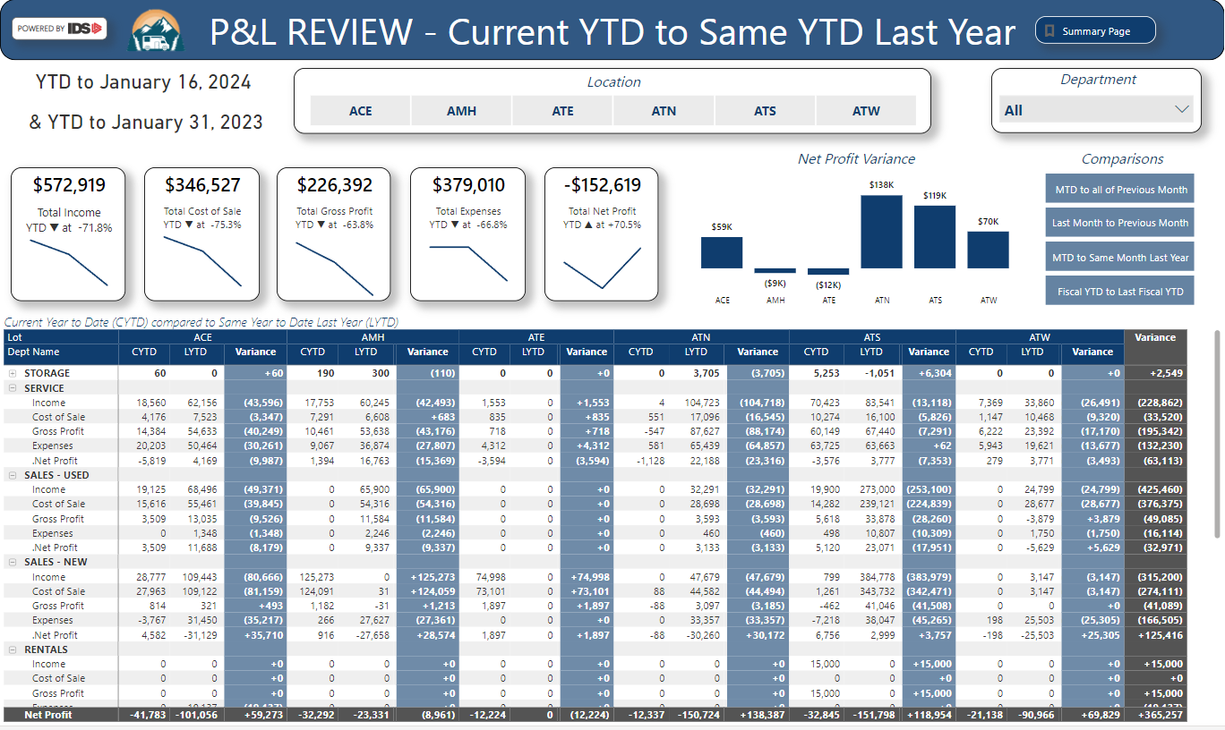
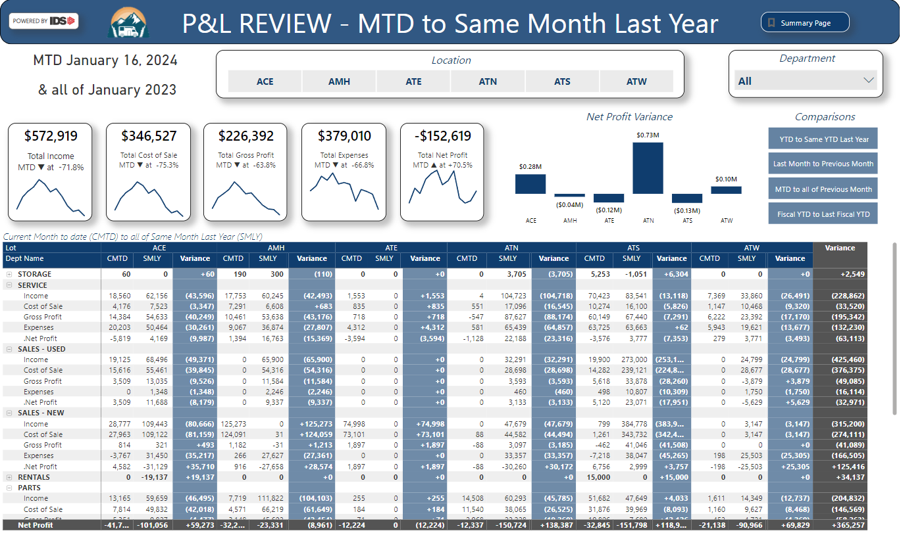
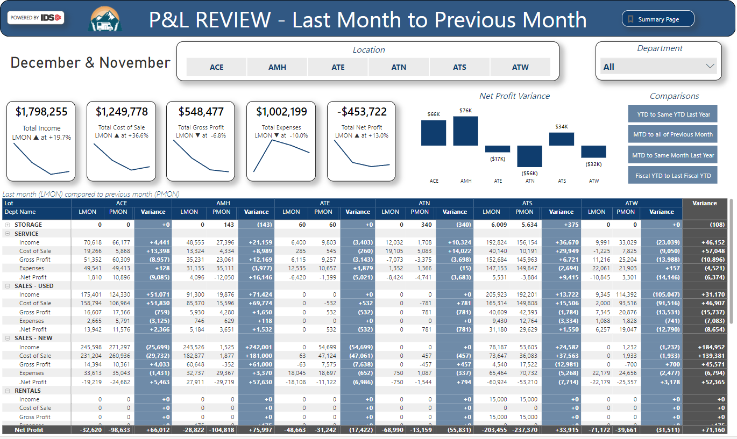
Standard Reports – Comparisons
Notes:
Financial reports compares total income, cost of sales, gross profit, expenses and net profit.

Slide 19
Leadership Insights
Live Report Review

Slide 20
Leadership Insights
Provide timely insights (updating nightly)
Ability to access from anywhere (browser & mobile)
Combine all locations (uses DMS data)
Easy to review and understand (built using MS Power BI)
Easy to set up & implement (templated reports)

Slide 21
Leadership Insights
If you can't inspect it, you can't track it.
If you can't track it, there is no accountability.
No accountability means no motivation.
No motivation means no reasons to change.
Don’t expect what you can't inspect.
Your data is like gold. Mine it often.

Slide 22
Leadership Insights
www.ids-astra.com/leadership-insights/

