Slide 1
Accounting
February 2024

Slide 2
Kurt Vajgrt
PSG Consultant

Slide 3
About me
Accounting Degree - Wisconsin
Worked at dealership 3 years
IDS software experience 25 year
Houston – Texas

Slide 4
Managing your Dealership with Finance Precision
February 2024

Slide 5
What tools to use to monitor your dealership.
2. Measuring performance for improvement
o use to monitor your dealership
What tools to use to monitor your dealership
at tools to use to monitor your dealership
February 2024

Slide 6
o Tools to Monitor your dealership
Manager Views
KPI’s
Email Alerts
Exception Reports
DMS
Cash Flow Statement
What tools to use to monitor your dealership
at your dealership

Slide 7
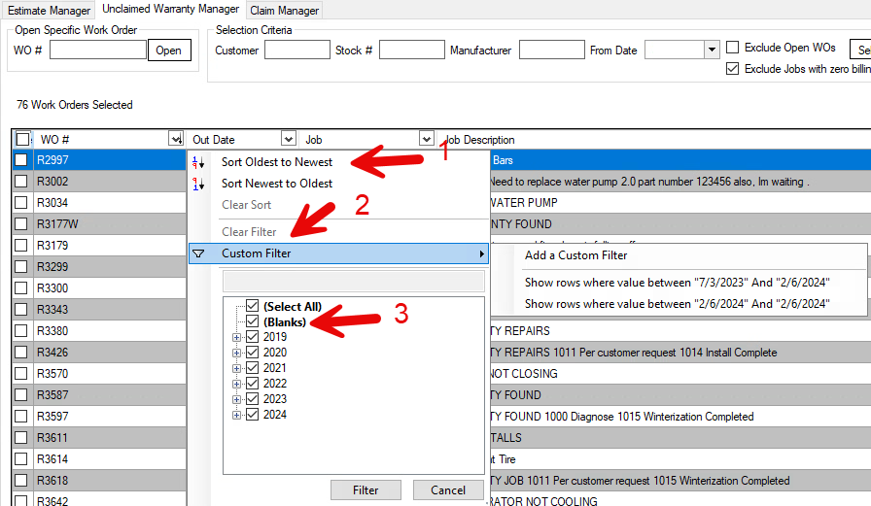
Manager View – New Feature
Sort Newest – Oldest
Add custom filter
Between dates
From date
Double click to select
Double click selection to
reset to all

Slide 8
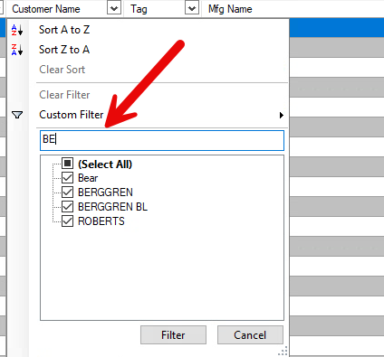
Manager View – New Feature
Custom data filter - filters data as you type
Click filter button to display results or double click item
Double click select all to reset

Slide 9
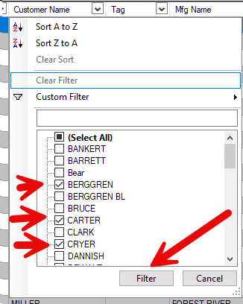
Manager View – New Feature
Use the filter button when selecting more than one
Double click select all to reset

Slide 10
Manager View – Sales
Quote Created by Sales
Purchase Agreement Printed
Deposit Received

Slide 11
Manager View – Sales
Right click in column to add Quote date, Delivery date, and FI Status
Use Selection Criteria
Leave the to date blank, always data to today

Slide 12
Manager View – Sales
Right Click on column to add – FI Status
Set up Custom status codes – 14-2-11
Ability to email notification when status code changes

Slide 13
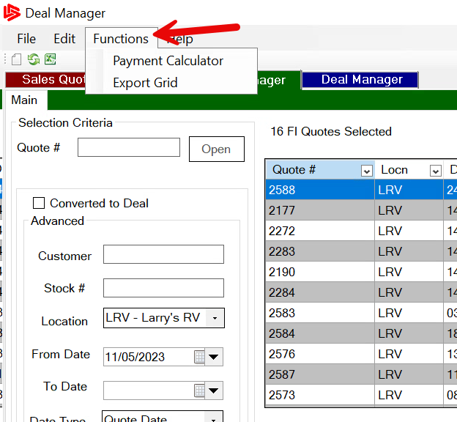
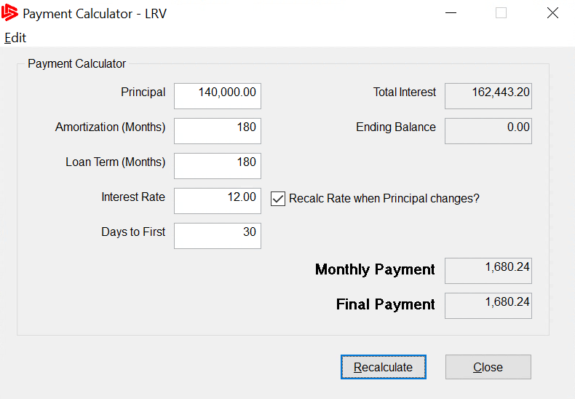
Manager View – Sales - Payment Calculator

Slide 14
Manager View – Sales – Deals
Export to excel
Capped – Posted Deals
Deal Count
Save view – Customize columns

Slide 15
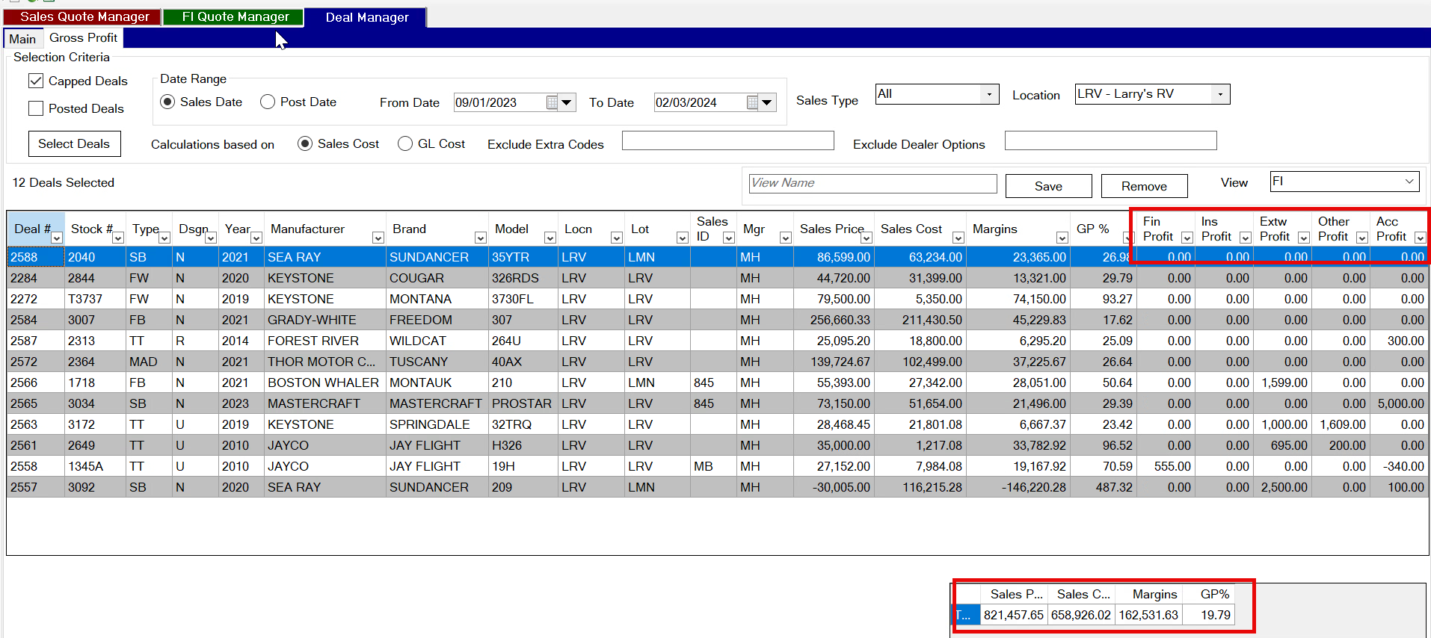
Manager View – Sales – Gross Profit

Slide 16
Manager View – Service
Include Closed but not Paid – Service Config 168
Actual Hours – Check count with zero hours
WO/Job Status - N

Slide 17
Manager View – Service
Unit Location
Special Order Parts
All Jobs Done
Category
Go to admin>setup>codes and tables
Service>Wo Categories
Create New - update code and description. Tech code and Name

Slide 18
Manage Unclaimed Warranty
Ability to split claim
Select multiple jobs from the same WO
Requires display resolution to be set at 100%

Slide 19
Manage Unclaimed Warranty
Sort Unclaimed by Dollars – Age
Filter Closed and Open Work Order with Warranty
Set a from date – otherwise manager may load slow, searches every WO since live on system for unclaimed warranty

Slide 20
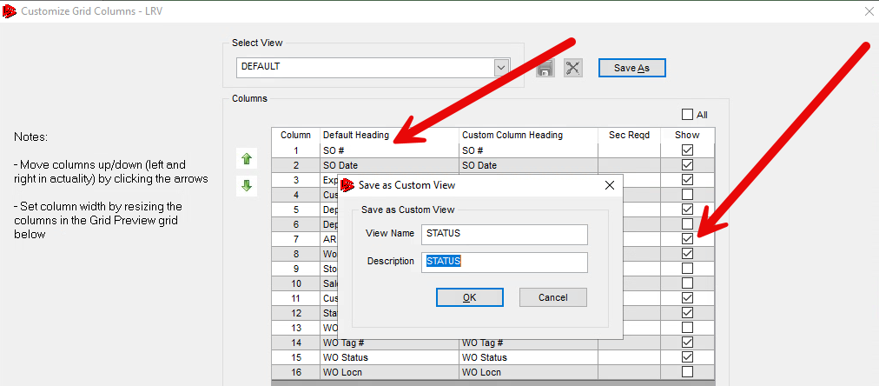
Manager View – Parts
Special Order Status
Wo Status
Tag
Customer Name

Slide 21
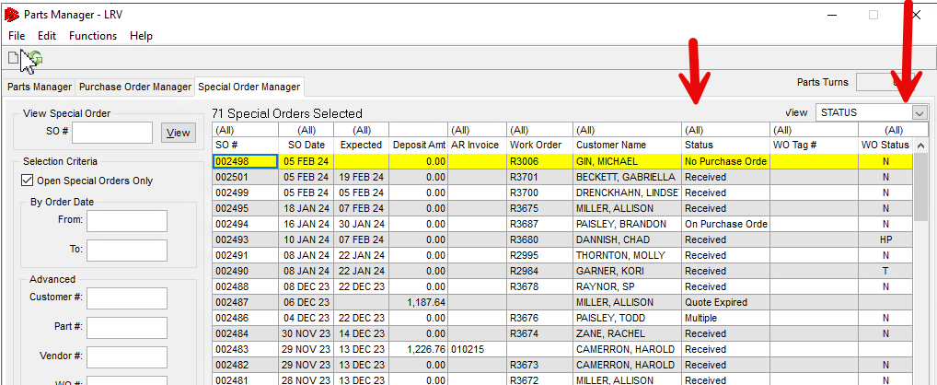
Manager View – Parts
Special Order Status
Wo Status
Tag
Customer Name

Slide 22
Manager View – Parts
Special Order Status
Parts Needed
Aging Parts

Slide 23
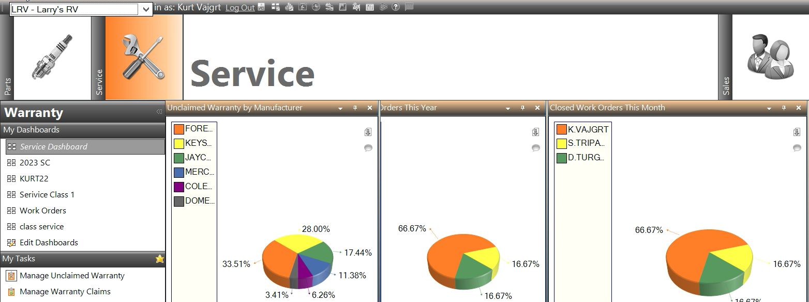
KPI’s Service

Slide 24
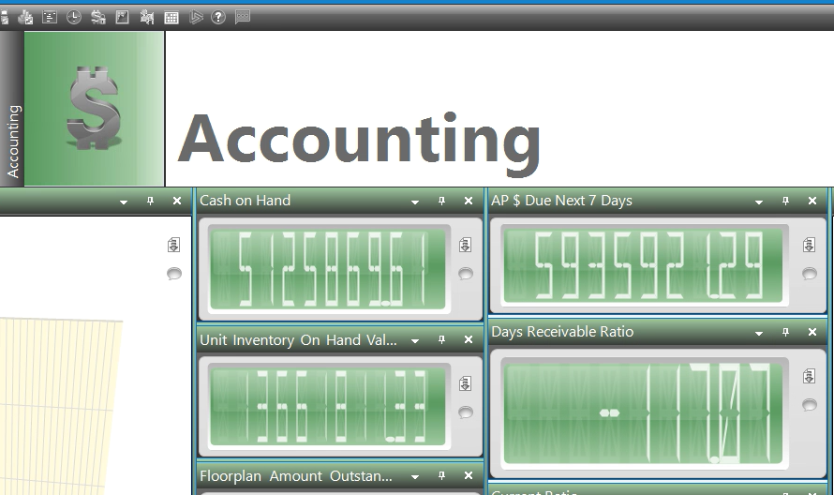
KPI’s Accounting

Slide 25
KPI’s Parts
Daily sales average ticket
Gross profit
Total parts tickets

Slide 26
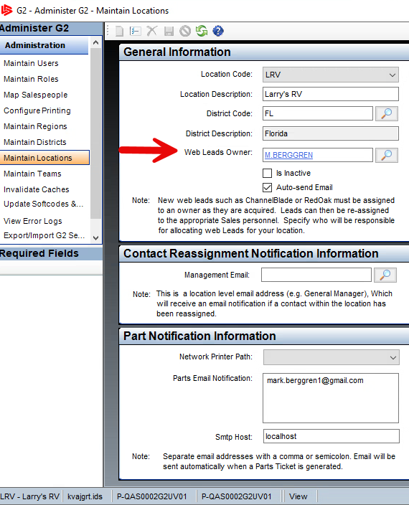
Alerts – Emails
Admin – Security – Administer G2
Leads - sales and service – Administer G2

Slide 27
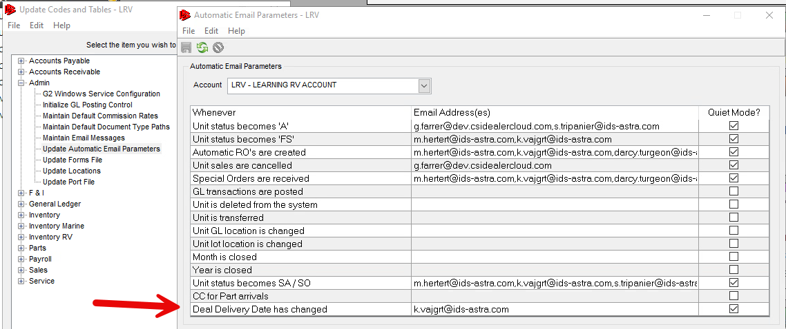
Alerts – Emails
Leads - sales and service – Administer G2
Parts Needed, quote and research – Parts Request Manager
Sold unit, delivery date – Codes and Tables – Automatic Email Parameters
Service Wo and Job status changes. Service CRM Schedules

Slide 28
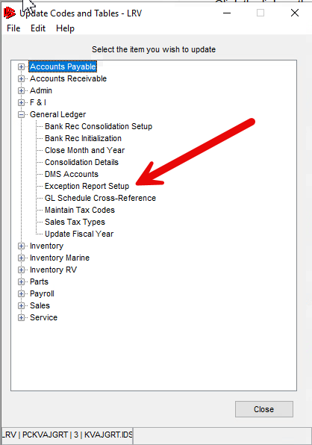
Exception Report
Set up exception criteria –
codes and tables – GL
Leave blank to not report
Run Report in GL Reports
Exception Report

Slide 29
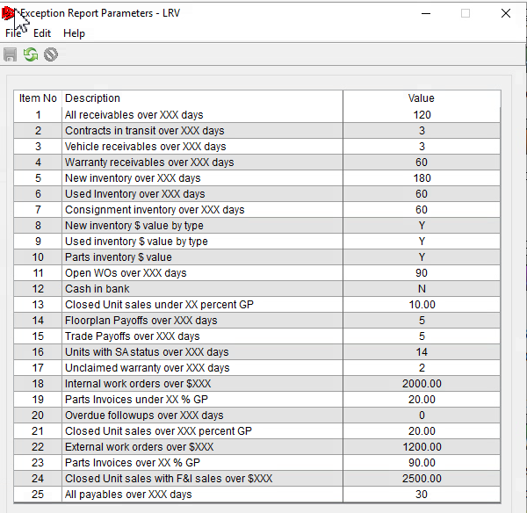
Exception Report
Set up exception criteria –
codes and tables – GL
Leave blank to not report
Run Report in GL Reports
Exception Report

Slide 30
Exception Report
Trade Payoffs, Sold not delivered units

Slide 31
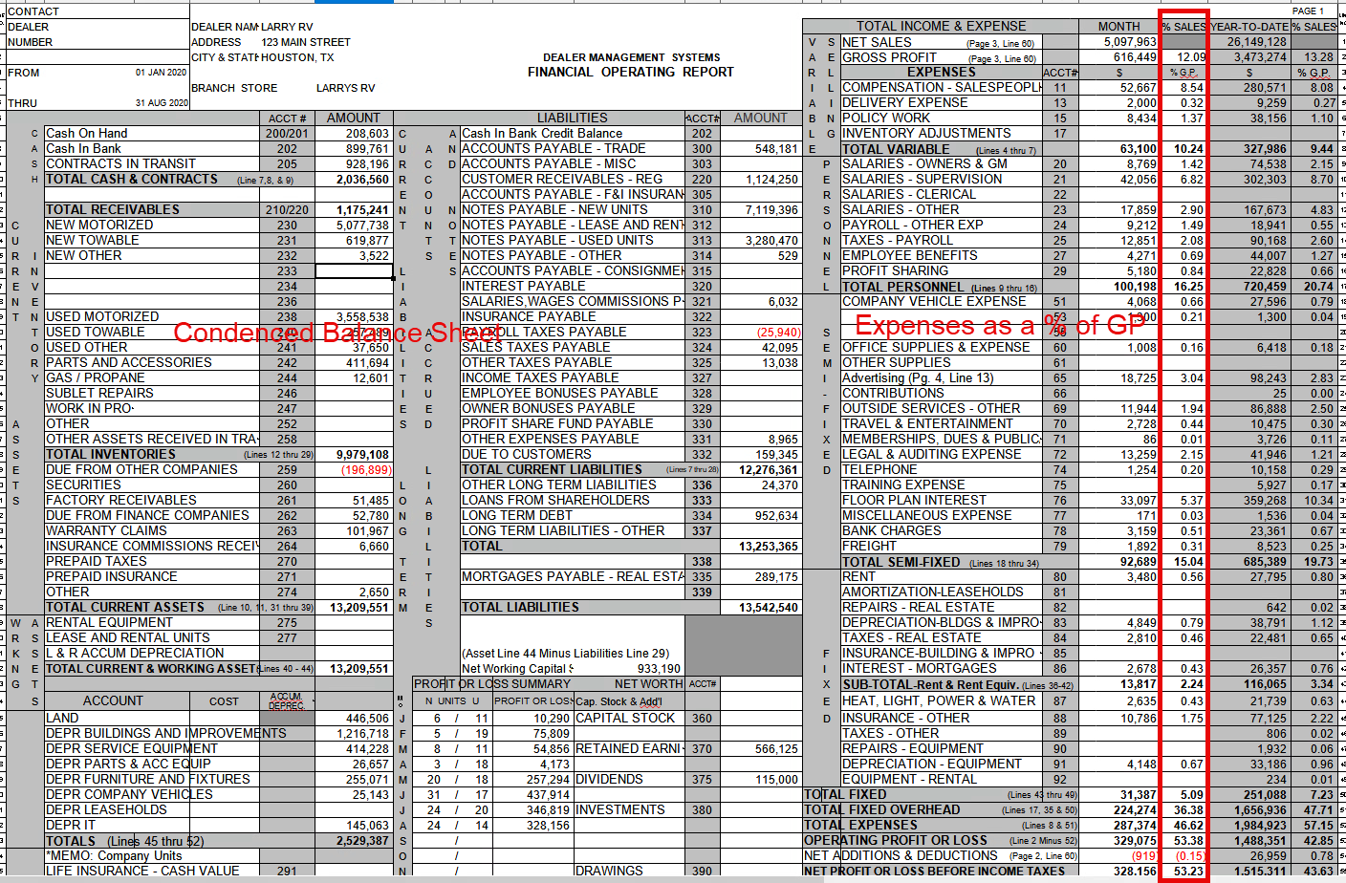
D
M
S

Slide 32
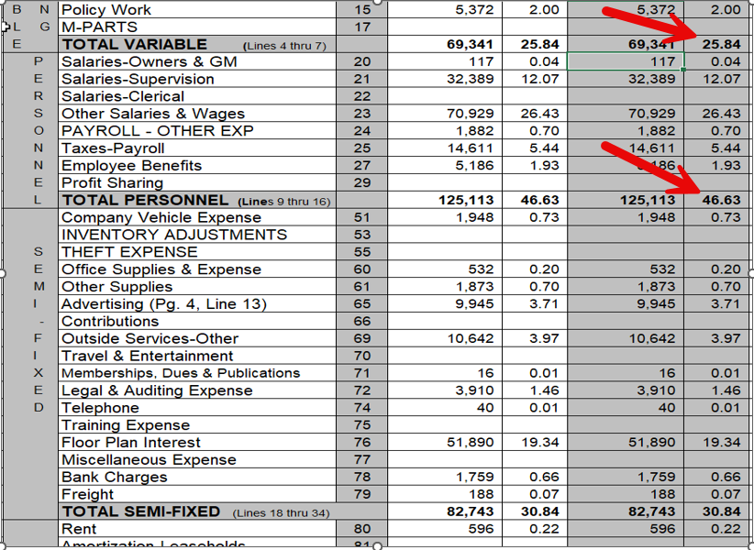
DMS Statement
Month and YTD Numbers
Expenses as a % of GP
Customize DMS accounts/Names

Slide 33
DMS Statement
Departmental P/L
Gross Profit by Dept
Month, YTD
Config 14 add 5th page for FI products

Slide 34
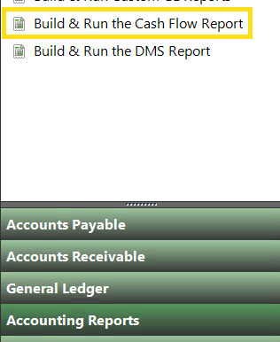
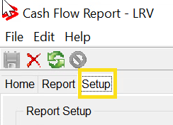
Cash Flow Statement
Set up Accounts
Accounting Reports Build and run Cash Flow Report
Select the Setup Tab

Slide 35
Cash Flow Statement
Select the Line Description – add Gl account numbers for each category

Slide 36
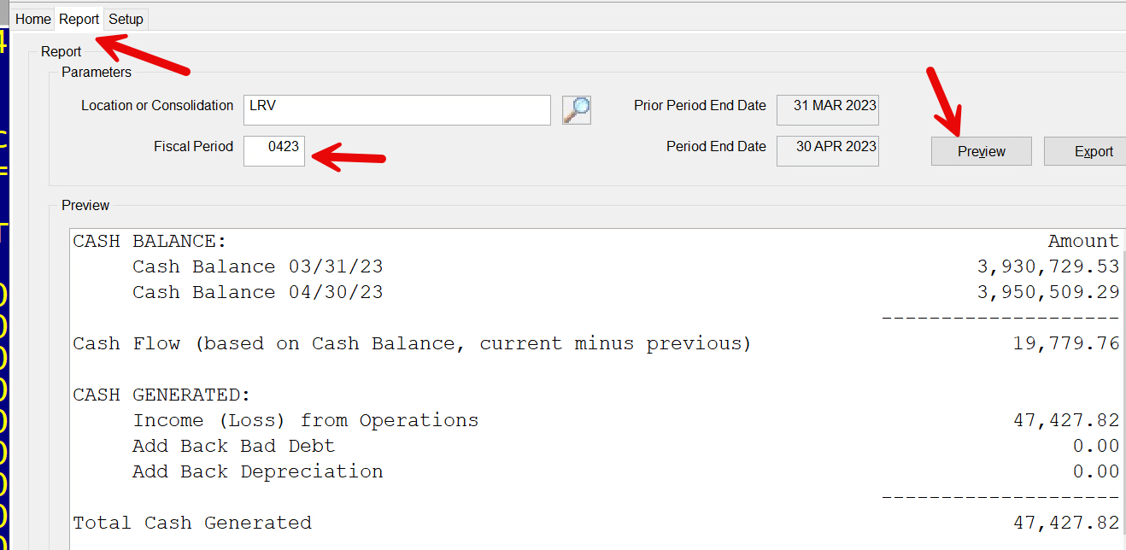
Cash Flow Statement
Select Report, enter fiscal period, preview.
Show Increase(decrease) bank balance and cash generated from P/L.

Slide 37
Cash Flow Statement – Cont.
Difference is a negative position. Cash, Income, AR, AP.

Slide 38
Cash Flow Statement – Cont.
What does this show.
Business activities generated a Profit of $47,427
Cash in Bank increases by $19,779
Cash Expended - $73,407
Difference – $101,056, not a good sign to see a trend of negative cash flow.
Spending more than the business is making

Slide 39
Measuring performance for improvement
Set measurable goals for employees.
Weekly reporting of progress, review.
Training
Identifies areas that we can improve.
Review workflow adaption.

Slide 40
KPI’s
Department Indicators
Key Performance Indicators
How does each department/role, see their daily/weekly results.
Set a goal and report on it frequently.
Ability to see target and progress daily.

Slide 41
o Tools to Monitor your dealership
What tools to use to monitor your dealership
Daily individual performance – Show Gross Profit, count, age/cycle
Factors that negatively affect GP - Chargebacks, Policy, Adjustments.
non-moving Opps – Aged WO’s, Deals, Parts.
at your dealership

Slide 42
Warranty
Department Indicators
Warranty
Warranty paid as a percentage of units purchased.
Warranty in process – Stages WIP, Unclaimed, Open Receivables.
Review Warranty Manager Views
Paid Warranty, Shortages with reason.

Slide 43
Service
Department Indicators
Service
Mechanic productivity – with bill types
Effective Labor Rate by Author
Service Dollars Retail-Warranty-Internal as a percentage
WO with All Jobs Completed – Aging
WO with no Actual Labor > 3 Days
CP Work Order with no Feed-Activity > 5 Days
Service Policy $

Slide 44
Sales
Department Indicators
Sales
Finance Dept Penetration Financed Produces New and Used
Inventory Turns – Inventory New over 180 used over 90
Used Inventory with Open Reconditioning WO - Age
Floorplan Interest as a Percentage of GP Average last 30 days
Per Vehicle Retail – Average Backend Gross Profit Motorized /Towable
PPRU – Products Per Retail Unit = By Type Motorized /Towable
Finance Chargebacks – By FI MGR
Leads to Close Ratio – Total Leads vs Closed Deals for the MTD
Opportunities with Sales Stage
Sales Deposits not tied to a deal
Sales GP$ % and Count by Salesperson
Cost of Sales Adjustments after Deal Posted

Slide 45
Parts
Department Indicators
Parts
Parts Sold by Sales ID Sales GP$ % - Last Month
Parts Sold By Sales IDS Sales GP $ - Current Month
Part Adjustments COS – Count
Parts Received but not sold for 90 days $
Cash Flow – Daily – Monthly Change in Cash Position

Slide 46
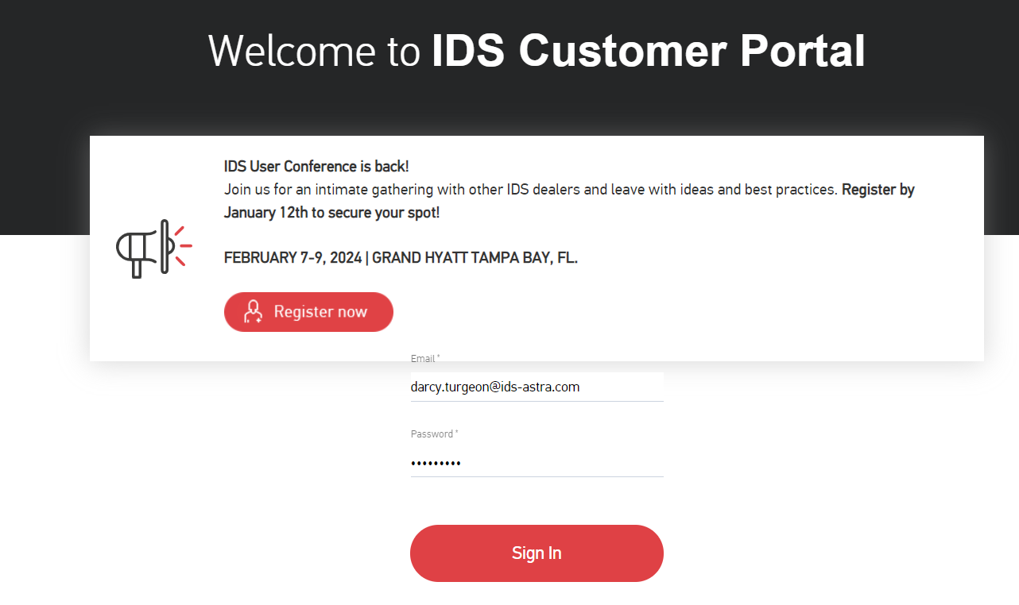
How to get Support Help
The best way to get support is to sign up on the IDS Portal website,
Visit: https://portal.ids-astra.com/login
Here you can register to send in a support ticket and access the vast amount of online reference materials.

Slide 47
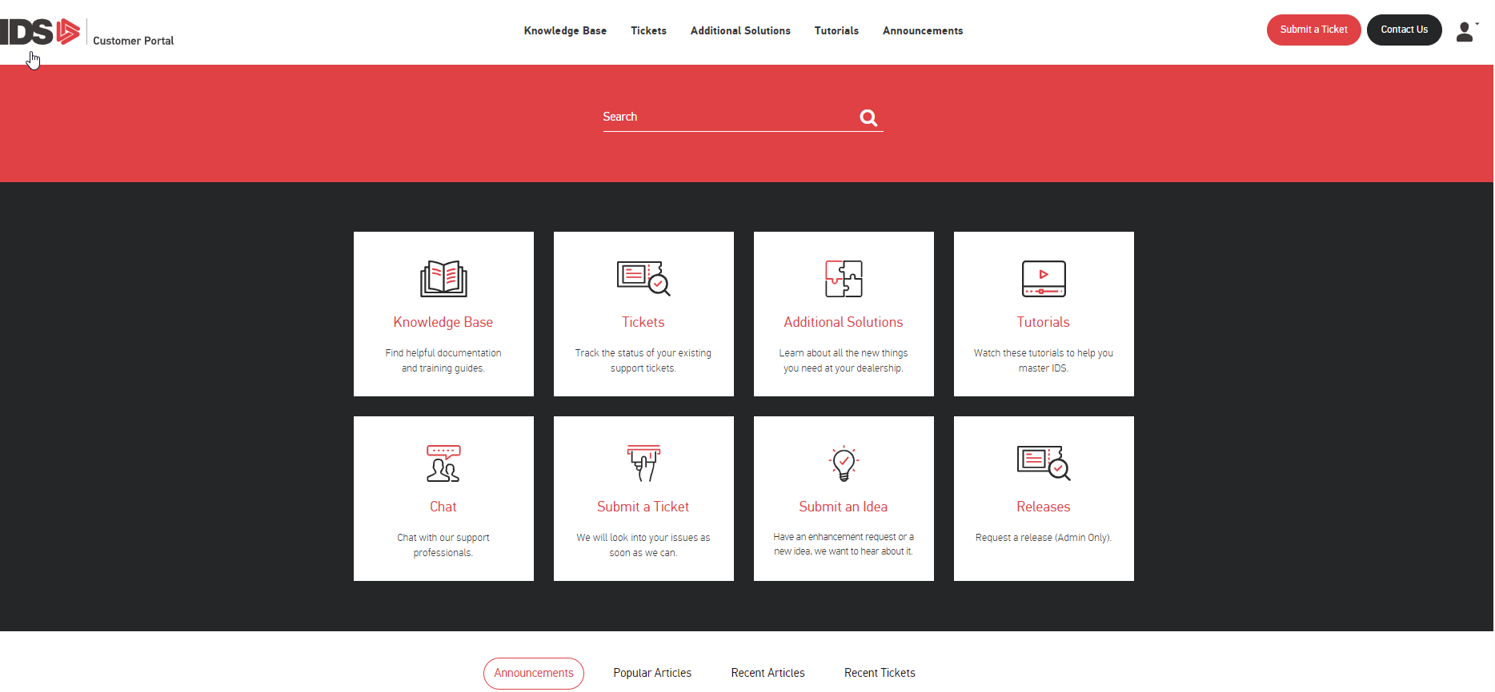
How to get Support Help

Slide 48
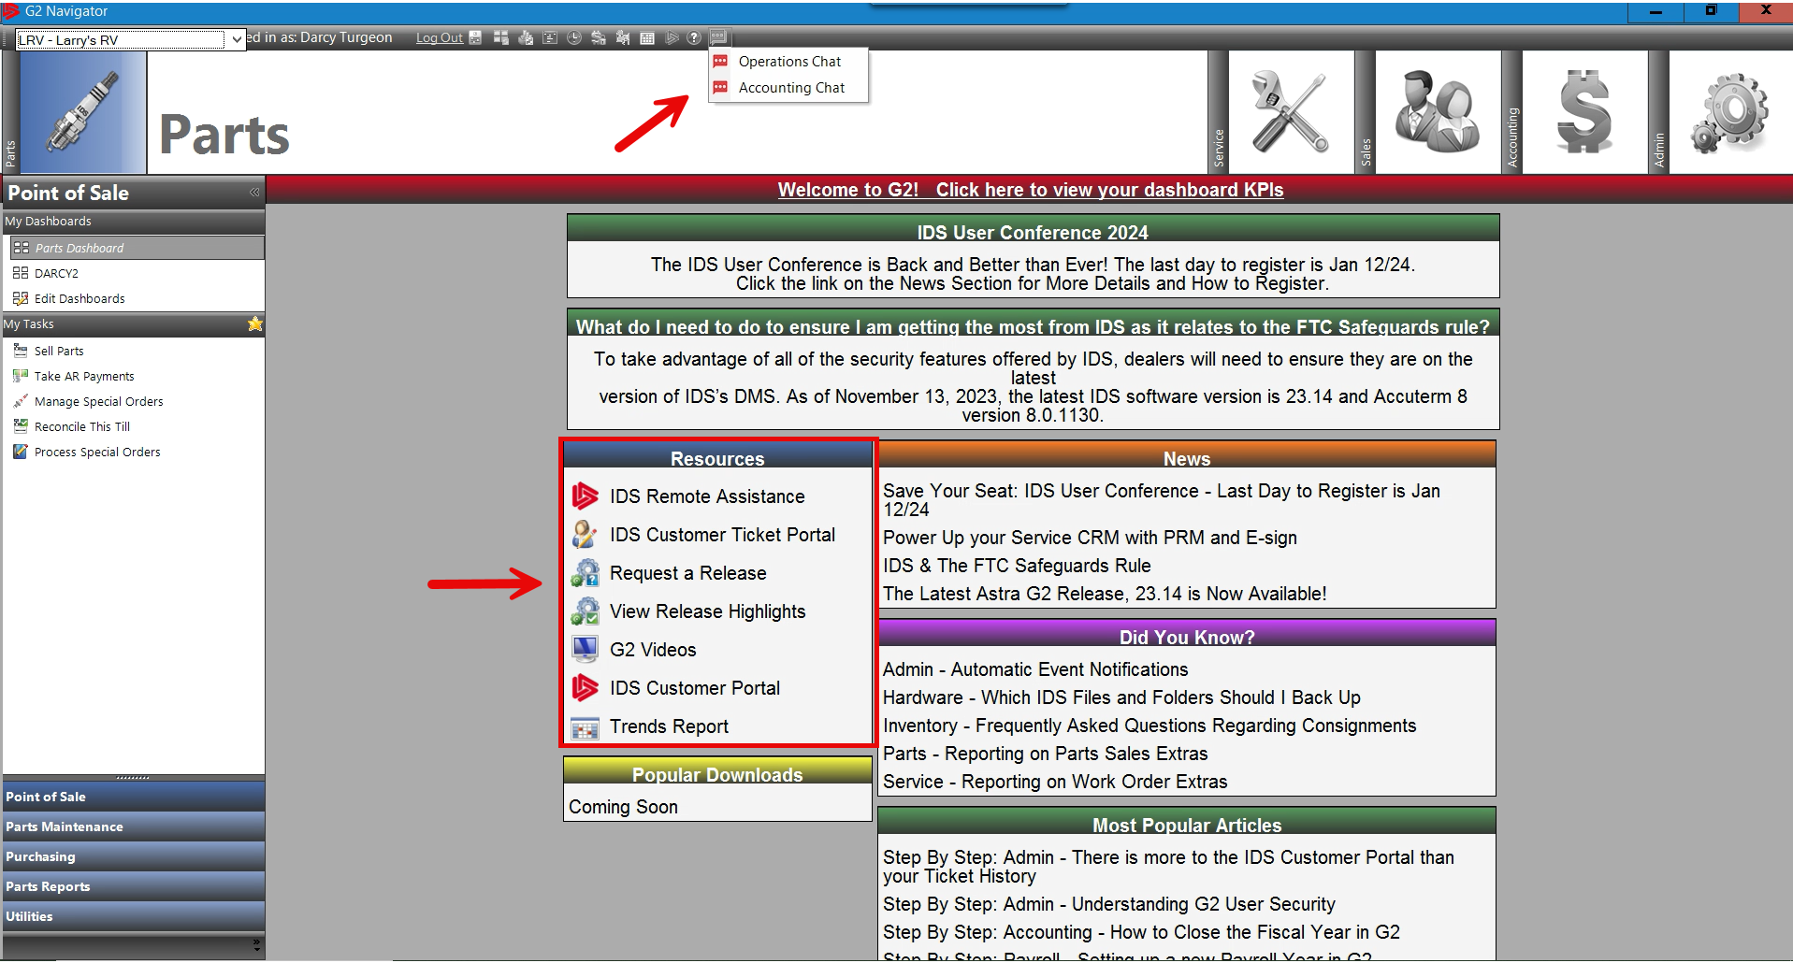
How to get Support Help

