Slide 1
Back to Basics
Parts and Service

Slide 2
Welcome…Thank you for coming
We appreciate your time and commitment to learning more about your G2 software system. We realize your time is valuable, and we want you to get the most out of these training classes.
We strive to help you discover the most efficient and productive ways to use the software, which would include reports, manage menus, as well as daily, weekly and monthly activities to ensure your data is as accurate and timely as possible.
Please keep your phones on MUTE, we will have time for Questions at the end of the presentation.

Slide 3
Darcy Turgeon
Professional Service’s Consultant

Slide 4
Background
25 years in the IT industry with 15 years as an Owner Operator for a full line dealership, with products ranging from small RV’s to a large diesel pushers. My main focus included being the fixed operations manager with support roles in Sales, Marketing and Finance.

Slide 5
PARTS AGENDA
SERVICE AGENDA
How to Sell Parts
How to Manage Special Orders OTC
How to See Customer History OTC
How to Maintain Parts
How to Create a Purchase Order
How to Receive a Purchase Order
Inventory
The Appointment Calendar
The Work Order Manager
How to Create a Work Order
How to Close a Work Order
How to Use Status Codes
Mechanic Daily View

Slide 6
PARTS AGENDA

Slide 7
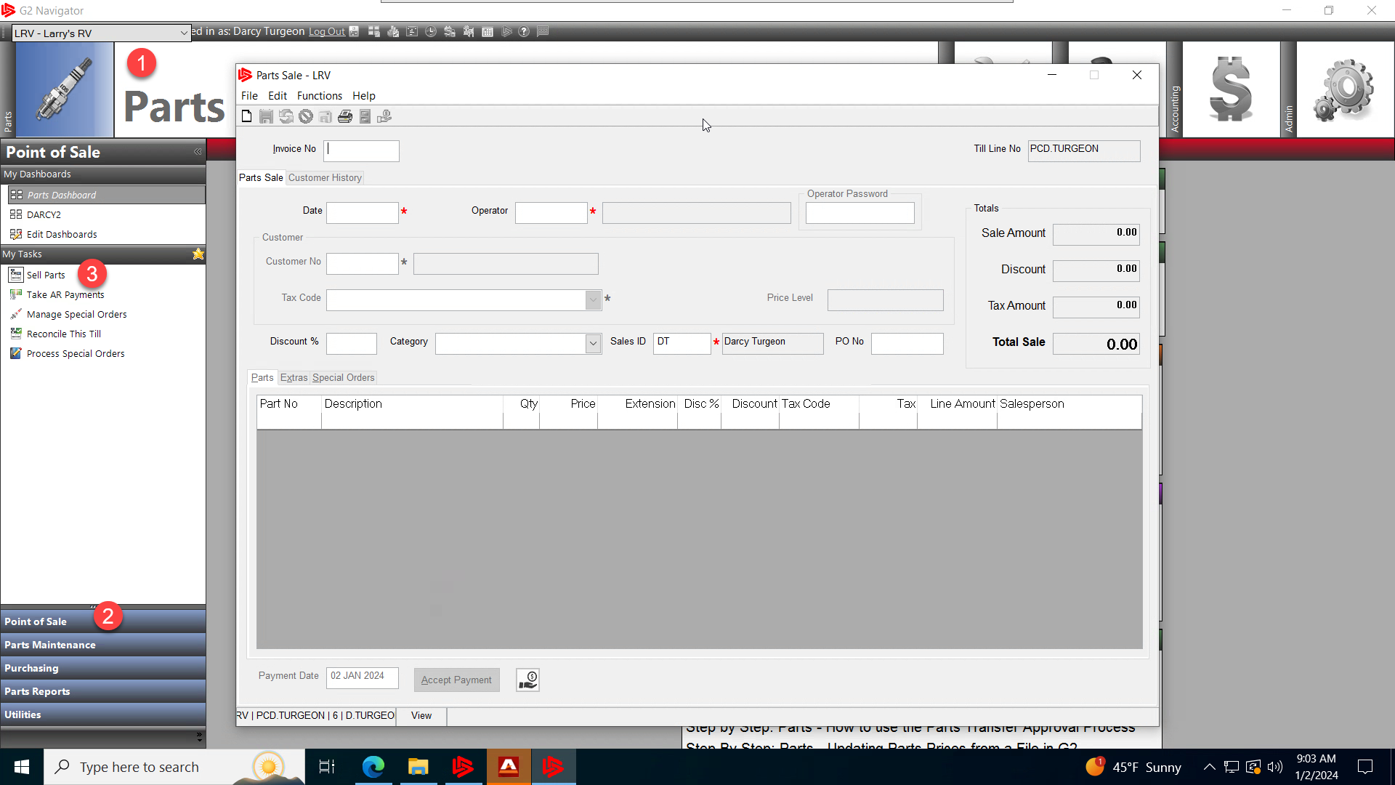
PARTS - How to Sell Parts
In order for you to sell parts to a customer over the counter you will need to go to:
Go to the Parts Module
Click on the Point of Sale Sub-menu
And Click on Sell Parts

Slide 8
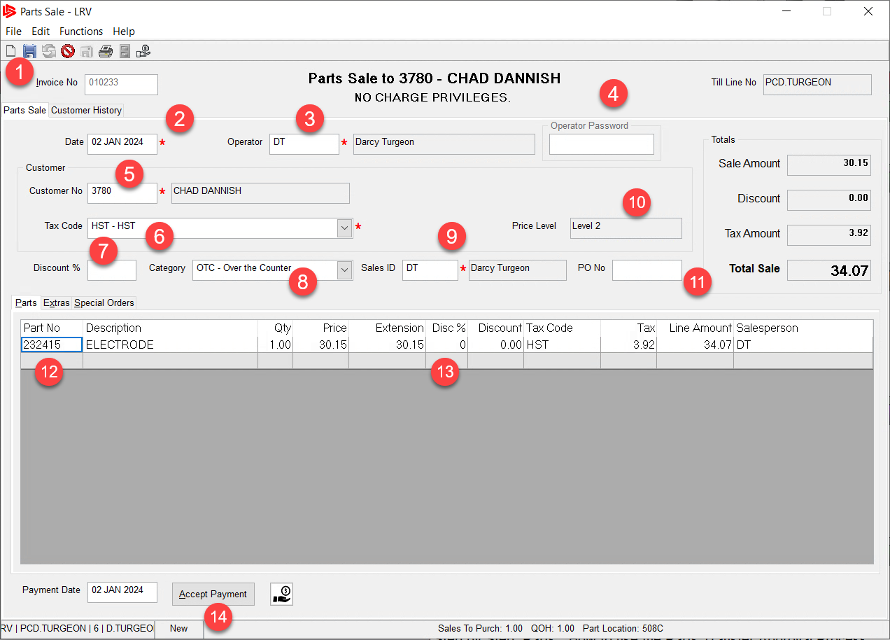
PARTS - How to Sell Parts
The Parts Sale Form will appear:
Click on the new piece of paper in the upper left corner to start a new transaction.
The date will default in, to the date of the transaction.
Your operator code will default in, if it does not then enter it here, it is usually the first and last initials.

Slide 9
PARTS - How to Sell Parts
If you need to enter in your password, then enter it here.
If you know the customer number enter it in here or right click to search for the customer. This will bring up the customer lookup screen which allows you to create a new customer if they are not in the database. You can also at this point use the code 999 for a cash customer.

Slide 10
PARTS - How to Sell Parts
The Tax code will default in for this customer, you can change this in the customer file or change it here by choosing from the drop down.
The Discount % box is for giving a discount in % for the whole transaction and must be done prior to adding any part lines to the parts sale form.

Slide 11
PARTS - How to Sell Parts
If you use Categories, then choose a category for the transaction from the drop down list. You can add/remove categories by going to the Updates Codes and Tables section in the Admin if you have security to do so.
Your sales ID should default in, again if it does not then enter them here it will be your first and last initial usually.

Slide 12
PARTS - How to Sell Parts
The Price Level comes from the customer file, it is used for automatically giving customers parts discount and is setup in the Update Parts Pricing Grid located in the utilities section of the parts module.
If the customer has a PO and wants it printed on the receipt, enter it here.

Slide 13
PARTS - How to Sell Parts
Enter in the part number here if you know it, you can scan the bar code or right click and search for the part. Enter in the quantity the customer is purchasing and verify the price.
The Discount % is where you give a line-by-line discount on any part. Enter it here to discount the line only.

Slide 14
PARTS - How to Sell Parts
Once you are satisfied that the Part Sale form is complete, Click on the Accept Payment button or click the Save Icon at the top to initiate the Take Payment screen.

Slide 15
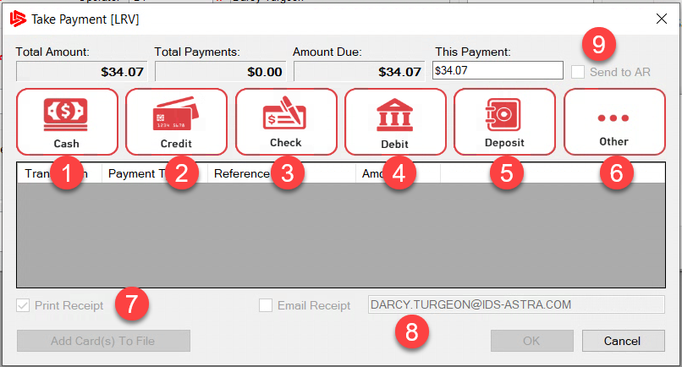
PARTS - How to Sell Parts
Once the take payment screen appears you have 6 options to choose from in order to accept payment, Cash, Credit, Check, Debit, Deposit and Other
Choose Cash if the customer pays you in Cash.
Choose Credit if you are setup with Charge It Pro.
Choose Check if they pay by a check
Choose Debit if customer wants to pay using their debit card

Slide 16
PARTS - How to Sell Parts
Use Deposit if the customer has a deposit/credit with your company
If you use your own payment terminal, choose Other.
By clicking on the Other button, you will be able to choose from Visa, Mastercard, American Express, Wire Transfers and Gift Cards etc...
Check this box if you want to print a receipt
Check this box to email the receipt

Slide 17
PARTS - How to Sell Parts
If the customer has charge privileges, then the Send to AR checkbox will not be greyed out and you can send it to AR. To add charge privileges for a customer you must have the
security to do so and this is maintained in the customer file.
Once you are satisfied with the payment and options, click the OK button to process the payment.

Slide 18
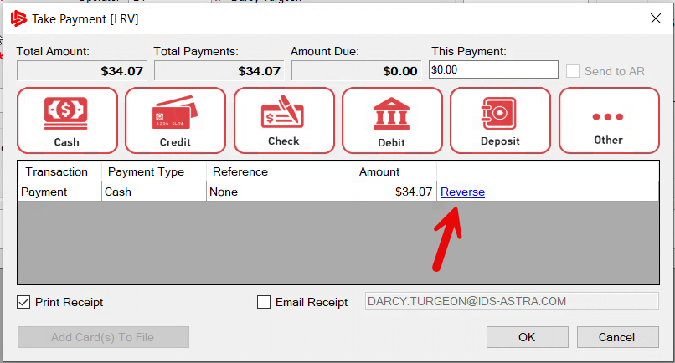
PARTS - How to Sell Parts
If you make a mistake during the take payment process, you can always use the Reverse payment hyper link as shown.
This will reverse the current payment and allow you to start over with a new payment option.

Slide 19
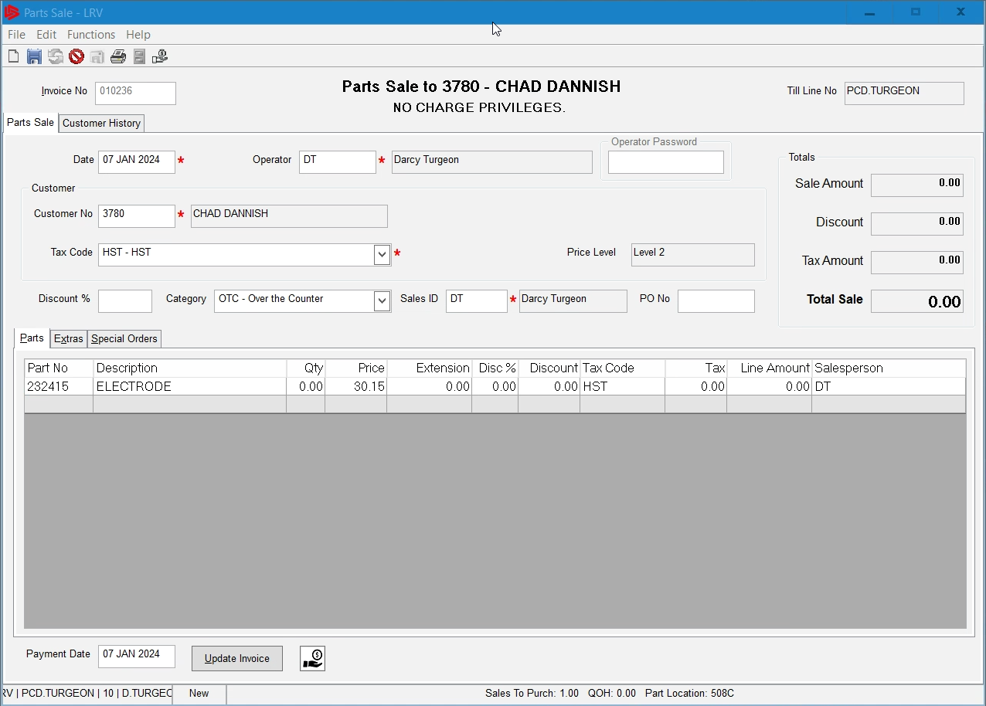
PARTS - How to Manage Special Orders OTC
We manage special orders over the counter using the sell parts form. The process is the same
As selling a part in stock. The exception is the part quantity is 0, this will trigger the special order to activate once we put a quantity to order in the quantity field.

Slide 20
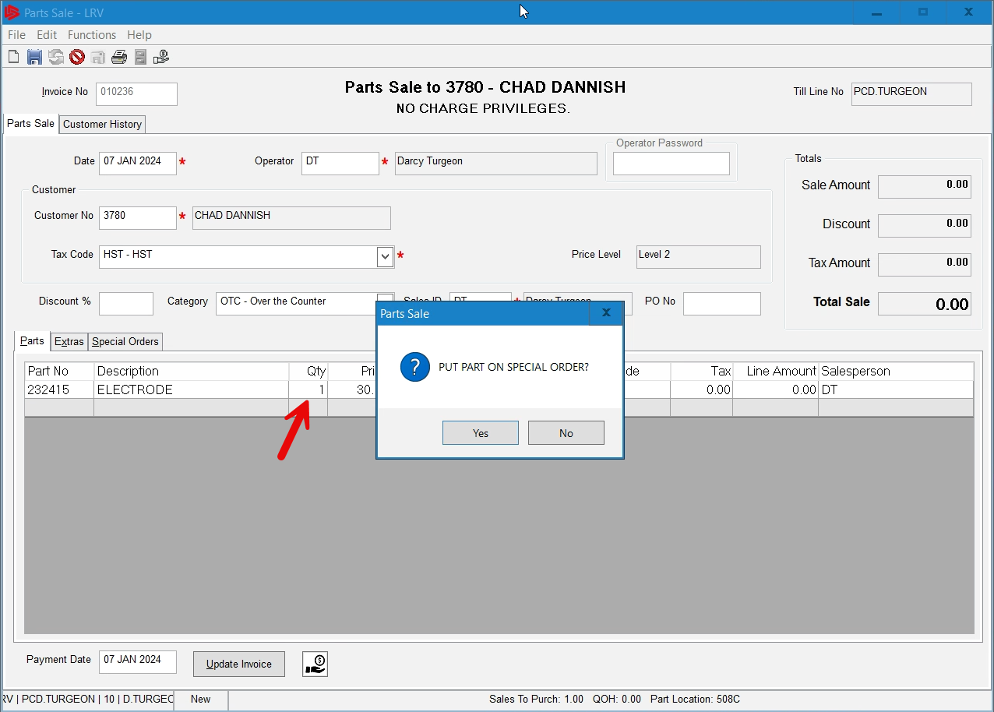
PARTS - How to Manage Special Orders OTC
Putting in a quantity and tabbing over will trigger the system to put this part on special order as shown. Press the Yes button.

Slide 21
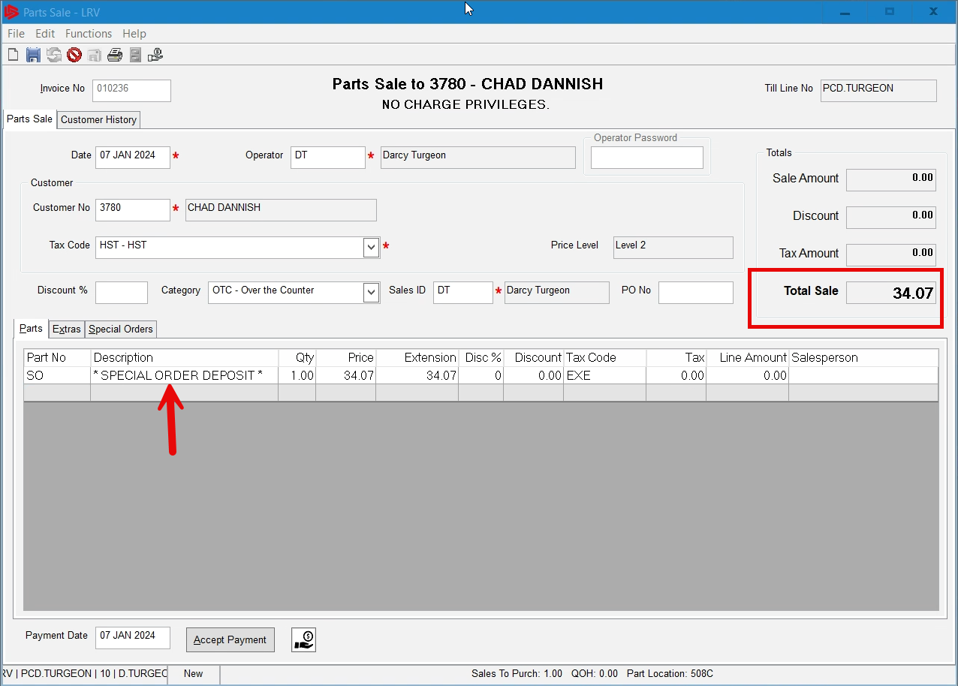
PARTS - How to Manage Special Orders OTC
When we put the part on special order we are taking a deposit on the part, in this case a 100% deposit is required and this can be changed in the settings. When we get the part in we will add the shipping charges in the extra tab when the customer comes to pick up.

Slide 22
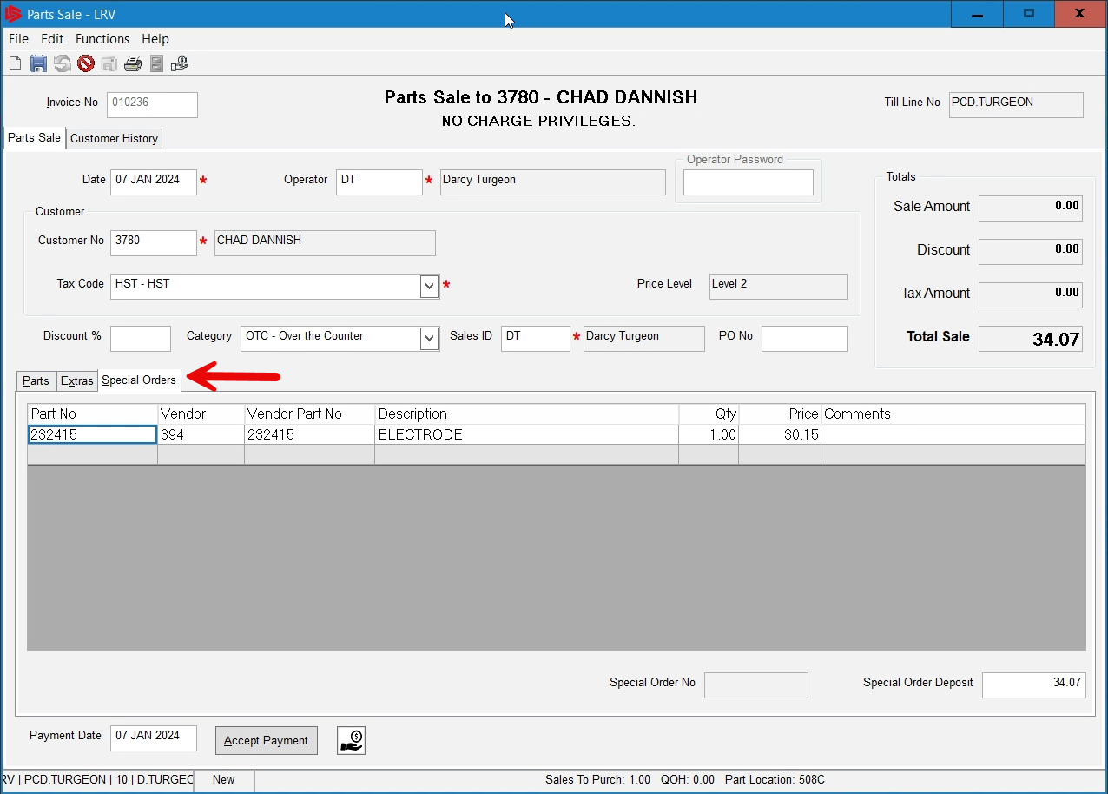
PARTS - How to Manage Special Orders OTC
If you need to make changes to the part, click on the Special Orders tab to see the part, here you can update and change as needed. In this tabbed view you can also change the amount of the deposit in the bottom right corner, not recommended.

Slide 23
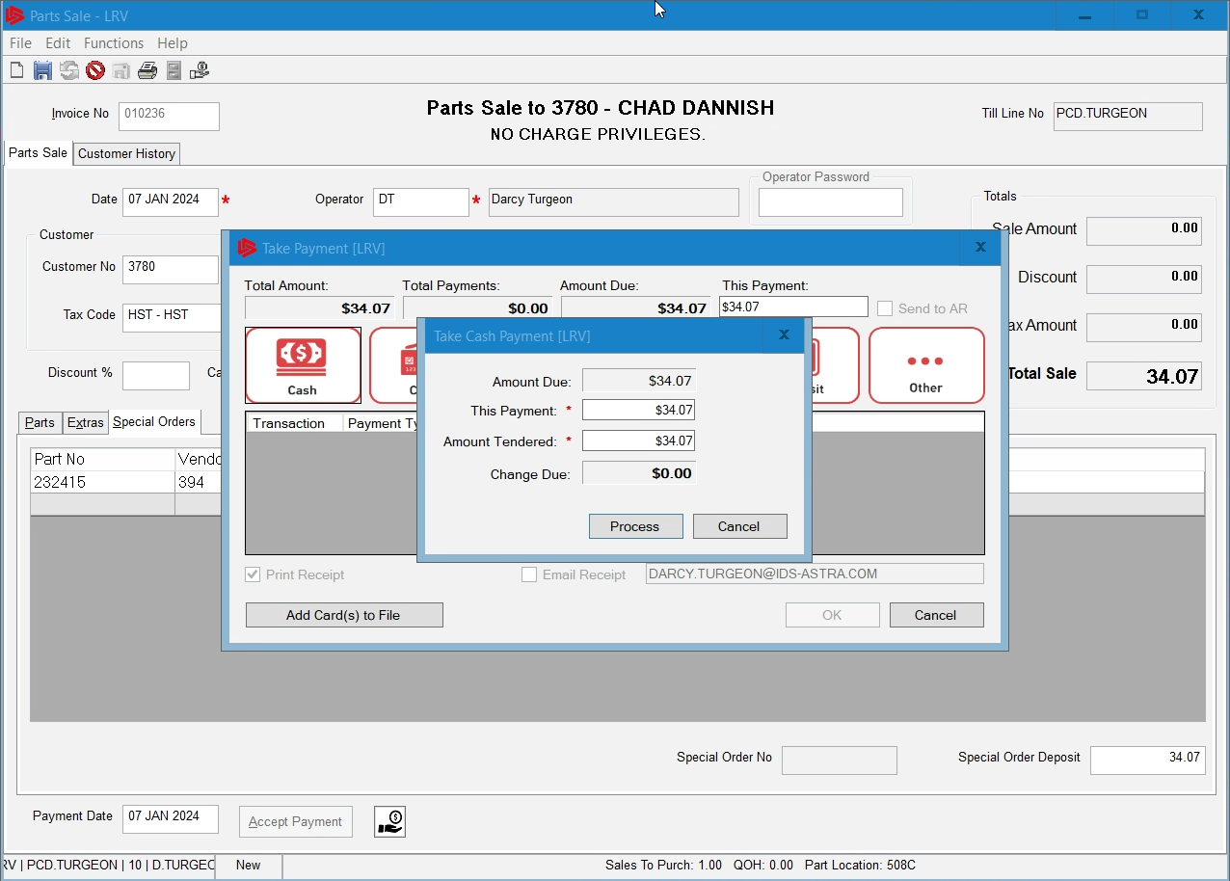
PARTS - How to Manage Special Orders OTC
Click accept payment and process the special order once you are satisfied with the purchase agreement.

Slide 24
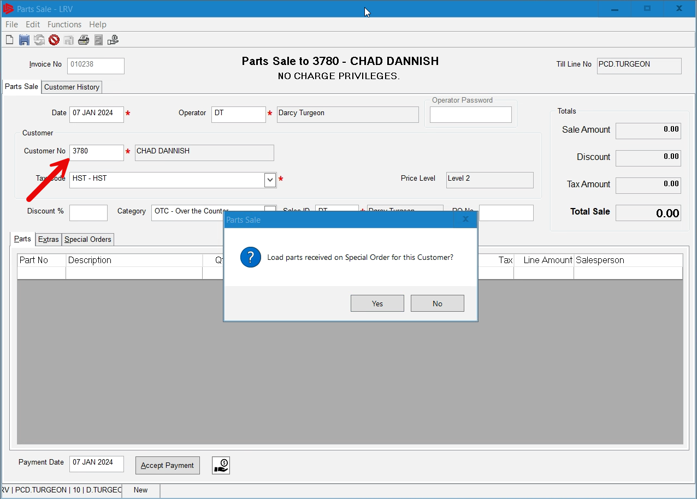
PARTS - How to Manage Special Orders OTC
Once the part is received by the dealership we would call the customer to come in and pick up the part. At this time the customer will pay any taxes and shipping charges. We create a new counter invoice for this procedure. Once we put the customer number in the invoice the system informs us of the special order for this customer.

Slide 25
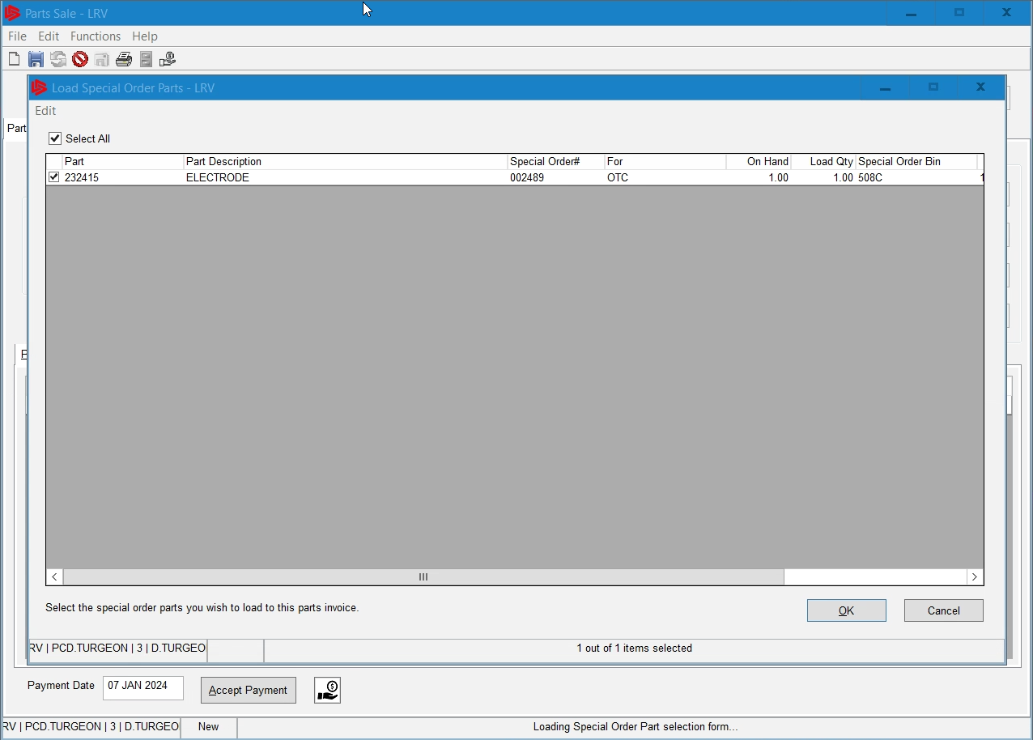
PARTS - How to Manage Special Orders OTC
When we click Yes, the load special order form will appear, we simply choose the parts to load them onto the parts sale invoice.

Slide 26
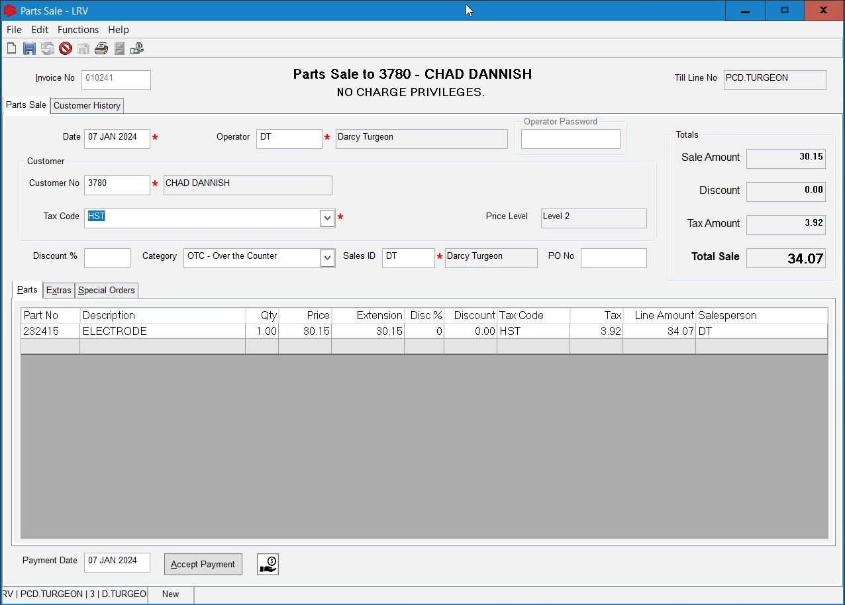
PARTS - How to Manage Special Orders OTC
The part now shows up in the parts tab and comes in with the applicable taxes. We still have to charge the customer for the freight if there are any freight charges.

Slide 27
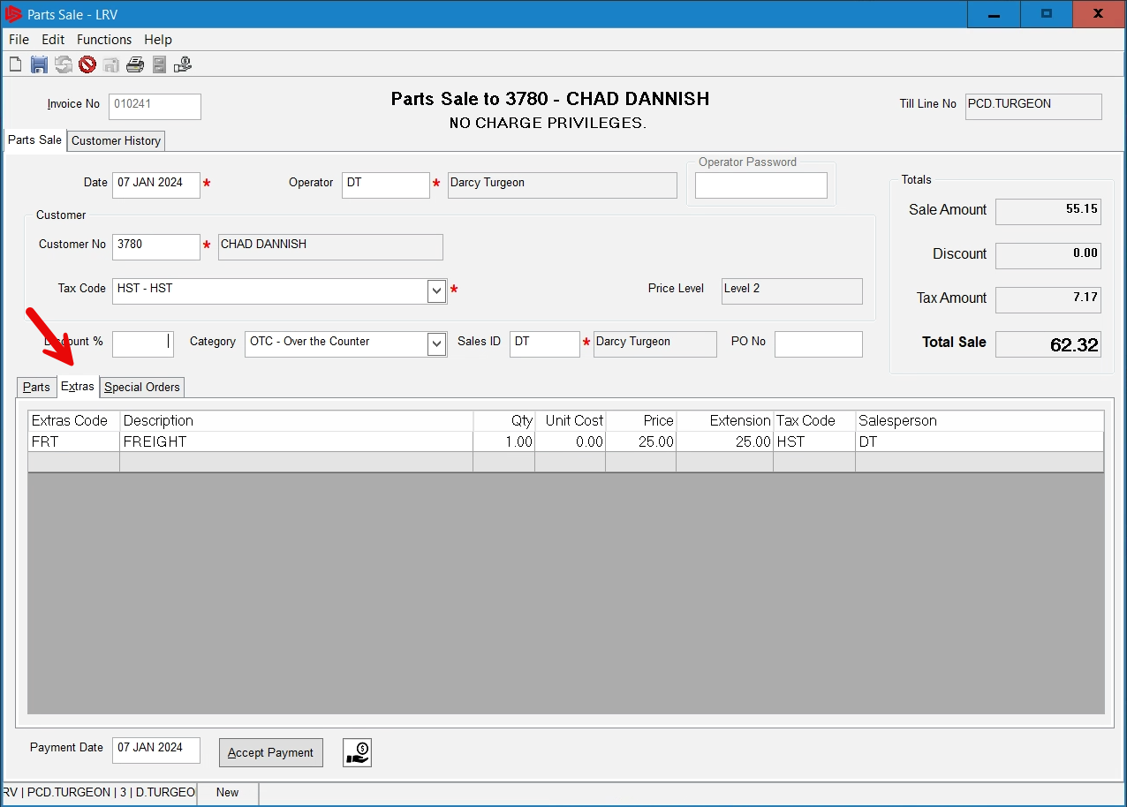
PARTS - How to Manage Special Orders OTC
To Charge any freight, go to the Extra tab and enter in your freight extra code and put the price you are charging the customer for.

Slide 28
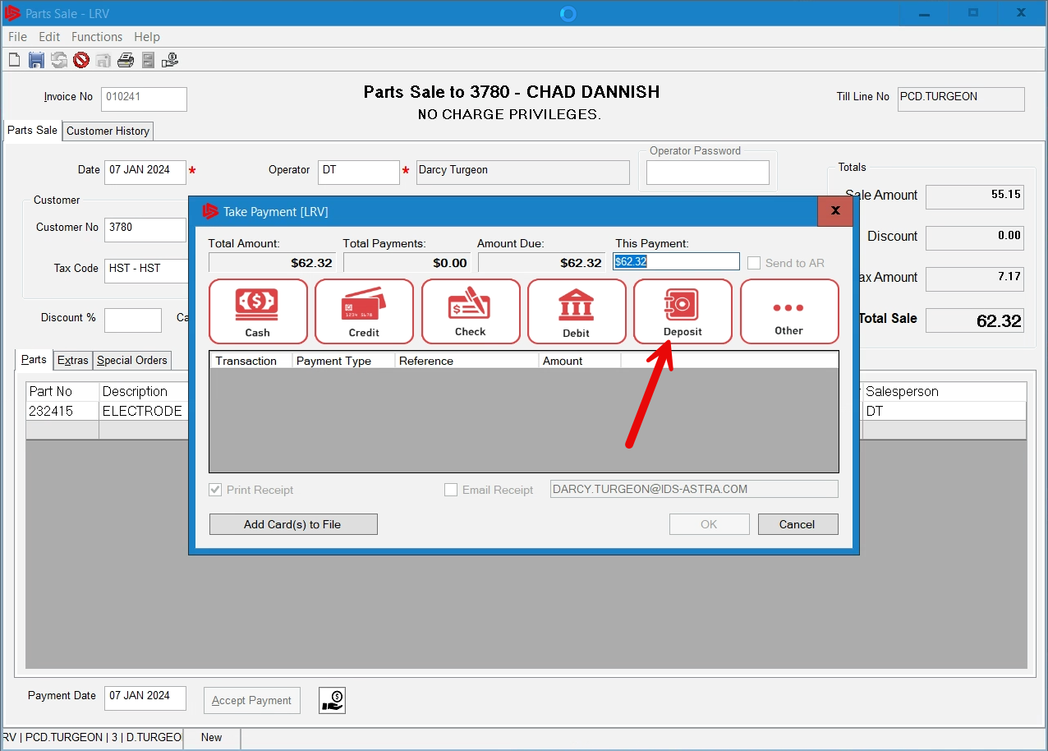
PARTS - How to Manage Special Orders OTC
Click on the Accept payment button and the take payment screen appears. Since we took a deposit when we ordered the part. The deposit button appears in Red and now allows us to choose that deposit.
Click the deposit button.

Slide 29
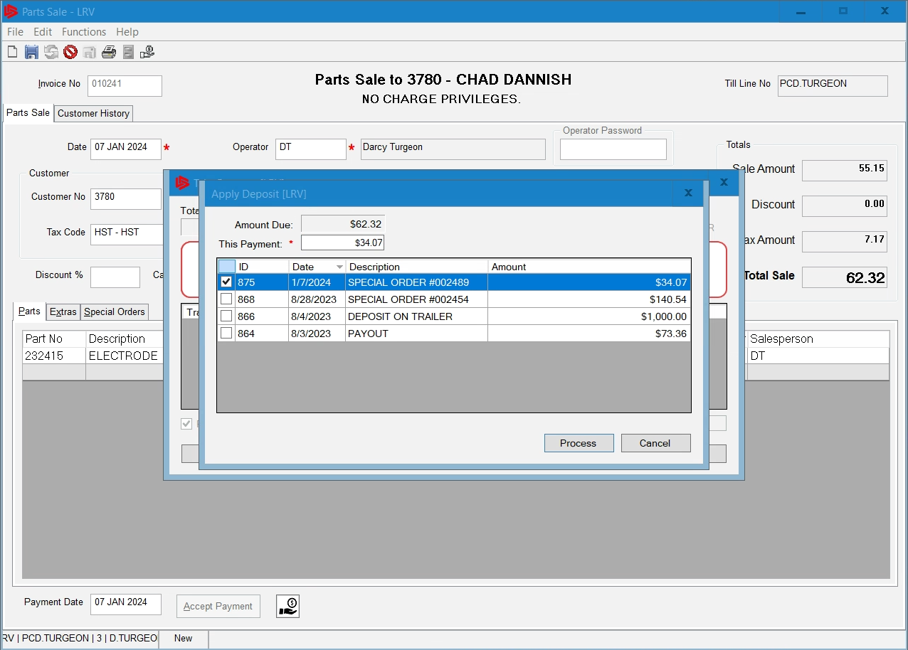
PARTS - How to Manage Special Orders OTC
The apply deposit form appears and here we can choose the deposit the customer first gave up to order this part. Choose the deposit and click process.

Slide 30
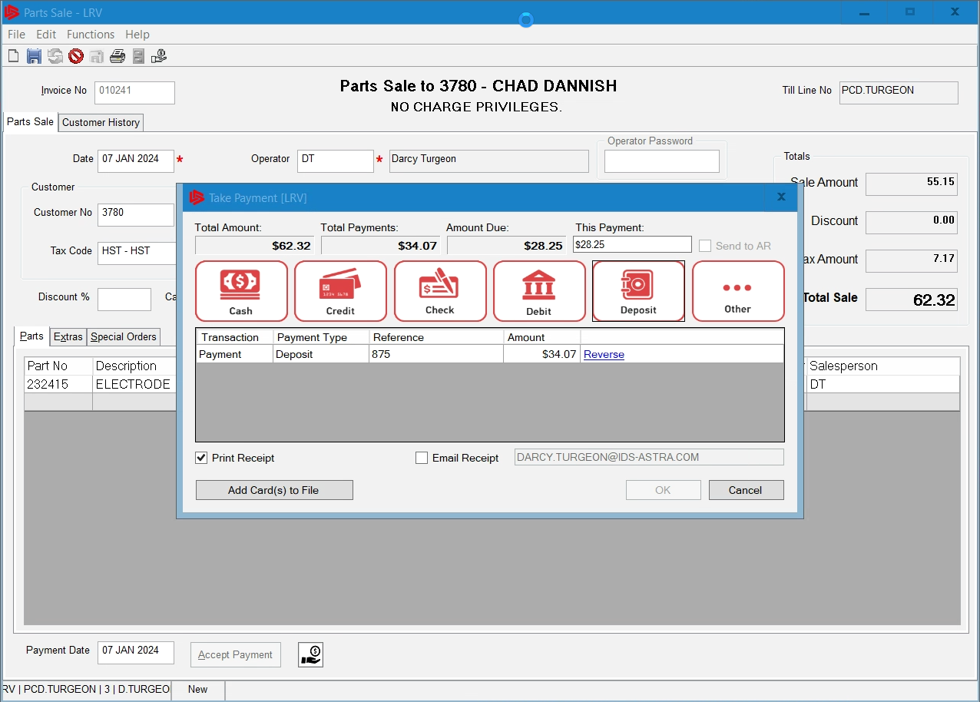
PARTS - How to Manage Special Orders OTC
The Deposit loads and now we choose how the customer will pay the final charges, in this case we will choose cash.

Slide 31
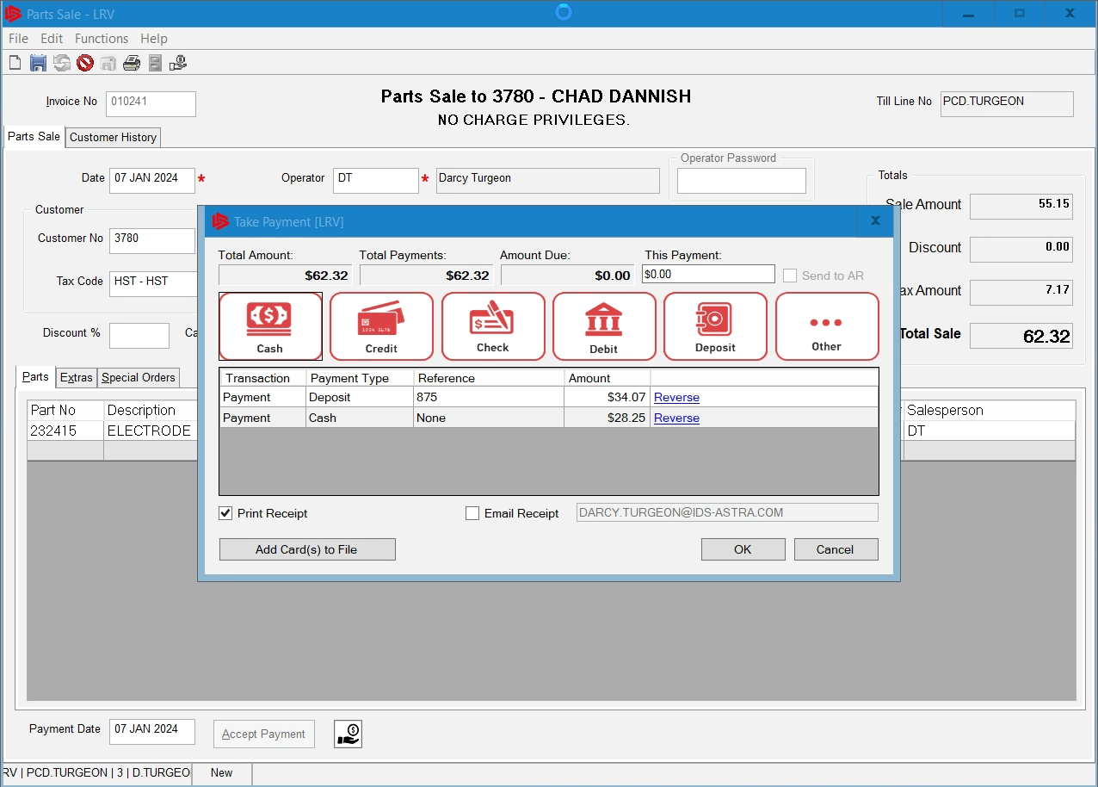
PARTS - How to Manage Special Orders OTC
The deposit will now be applied to the invoice and the customer will pay the balance owing, choose to print or email his/her receipt.

Slide 32
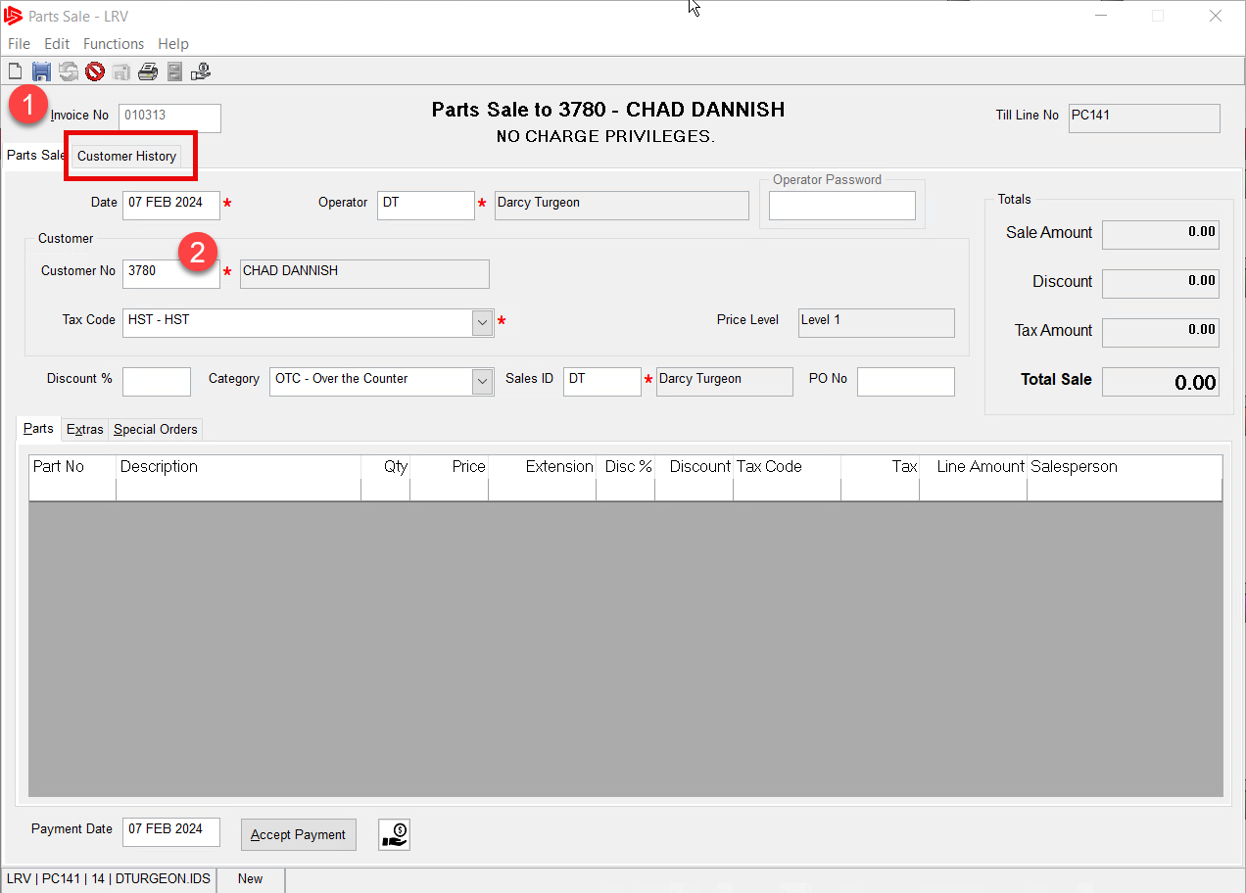
PARTS - How To See Customer History OTC
The fastest and easiest way to view a customer history while in the parts sell screen is to:
Create a new parts invoice
Put in the customer number or search for them.
Note: Cash Customer 999 will not work for this, highly recommended to always try and get a customer number

Slide 33
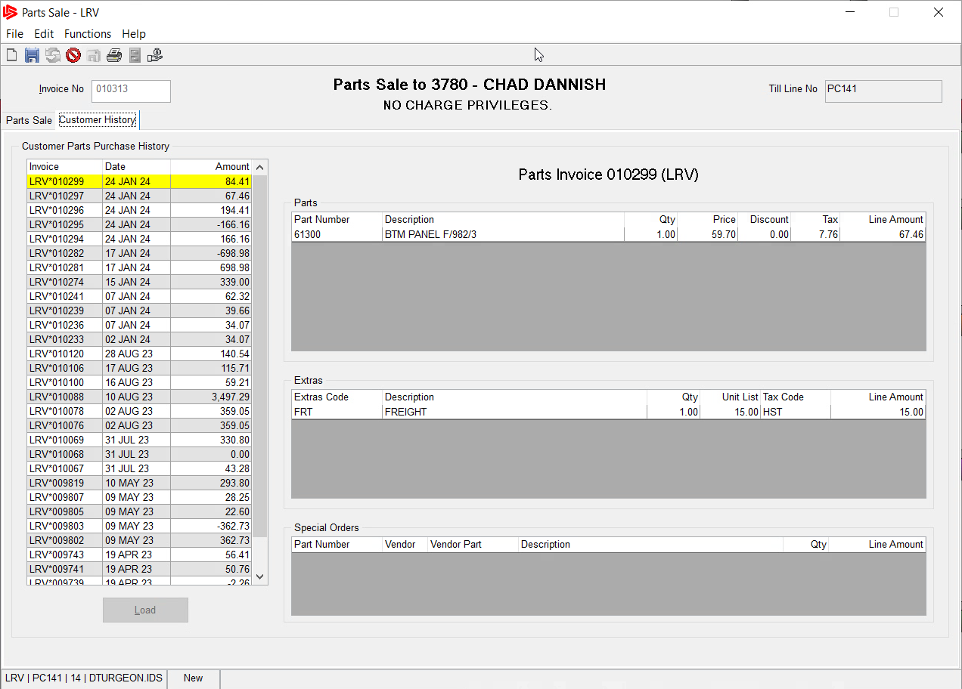
PARTS - How To See Customer History OTC
You can now select the invoice number from the history list on the left and see the details on the right.
Note: You also have the ability to do a reprint from the screen if the receipt printer did not print for you during initial transaction.

Slide 34
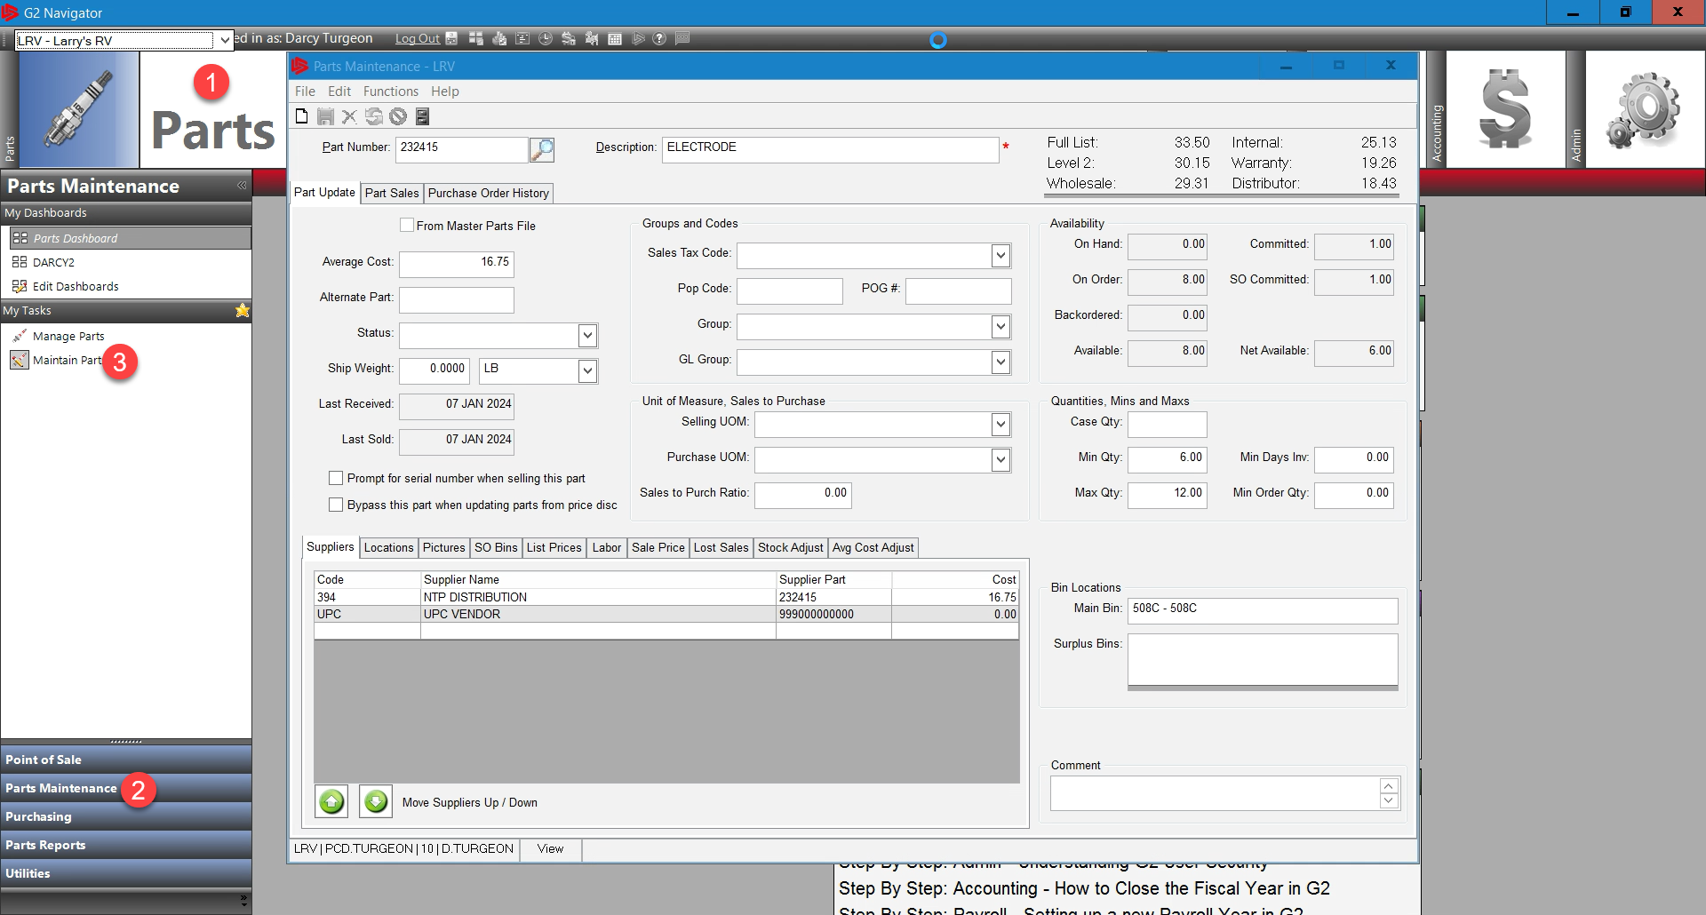
PARTS - How to Maintain Parts
In order to maintain your parts we need to:
Go to the Parts Module
Click on the sub-menu Parts Maintenance
And choose the parts menu Maintain Parts

Slide 35
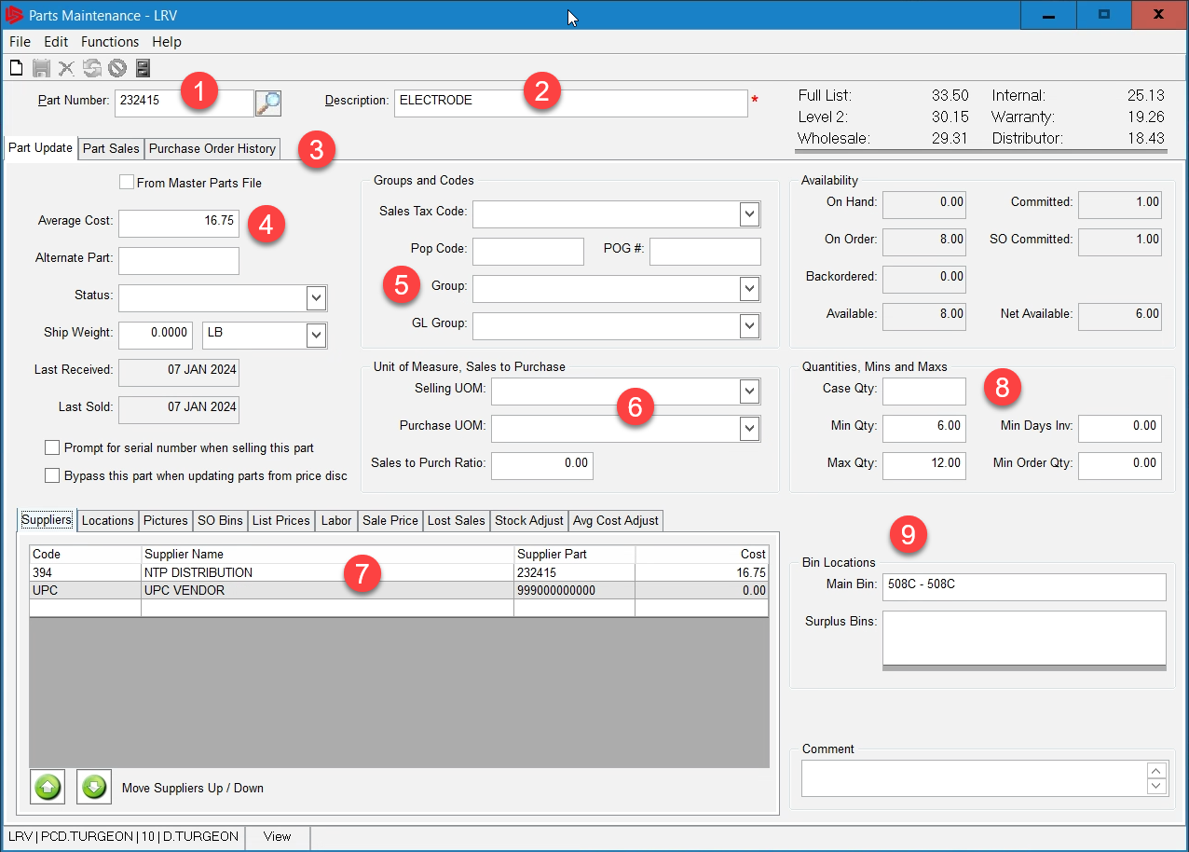
PARTS - How to Maintain Parts
On the Parts Maintenance screen the items with an Asterisks in red are mandatory fields and must be filled in.
Fill in or search for the part number of interest
Put in a description for the part
The part history can be viewed by going to these tabs.

Slide 36
PARTS - How to Maintain Parts
The average cost is shown here
The Group Code is listed here. If you are a Canadian Dealer and this part is in US currency you must choose the US pricing group, this will calculate the exchange when receiving this part. Otherwise leave this blank.

Slide 37
PARTS - How to Maintain Parts
The selling amount and purchasing amounts are listed here, ex: if you purchase by the roll and sell by the foot. Put that ratio in so it calculates correctly.
Your suppliers are listed here, this is the vendors you buy this part from and the cost you purchase it at. Discuss the other tabs as shown

Slide 38
PARTS - How to Maintain Parts
If you use Mins and Max to stock your shelves, this is where you put those stocking numbers.
This is the bin location for this part, Note: As part of IDS best practices, it is highly recommended all parts have a bin number.

Slide 39
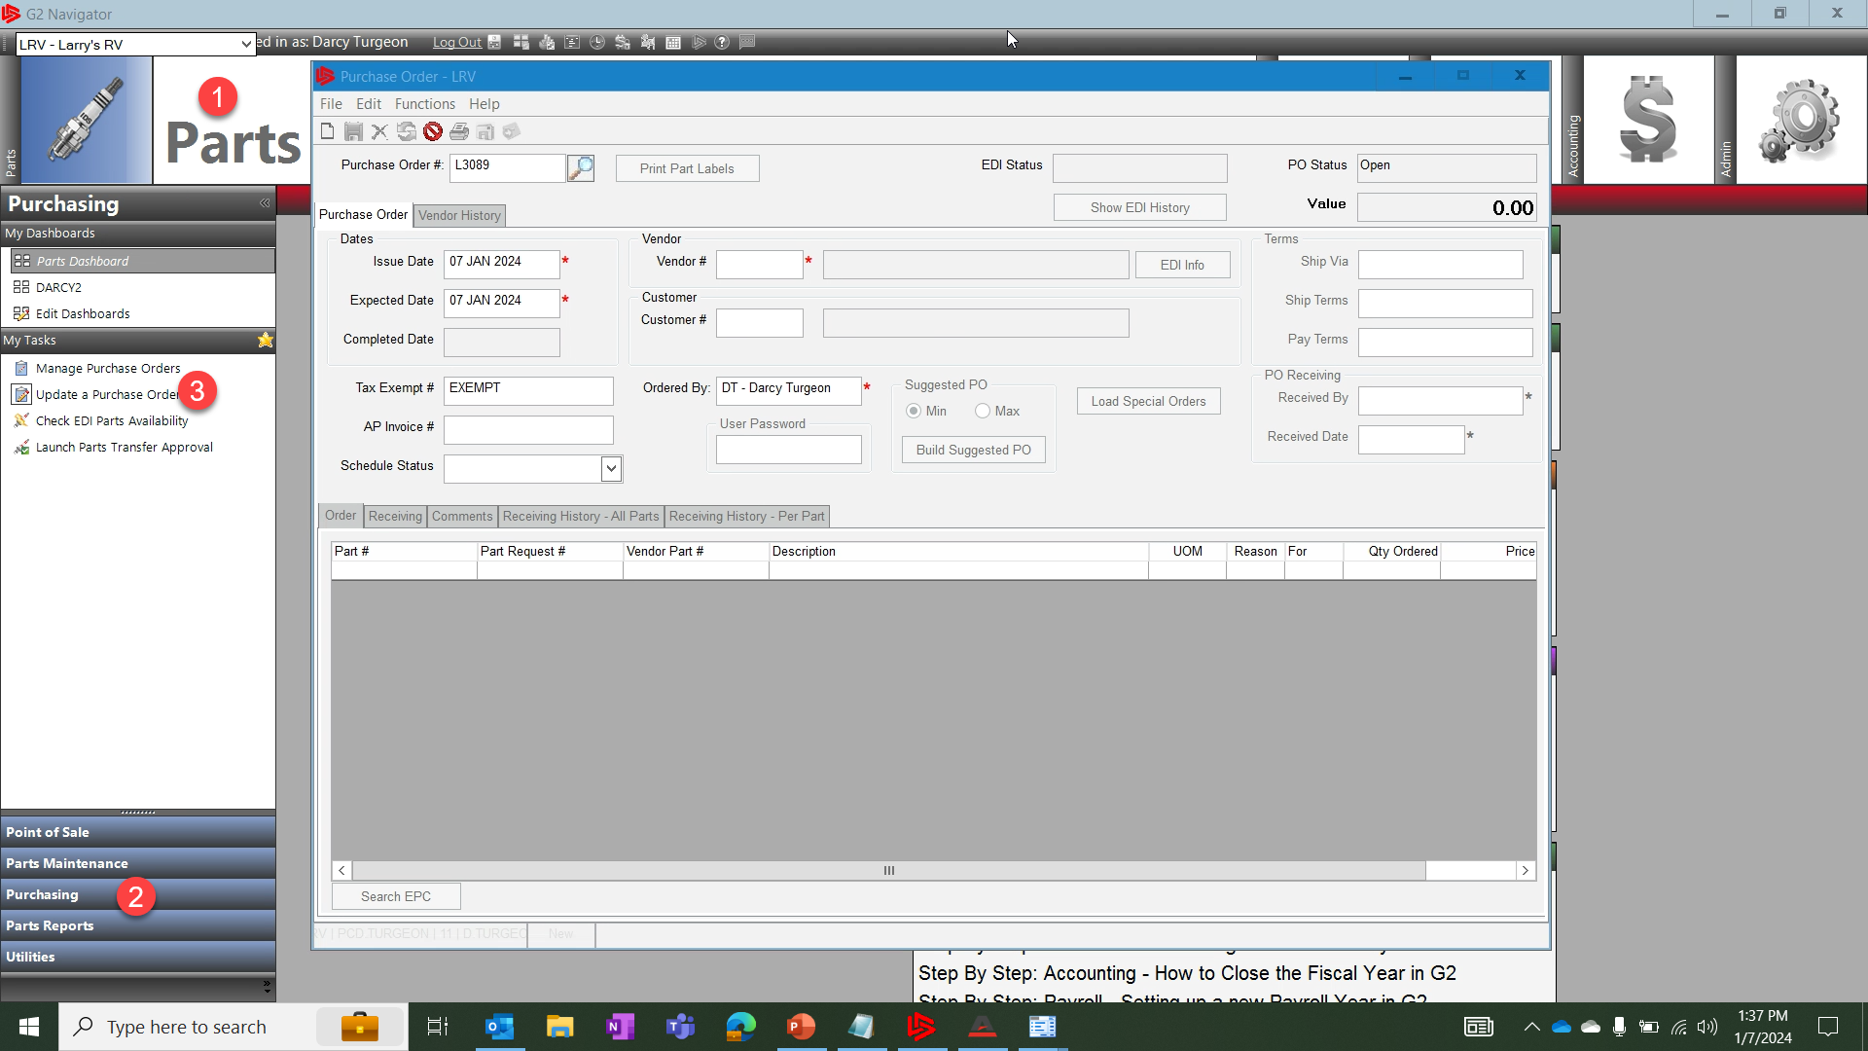
PARTS - How to Create a Purchase Order
To create a Purchase Order, go to the
Parts Module
Click on the sub-menu Purchasing
And click the menu Update a Purchase Order.

Slide 40
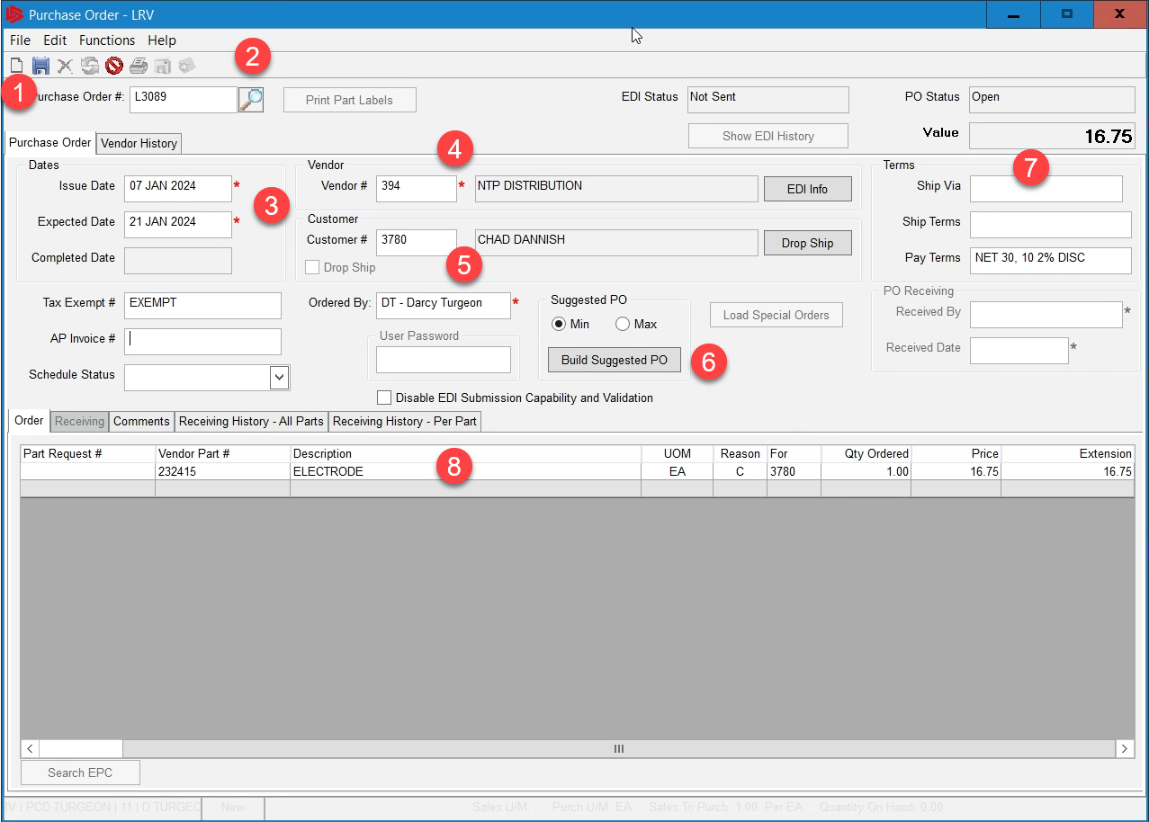
PARTS - How to Create a Purchase Order
To create a new purchase order:
Click on the piece of paper in the upper left.
The PO number will automatically default in.
Note: mandatory fields are all listed with a red asterisk
The date of the purchase order was created will default in, to todays date.

Slide 41
PARTS - How to Create a Purchase Order
The Expected date is calculated from the Vendor file and can be changed
Enter in the vendor number or search for it here, this is the vendor your are purchasing from
Enter in the customer number the Purchase Order is for.

Slide 42
PARTS - How to Create a Purchase Order
When you put in the vendor number the Build Suggested PO button allows you to add any parts that are on special order for this vendor and add them to this purchase order.
The terms of the Purchase order are listed here

Slide 43
PARTS - How to Create a Purchase Order
Enter in the part number(s) here, or right click and search for them. The reason column has several options:
C: Customer
S: Stock
W: Work Order
You choose which one and reference to each in the for column

Slide 44
PARTS - How to Create a Purchase Order
If you want you can use the comment section for adding any notes for your accounting department you also have the ability to see any receiving history.

Slide 45
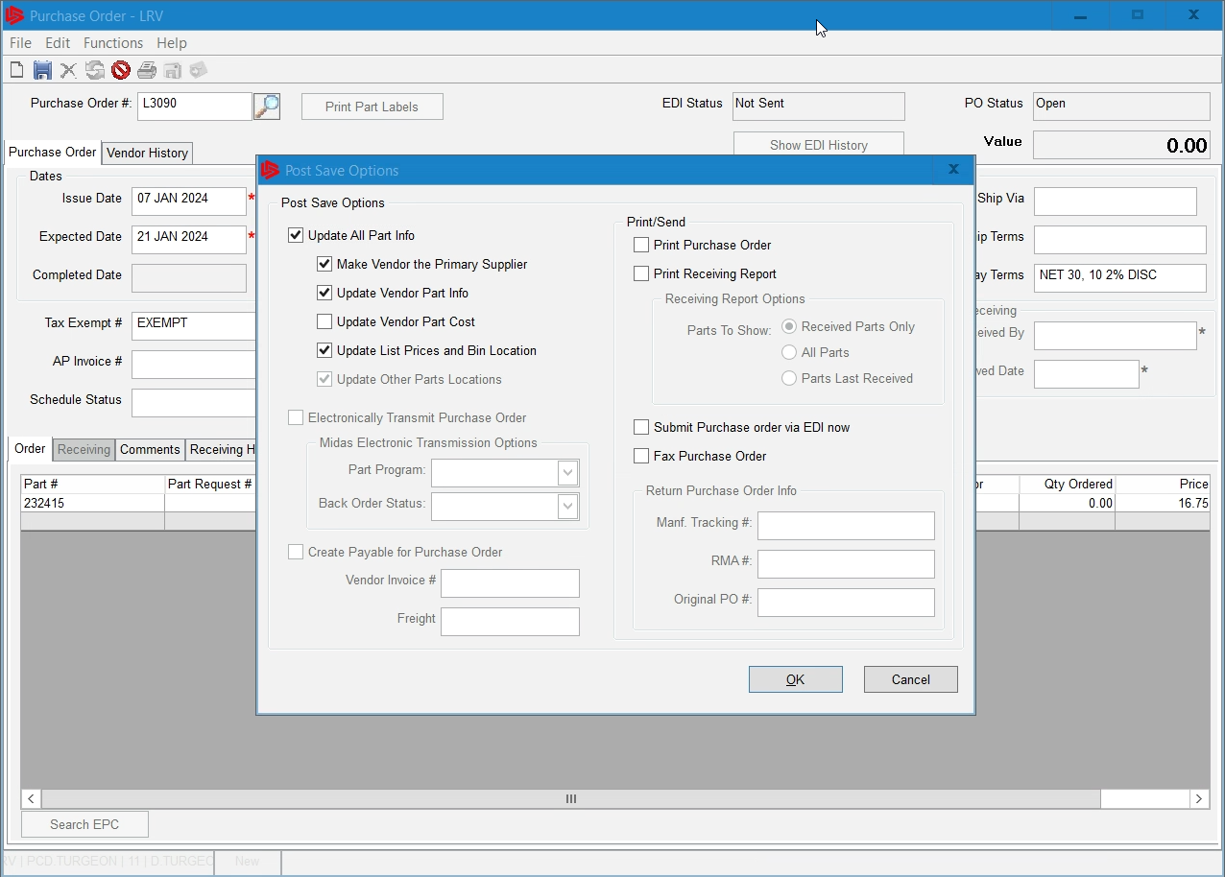
PARTS - How to Create a Purchase Order
Once you have filled out the purchase order, click on the Save Icon
This will bring up the post save options screen, check which post save items you want. You also have the choice to print out a PO for your records here

Slide 46
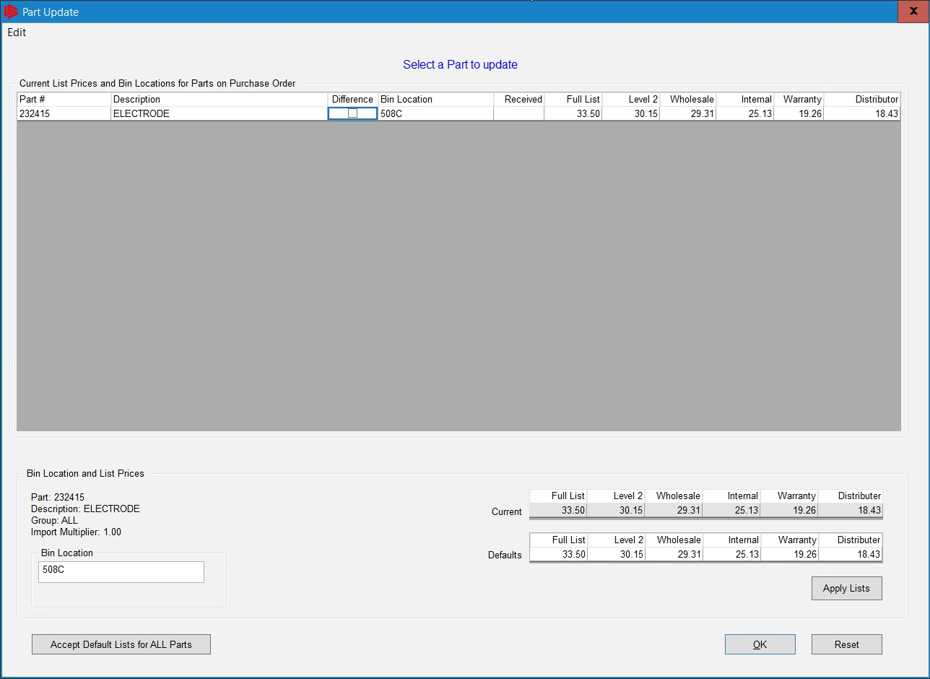
PARTS - How to Create a Purchase Order
Since we chose to update pricing on the previous screen the part update screen appears to choose a bin location and update any pricing. We usually change the pricing once we receive the part if there were any changes. We leave the defaults here for now.

Slide 47
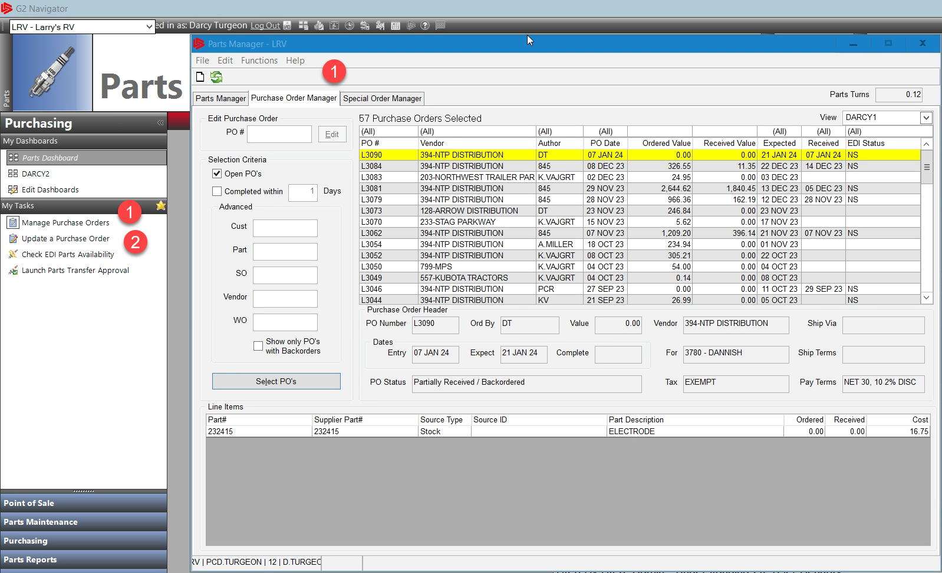
PARTS - How to Receive a Purchase Order
To receive a purchase order, we first open the Purchase Order. We can do this in two ways,
Use the purchase order manager and select the purchase order from the list
Use the update purchase order screen, both ways will open the purchase order.

Slide 48
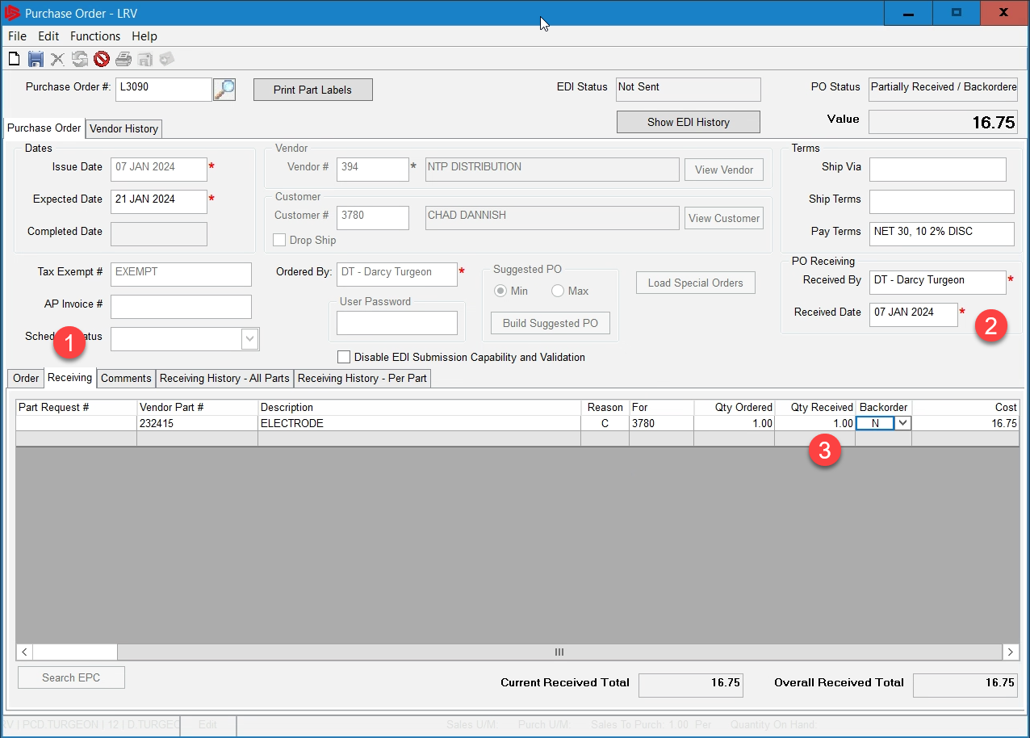
PARTS - How to Receive a Purchase Order
To receive the purchase order go to
The receiving tab located at the bottom of the purchase order
The Received by and date will default in
Enter in a quantity received, you can right click the line and choose receive all if you have a large list.

Slide 49
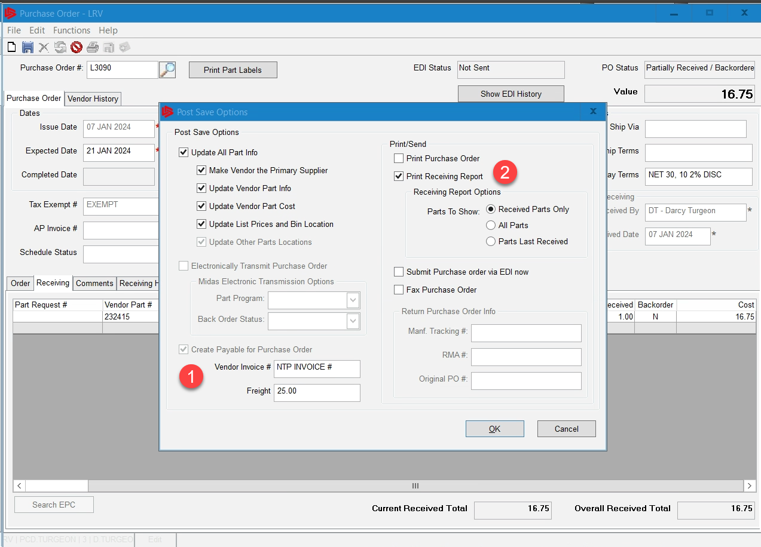
PARTS - How to Receive a Purchase Order
When you click the save button the post save screen will appear, choose the options you want to update, you would want to choose update pricing.
New to IDS in version 23.14 is the ability to add freight and invoice for accounting purposes, two configs must be set in order to use this new feature.

Slide 50
PARTS - How to Receive a Purchase Order
Config #51 in the parts module must be set to PR, config #93 must have a GL account setup. Once both these settings are in place you can start to add freight and invoice numbers as shown.
Click on Print Receiving report to print out a receiving report and attach to your invoice.
Then Click OK

Slide 51
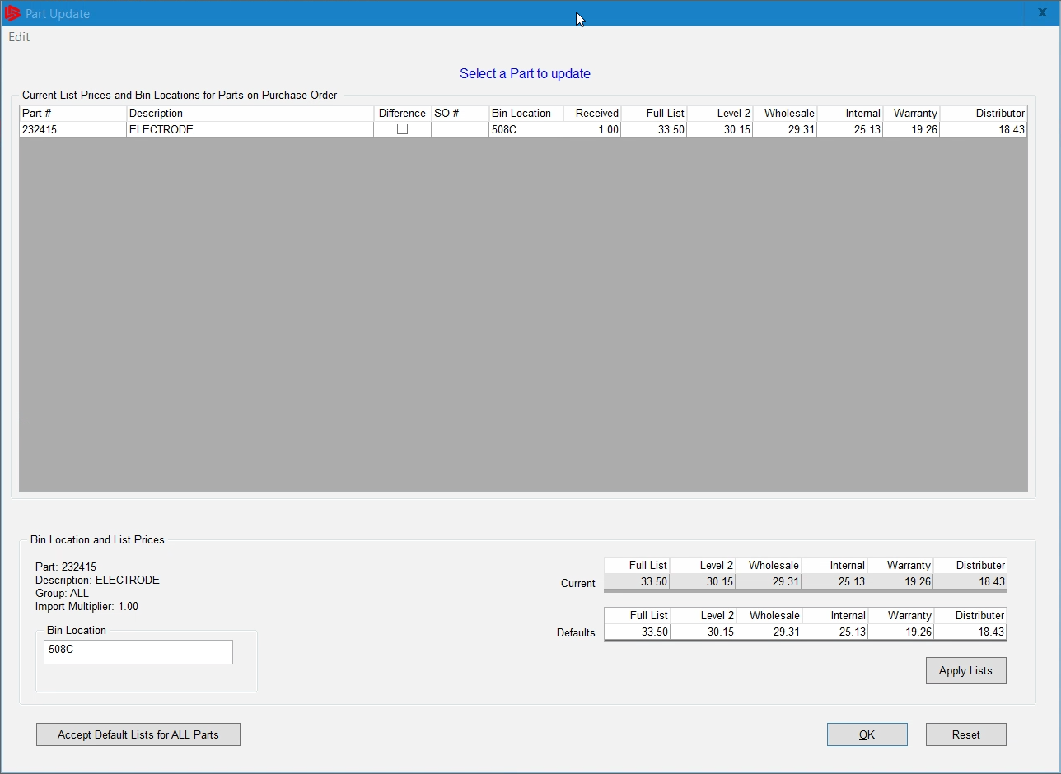
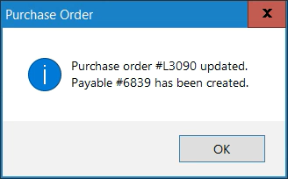
PARTS - How to Receive a Purchase Order
The part update screen appears and here we would adjust any pricing differences, we would also choose a bin location for this part. Once we click ok the purchase order is created and the payables are created

Slide 52
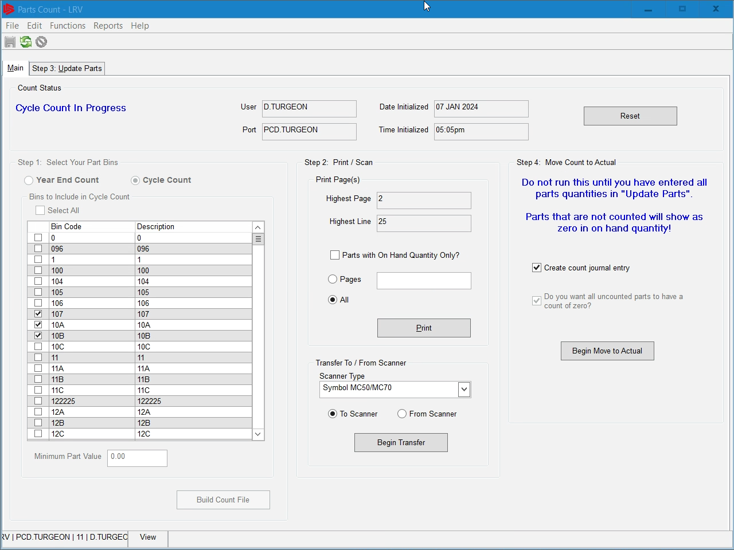
PARTS - Inventory
Inventory in parts is very important of any dealership, some of the reasons are
Operational Efficiency, being able to know where any part is at any given time.
Cost management, knowing what it cost the dealership to house and store inventory, Max/Mins

Slide 53
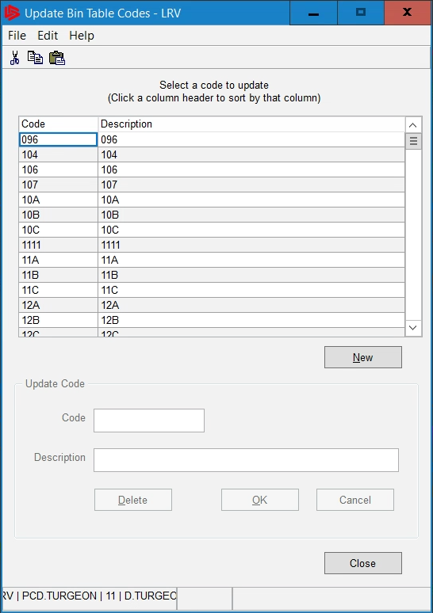
PARTS - Inventory
Every dealership should have bin locations setup, if you don’t, contact our support team to help you set them up. Your staff should be trained on changing bin locations when parts are moved around the department. This save a tremendous amount of time when it comes to year end and cycle inventory counts.

Slide 54
SERVICE AGENDA

Slide 55
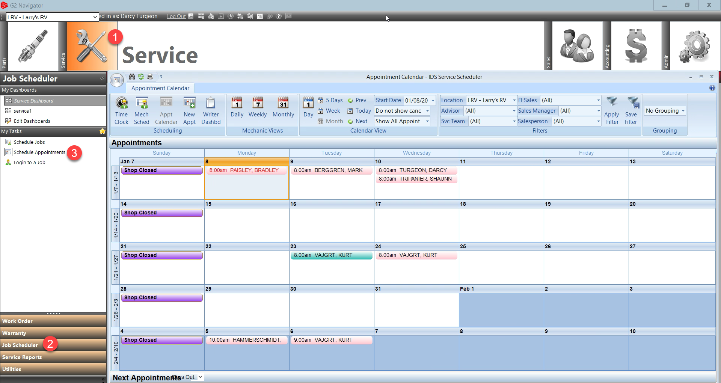
SERVICE - The Appointment Calendar
The Appointment Calendar is located by going to:
The Service Module
Clicking on the Sub-Menu Job Scheduler
And clicking the menu item Service Appointments

Slide 56
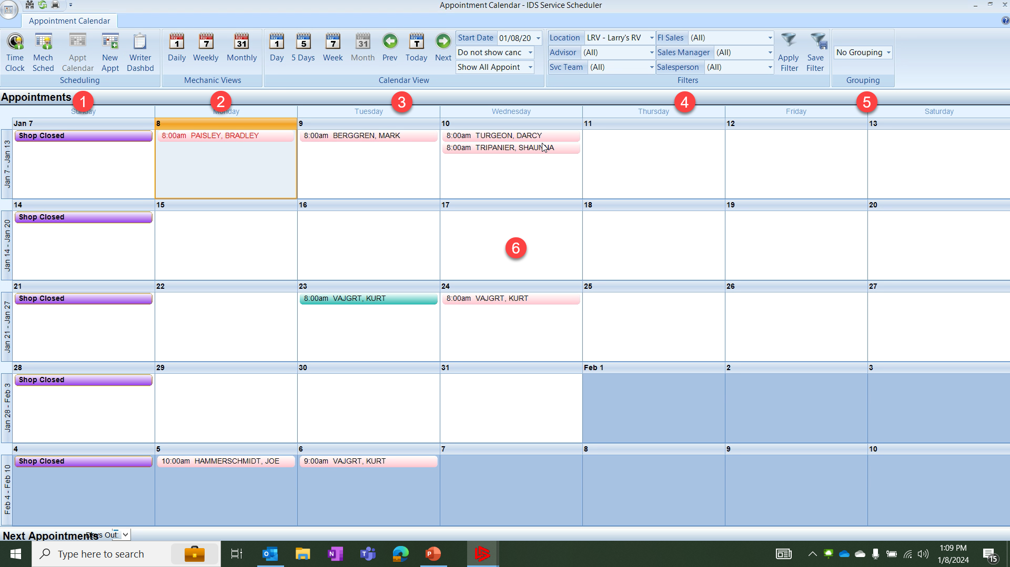
SERVICE - The Appointment Calendar
On the Appointment Calendar
This area is the various scheduling dashboards shortcuts
This is the Mechanics Views
This is the Calendar Views

Slide 57
SERVICE - The Appointment Calendar
This is the where we set our filters for the calendar
If you use grouping then you can set them here.
This is the calendar and can add/remove items as needed.

Slide 58
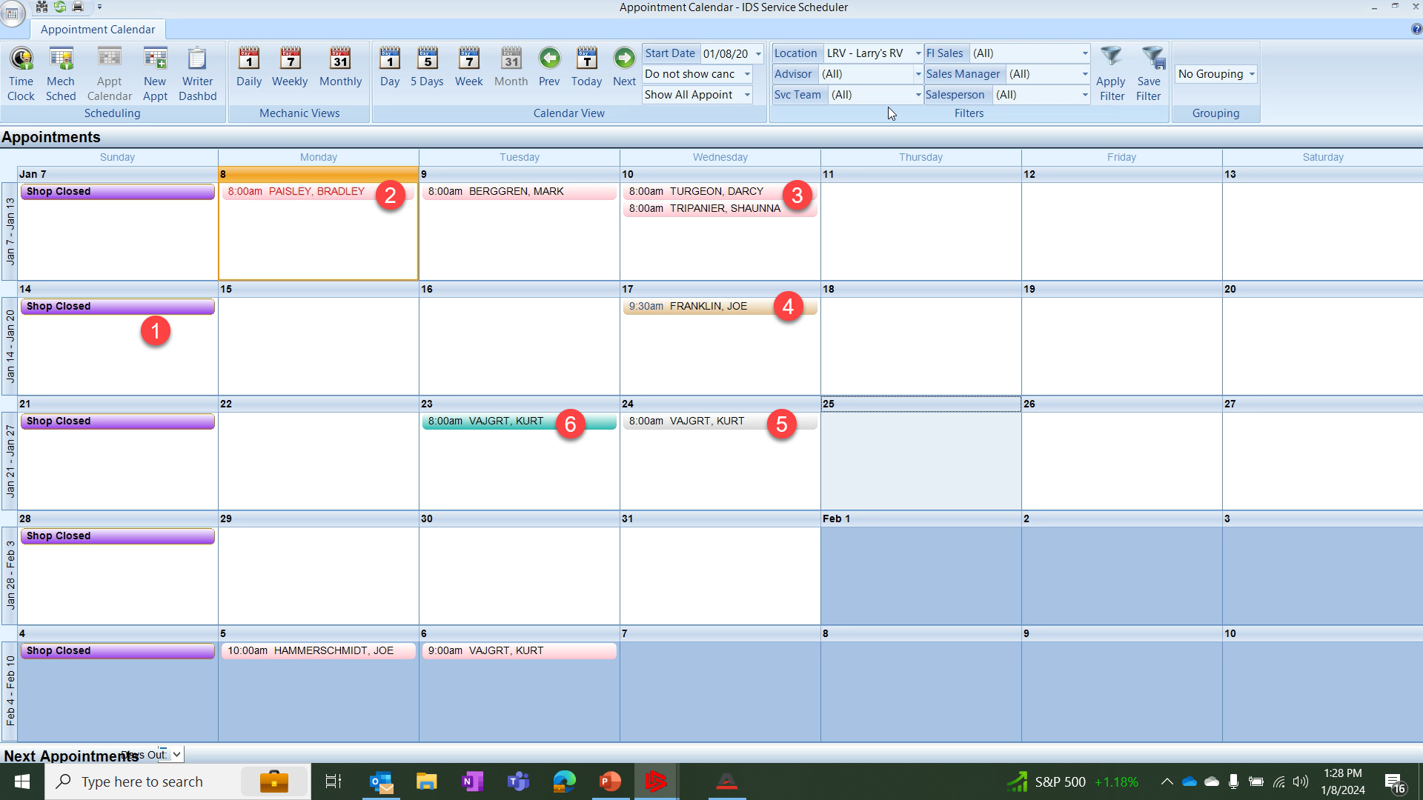
SERVICE - The Appointment Calendar
The Appointment Calendar uses Color coding for ease of use the following colors are used
Purple for days the shop are closed
Pink with Red text are for new appointments missed.

Slide 59
SERVICE - The Appointment Calendar
Pink with black text are upcoming service appointments
Tan appointments are unit deliveries scheduled by sales.
Grey appointments are service appointments converted to estimates

Slide 60
SERVICE - The Appointment Calendar
Green appointments are service appointments converted to work orders
Note: once the appointment has been converted to a work order it is now available to the advisor on their mobile device.

Slide 61
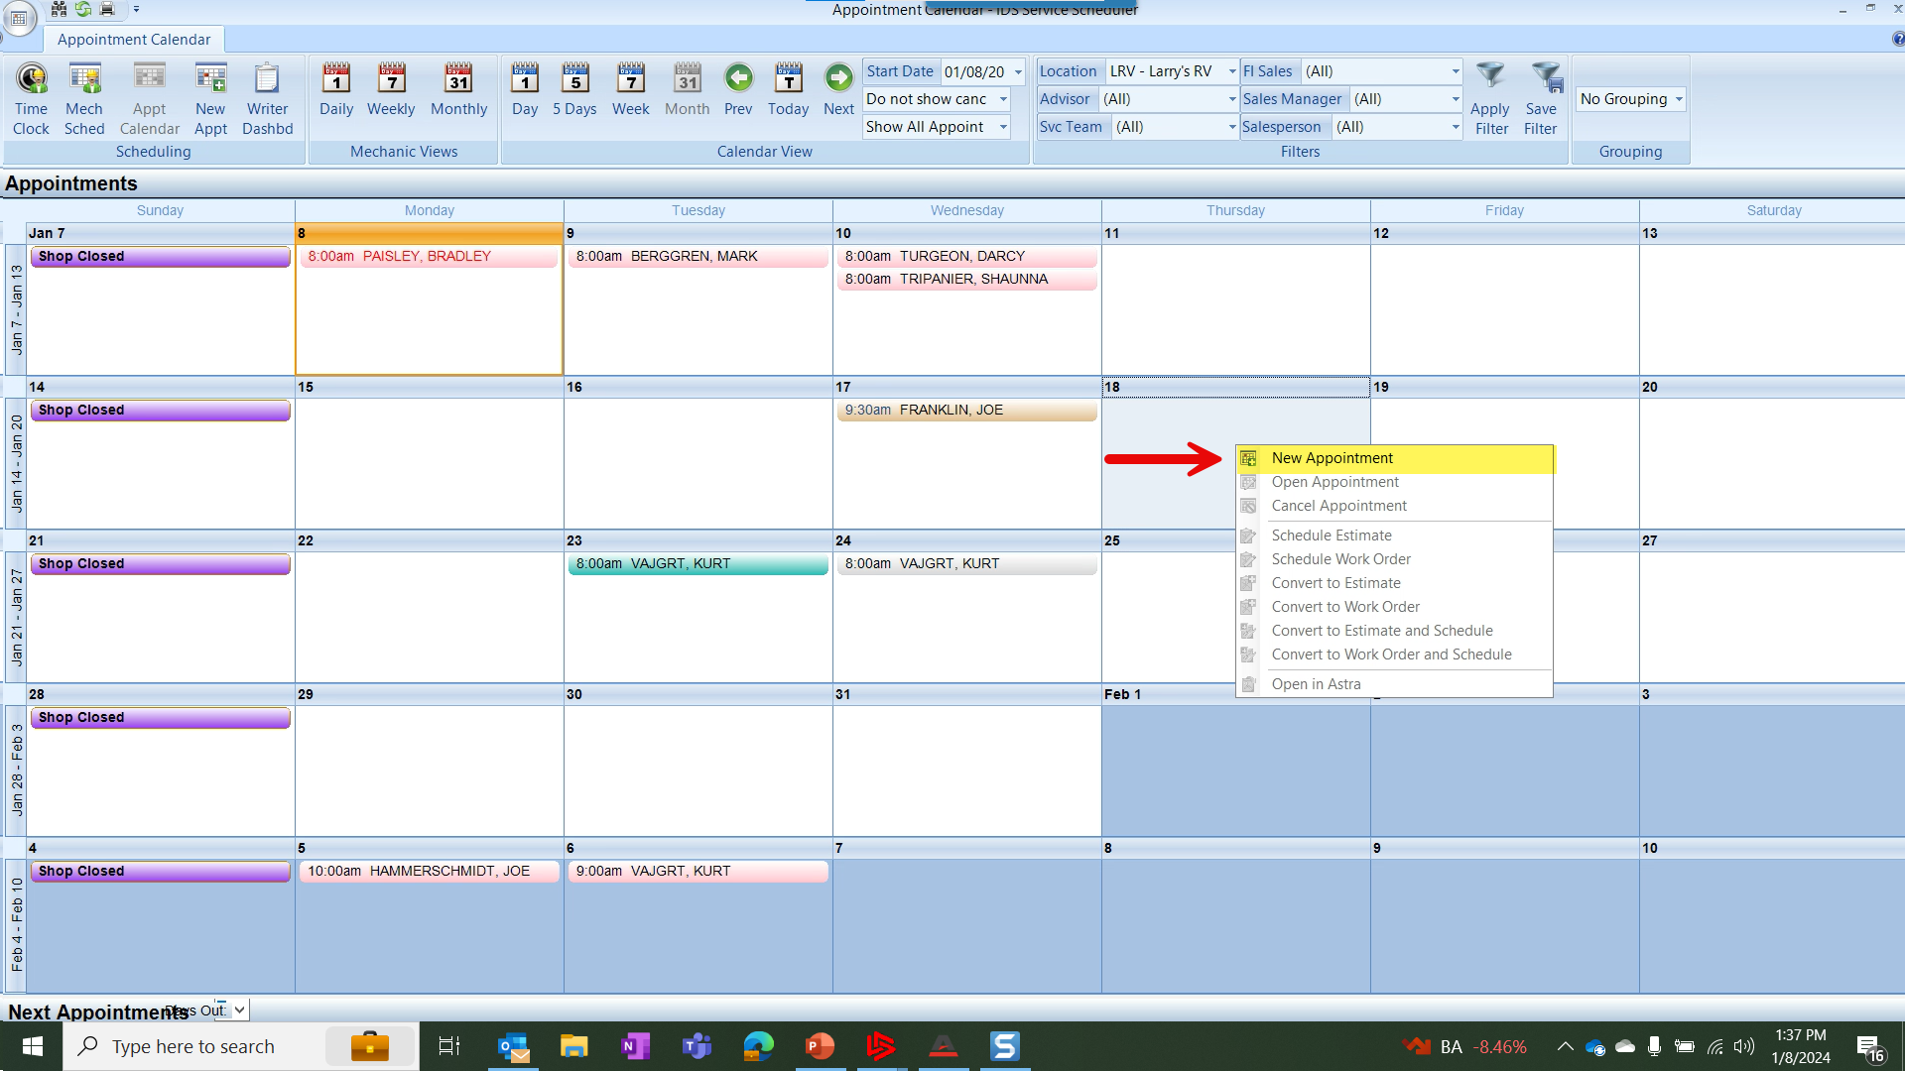
SERVICE - The Appointment Calendar
To Create an appointment simply find a date available and right click the white space and choose New Appointment

Slide 62
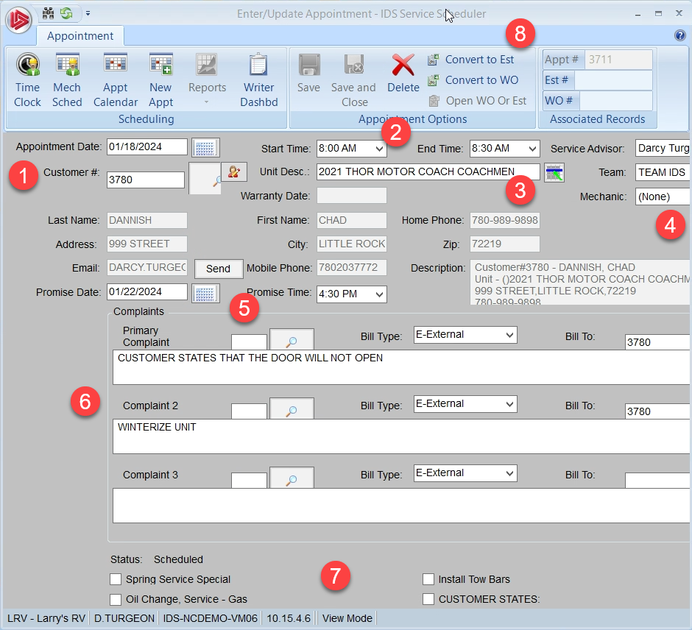
SERVICE - The Appointment Calendar
The Enter/Update form will appear, here we can enter in information about the customer such as:
The Customer name and contact info
The time of the appointment
The unit the customer will dropping off
The team that will work on the unit
Promise date and time
The complaints the customer has
The canned jobs we can choose from on the fly. Total of 8 listed and can be customized.

Slide 63
SERVICE - The Appointment Calendar
Once the information is added and we are satisfied with our appointment we can now save the appointment and this will allow us to convert the appointment to a work order or estimate (8)
By converting this to a work order the advisor will now have the work order show up on their mobile device and they can now take the 4-corner pictures and capture the customer signature remotely. Note: estimates will not show on mobile devices

Slide 64
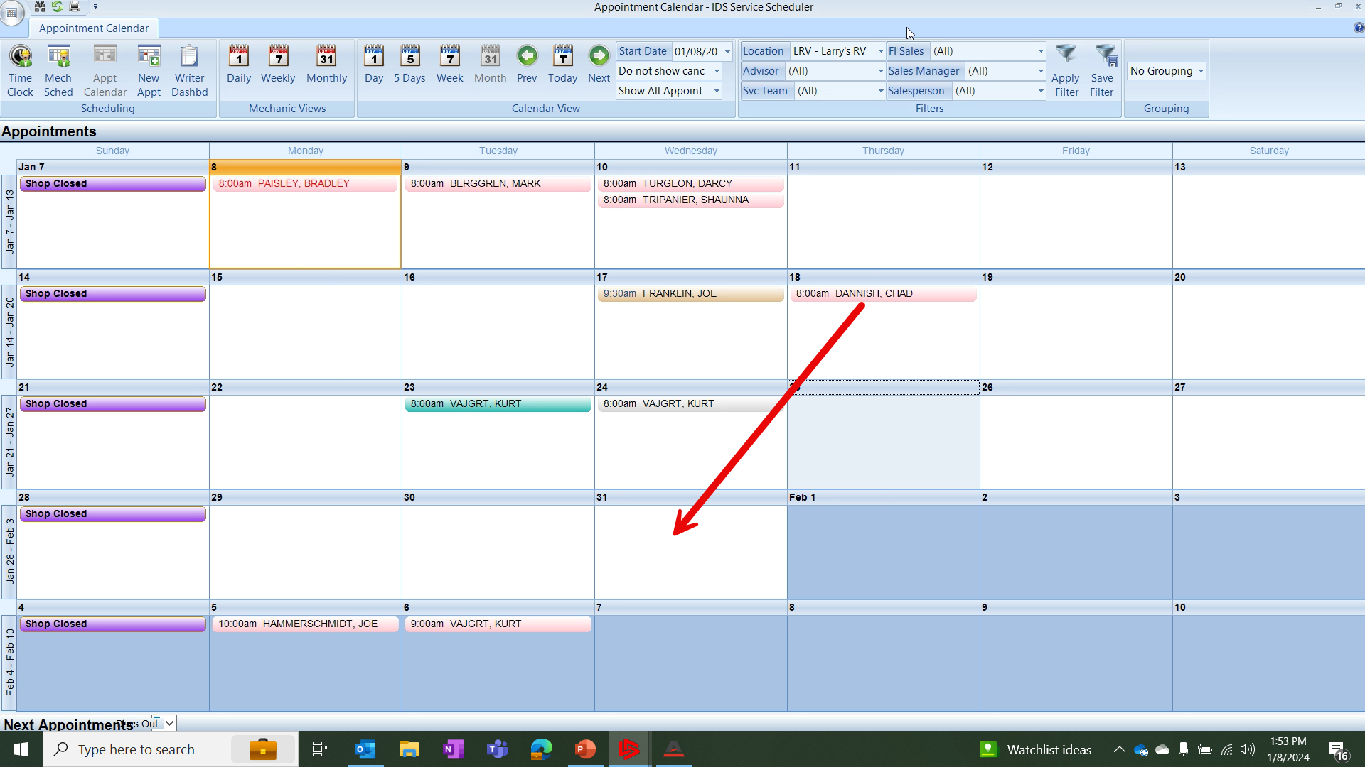
SERVICE - The Appointment Calendar
You can drag and drop appointments on the calendar view or you can modify the actual appointment dates and times either way will result in the same outcome. IDS best practices recommend you schedule your appointments to allow for time between appointments. 4 per day?

Slide 65
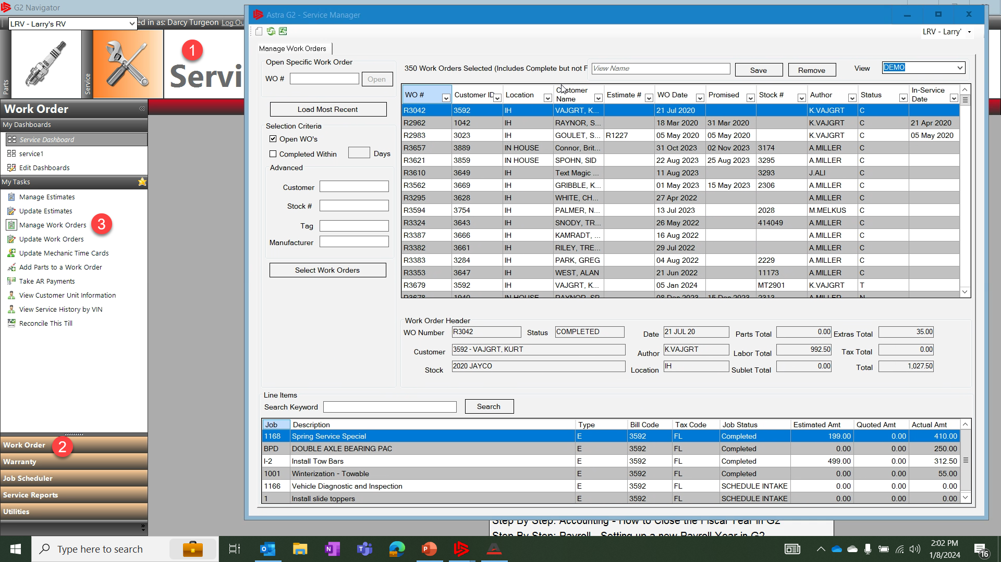
SERVICE - The Work Order Manager
The Work Order Manager grid can be accessed by going to:
Service Module
Clicking the the sub-menu Work Orders
And choosing the menu item Manage Work Orders

Slide 66
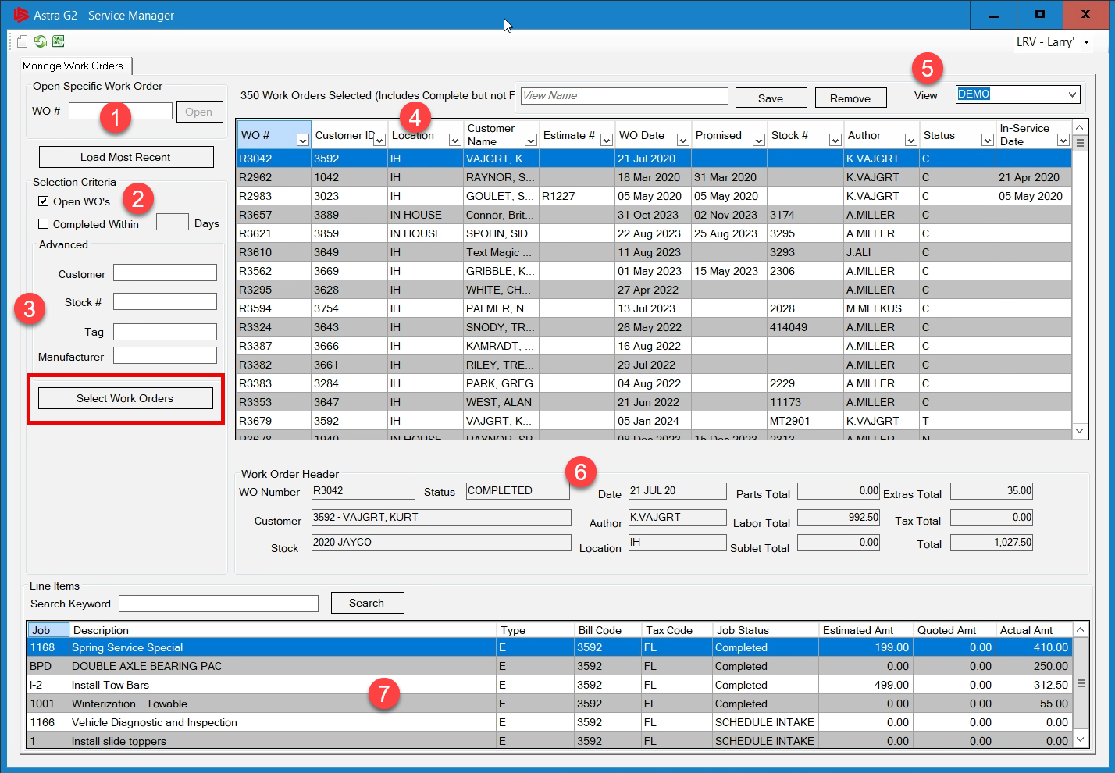
SERVICE - The Work Order Manager
The Service Manager window grid will open and here you can:
Enter in a work order number or right click and search for the work order
You can select by checking the boxes whether you want to see open or closed work orders

Slide 67
SERVICE - The Work Order Manager
The grid can be refined by choosing whether you want to show customer number, stock number, tag or manufacturer
You can add/remove, move and filter the column headers by clicking the down arrow on each

Slide 68
SERVICE - The Work Order Manager
Once you make a change to the grid you can save the view here by giving it a new name and clicking save.
When you click on work order you will have a quick view of the work order here and
The line items of the work order show here

Slide 69
SERVICE - The Work Order Manager
If you want to see all the work orders simply remove all the search criteria and click the Select Work Order button

Slide 70
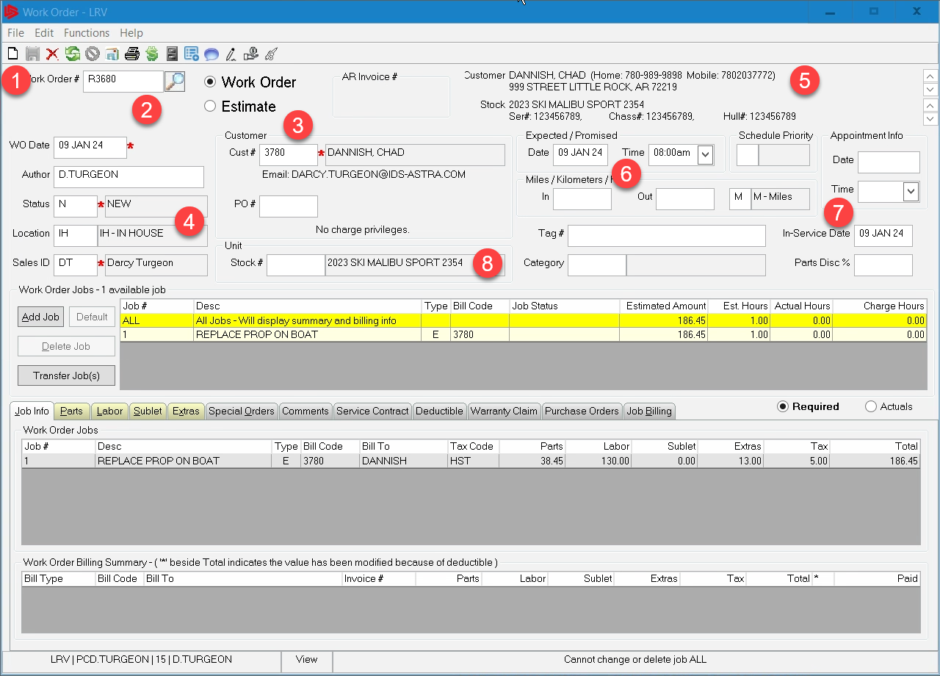
SERVICE - How to Create a Work Order
To create a new work order you can do so from the work order manager or update work order.
Click on the white piece of paper at the top of the form
This will automatically assign the next work order from the que
Choose the customers name

Slide 71
SERVICE - How to Create a Work Order
The Author, Status, Location and Sales ID will all default in, you can change these
The customer information is all listed in this area of the work order
Choose an expected promise date

Slide 72
SERVICE - How to Create a Work Order
Add the In Service date, this may or may not be mandatory
Choose the unit associated with the customer, this will pop up once you input the customer number

Slide 73
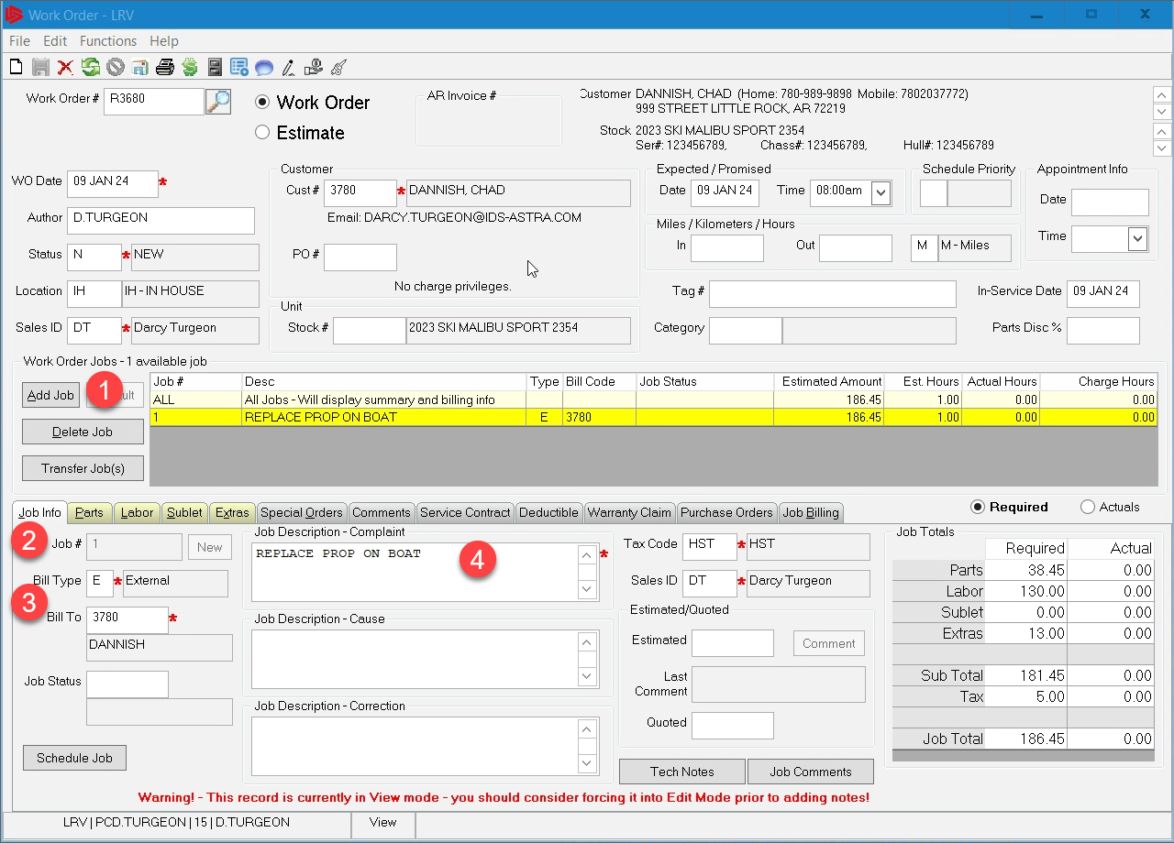
SERVICE - How to Create a Work Order
Click Add Job to create a job line for this work order, all work orders must have at least one job line
Assign the job line a number you can use N for next if you have a large amount of jobs
Assign a Bill to Code, E: External, W: Warranty or I: Internal jobs.

Slide 74
SERVICE - How to Create a Work Order
Type in the description for this job, so the mechanic know exactly what to do.

Slide 75
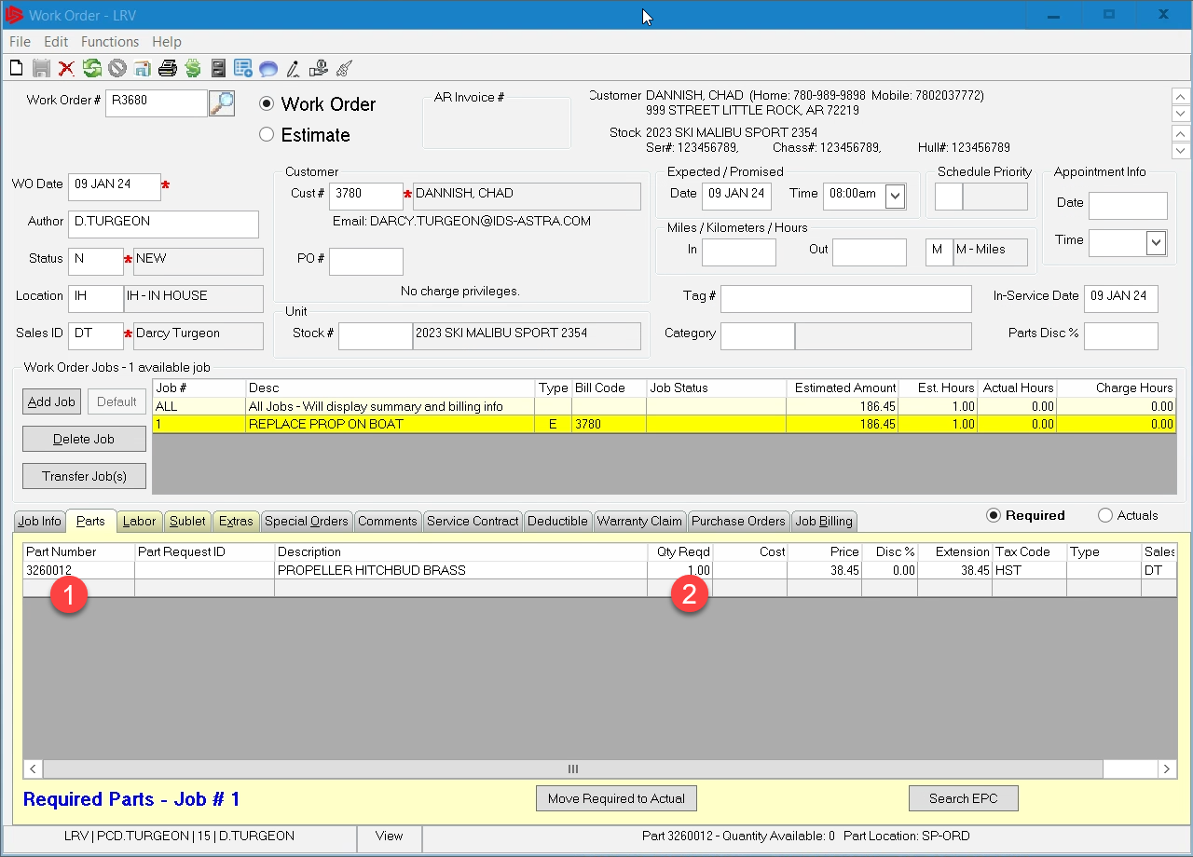
SERVICE - How to Create a Work Order
If the job requires a part, click on the part tab
Add a part number or right click and search for your part.
Enter in how many are required

Slide 76
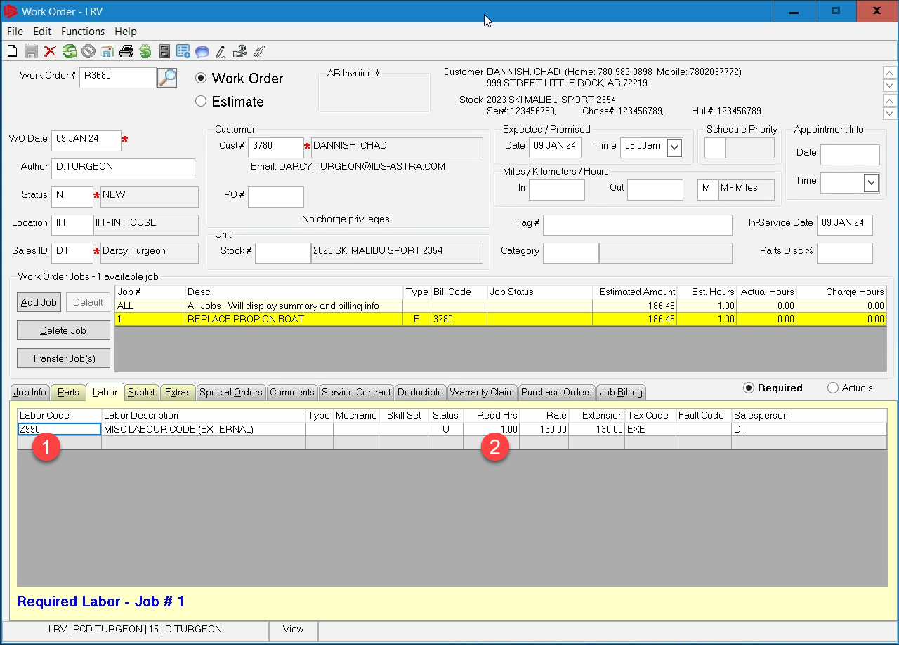
SERVICE - How to Create a Work Order
Next add some labor to this work order by clicking on the Labor tab
Add a labor code here you can use the prebuilt codes or a spader line code
Put in the amount of labor it will take to complete this line, this is what the mechanic see on the ipad.

Slide 77
SERVICE - How to Create a Work Order
Make sure you are in required mode, depicted by the yellow background. Only use Acutual mode if you are manually applying labor and do not require the techs input. Techs can only see required mode on their tablets.

Slide 78
SERVICE - How to Create a Work Order
Once you are satisfied with the work order click the save icon in the upper left to save the work order. The work order is now ready to be dispatched to the shop floor.

Slide 79
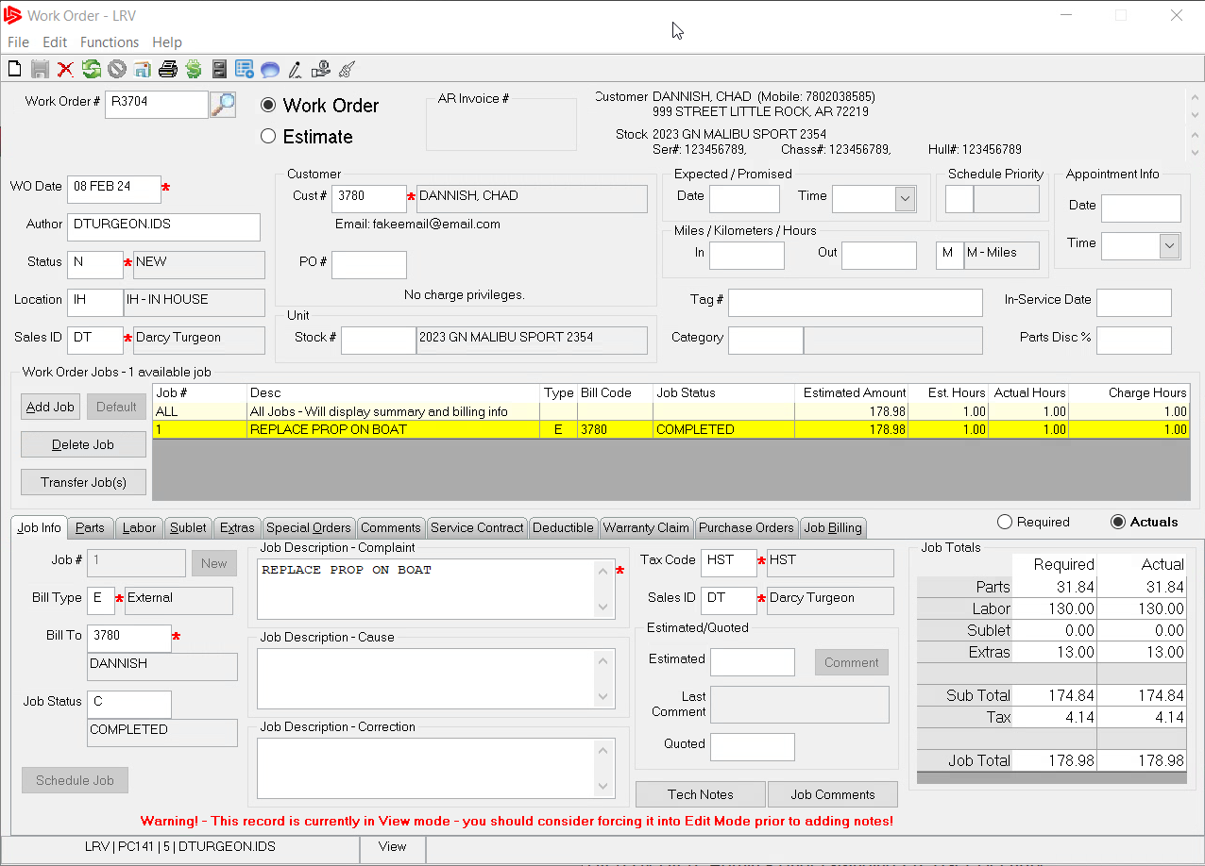
SERVICE - How to Close a Work Order
To Close a work order you will first switch into actual mode. You will then start a line by line review of the work order and review each tab on the work order, once you review a line, change the job status to C=COMPLETED, uppercase this tells you that it was reviewed.

Slide 80
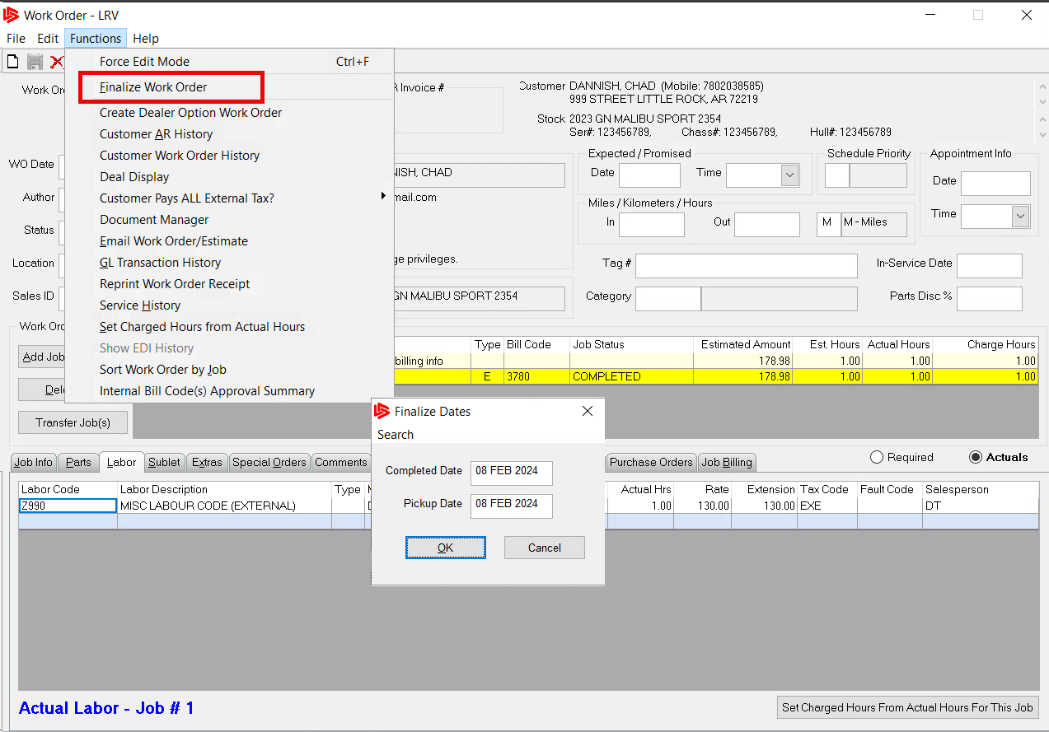
SERVICE - How to Close a Work Order
Once you review the work order completely. Click on functions at the top of the form and from the drop down, choose finalize work order. Finally, put in a date the work order is posting to.

Slide 81
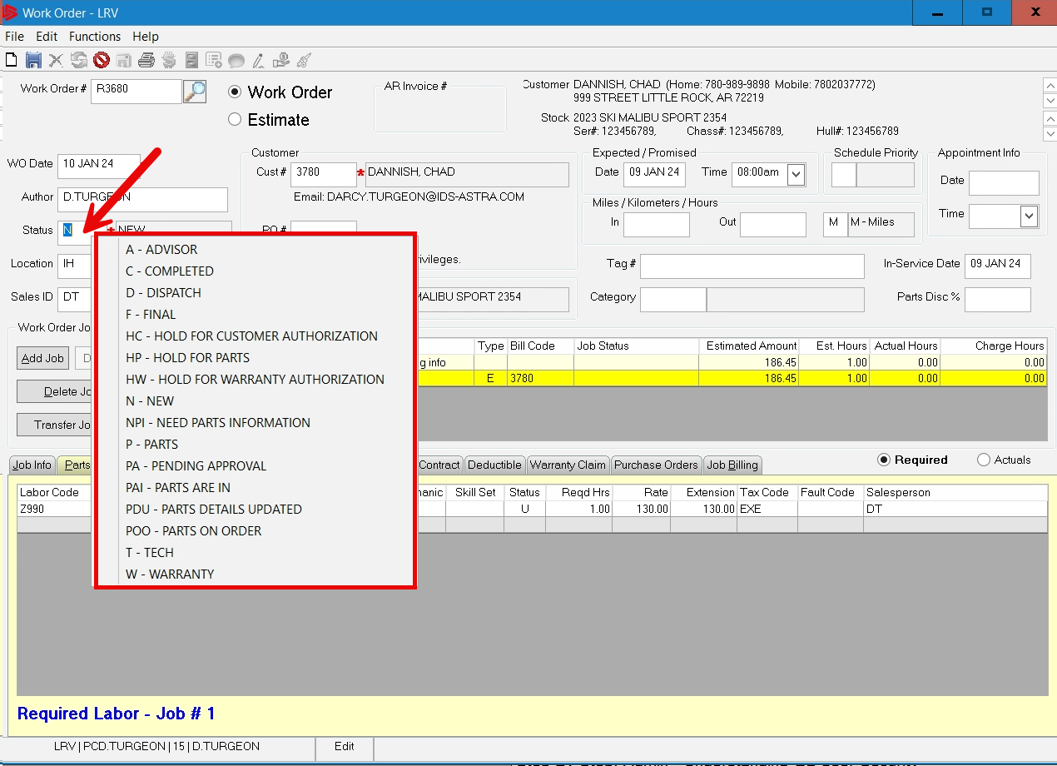
SERVICE - Status Codes
Work order status codes are very import part of organizing your work orders over the history of the work order. When you create a new work order it will assign the letter N for New. As the work order moves along the shop floor these status codes must be updated.

Slide 82
SERVICE - Status Codes
For example, if the mechanic needs authorization from factory for a job, he/she will put the job line on hold for authorization, the advisor will now put the whole work order on Hold for Authorization, because the unit is most likely pulled out of the bay.

Slide 83
SERVICE - Status Codes
Here is a sample list of status codes recommended by IDS to be used:
POO: Parts on Order
PAI: Parts are In
HWA: Hold for Warranty Auth
WP: Warranty Approved
HCA: Hold for Customer Auth
HS: Hold for Sublet

Slide 84
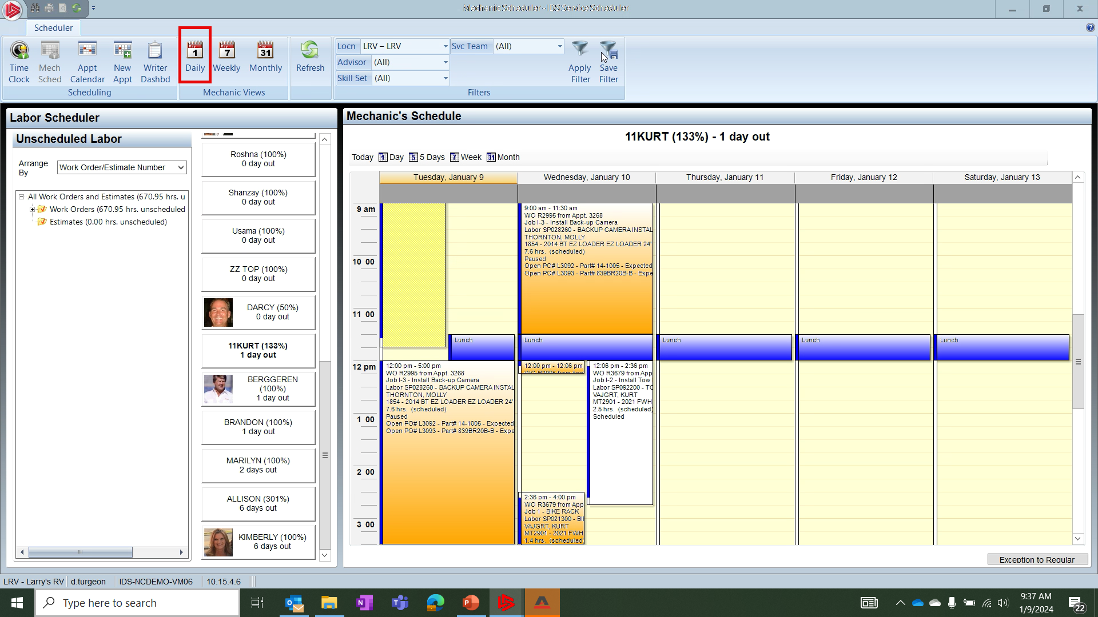
SERVICE - Mechanic Daily View
The Mechanic Daily view is one of the most important screens available in Service. If you are not using this screen you should be!
You access the Mechanic Daily view screen by clicking on the Daily button in the mechanic scheduler window.

Slide 85
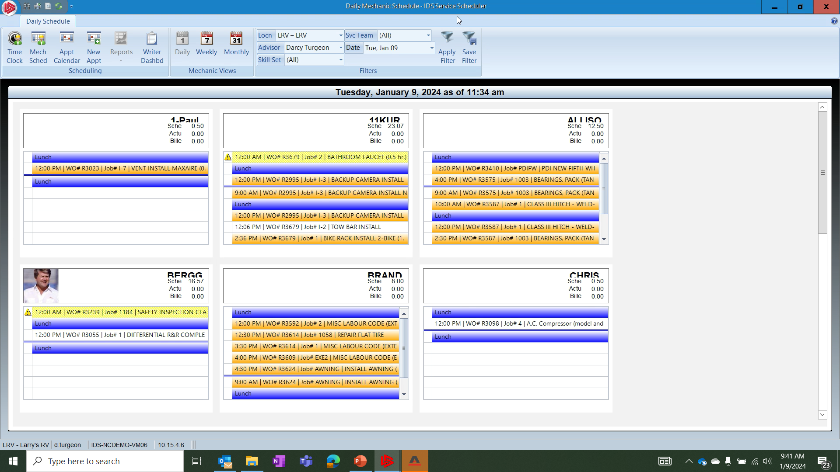
SERVICE - Mechanic Daily View
In the Mechanics Daily view window, you will notice various colors depicting the job lines. The most important color in this view
Is the color yellow. This color tells you whether the mechanic is clocked into a job and working. If you do not see yellow, then the mechanic is not clocked into any work and the advisor needs to find out why.

Slide 86
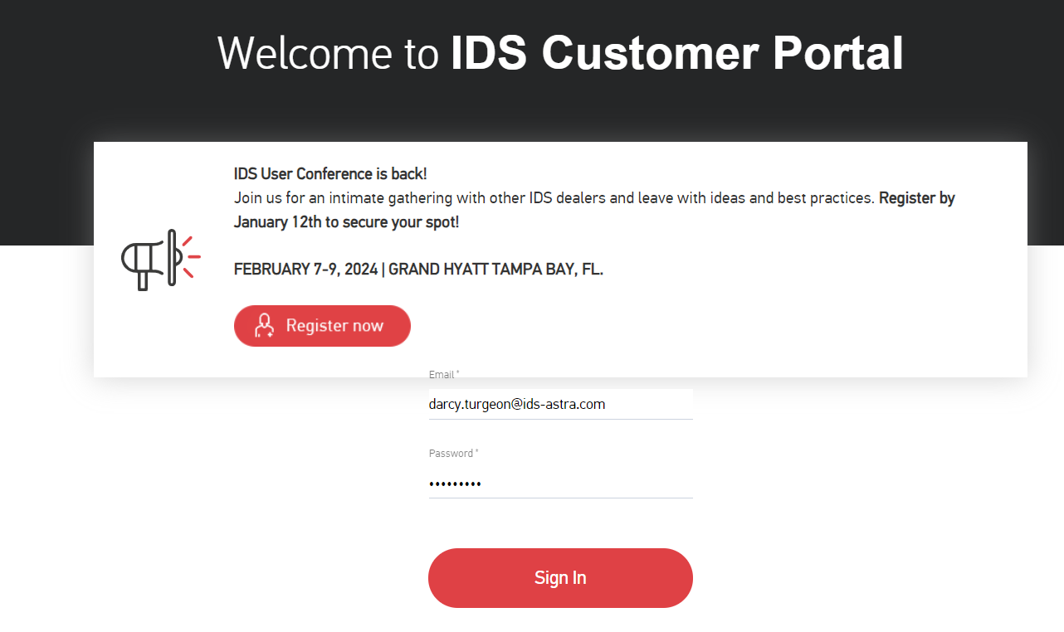
How to get Support Help
The best way to get support is to sign up on the IDS Portal website,
Visit: https://portal.ids-astra.com/login
Here you can register to send in a support ticket and access the vast amount of online reference materials.

Slide 87
How to get Support Help

Slide 88
How to get Support Help

