Slide 1
Parts – Optimizing Parts Inventory Management
February 2024

Slide 2
Brandon Paisley
Professional Services Consultant

Slide 3
Personal Background
A decade of IDS experience, half coming from a multi-location dealership and the other half traveling the continent as a Professional Services Consultant for IDS. Over my time with IDS I have been to hundreds of dealer rooftop locations varying from family owned to enterprise customers.

Slide 4
Welcome, Thank you for Joining Us Today
We realize that your time is valuable, and we are thrilled to have you with us today.
Please keep your phones on Mute, we will have a Q&A session at the end of this presentation.

Slide 5
Today’s Agenda
Main Topics:
Monitoring & Managing Recommended Orders
Uncovering & Managing Obsolete Parts
Generating Orders Based on Parts Movement Trends
System Features/Highlights:
Partially Received Payables (New Function)
Benefits of Utilizing Special Orders
Inventory Turns
Transfer Parts Routine
Cycle Counting
Suggested Reports
Notable Configs
Lesser-Known Features

Slide 6
Monitoring & Managing Recommended Orders
How Recommended Orders are Generated
Ways to Generate Recommended Orders
Placing Recommended Orders

Slide 7
How Recommended Orders are Generated
Min/Max Quantities
Parts Maintenance
Special Orders
Work Order
Over the Counter

Slide 8
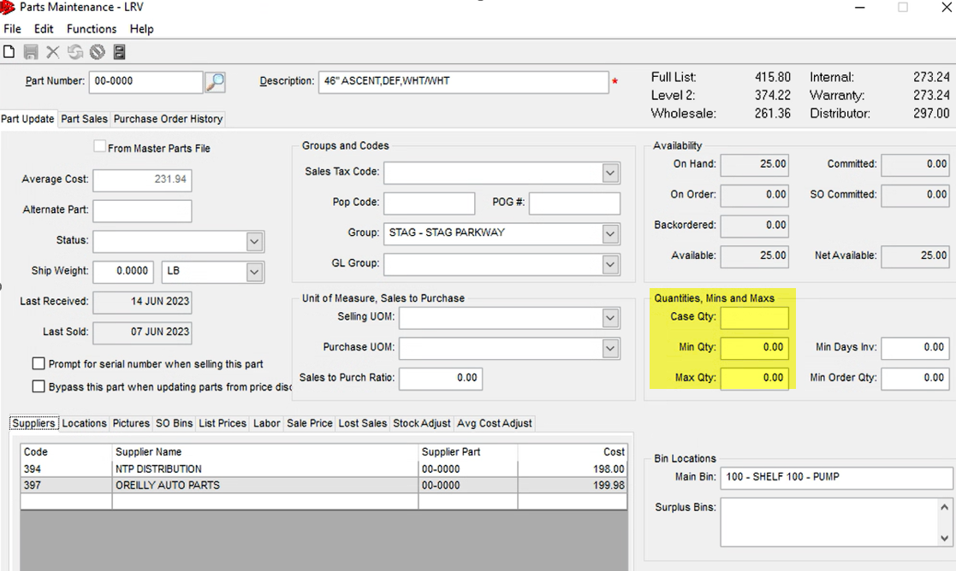
How Recommended Orders are Generated Cont.
Min/Max Quantities are setup within Parts Maintenance

Slide 9
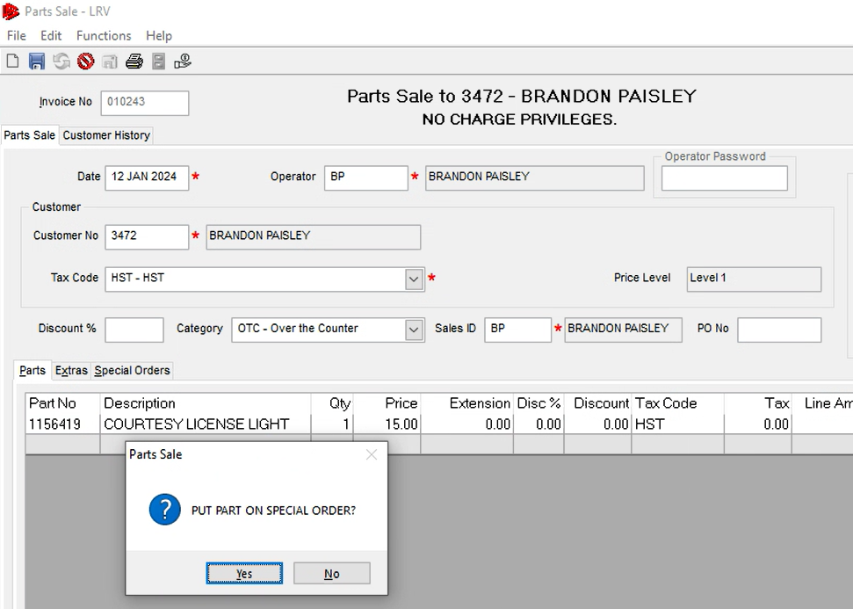
How Recommended Orders are Generated Cont.
Special Orders can be generated from Work Orders or Point of Sale
There is config for SO prompt message when parts are not on hand but SO can be manually created if parts are “On Hand” but you wish to SO part still

Slide 10
Ways to Generate Recommended Orders
Update Purchase Orders

Slide 11
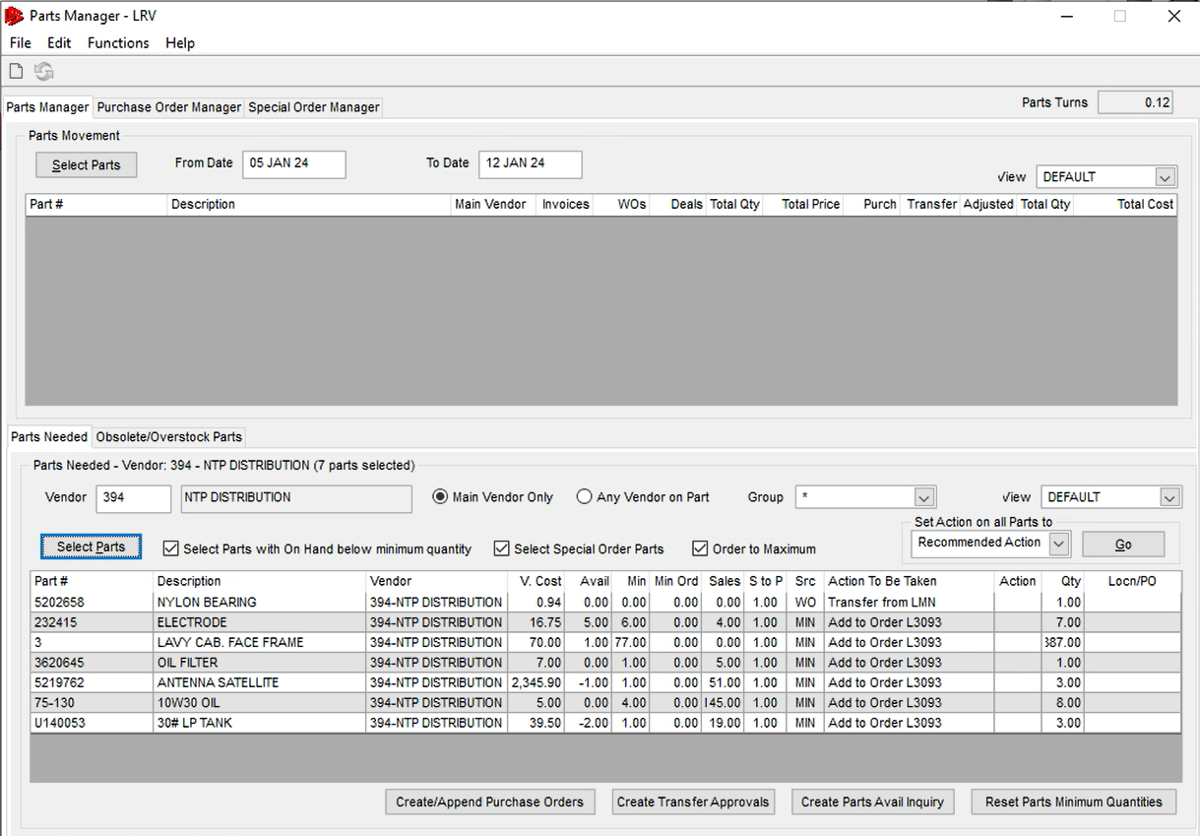
Ways to Generate Recommended Orders Cont.
Manage Parts
Grid Exporting

Slide 12
Uncovering & Managing Obsolete Parts
What are Obsolete Parts?
Viewing Obsolete Parts
What to do with Obsolete Parts?

Slide 13
What are Obsolete Parts?
Obsolete parts are parts that have not moved via selling and/or receiving.
Example:

Slide 14
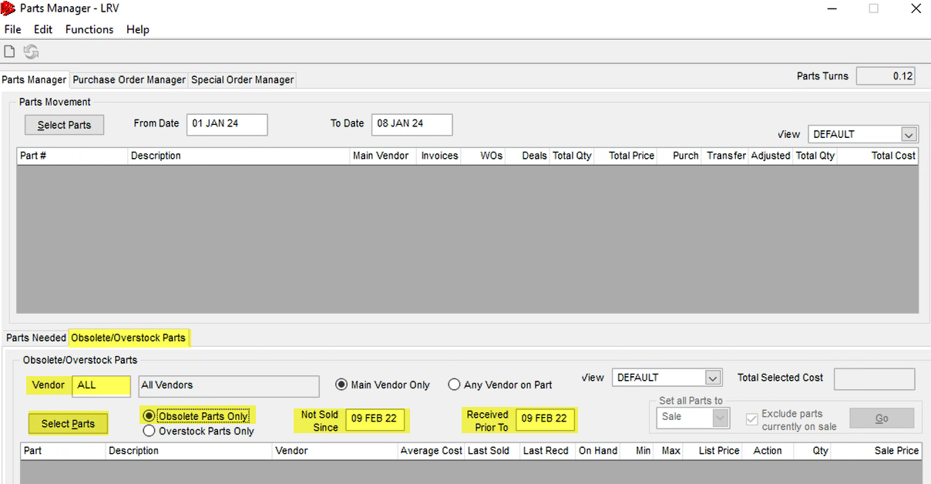
Viewing Obsolete Parts
Parts Manager
Select Obsolete Tab
Check Obsolete Parts
Run by Specific Vendor or All
Input “Not Sold Since” and “Received Prior To” depending on what you consider obsolete
Select Parts

Slide 15
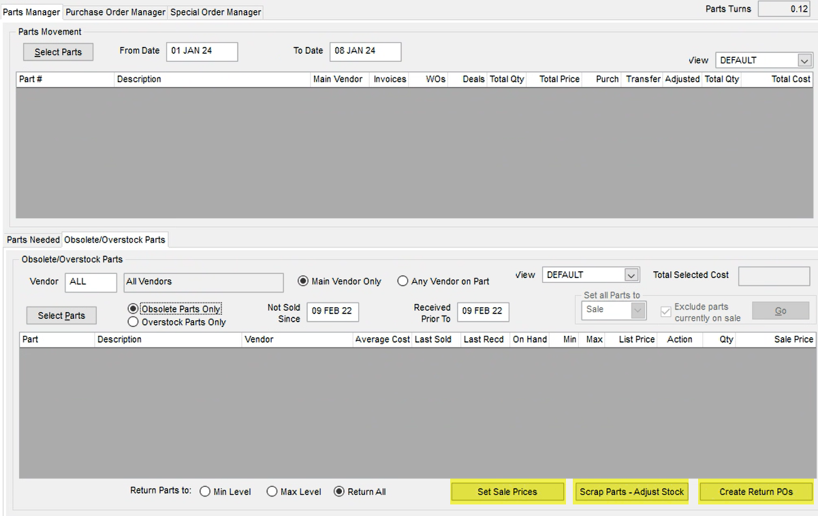
What to do with Obsolete Parts?
Set Sale Price
Allows you to set permanent or temporary sale price
Scrap Part
Does a stock adjustment on the parts quantity (Have conversation with accounting prior)
Some dealers prefer writing down the avg cost vs QOH
Create Return PO
Return to supplier if within contract terms

Slide 16
What to do with Obsolete Parts?
Best Practices
If obsolete parts are physically being thrown out then QOH adjustment, if parts are being kept then write down avg cost and move them into special bin location. Obsolete parts that are kept are not worth the value of employee labor to continually count.

Slide 17
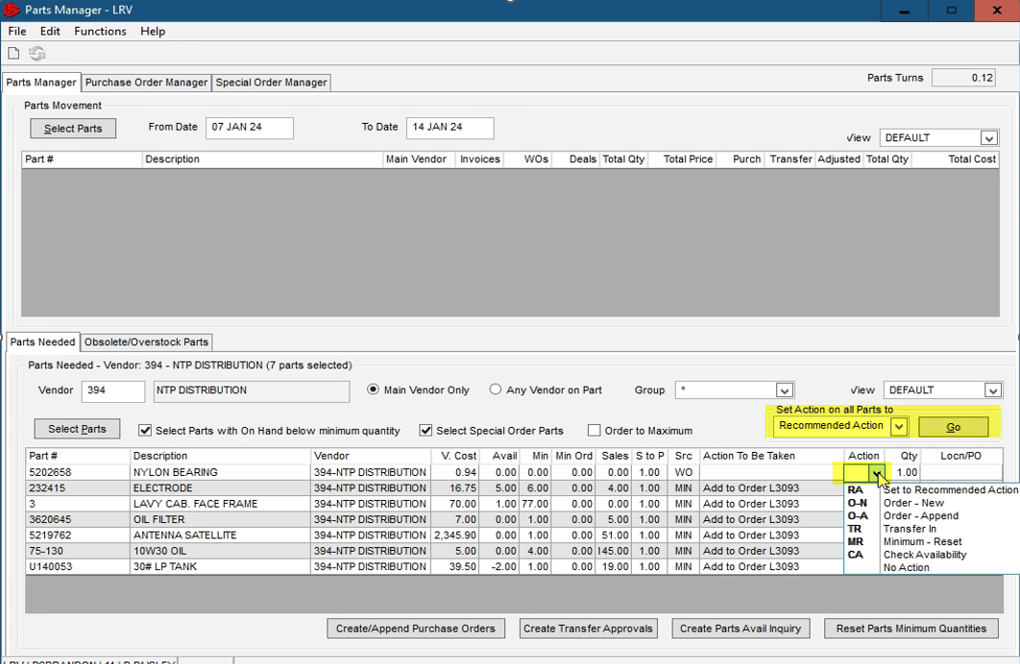
What to do with Obsolete Parts? Cont.
Setting actions on all or individual obsolete parts

Slide 18
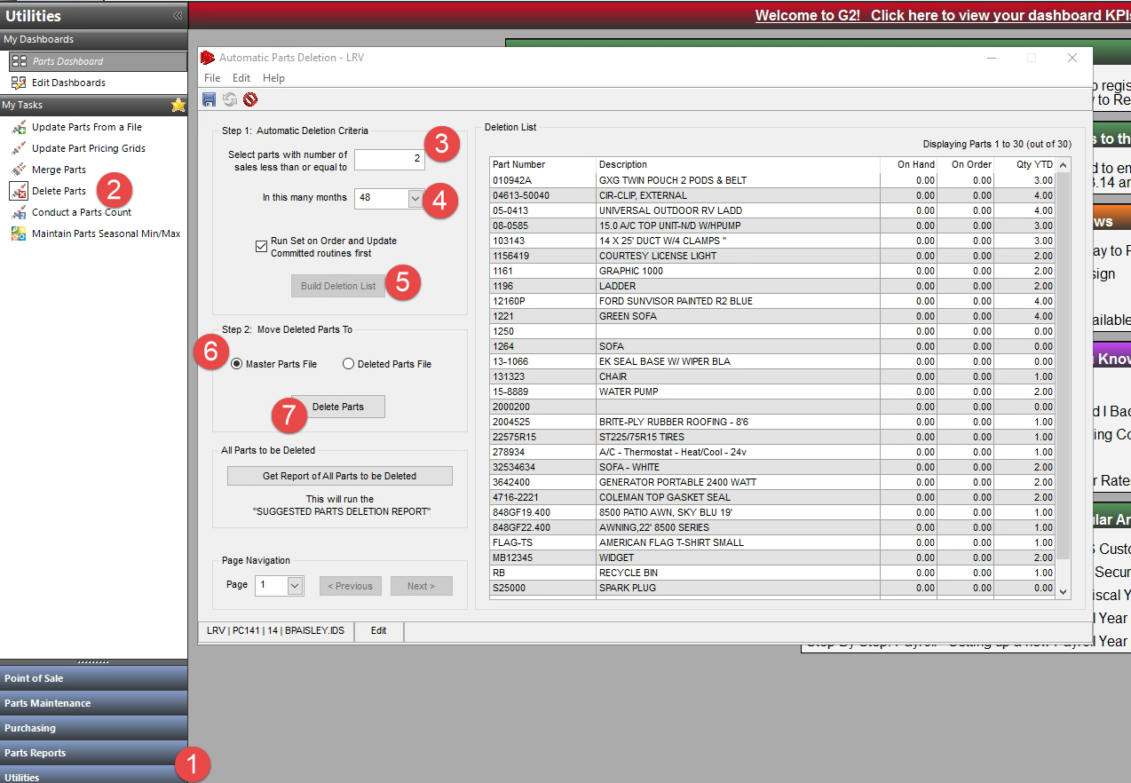
What to do with Obsolete Parts? Cont.
Parts Deletion Routine
Mass Move Parts w/out on hand quantity from Local File to Master File
Builds Full List Instead of Capping at 500 Now

Slide 19
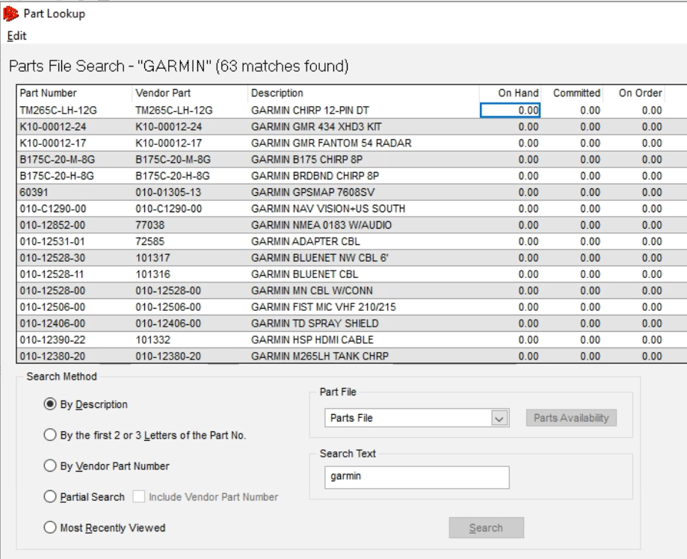
What to do with Obsolete Parts? Cont.

Slide 20
What to do with Obsolete Parts? Cont.
Rebuild Indexes in Blue Screen
3-5-3 – Rebuild Master
11-8-5 – Rebuild Part Soundex
11-8-6 – Rebuild Vendor Parts Index
11-8-13 – Rebuild Master Vendor Part Index
If indexes are not rebuilt, then the system could display part(s) in the search window that are not actually still within the parts file. There is no harm running these indexes.

Slide 21
Generate Orders Based on Parts Movement Trends
Viewing Parts Movement
Generate Order

Slide 22
Viewing Parts Movement
Parts Manager
Movement with Parts Manager shows all movement for all vendors
Parts Consumption Report
Allows individual vendor consumption

Slide 23
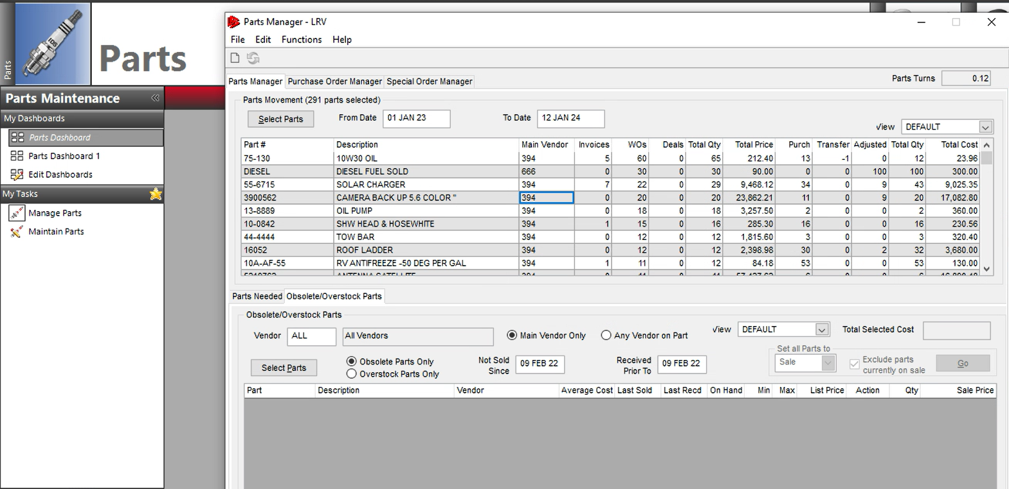
Parts Manager - Movement

Slide 24
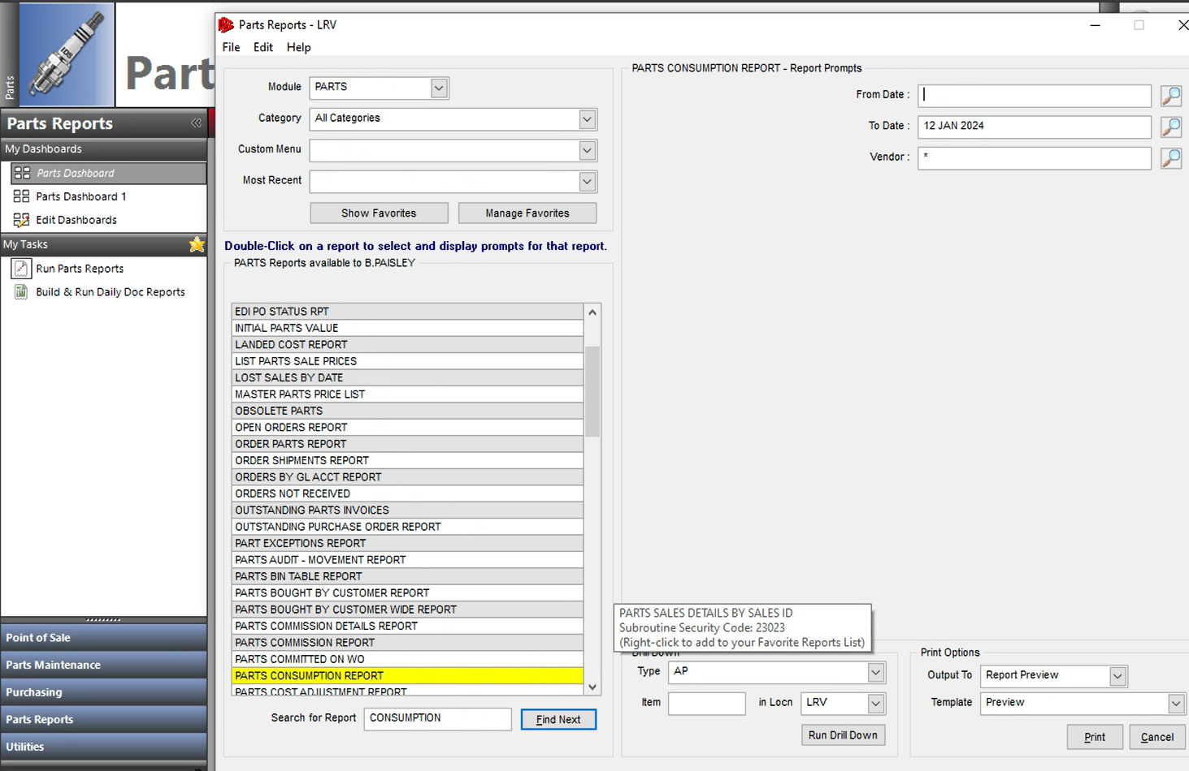
Parts Consumption Report
Export to excel and sort “Total” column to see highest moving
Notes:
Ability to and recommend export to excel so that movement column can be sorted highest to lowest

Slide 25
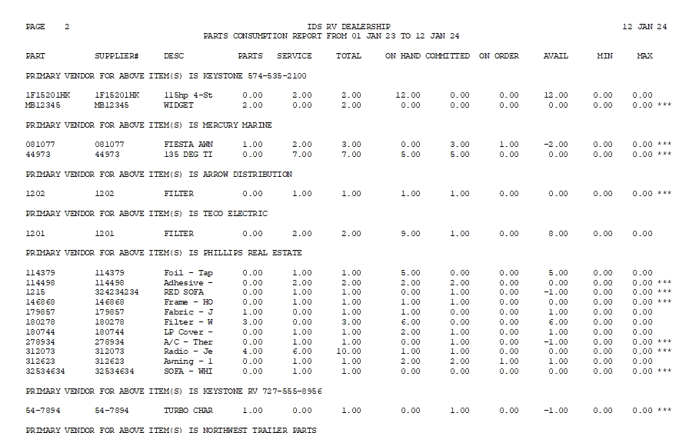
Parts Consumption Report Cont.
Highlight Part # Drill Down to Parts Maintenance and Update Min/Max Quantity – Prioritize Min/Max’s on Highest Moving Parts
Notes:
Drill down from report, Total sold between otc and wo, current on hand remaining, and min/max quantity setup

Slide 26
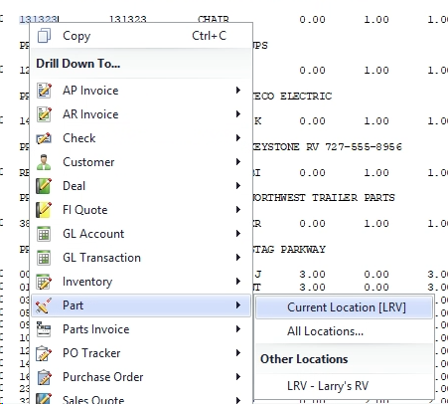
Parts Consumption Report Cont.
Notes:
Drill down from report, Total sold between otc and wo, current on hand remaining, and min/max quantity setup

Slide 27
Generate Parts Order Based on Movement
Stock Order based on Parts Consumption Report
Add Parts to daily stock order or generate a new purchase order

Slide 28
System Features/Highlights

Slide 29
Partially Received Payables
Automatic Payables can now be generated on partially received purchase orders instead only on fully received
Config 51 = PR (Partially Received)
Invoice & Freight Fields – Populate to Accounting Payable

Slide 30
Partially Received Payables Cont.

Slide 31
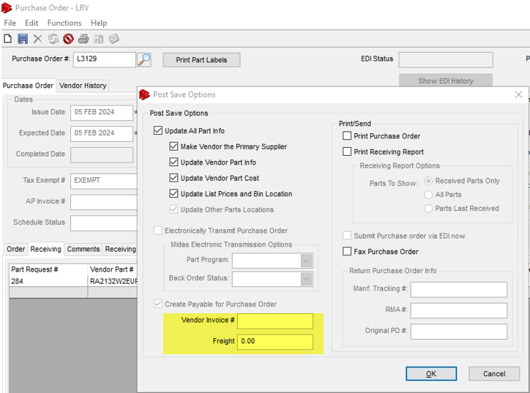
Partially Received Payables Cont.
Vendor Invoice #’s
Freight Amount
Transfers to Payable

Slide 32
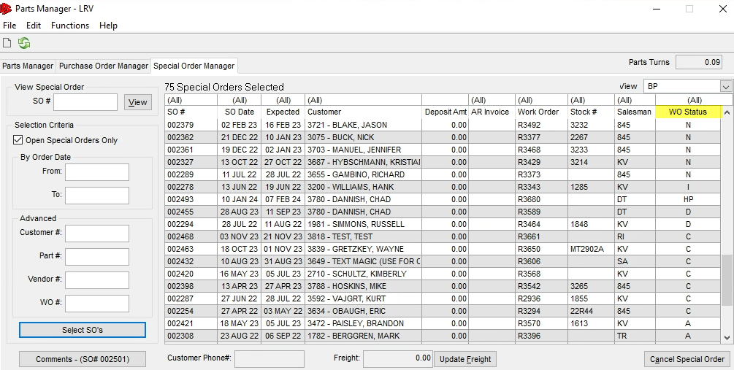
Benefits of Utilizing Special Orders
SO Bin Tracking Separate of Main Bin
Follows Customer
Track WO SO’s even if original WO is closed
Ability to Track Parts not Picked Up (OTC) or not Used/Billed (WO)

Slide 33
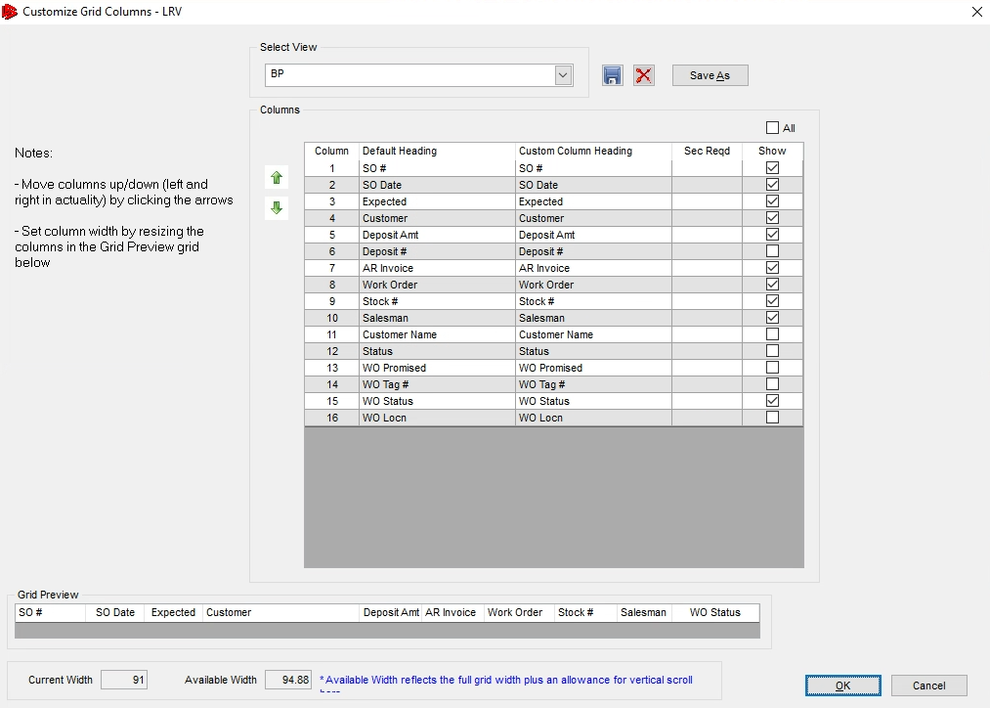
Modifying SO Manager Columns/View

Slide 34
Inventory Turns
Parts Manager – Turn Ratio
Starting goal of 3x
Obsolete Parts & Overstock Parts Play Huge Role
Increase Sales or Decrease Value on Hand
Write Off Obsolete Parts – Whether that be by QOH or AVG Cost

Slide 35
Multi-Location Parts Transferring
Security
Transferring from Location
Receiving into Location

Slide 36
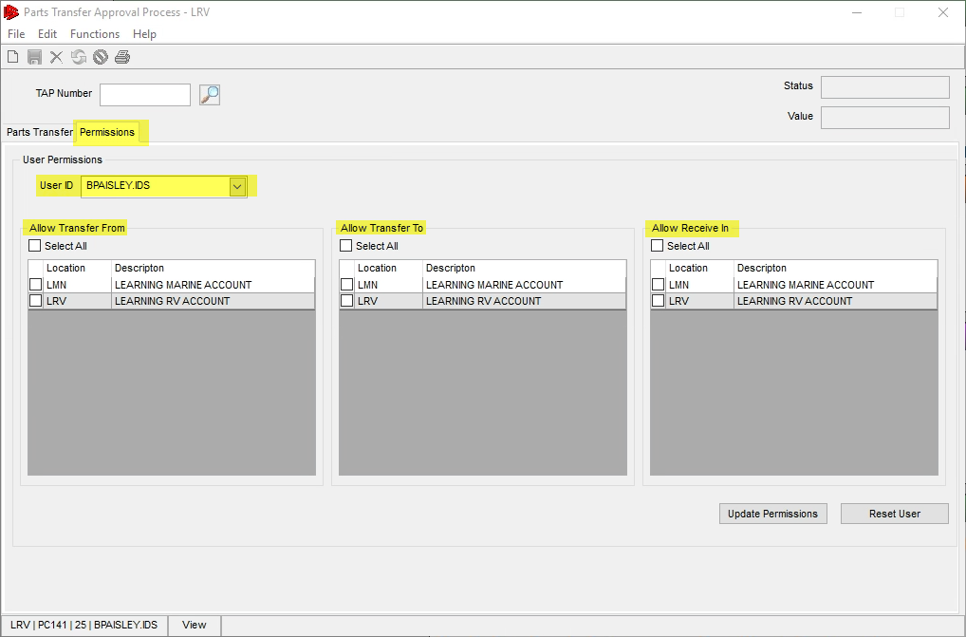
Multi-Location Parts Transferring Cont.
Security is setup withing the TAP routine and is restricted behind subroutine 10172

Slide 37
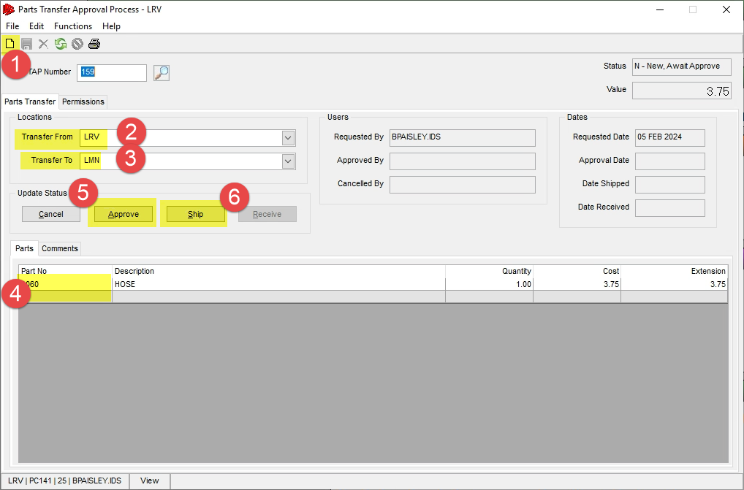
Multi-Location Parts Transferring Cont.
Transferring from Location
Input Part(s)
Transfer From/To
Save
Approve/Ship
Communicate with other location – No System Notifications for TAP

Slide 38
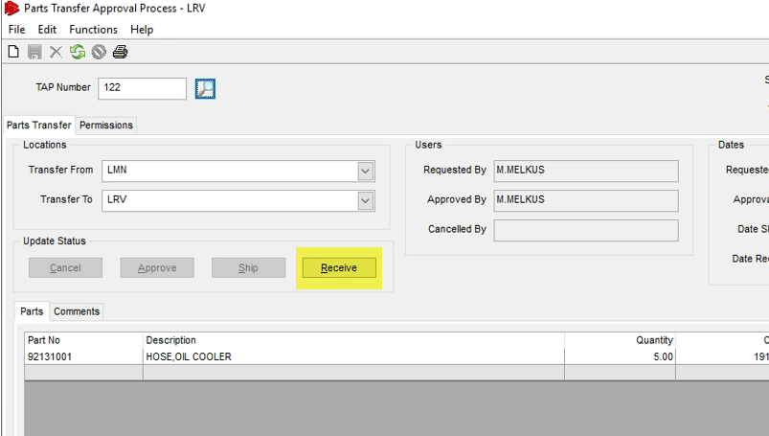
Multi-Location Parts Transferring Cont.
Receiving into Location
Input TAP # or Search
Receive

Slide 39
Cycle Counting
Best Practices
Recommend Cycle Counting All Bins (Exception of Obsolete Bin) 2 Times Minimum Per Year
Minimal SKU’s per bin
Timely
Mobile App (IDS Mobile)
Initiate Conduct a Parts Count from G2

Slide 40
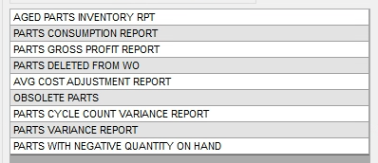
Suggested Reports

Slide 41
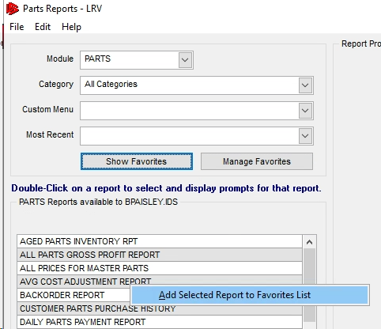
Adding Favorite Reports

Slide 42
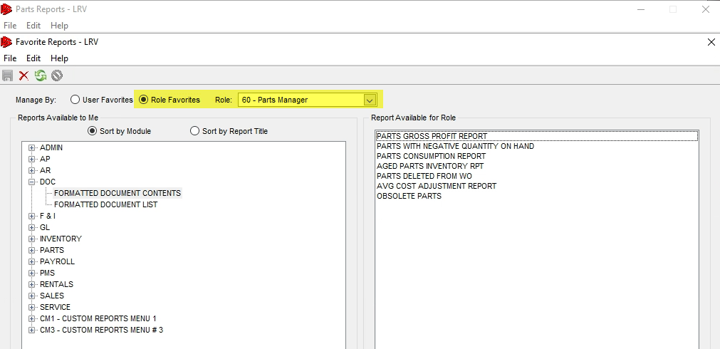
Adding Favorite Reports Cont.

Slide 43
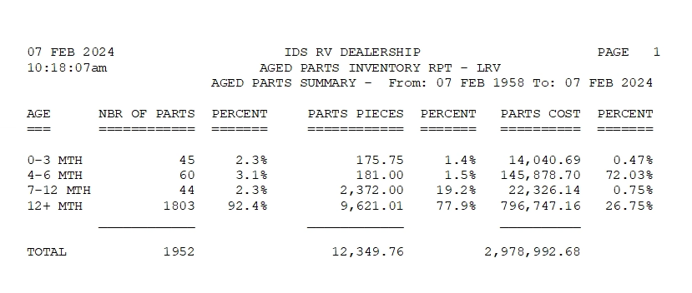
Aged Parts Inventory RPT

Slide 44
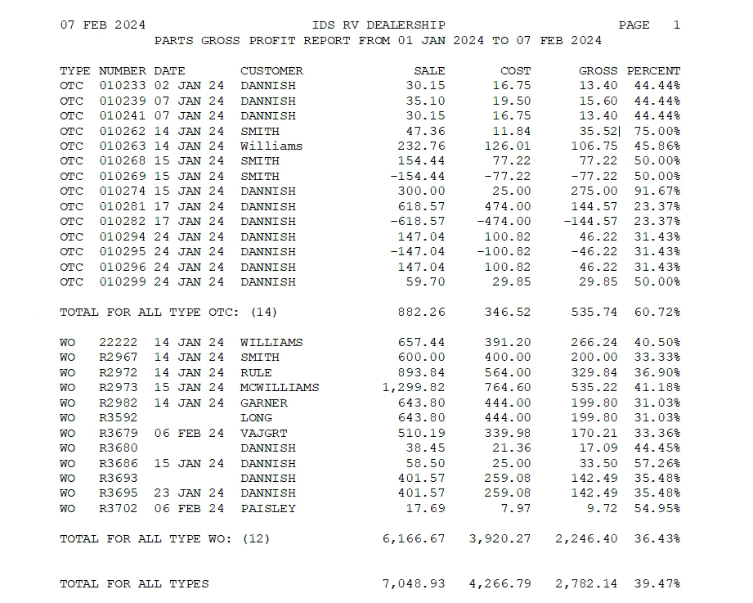
Parts Gross Profit RPT

Slide 45
Parts Deleted From WO

Slide 46
Avg Cost Adjustment

Slide 47
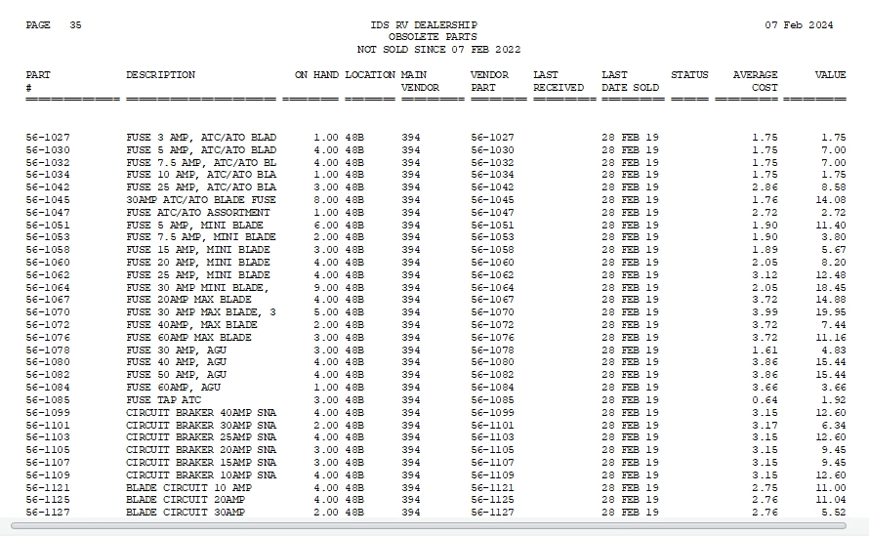
Obsolete Parts

Slide 48
Parts Cycle Count Variance

Slide 49
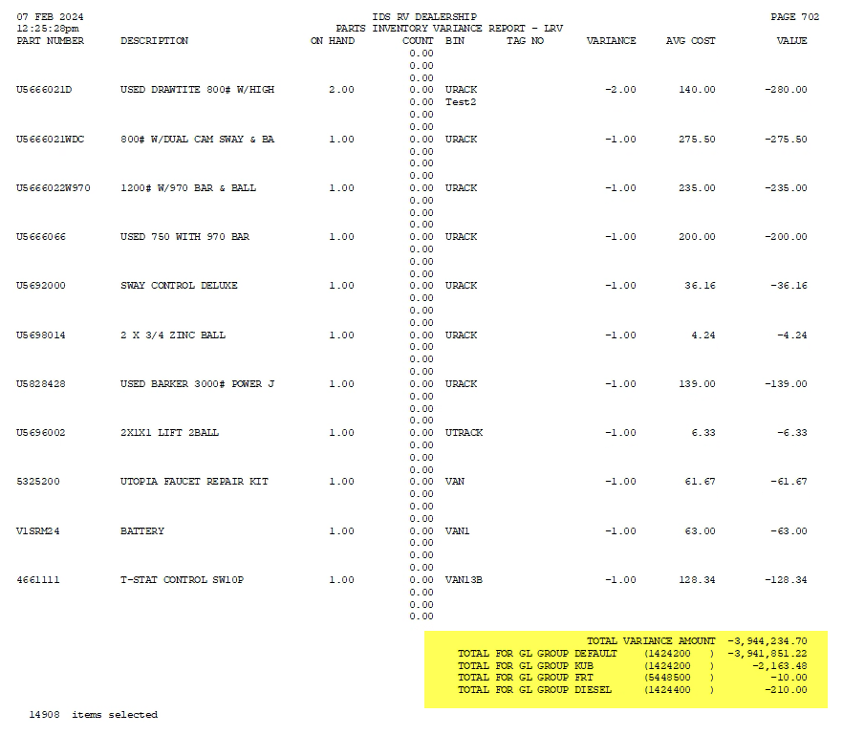
Parts Variance Report

Slide 50
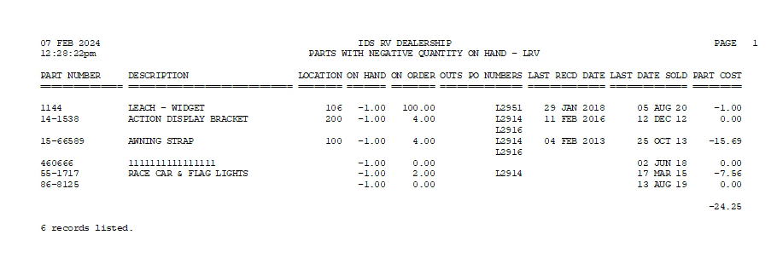
Parts With Negative Quantity on Hand

Slide 51
Notable Configs
Parts Module:
18 - Special order if qty on hand < qty ord (Y/N)
19 - Special order default deposit percentage – F (Full)
32 - Prompt for Bin when updating parts receiving – (Y,N)
51 - Create Payable when PO is complete - (Y/N/P/PR)
60 - Update PARTS bin when entering bin for special order receipts - (Y/N)
63 - GL Freight EXP/COS account for parts receiving payables – 5448500
Service Module:
171 - G2 - Finalize WO - Warn if required parts have not been moved to actual – (Y/M/N)
175 - Allow Job Transfer with billed Labor, Parts, Sublets and Extras, for Open Work Order – (Y,N)

Slide 52
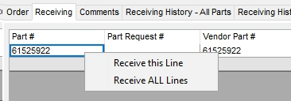
Lesser-Known Features
Parts Receiving – Receive All
Right Click on Part # in Receiving Tab
Customer # and SO PO’s
Delete Parts Routine – Discussed in Obsolete Section
Set On Order Routine – Corrects QOO for All Parts

Slide 53
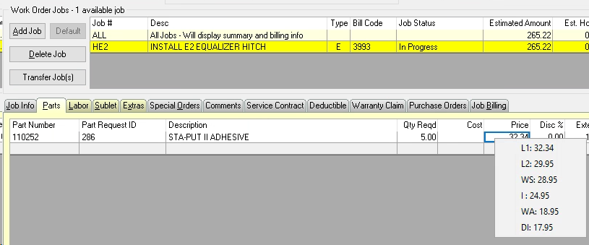
Lesser-Known Features Cont.
WO Part Line Prices
Right Click for Price Levels
Type P# (Example: P30 for 30% markup)

Slide 54
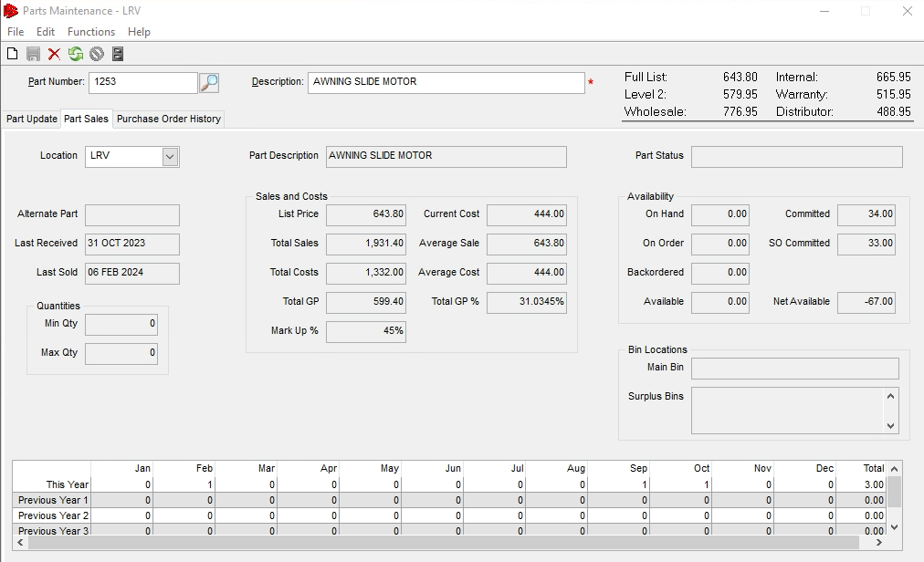
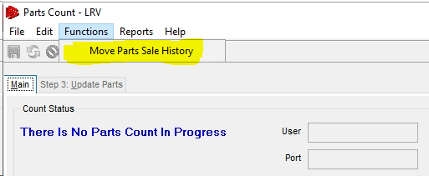
Lesser-Known Features Cont.
At year end “Move Parts Sale History” to start new year of sales history

Slide 55
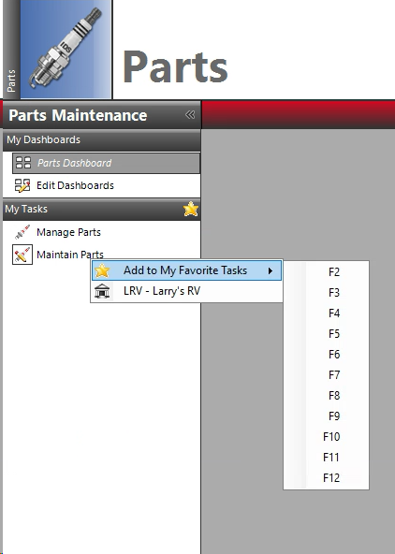
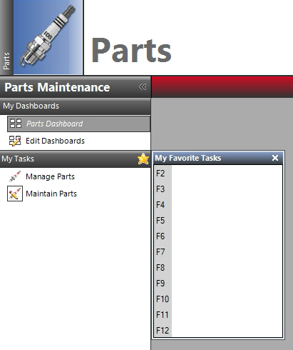
Lesser-Known Features Cont.
F Keys to set shortcuts on most common G2 funtions

Slide 56
Lesser-Known Features Cont.
Parts Searching
Local vs Master (Typing Part # Auto Looks at Both Files)
Search Options

Slide 57
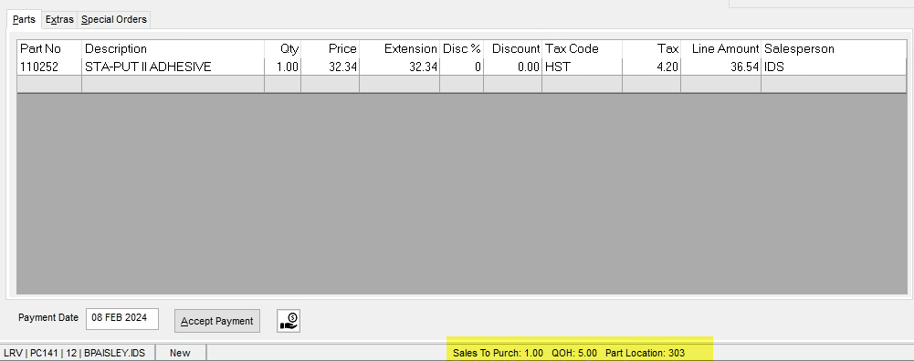
Lesser-Known Features Cont.
Parts Quantities, Ratio and Location from WO/OTC/PO

Slide 58
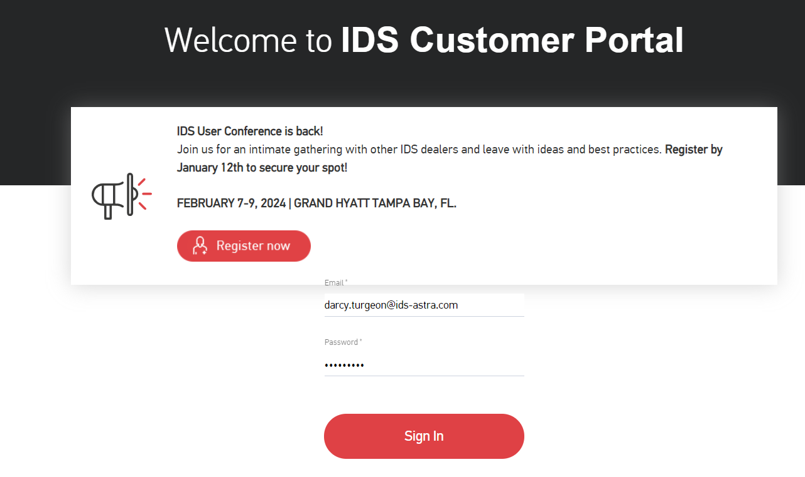
How to get Support Help
The best way to get support is to sign up on the IDS Portal website,
Visit: https://portal.ids-astra.com/login
Here you can register to send in a support ticket and access the vast amount of online reference materials.

Slide 59
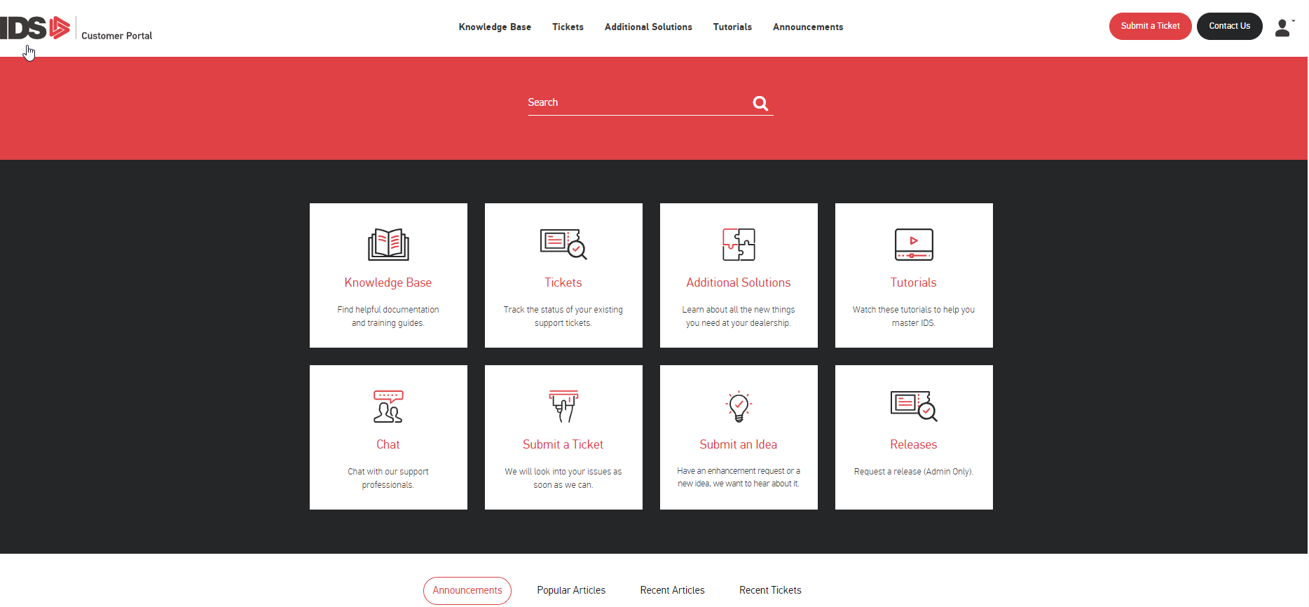
How to get Support Help

Slide 60
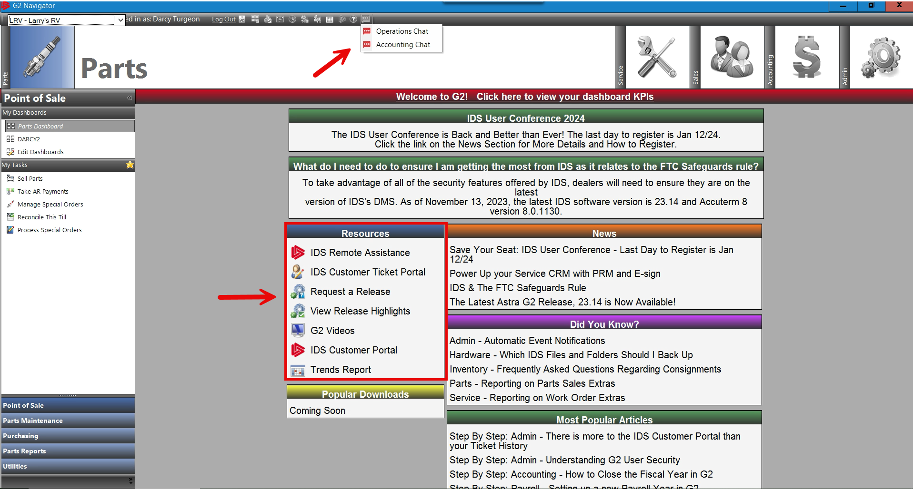
How to get Support Help

