Slide 1
R.E.C.T. Reporting
February 2024

Slide 2

Don Miller
Senior Consultant

Slide 3
R.E.C.T. Reporting
Delivered Monthly
Previous Month’s Cycle Times
National & Regional Results
Impact of Major Bottlenecks
Historical Data
Detailed Information

Slide 4
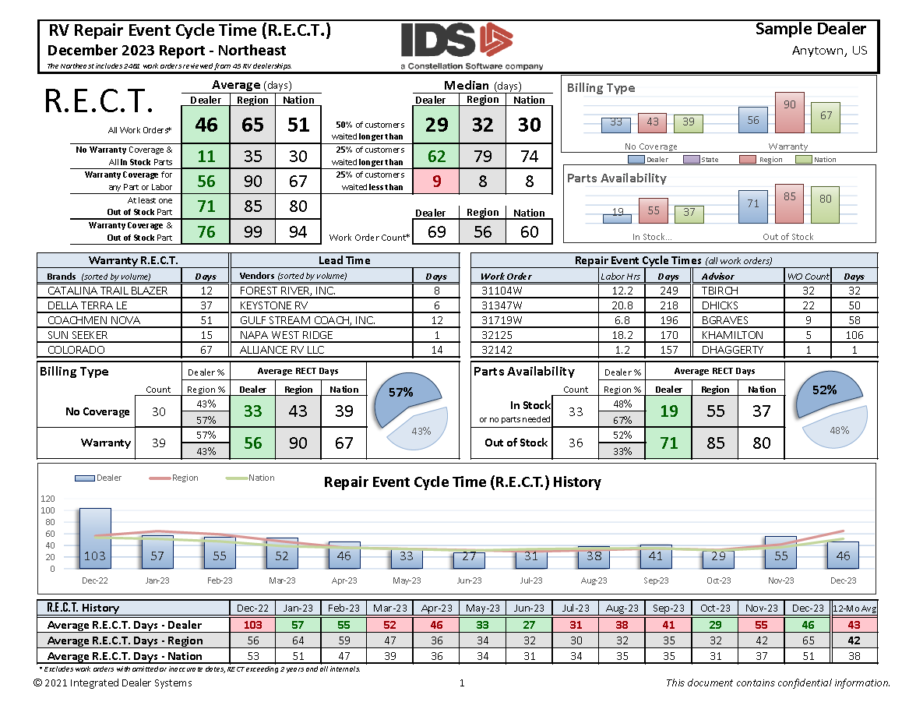
R.E.C.T. Reporting
Summary Page
Brand & Vendor Review
Top Work Order & Advisor
Historical Trends

Slide 5
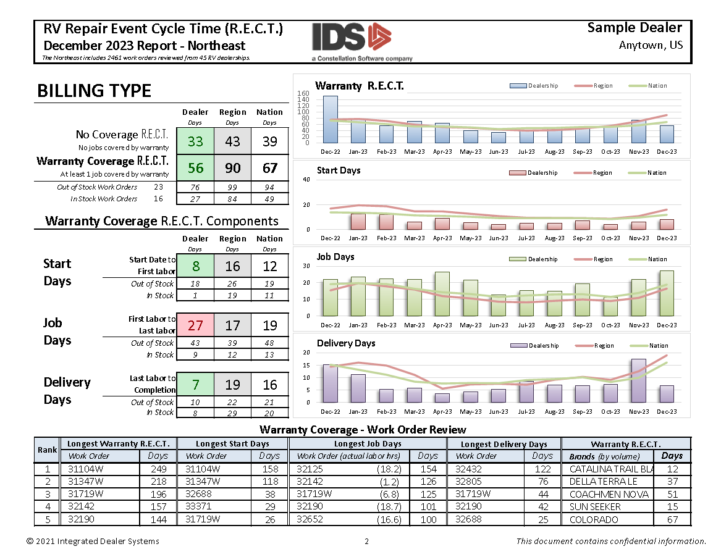
R.E.C.T. Reporting
Billing Type
Major Components
Historical Trends
Work Order Review

Slide 6
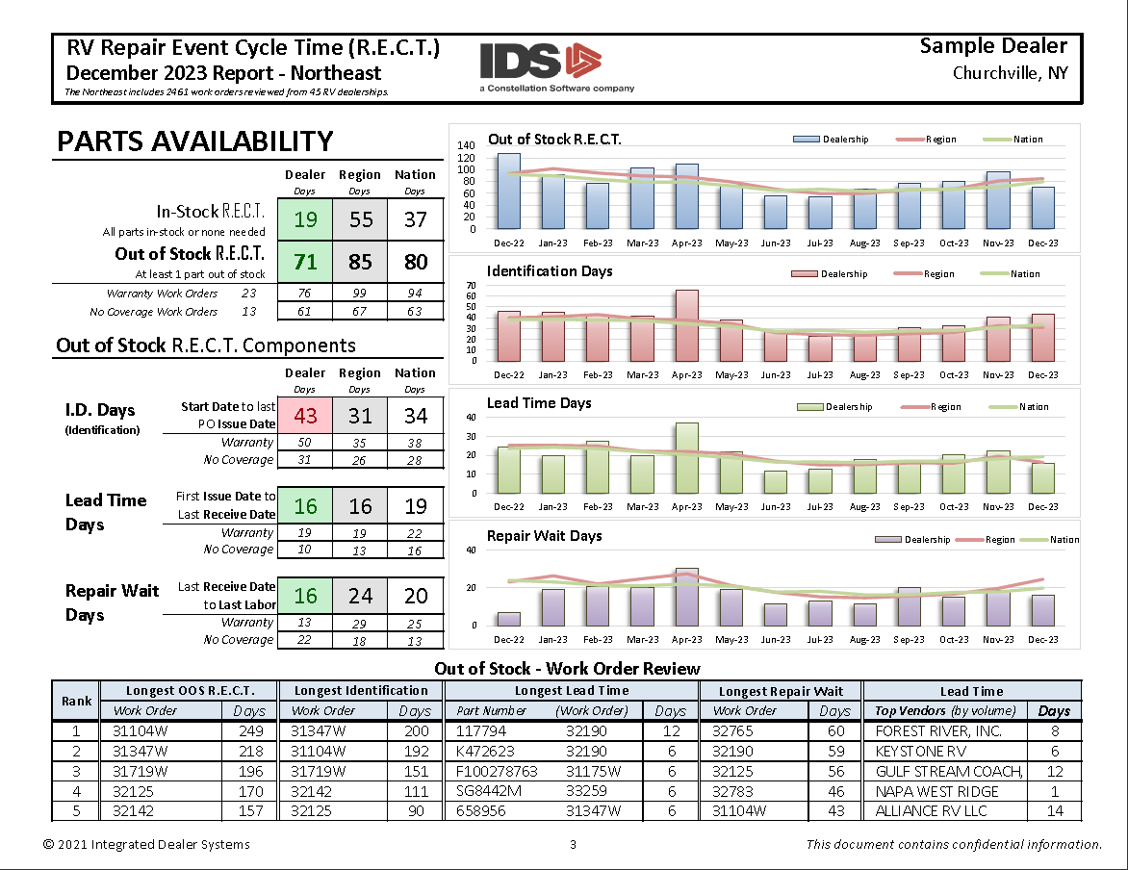
R.E.C.T. Reporting
Parts Availability
Major Components
Historical Trends
Work Order Review

Slide 7
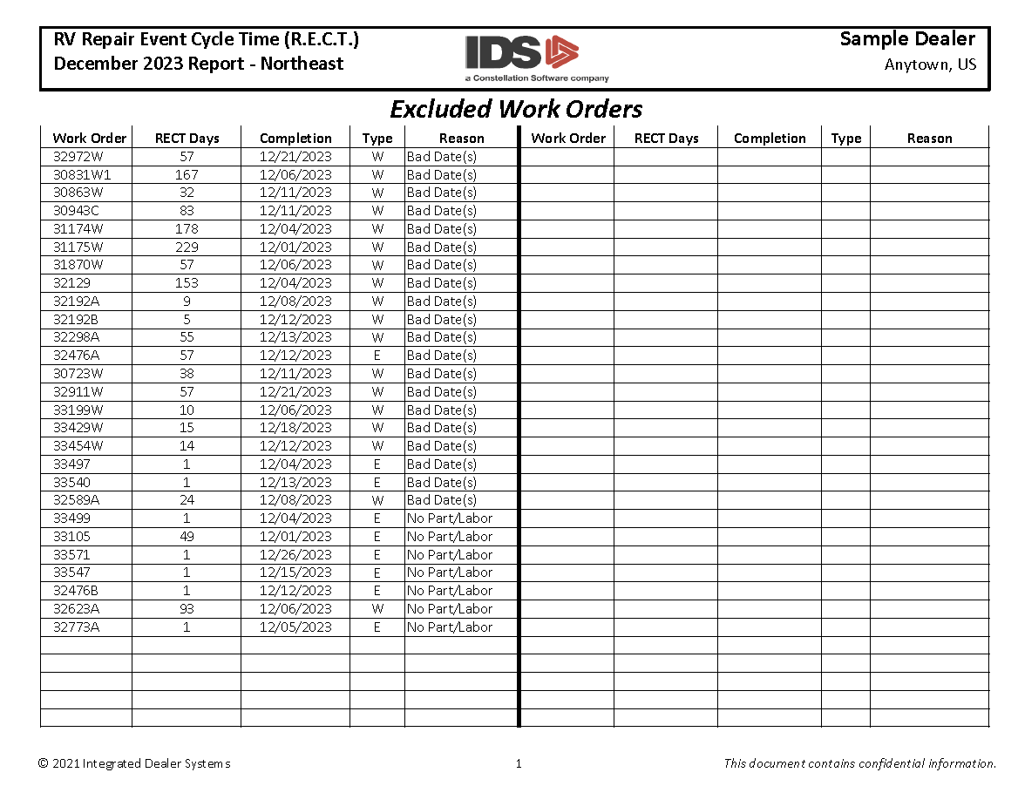
R.E.C.T. Reporting
Excluded Work Orders
Excessive R.E.C.T.
No Parts or Labor
Bad Dates

Slide 8
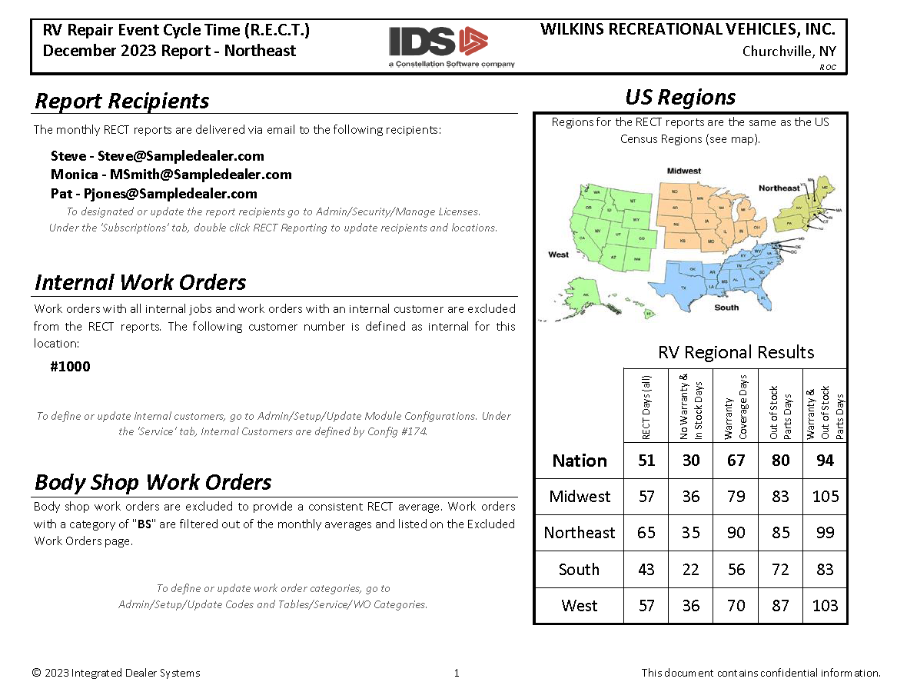
R.E.C.T. Reporting
Info Page
Report Recipients
Internal Customers
Work Order Categories
Regional Averages

Slide 9
R.E.C.T. Reporting
Compare your results to reginal & national averages
Compare your results to historical averages
Monitor your top Brands & Vendors
Compare the impact of each bottleneck on each other
Dive into the details (bottleneck components & specific work orders)

Slide 10
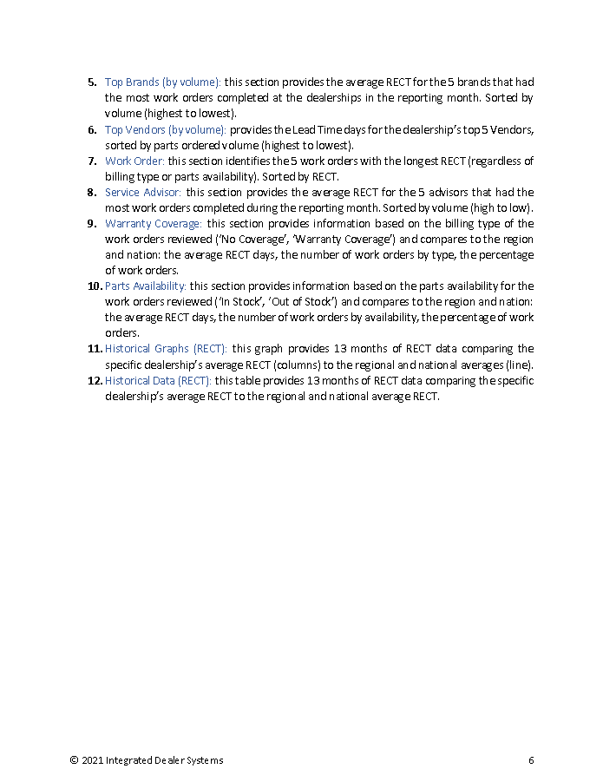
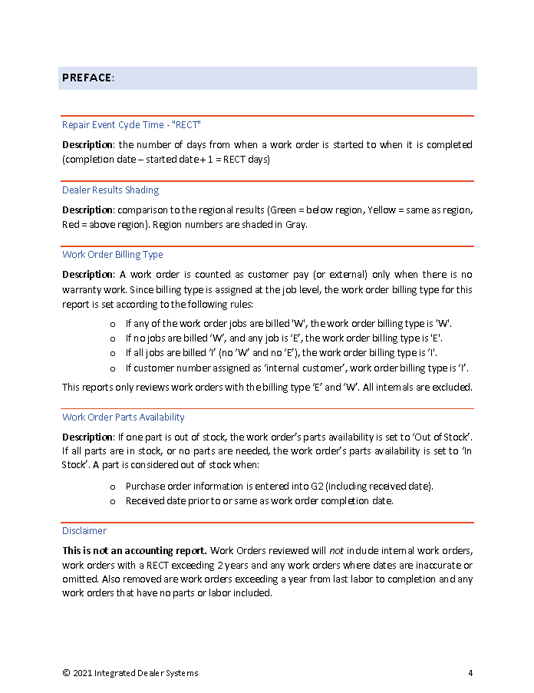
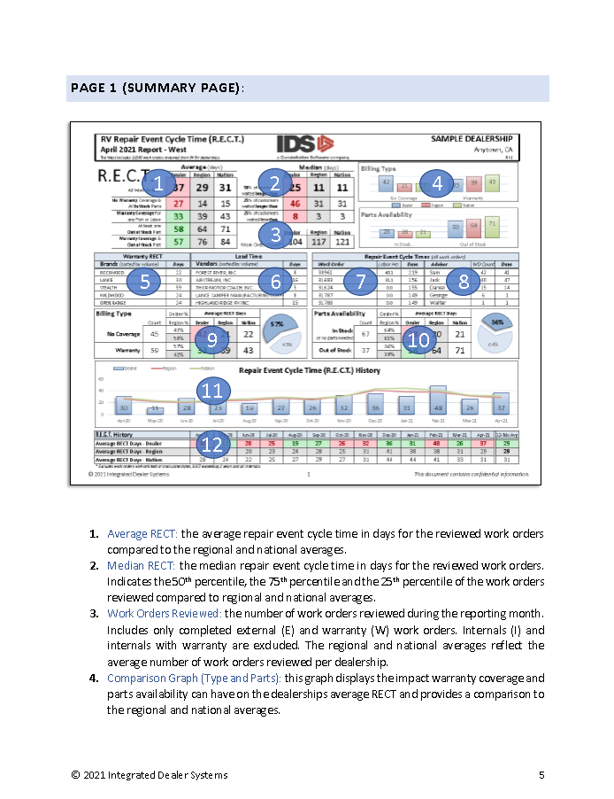
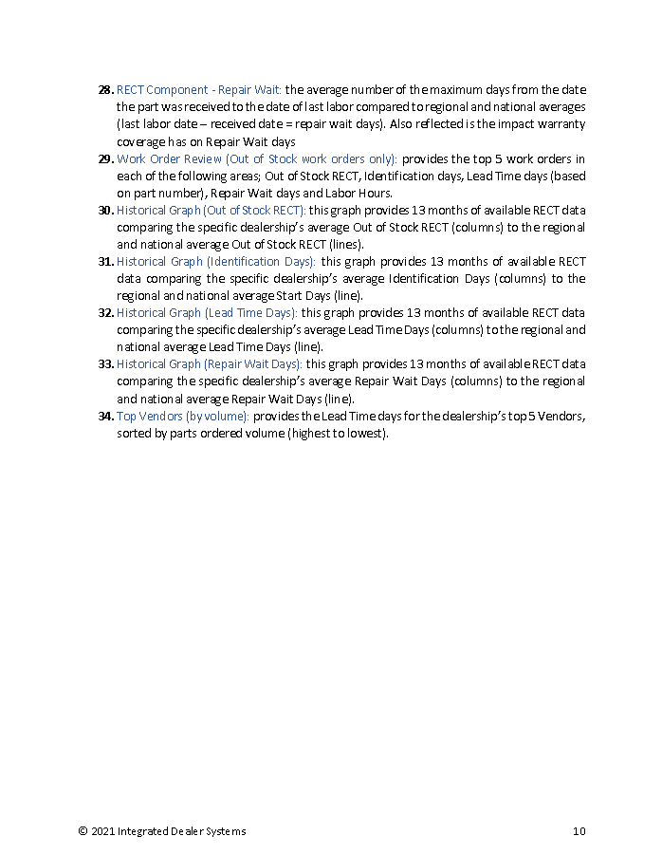
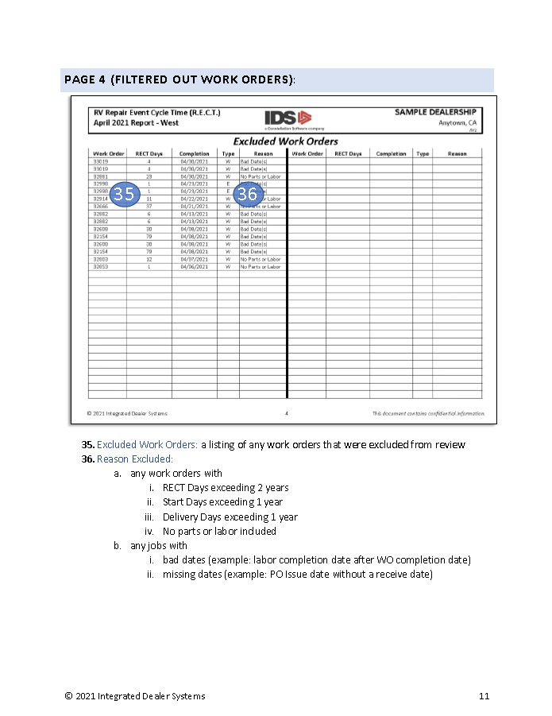
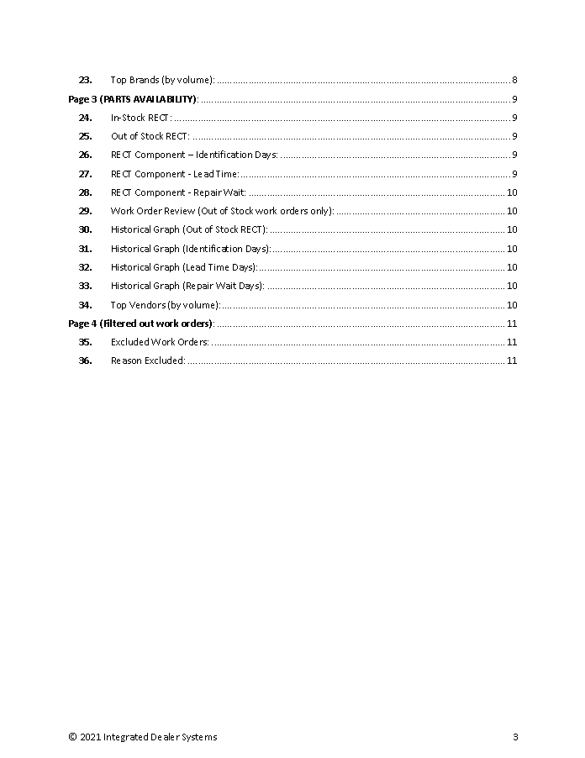
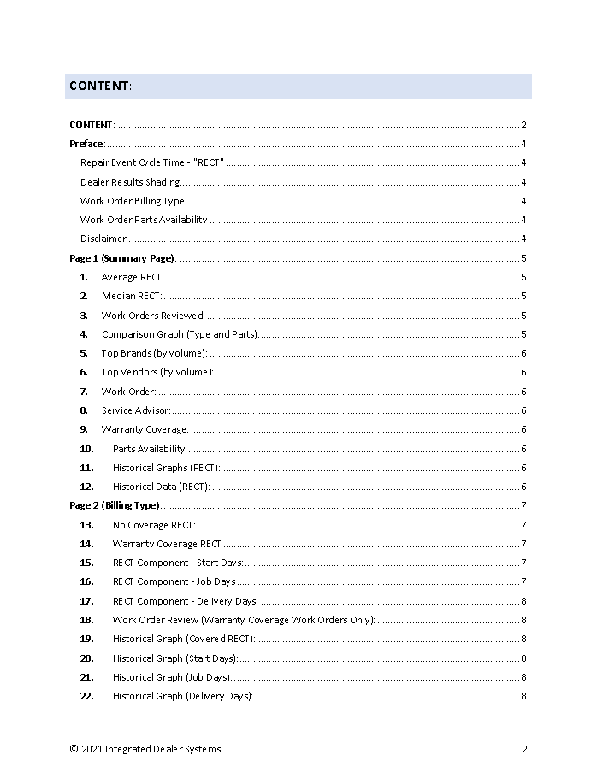
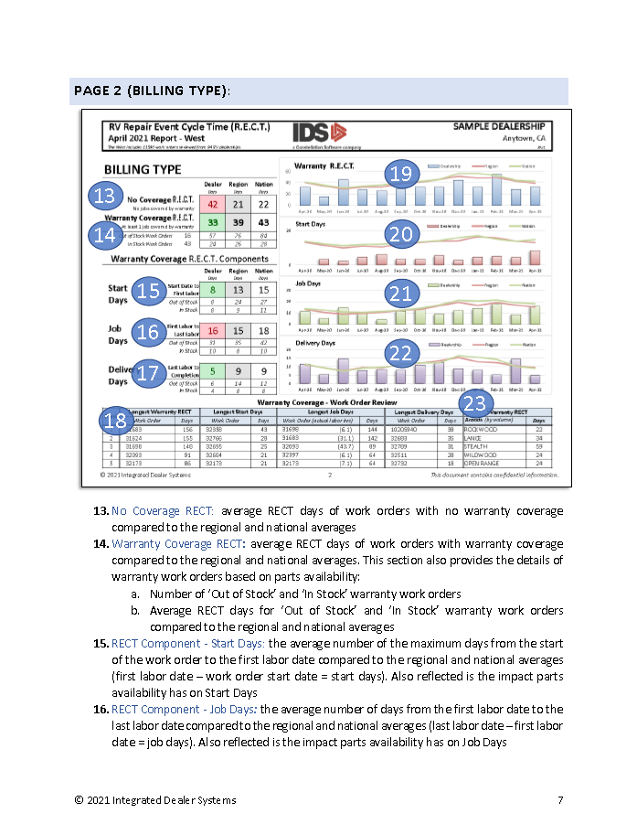

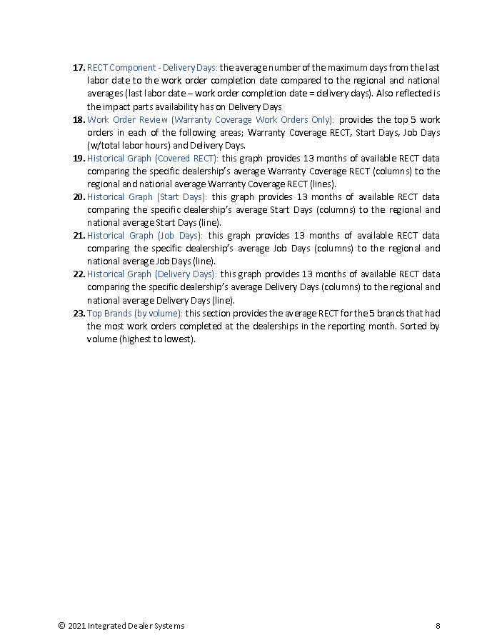
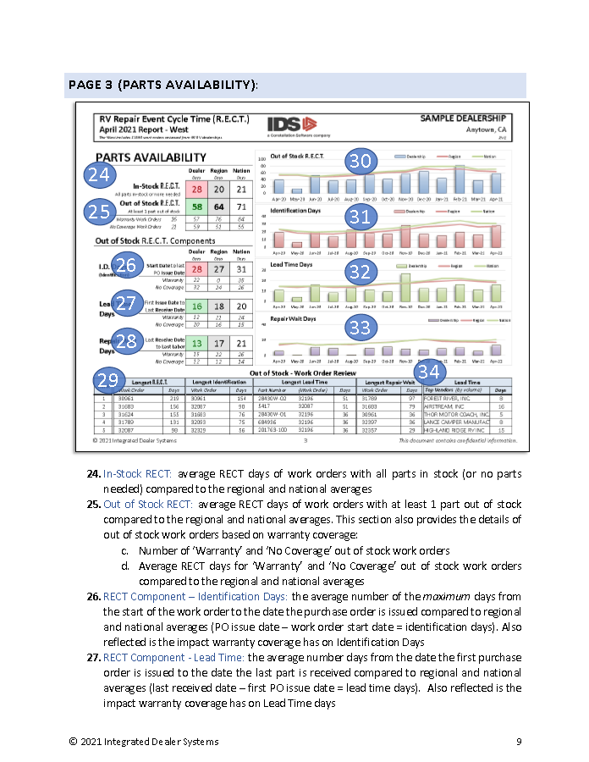
R.E.C.T. Reporting
Report Key

Slide 11
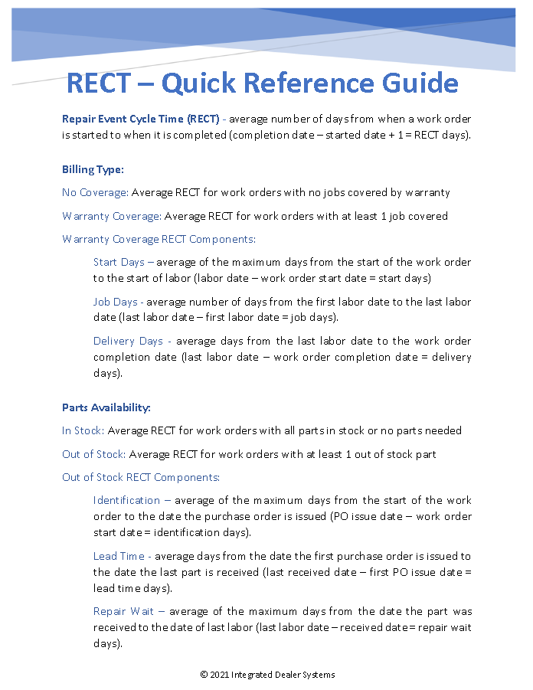
R.E.C.T. Reporting
Report Key
Quick Reference Guide

Slide 12
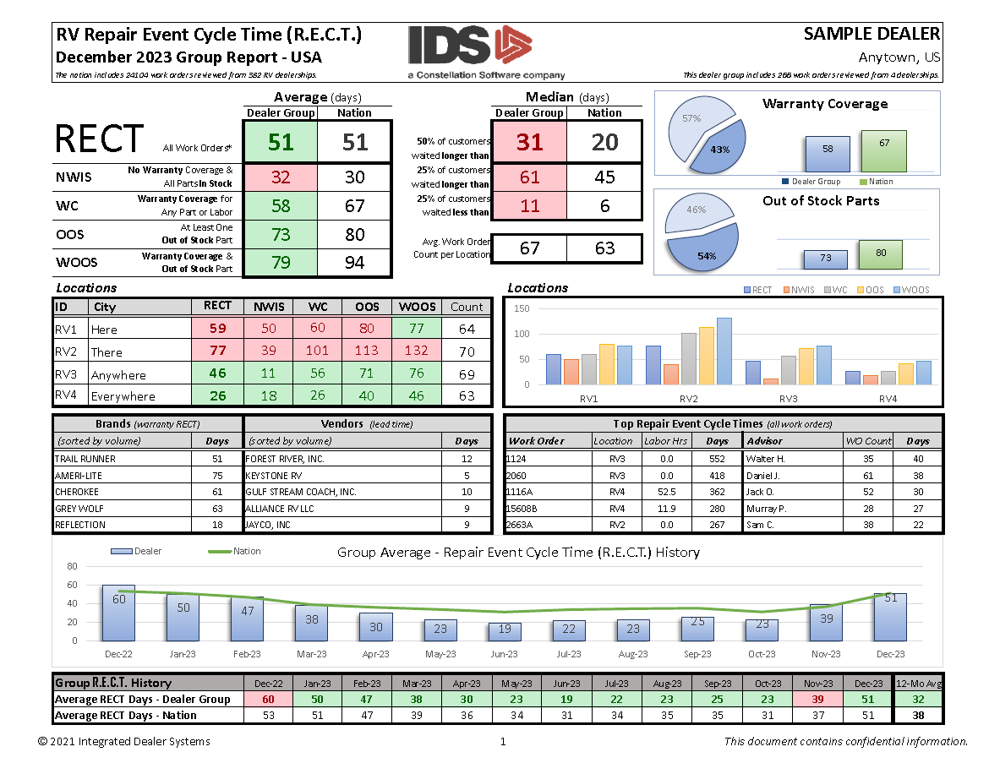
R.E.C.T. Reporting
Group Report
Group Averages
Side-by-side Comparison
Brand & Vendor Review
Top WO & Advisors
Group Historical Averages

Slide 13
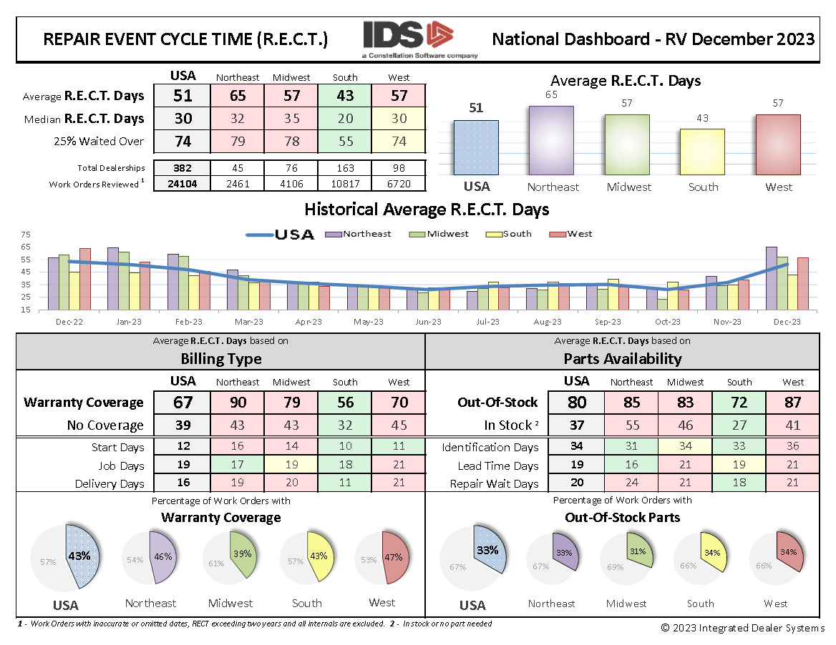
R.E.C.T. Reporting
National Dashboards
Regional Comparison
Bottleneck Percentage
Historical Graphs
Canadian RV Dashboard
US RV & Marine

Slide 14
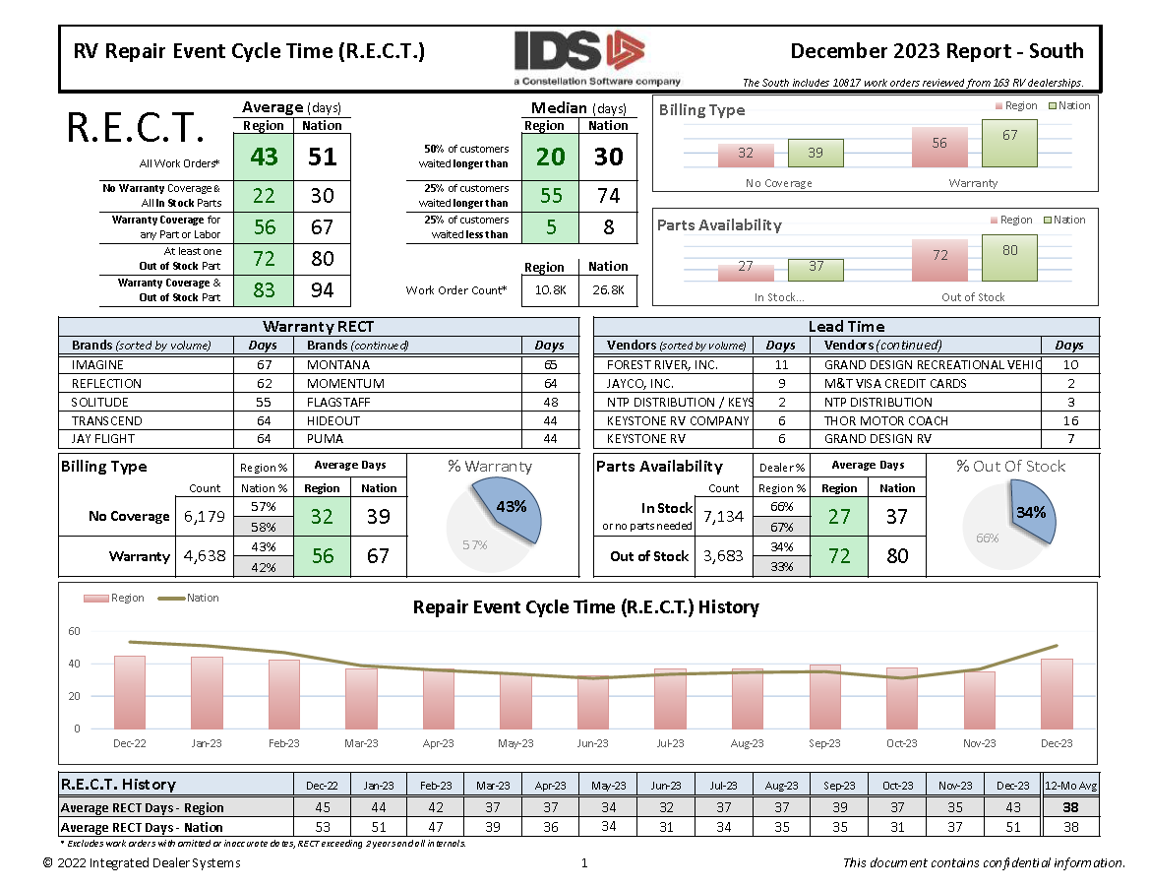
R.E.C.T. Reporting
Regional Reports
Top-10 Vendors & Brands
Bottleneck Percentage
Historical Graphs

Slide 15
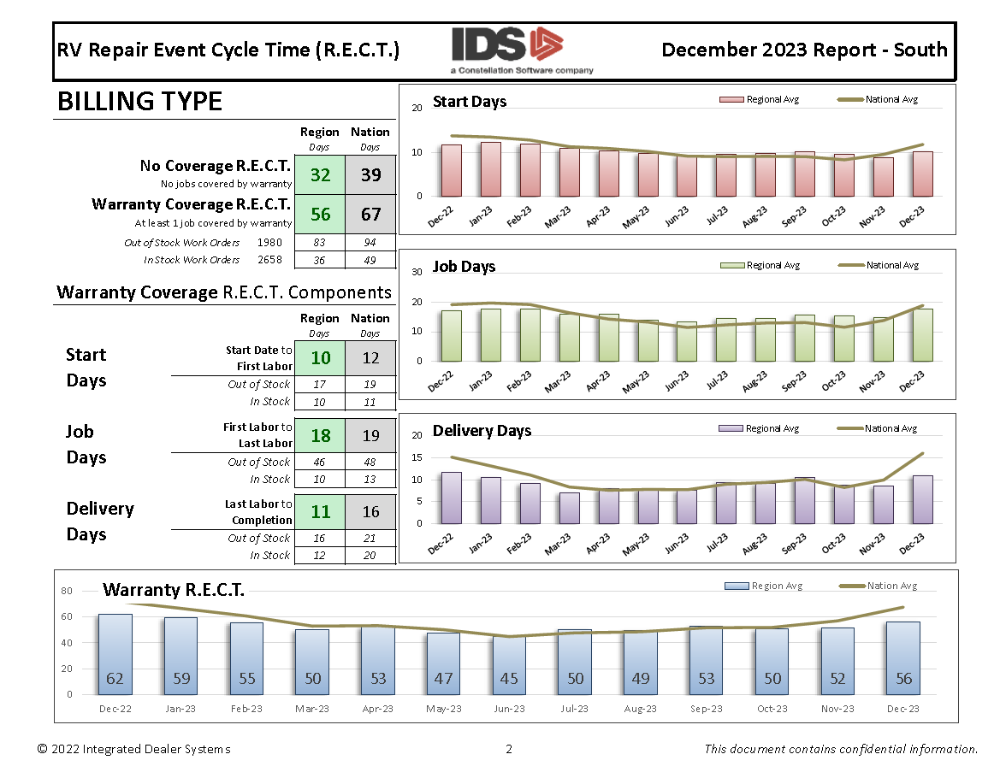
R.E.C.T. Reporting
Regional Reports
Top-10 Vendors & Brands
Bottleneck Percentage
Historical Graphs
Warranty Coverage

Slide 16
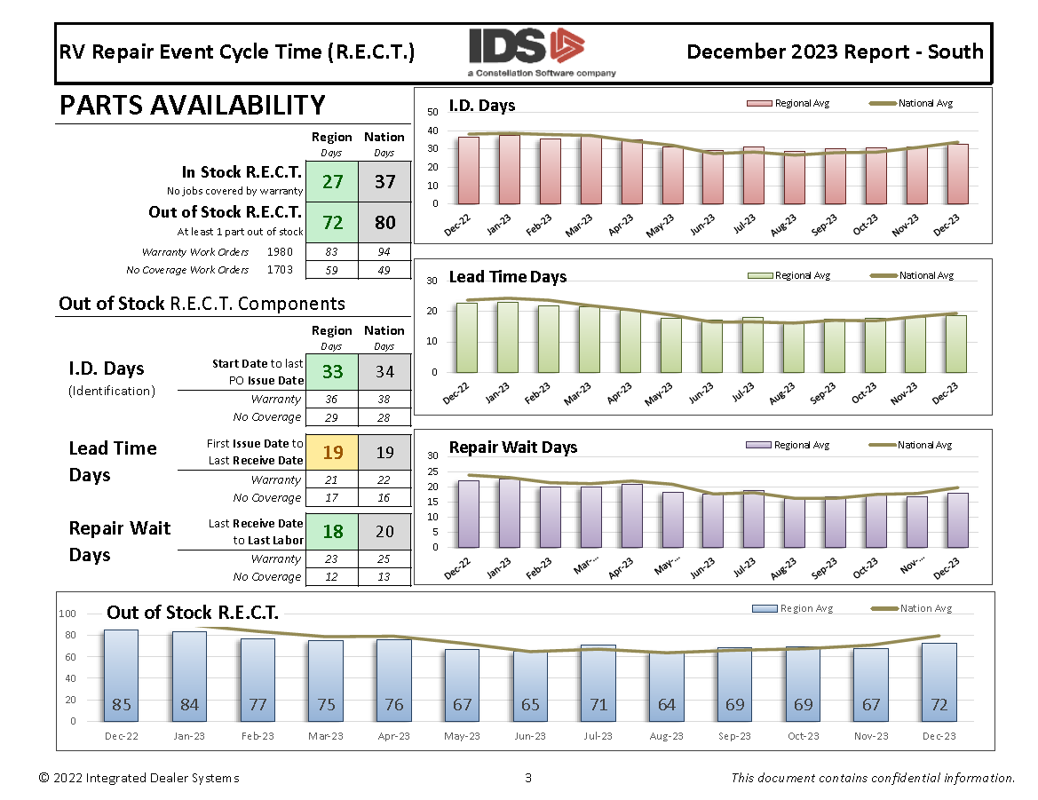

R.E.C.T. Reporting
Regional Reports
Top-10 Vendors & Brands
Bottleneck Percentage
Historical Graphs
Warranty Coverage
Out-of-Stock Parts

Slide 17

R.E.C.T. Reporting
Download today at
www.ids-astra.com/services/rect/

Slide 18

R.E.C.T. Trends

Slide 19
R.E.C.T. Trends

Slide 20
R.E.C.T. Trends

Slide 21
R.E.C.T. Trends

Slide 22
R.E.C.T. Trends

Slide 23
R.E.C.T. Trends
All – 37 days
National Avg

Slide 24
R.E.C.T. Trends
All – 37 days
Warranty – 54 days
National Avg

Slide 25
R.E.C.T. Trends
National Avg
All – 37 days
Warranty – 54 days
Out-of-Stock – 73 days

Slide 26
R.E.C.T. Trends
Lead Time – 14 days
National Avg
Notes:
Top Vendors

Slide 27
R.E.C.T. Trends
National Avg
Lead Time – 14 days
Identification – 37 days
Notes:
Top Vendors

Slide 28
“If you can’t measure it, you can’t manage it.”
“If you can’t track it, you can’t learn from it.”
“Knowledge is power.”
Your data is like gold. Mine it often.

Slide 30
R.E.C.T. Reporting
www.ids-astra.com/services/rect/

