Slide 1
Service Workflow
February, 2024

Slide 2
Kurt Vajgrt
PSG Consultant

Slide 3
About me
Accounting Degree - Wisconsin
Worked at dealership 3 years
IDS software experience 25 year
Houston – Texas

Slide 4
Today’s Agenda
Service Workflow: Beginning-to-end for Service Advisors and Technicians while using Service CRM/Parts Request Manager and E-Sign
Service Workflow: Beginning-to-end for Service Advisors and Technicians while using Service CRM/Parts Request Manager and E-Sign

Slide 5
Setup and Planning
WO Status Codes - W, P, A, T, I, F, HP, PO, PH
Job Status Codes - 1,2,3,4,4, HP, WA
WO Locations - CHU, IH, SUBLET
WO Categories – Tech Codes or Wo Types
Teams – DO, PU, WT, MH, TR, BS, EST
CRM – Schedules, Templates, Tasks, Text, Emails
Service Workflow: Beginning-to-end for Service Advisors and Techni

Slide 6
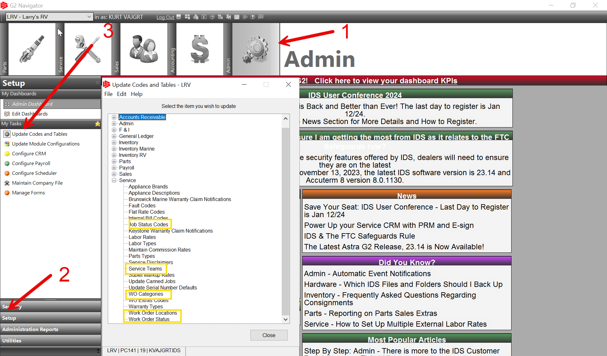
Service Workflow: Beginning-to-end for Service Advisors and Techni

Slide 7
Service CRM Setup
Setup is online through service 360 login
Servie Workflow: Beginning-to-end for Service Advisors and Techni

Slide 8
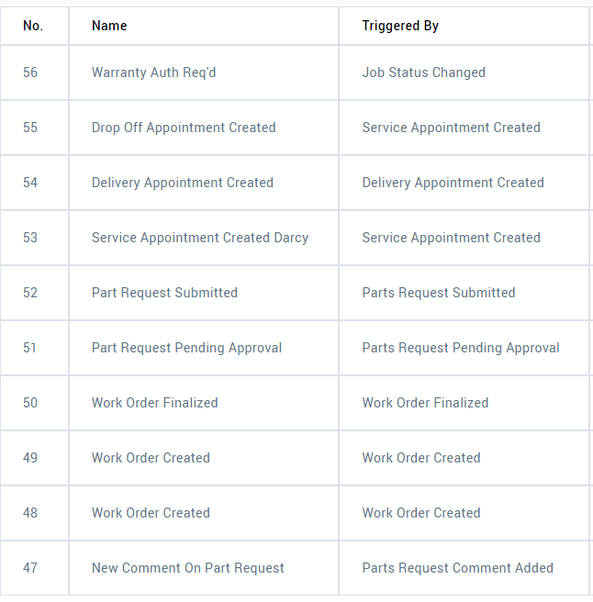
Service CRM Setup
Follow up Schedules – Text, Emails, Tasks
Changes to Wo Status, Labor, Comments,
Job status, appointments - auto text/emails
Text Customer
Email customer/appt owner
Task assigned to user/author

Slide 9
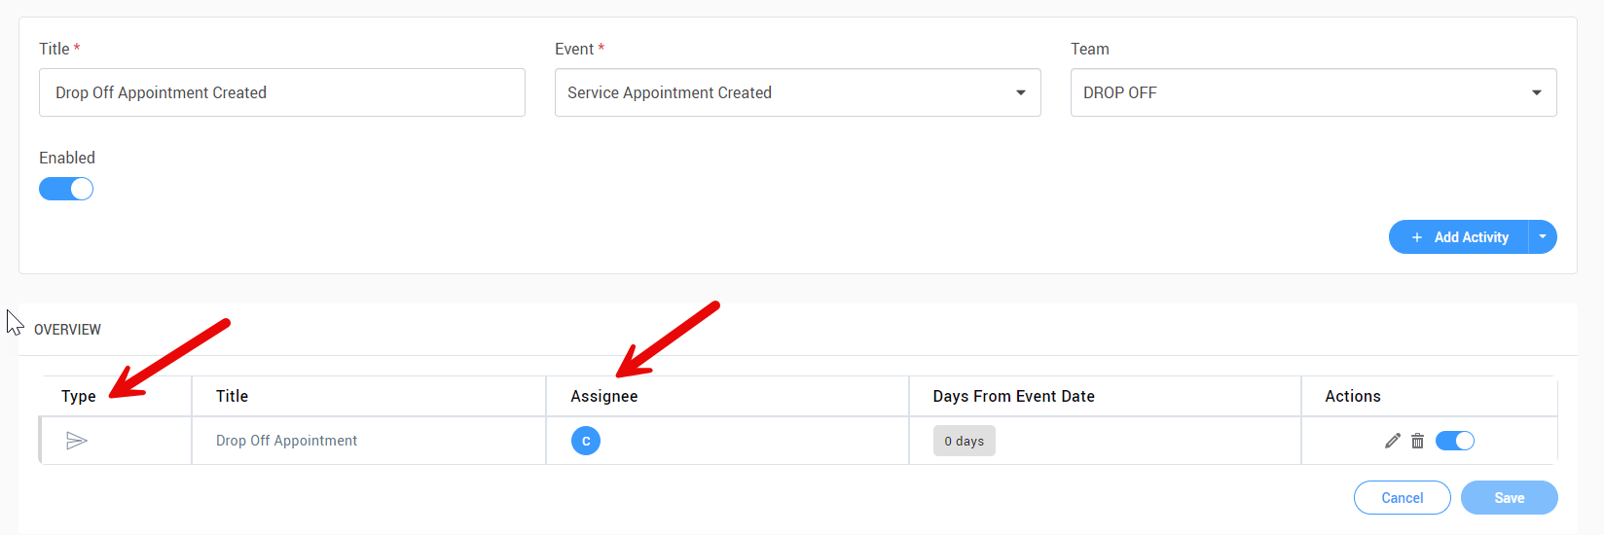
Follow up Schedule – Appointment - Team

Slide 10
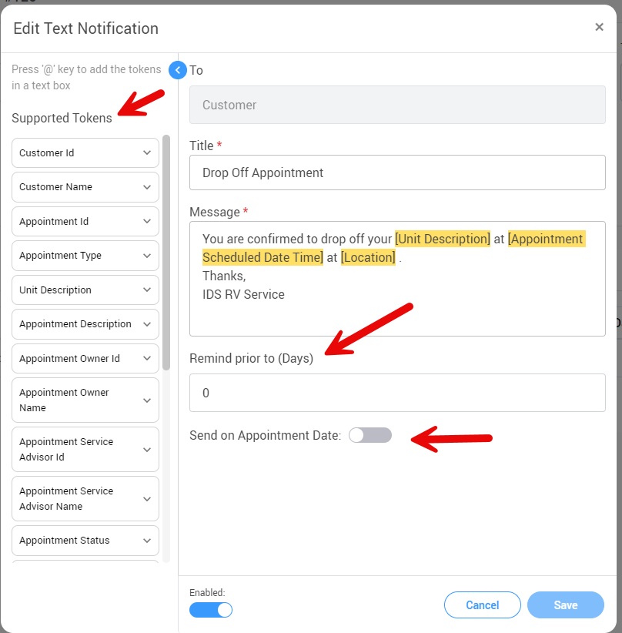
Follow up Schedule –
Appointment
Tokens
Sent on creation date
Reminder before Appointment
Confirmation of Appointment Change

Slide 11
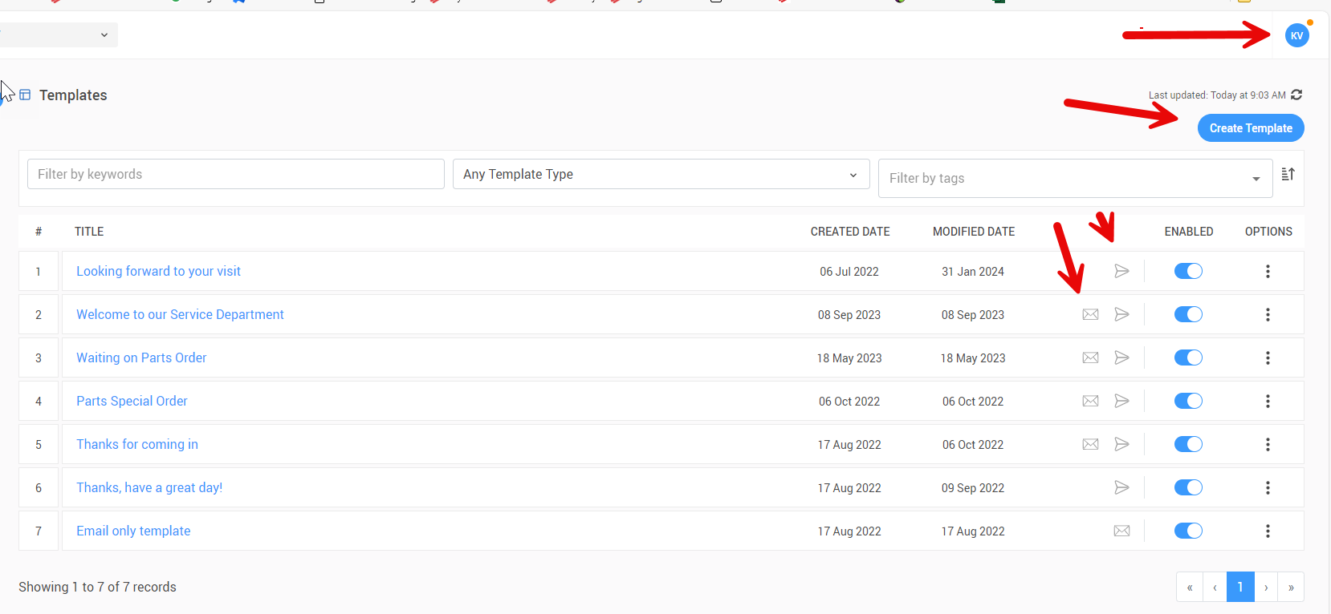
Service CRM Templates

Slide 12
Example - Service Workflow
CE CE
Post-Check In Review
and Assignment
(Service Advisor)
Appointment Booked
(Service Receptionist)
Preparation
(Service Advisor)
Check In
(Service Advisor)
Repairs Completed
(Service Technician)
Dispatch to Shop
(Shop Foreman)
Pick Up Appointment
(Service Advisor)
Parts not in Stock - Customer Updates Parts Status
(Service Advisor)
Not In Stock
Dispatch to Shop
(Shop Foreman)
Diagnosis
(Service Technician)
Close Work Order
(Service Advisor)
Work Completion – Parts in Stock
(Service Advisor)
Work Order Authorizations
(Service Advisor)
In Stock

Slide 13
Service Workflow – Customer Engagement
CE CE
Post-Check In Review
and Assignment
(Service Advisor)
Appointment Booked
(Service Receptionist)
Preparation
(Service Advisor)
Check In
(Service Advisor)
CE
Repairs Completed
(Service Technician)
Dispatch to Shop
(Foreman/Advisor)
CE
Pick Up Appointment
(Service Advisor)
Parts not in Stock - Customer Updates Parts Status
(Service Advisor)
Not In Stock
Dispatch to Shop
(Shop Foreman)
Diagnosis
(Service Technician)
Close Work Order
(Service Advisor)
Work Completion – Parts in Stock
(Service Advisor)
Work Order Authorizations
(Service Advisor)
In Stock
CE

Slide 14
AppointmentBooked
Create New Appointment
Input Customer, unit information, and customer complaints, Service Team
Service Team – Split Calendar – Text by Team
Service CRM - Auto text send to confirm/remind.
Set up text template
Scheduler – Email Appointment Reminder
Set up email Template

Slide 15
Preparation
Create New Appointment
Assign team when creating an appointment
Grouping – by service team – View 2 teams

Slide 16
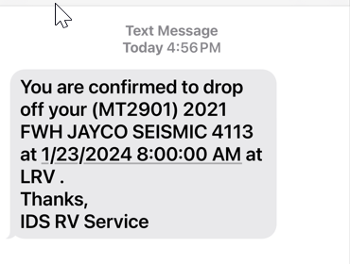
Preparation
Service CRM – Scheduled Text
Set follow-up schedules – auto text, email customer
Confirmation text
Reminder text
Text by Service Team
Drop Off
Pickup

Slide 17
Check In
Check in
Review appointment with customer.
Update additional complaints, if needed.
Convert appointment to work order.
Mobile - Walk around unit, capture photos, signature,
Email or print customer estimate – Document saved.
Communication – Welcome email – text CRM

Slide 18
Post Check In
Post Check In Review
Add labor required to jobs
Updated work order status

Slide 19
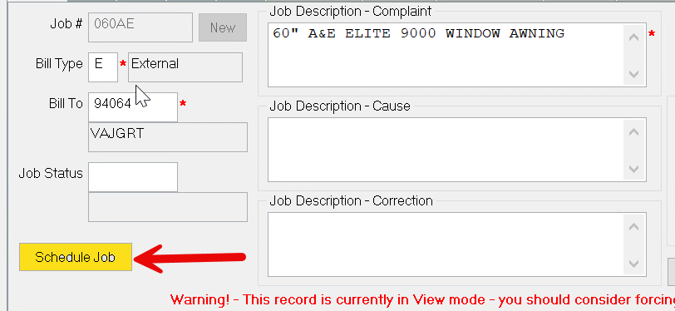
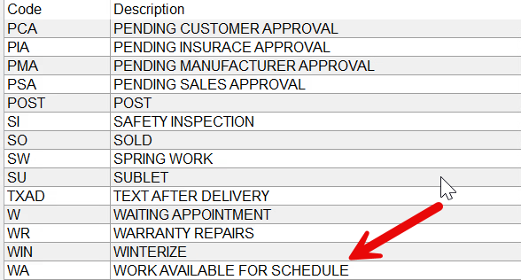
Dispatch
Dispatch to Shop
Sort Wo by WO status/Available Work
Click the Schedule Job – from the job

Slide 20
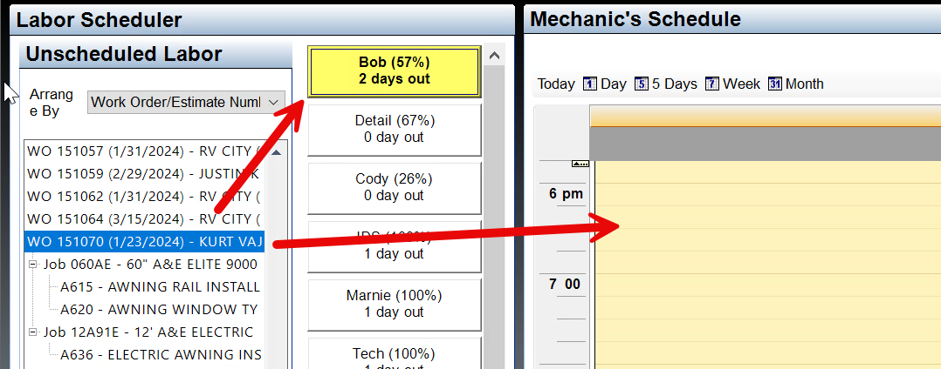
Dispatch
Dispatch to Shop
Select WO, job or labor line to schedule
Tech/Soft Schedule – Calendar – Set Start Time

Slide 21
Dispatch
Dispatch to Shop
Update WO Status
Promised Date

Slide 22
Dispatch
Dispatch to Shop – Service CRM
Feeds - Detailed view of wo changes
Task – Notifications
Updated Customer of Progress – text / email

Slide 23
Diagnosis
Diagnosis
Tech clock into job.
Create a part request if parts are needed
Update cause with recommended repair
Update Correction if job was completed- Clock out Done
Clock out – Pause, Hold Parts, Sublet, or Approval.

Slide 24
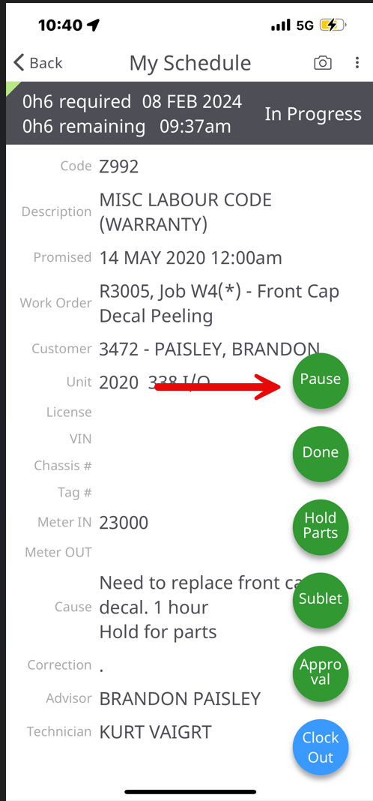
Shop
Tech Mobile
End of Day – In Progress
Lunch – In Progress
Logging into another Job
Break

Slide 25
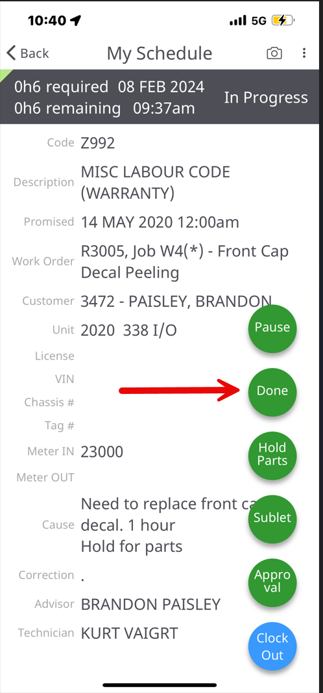
Shop
Tech Mobile
Diag Complete
Enter a period in correction
Job Complete – Enter Correction

Slide 26
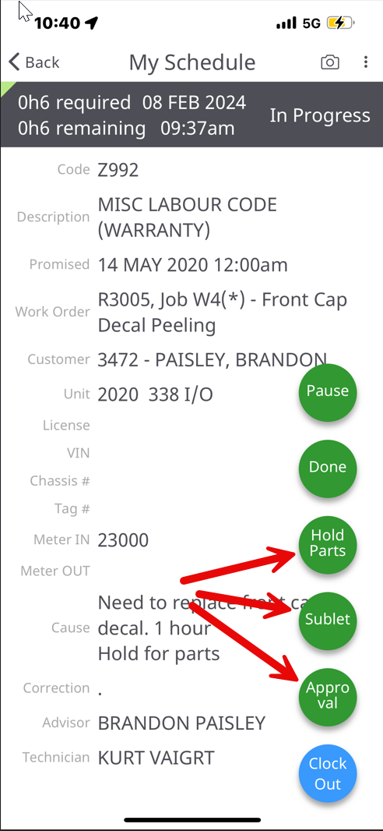
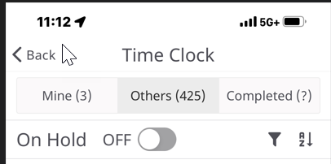
Shop
Tech Mobile
Repair – Diag In Progress
Need Auth/Parts/Sublet
Advisors manage hold Jobs
Open labor line

Slide 27
Shop
Pause, Hold, Approval, Sublet
Pause – No response required.
Sublet – needs to go to sublet shop.
Hold Parts – Fill out parts request form.
Approval – No Parts – Author should get approval
Done – Job Complete
Done – Diag Complete - Period in Correction Field

Slide 28
Foreman
/Author
Keep up with status changes
Run service report – wo jobs by job status report

Slide 29
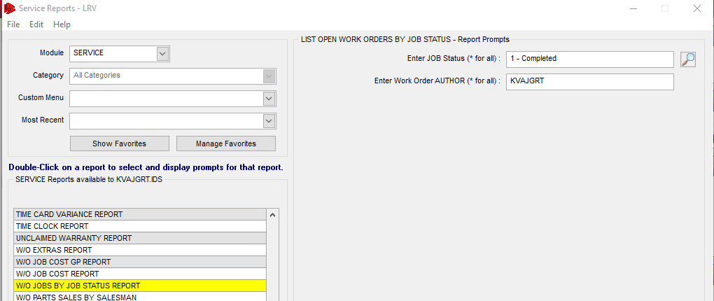
Foreman
/Author
Keep up with status changes
Run by job status and work order author

Slide 30
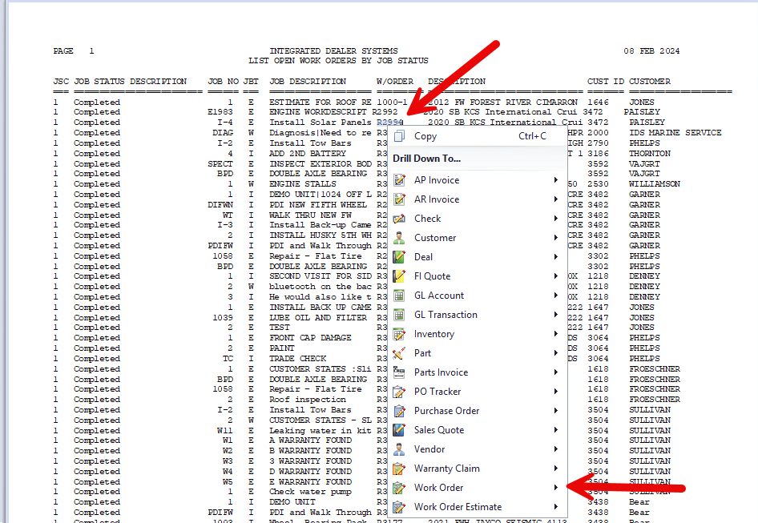
1- Job Complete
Drill into Jobs
Update and change
job status

Slide 31
Parts
Part Needed to complete Repairs
No More paper parts request forms
Photos uploaded from app
Description – Measurements
Urgent - notifications

Slide 32
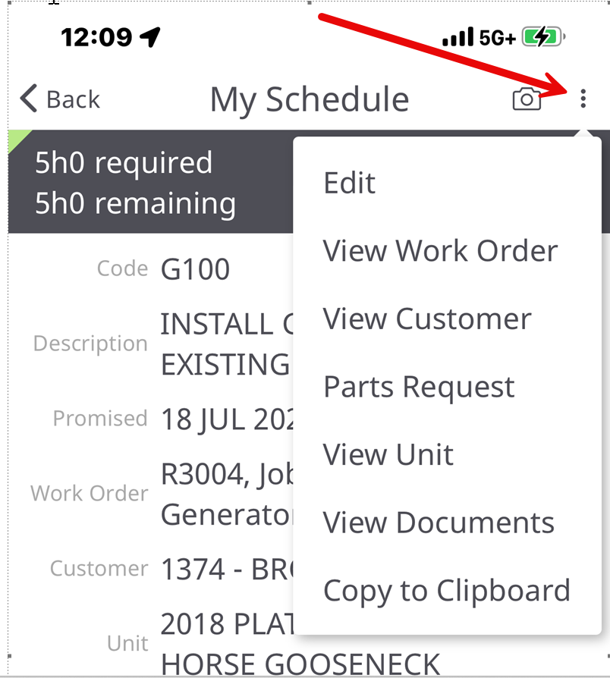
Parts
Part Request Creation
Parts Mobile
Clock out – Parts On Hold
3 Dots
Work Order
Parts Request

Slide 33
Parts
Part Request Pending
Unit Information - VIN
Mechanic – wo bill type

Slide 34
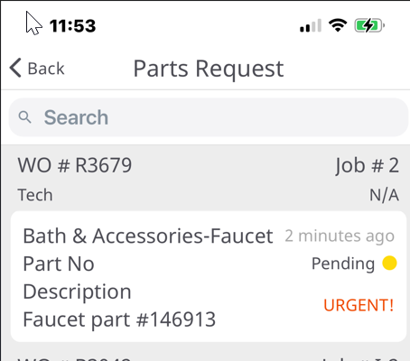
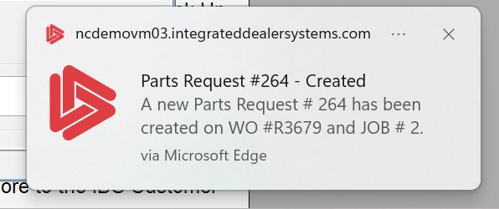
Updates
Keep up with status changes
Service CRM – Notification
Techs up to date on parts status

Slide 35
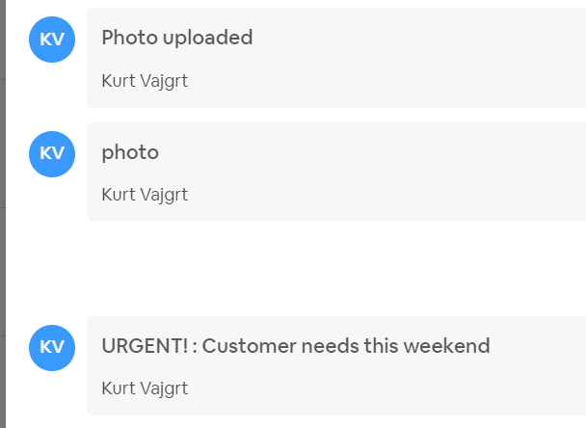
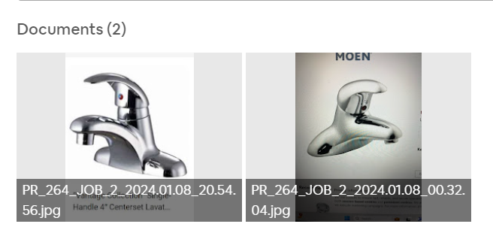
Parts
Part Request Pending
Photos uploaded from tech
Communication - comments

Slide 36
Parts
Part request – Pending Approval
Configure part type and sub types
Make and Model for appliances

Slide 37
Part Request
Part lookup/pull – Pending Approval
Part is added to WO as Required
Submitted from part request

Slide 38
Parts
Part lookup/pull – Approved
Special Order created when Loaded in SO/WO Tab
Status of part request updated with wo activity

Slide 39
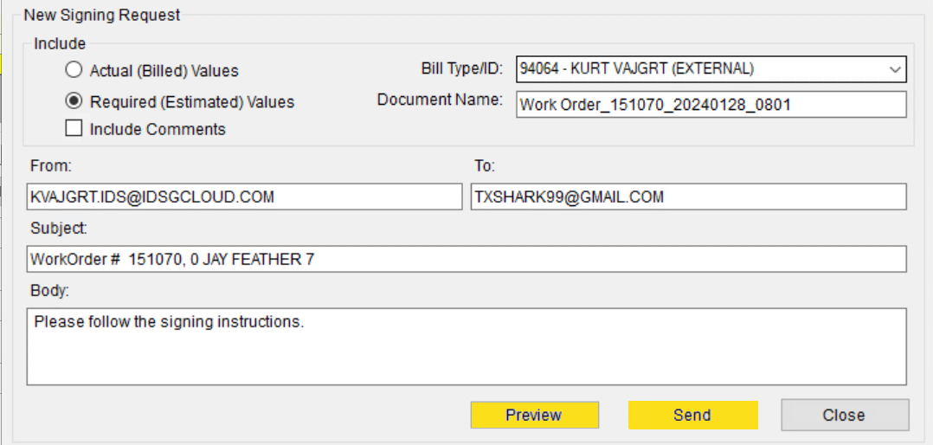
E-sign
Get Approval for Repairs – E-sign
Send E-sign approval request from wo/Estimate
Required Values

Slide 40
E-sign
Get Approval for Repairs – E-sign
Tracks signing request history
Saves a signed copy in document folder

Slide 41
Parts
Part Request – Part Ordered
Parts creates a PO – load SO part.
Updated expected receive date on PO.

Slide 42
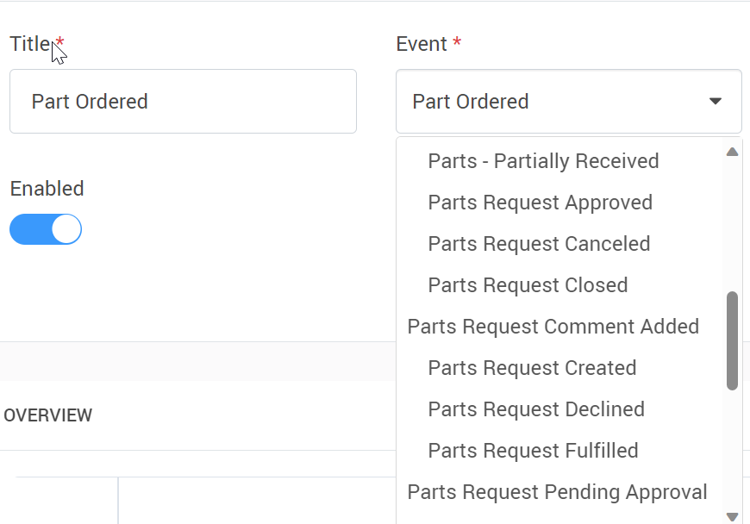
Parts
Part Request – Emails, Texts, Task
Schedule alerts through the PRO process

Slide 43
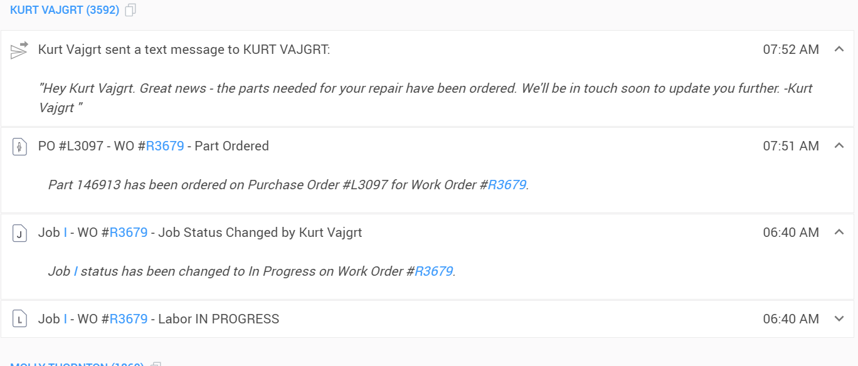
CRM
Feeds
Wo Updated – CRM Feeds Real Time

Slide 44
CRM
Feeds
Wo Updated – CRM Feeds Real Time
Part Ordered
Part Received Partial – Full
WO Manager – All Parts Received
All jobs Done

Slide 45
Parts In
All Parts Received
Ensure parts received are correct/ not damaged
Update WO with Required Time.
Email/Text Customer that parts are in.
If unit is in house, priority to shop.
Updated the Wo and Job status
Update job comments

Slide 46
Dispatch
Prep Wo for Dispatch
Add Required Labor – Approved Labor Code
Parts are place in SO Bin, update note in WO comments
Dispatch to Shop with Job Scheduler Update WO Status
Tech punches in and completes job with appropriate cause/correction and photos then clocks out "Done"

Slide 47
Shop Foreman/QC
All Jobs Complete
Quality Control Check Change WO & Job Status
Advisor Reviews all jobs, bills labor/parts/extras, approves tech notes. Change WO & Job Status
WO Status Change – Auto Text Customer, Unit Ready
Schedule Pick up appointment
Finalize WO when work complete or upon Customer Pickup

Slide 48
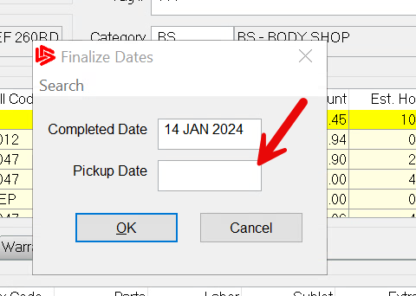
Pickup
Customer Pick up
Review jobs, tech cause, correct, billing
Customer work order
Get signature
Update WO Pickup date – Service Config 189
Function – Finalize WO

Slide 49
Service Workflow - Complete
CECE
Post-Check In Review
and Assignment
(Service Advisor)
Appointment Booked
(Service Receptionist)
Preparation
(Service Advisor)
Check In
(Service Advisor)
Repairs Completed
(Service Technician)
Dispatch to Shop
(Shop Foreman)
Pick Up Appointment
(Service Advisor)
Parts not in Stock - Customer Updates Parts Status
(Service Advisor)
Not In Stock
Dispatch to Shop
(Shop Foreman)
Diagnosis
(Service Technician)
Close Work Order
(Service Advisor)
Work Completion – Parts in Stock
(Service Advisor)
Work Order Authorizations
(Service Advisor)
In Stock

Slide 50
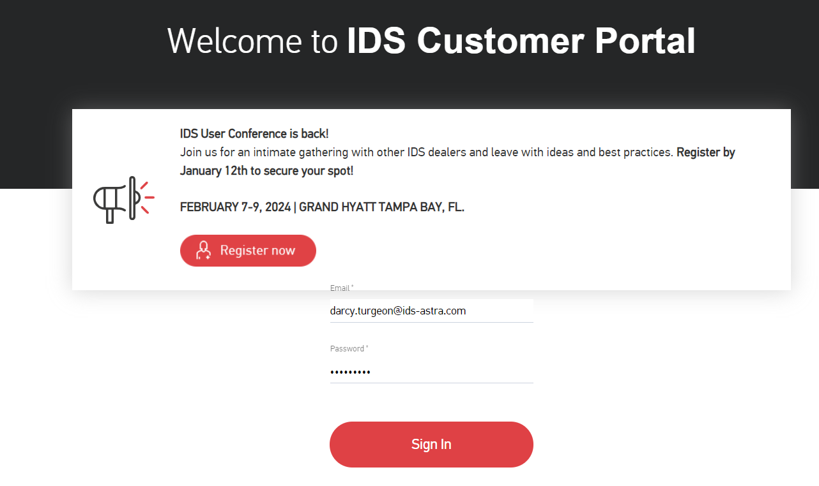
How to get Support Help
The best way to get support is to sign up on the IDS Portal website,
Visit: https://portal.ids-astra.com/login
Here you can register to send in a support ticket and access the vast amount of online reference materials.

Slide 51
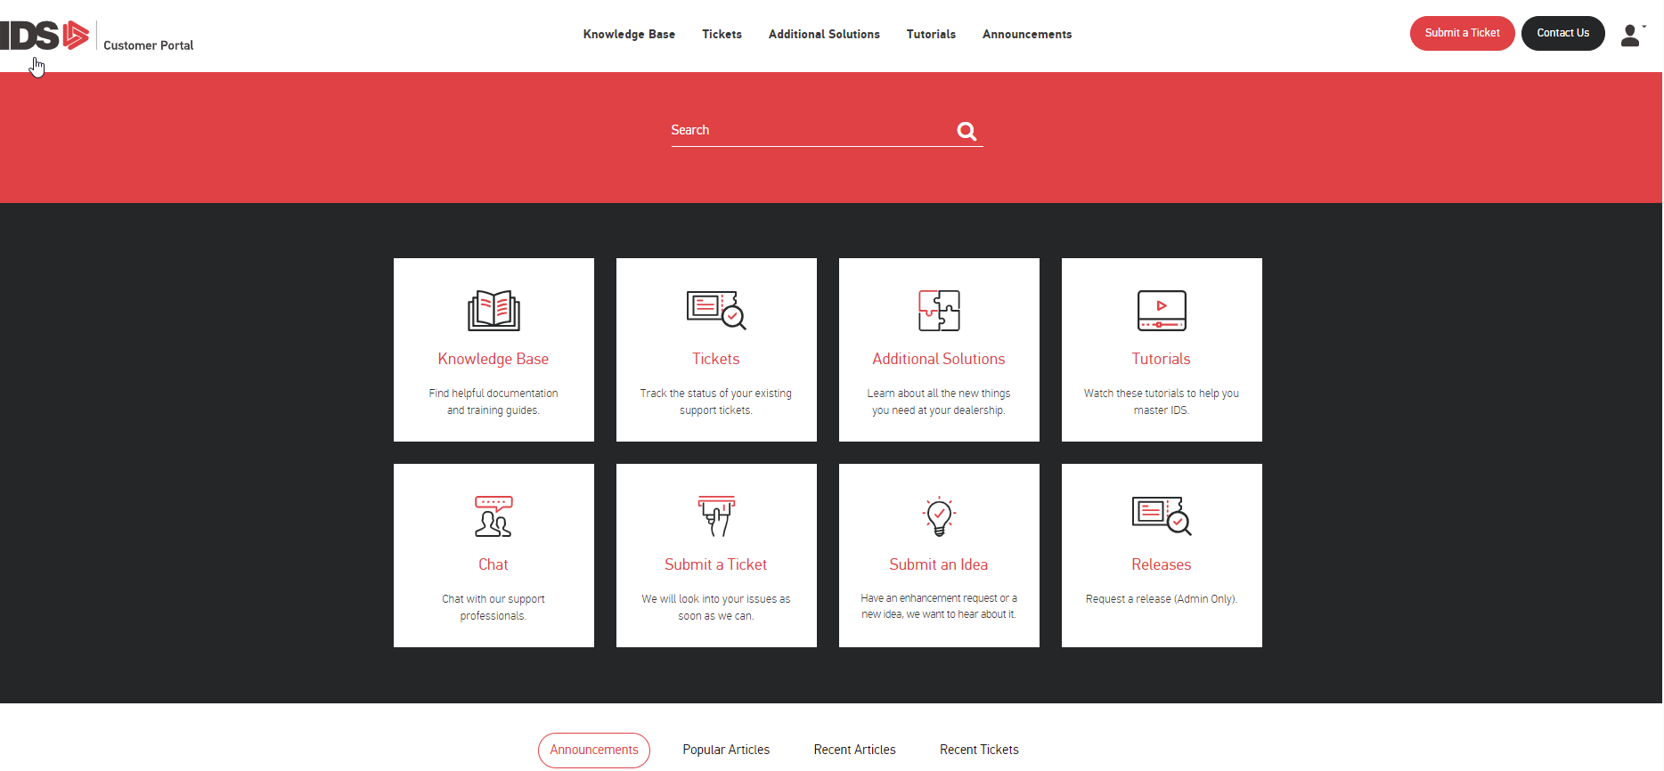
How to get Support Help

Slide 52
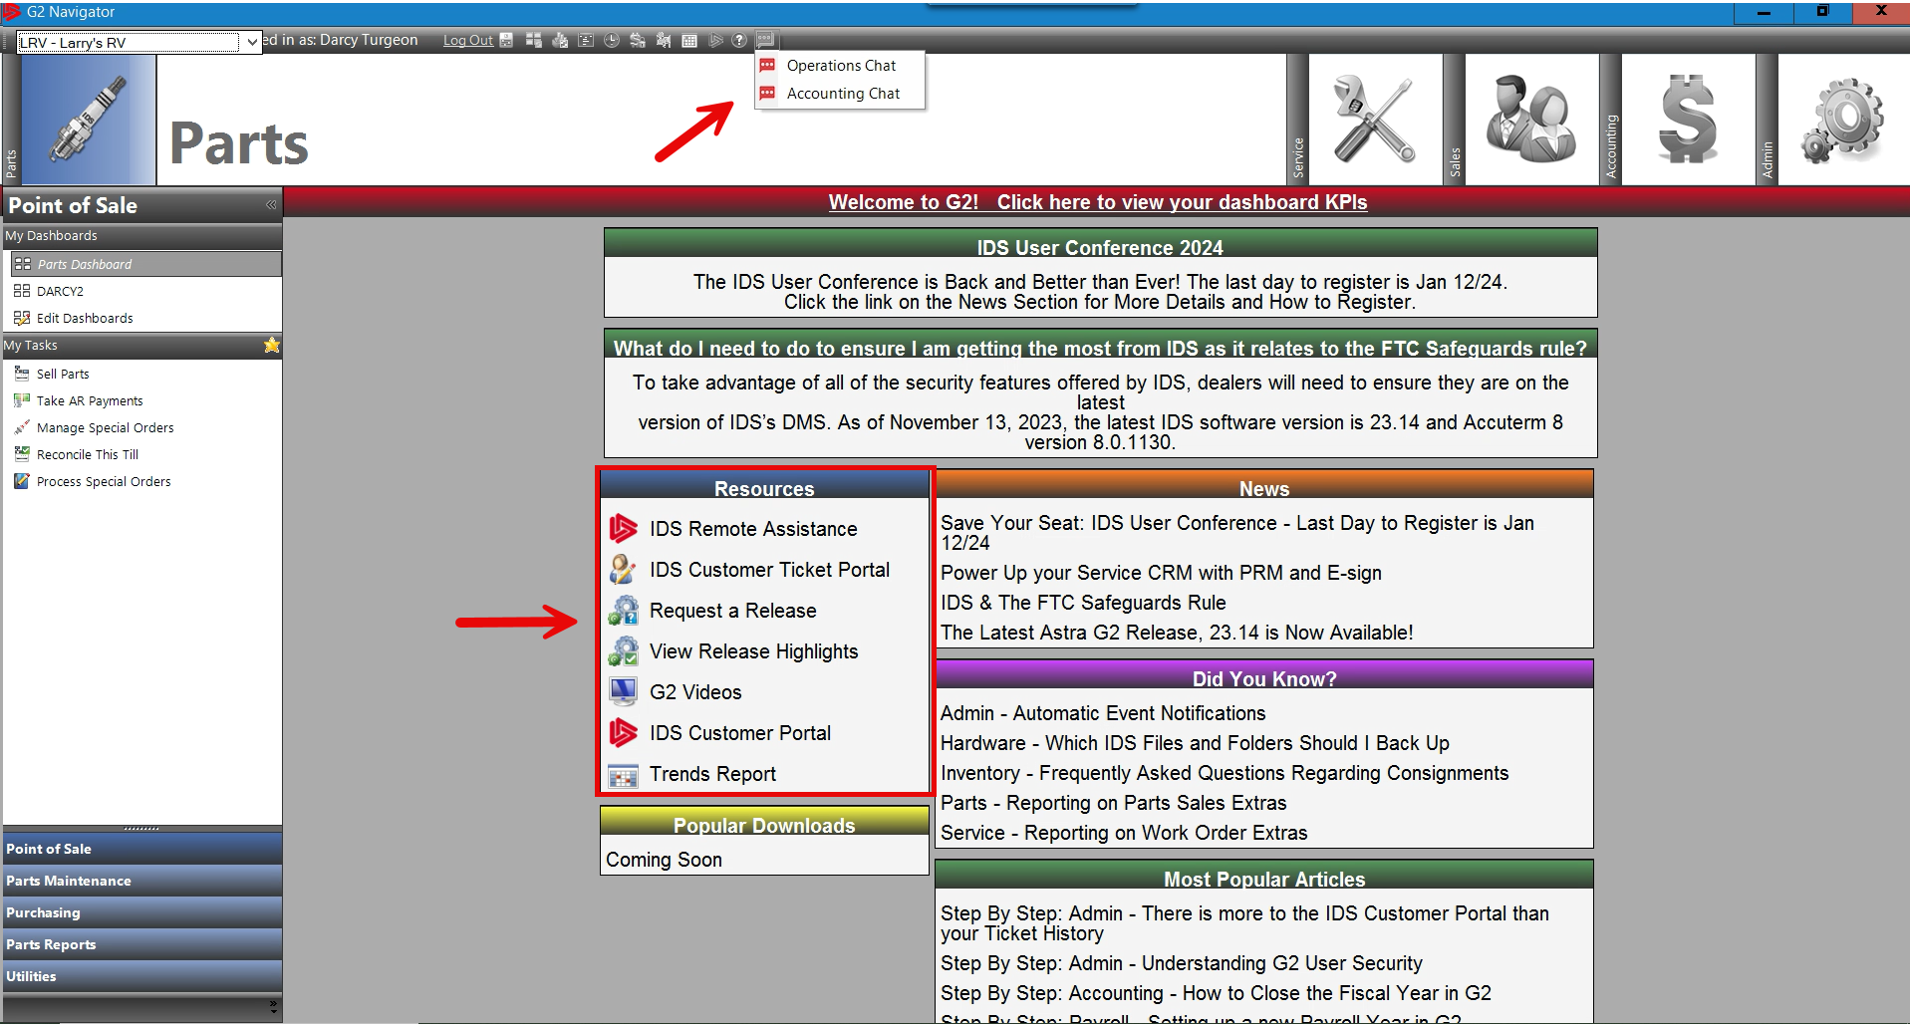
How to get Support Help

