Slide 1
Sales CRM Online
February 2024

Slide 2
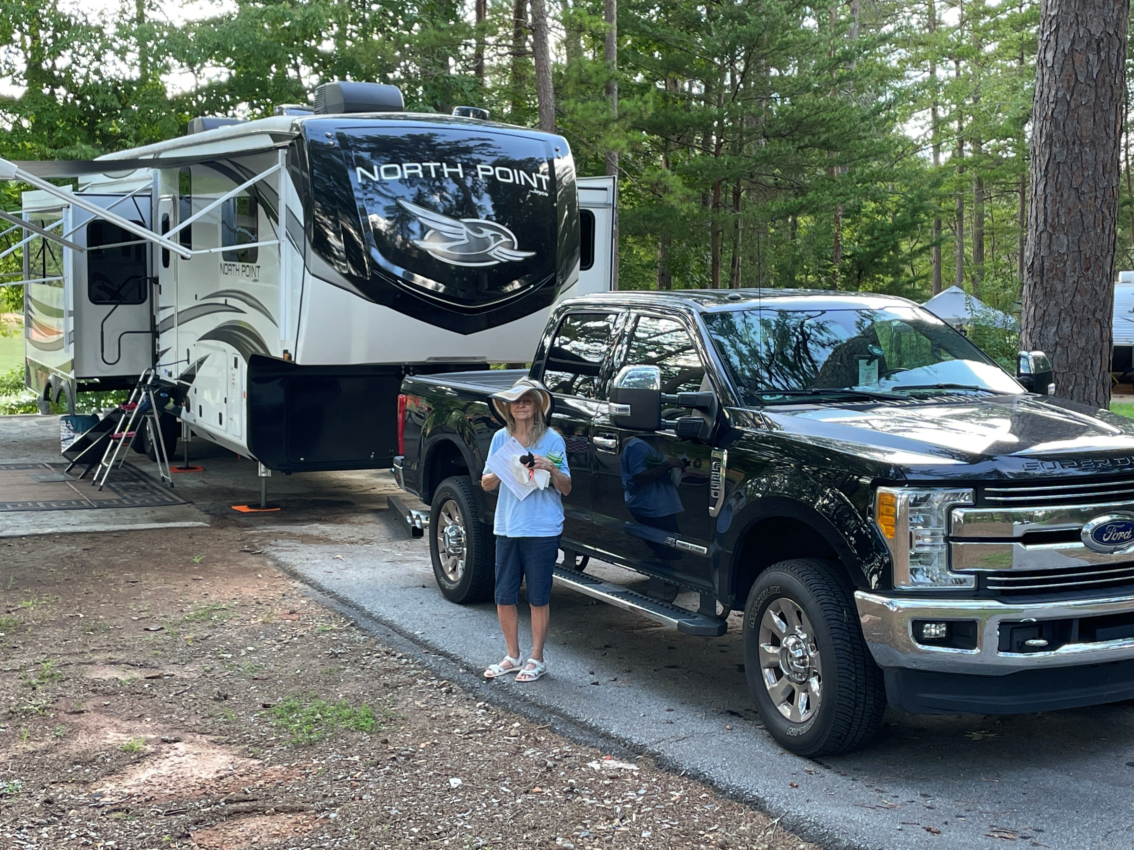
My name is Mark Berggren
Professional Services Account Team
Gray Court, South Carolina
My Background
12 years in the drug & grocery industry with Skaggs & Albertsons.
39 years in the RV & Marine industry.
* 12 years “Leisure Time RV” as a Finance Manager / Assistant Sales Manager.
* 12 years with an IDS marine dealer as their System admin for their southeast region.
* 15 years experience working directly for “Integrated Dealer System” IDS.

Slide 3
Will there be time during these 2 days for any one on one with an IDS representative in regard to these topics ?
YES…. See Kimberly Schultz during any break and she will try and arrange a meeting time for you.

Slide 4
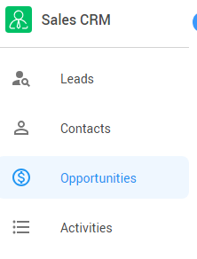
The Sales CRM menu bar has 4 distinct workflows
Sales CRM Online
Leads
Contacts
Opportunities
Activities
Go to “Leads” to review any Leads that have not been Qualified yet and your traffic
Go to “Contacts” to review your contacts by Last Activity Date & Next Activity date to ensure nothing has slipped thru the cracks
Opportunities is where you store what your customers/prospects are looking for
Go to “Activities” to review your scheduled Follow Ups for today

Slide 5
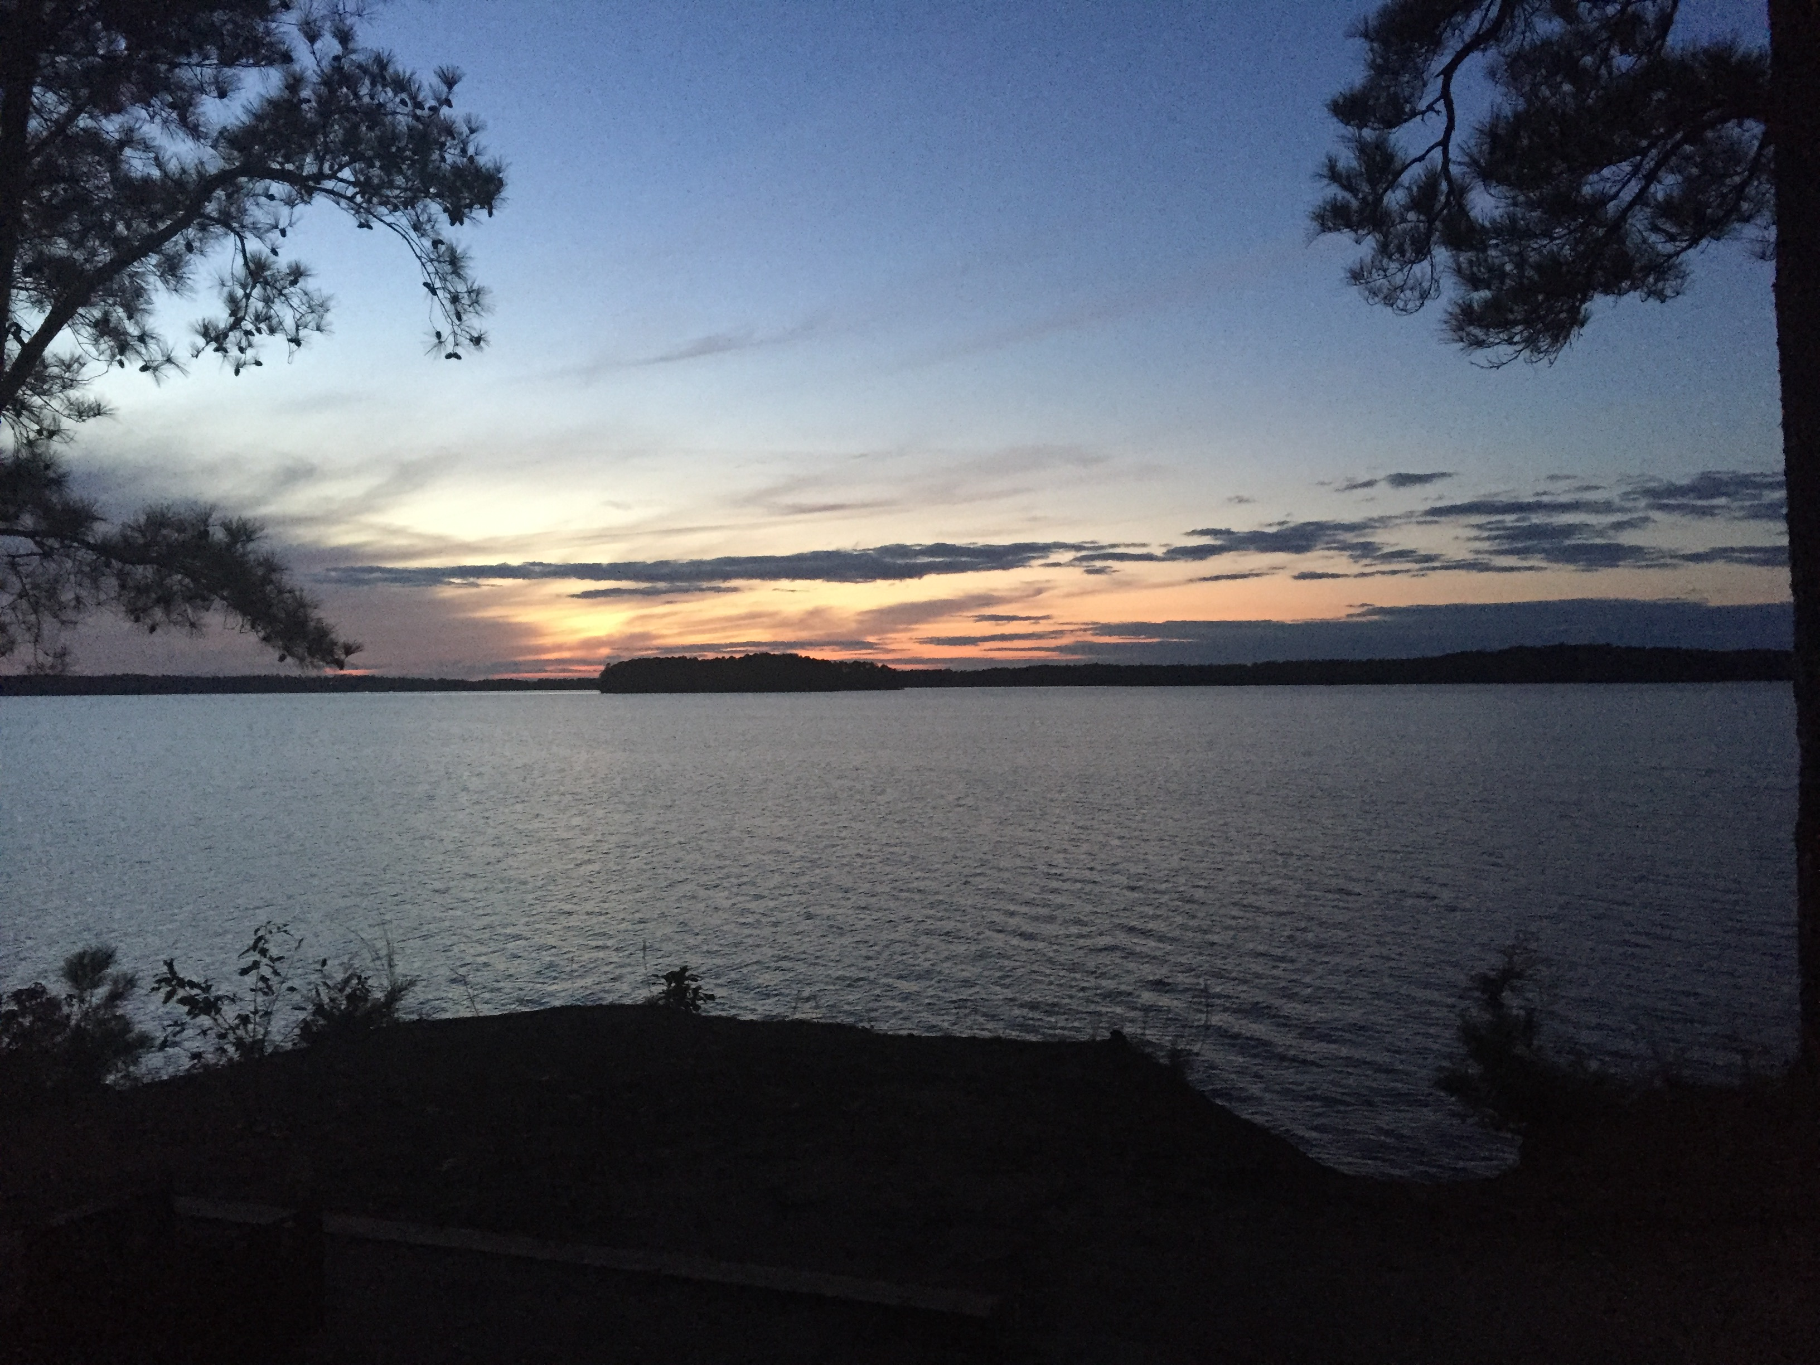

Slide 6
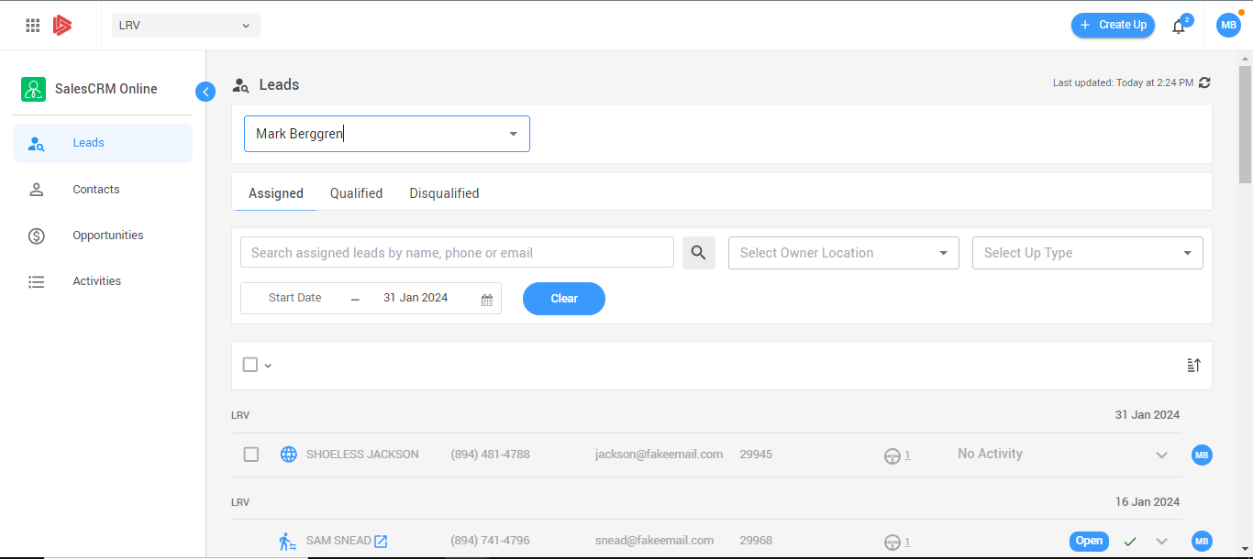
The Leads Tab: Assigned Web Leads and Lot Traffic

Slide 7
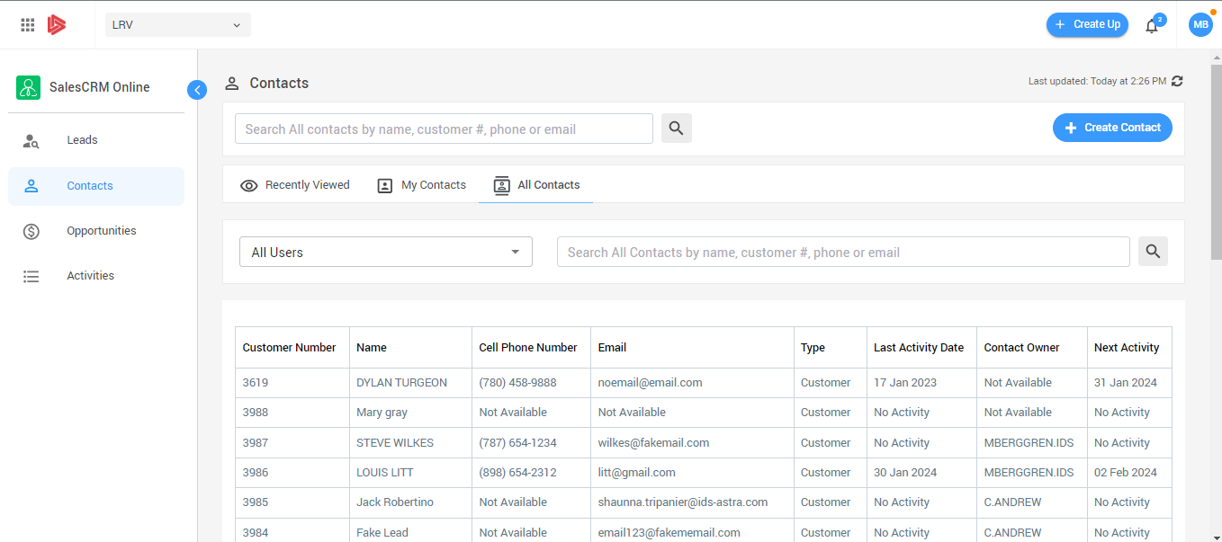
The Contacts Tab: Recently Viewed, “My Contacts” “All Contacts

Slide 8
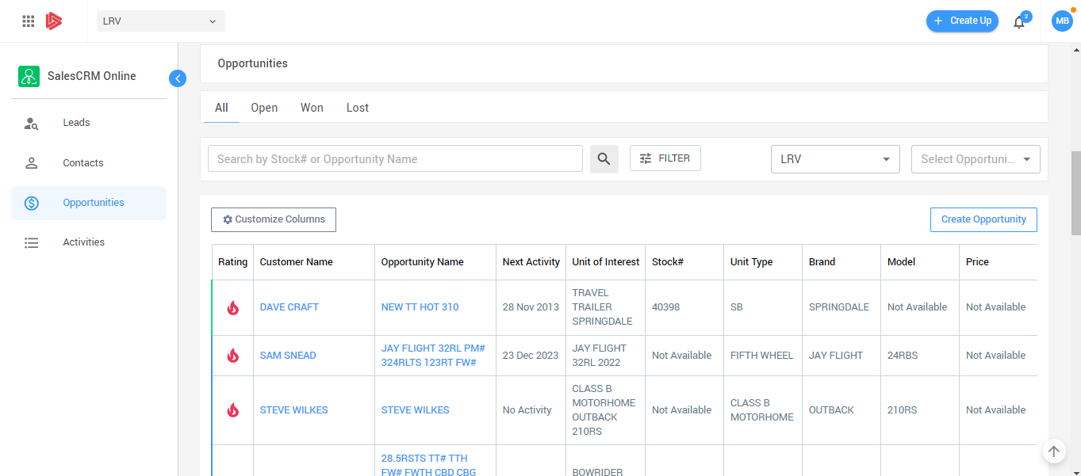
The Opportunities Tab: Listing of what your Customers are looking for.

Slide 9
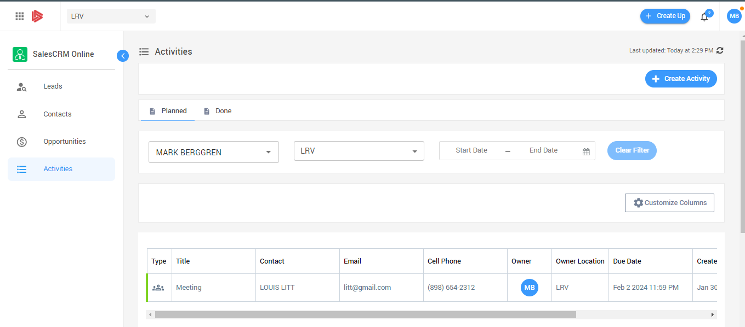
The Activities Tab: Listing of your Planned & Done follow Ups

Slide 10
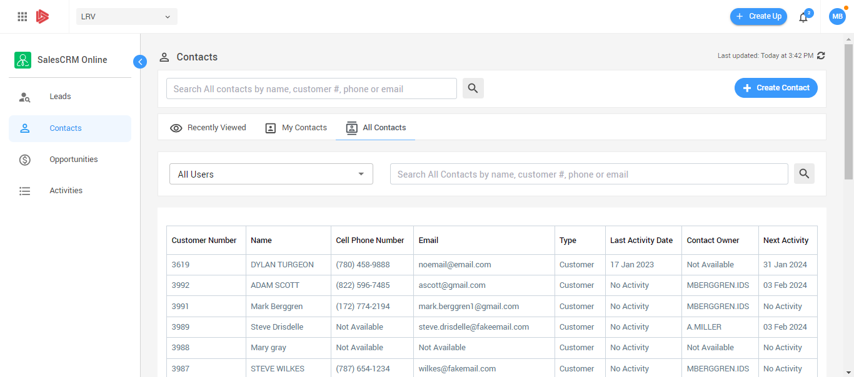
Everything starts with “Create Up”

Slide 11
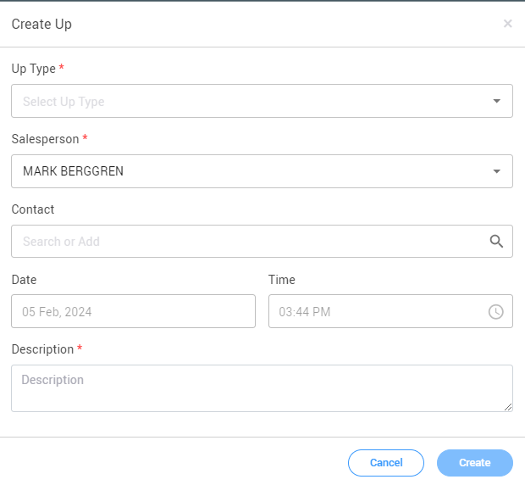
This 1 click wizard will create both a Contact and an Opportunity record.

Slide 12
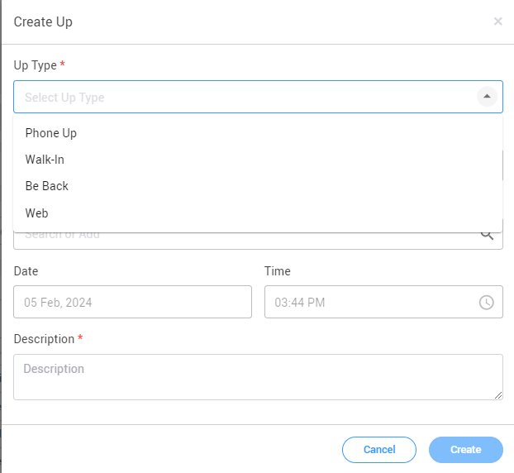
1st Select the type of “Up”

Slide 13
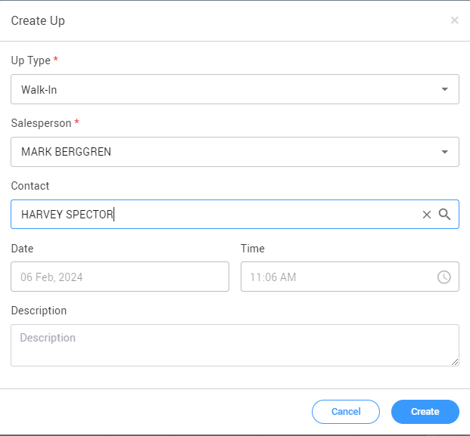
Find or Create Contact

Slide 14
Click Create….

Slide 15
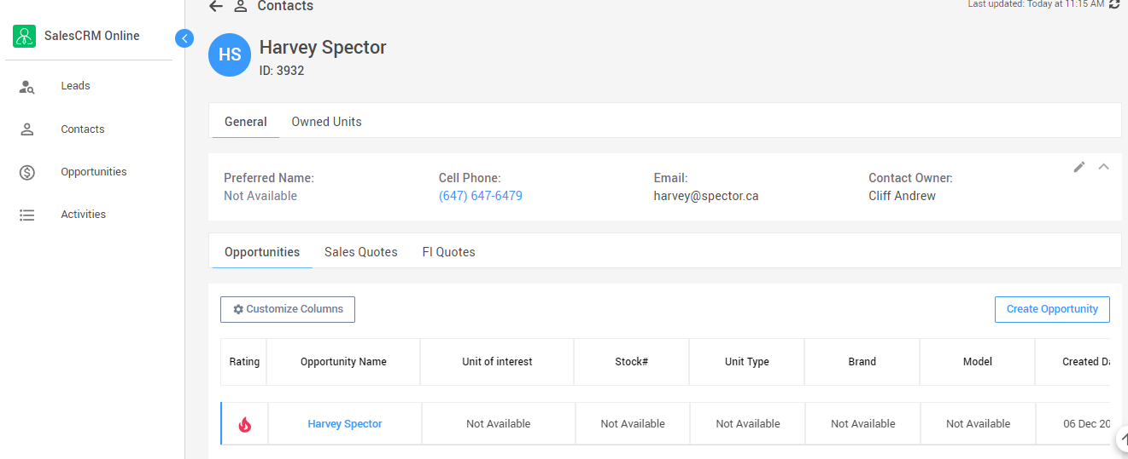
Your Contact & Opportunity !

Slide 16
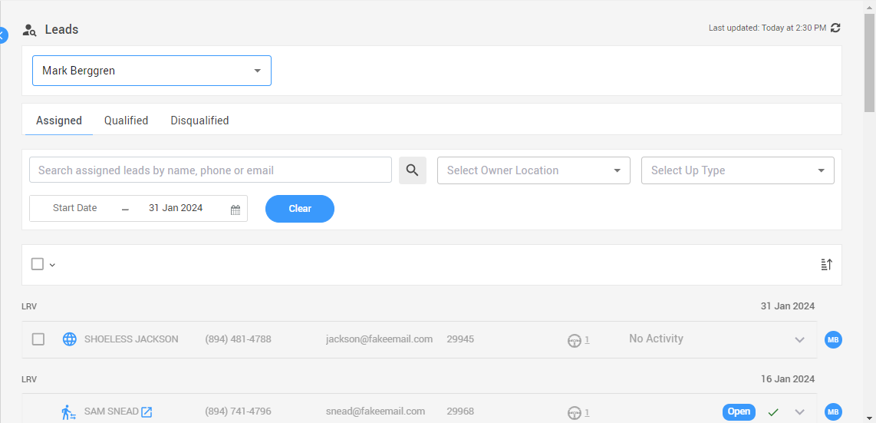
Now what is being shown in the “Leads Tab” ?
New Web Leads
Phone Ups
Walk-Ins
Be-Backs

Slide 17
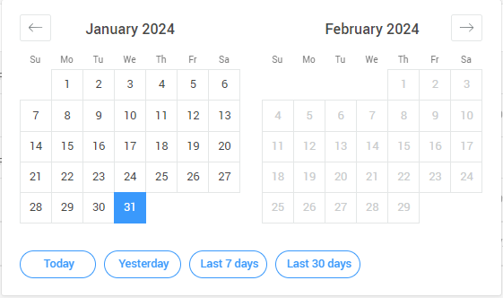
You can filter your data by
A pre-define date range or use the calendar to filter by a custom date range

Slide 18
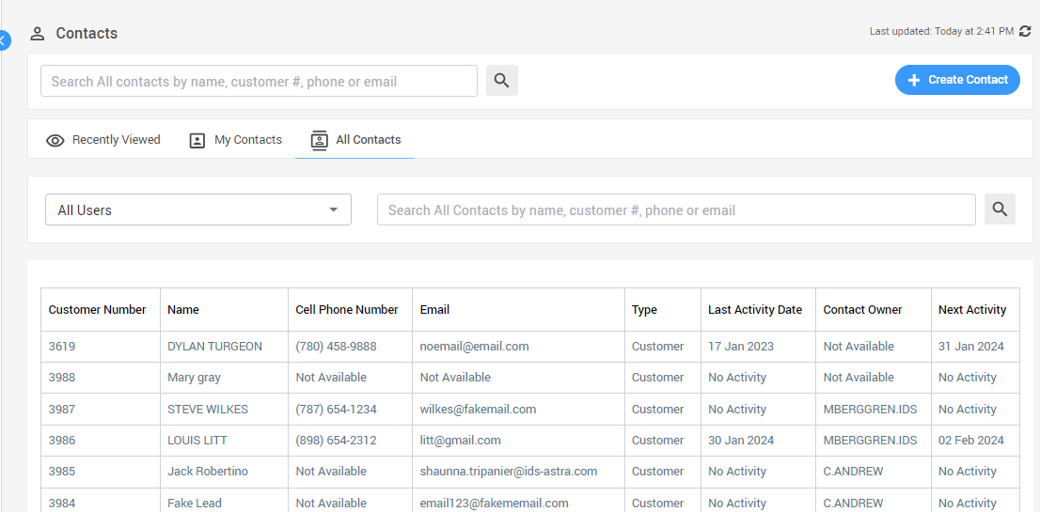
The “Contacts” tab
Easily view your contacts by pre-defined filters
Always make sure your up to date with your contacts.

Slide 19
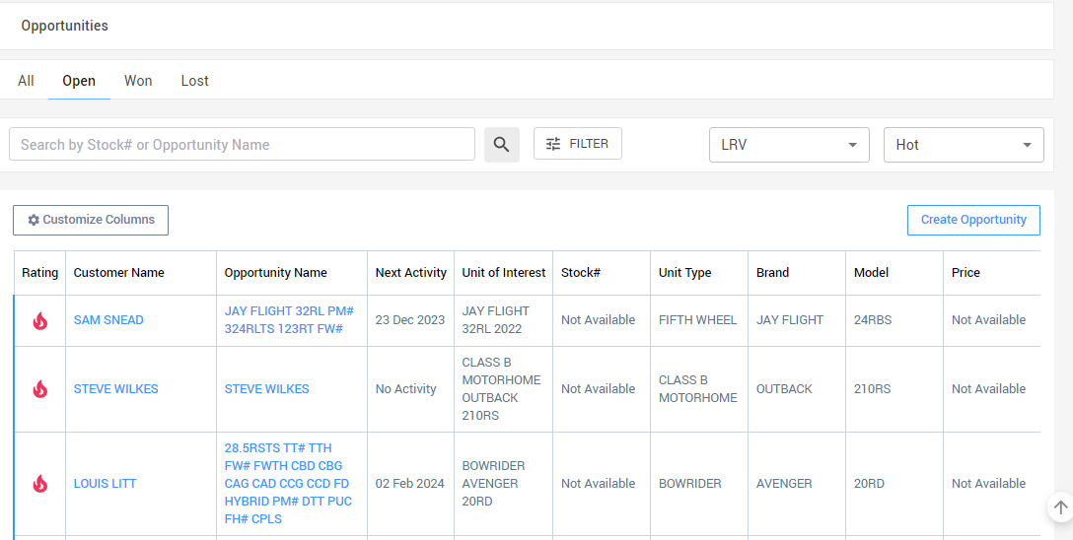
The “Opportunities” tab
View your Sales Opportunities by All, Open, Won or Lost
Notes:
Click on an Opportunity name

Slide 20
The “Opportunities” tab
View your Sales Opportunities by Hot, Warm or Cold with a click of the drop down
Notes:
Click on an Opportunity name

Slide 21
The “Opportunities” tab
Note: Any text in Light Blue is a hyper link
Notes:
Click on an Opportunity name

Slide 22
The “Opportunities” tab
Let’s click on a Opportunity and look at the “Details”.
Notes:
Click on an Opportunity name

Slide 23
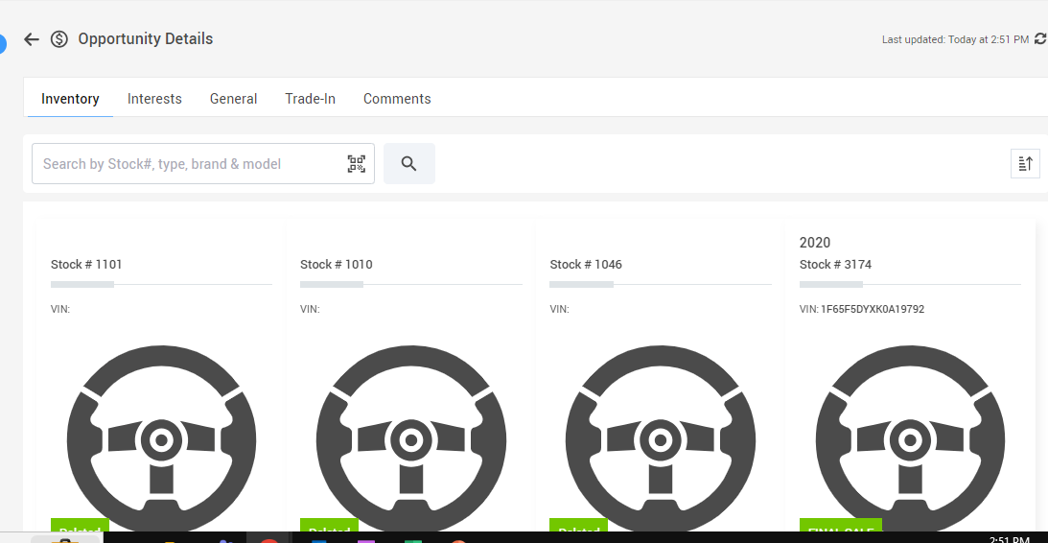
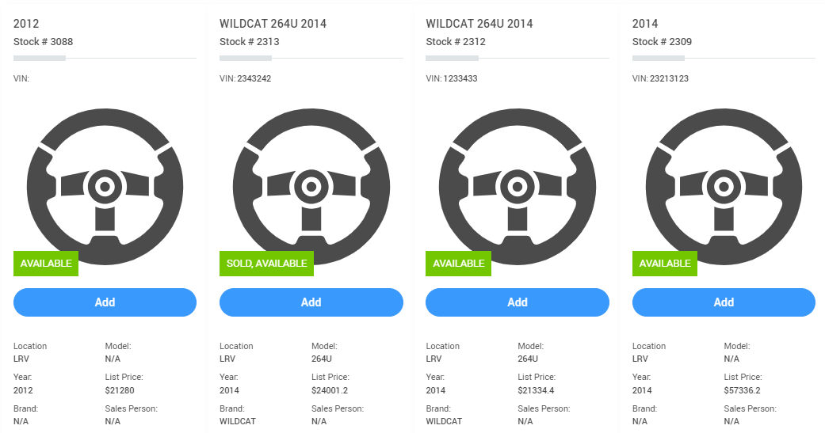
The Inventory tab is a listing of your inventory, just click the Add button to add it as a unit of interest for your customer

Slide 24
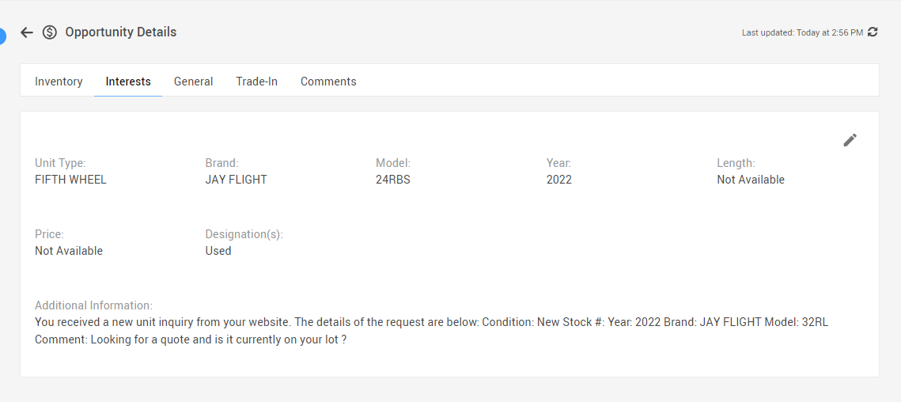
The Interest tab is where you can add a unit of interest for your customer by description…
(no stock number needed)

Slide 25
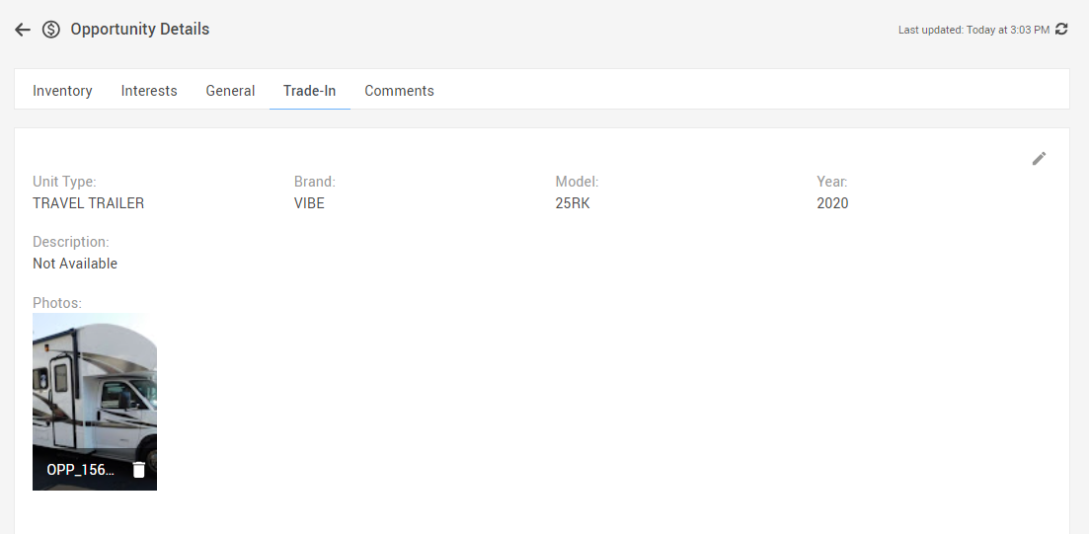
The “Trade-In tab” is where you edit information about the customer’s trade & even add pictures of it.

Slide 26
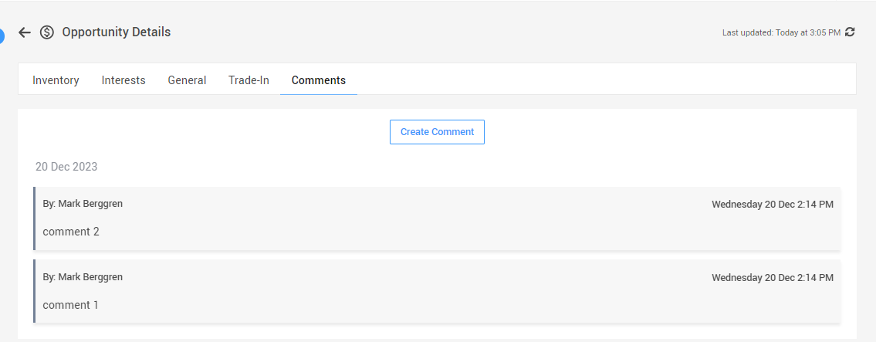
The “Comment tab” is where you add comments about what is going on.

Slide 27
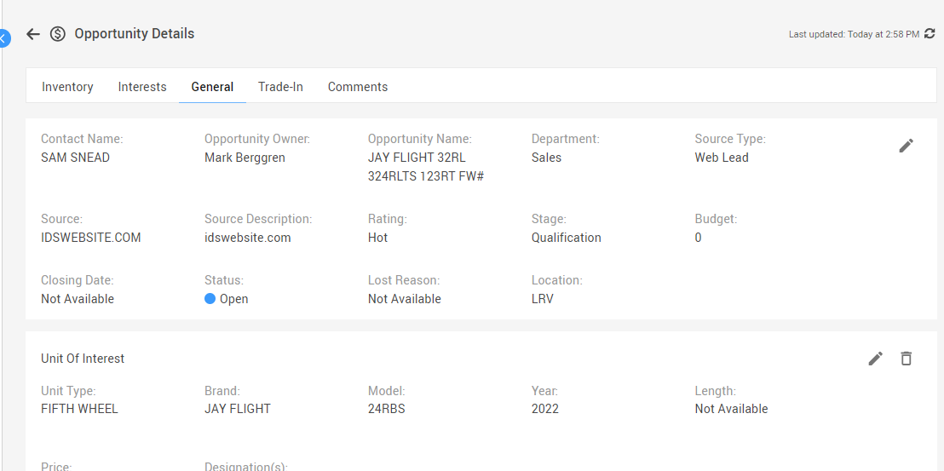
The “General tab” is where you edit information about the customer or what they are looking for

Slide 28
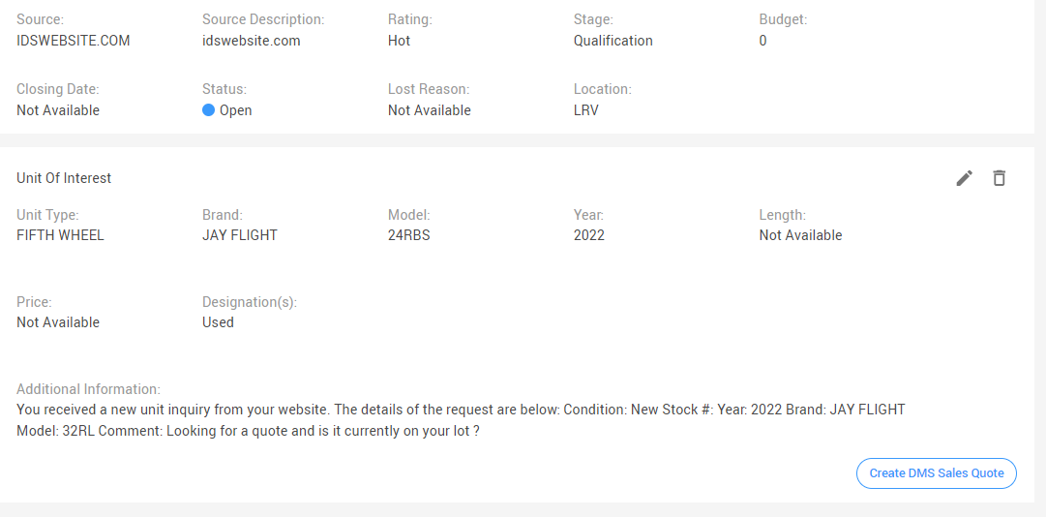
The “General tab” Also where you can create a “Sales Quote”

Slide 29
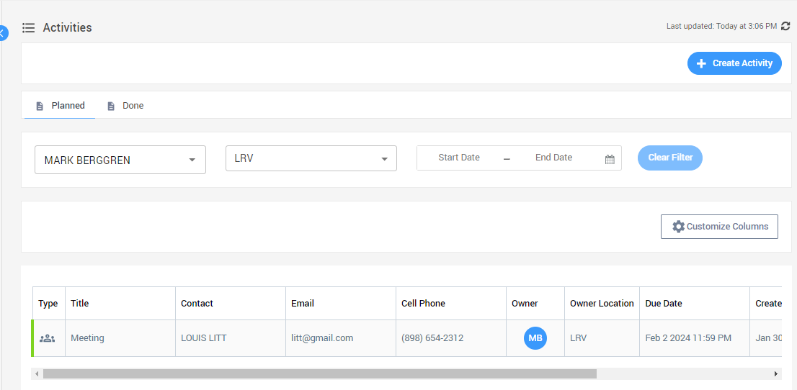
The “Activity Tab”
At anytime you can see any activities you have created or completed

Slide 30
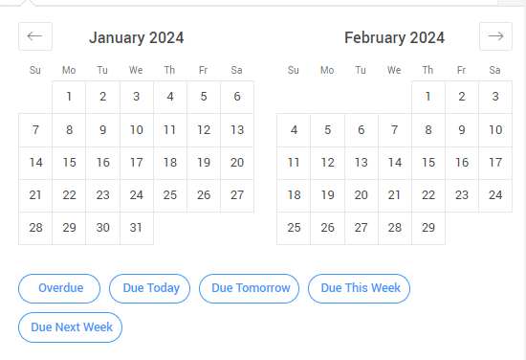
The “Activity Tab”
You can view your follow ups by handy predefined Date range’s

Slide 31
The “Activity Tab”
You can view your follow ups by handy predefined Date range’s
Or create a custom date range

Slide 32
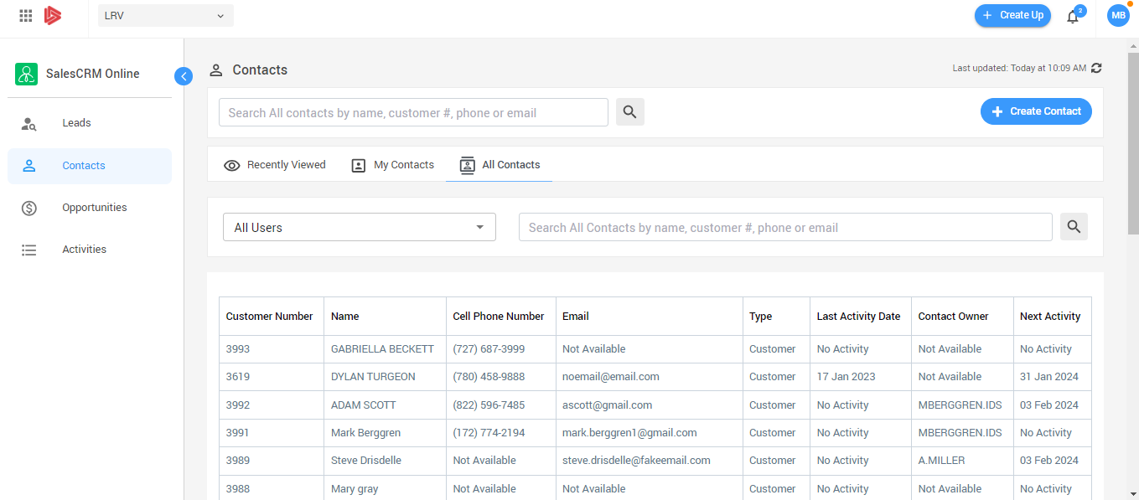
Let’s go to Sales CRM Online...

Slide 33
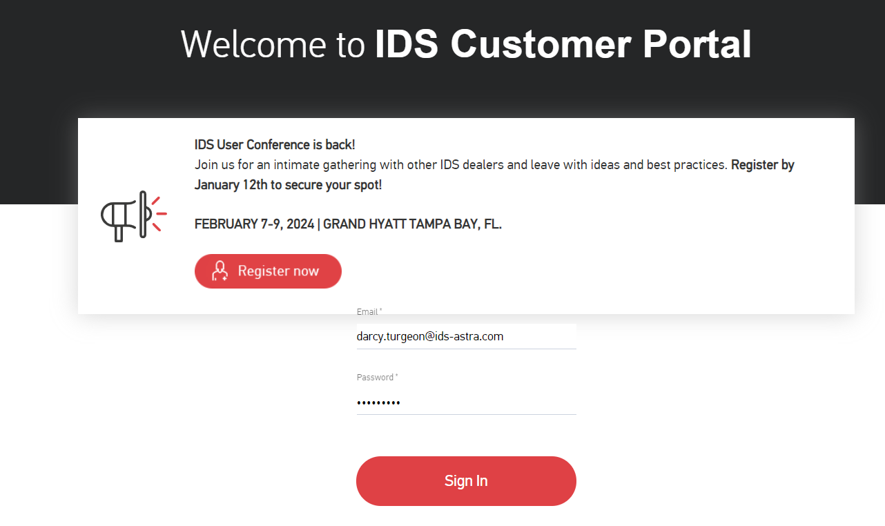
How to get Support Help
The best way to get support is to sign up on the IDS Portal website,
Visit: https://portal.ids-astra.com/login
Here you can register to send in a support ticket and access the vast amount of online reference materials.

