Slide 1
Efficient Warranty Claims Submission
Feb, 2024

Slide 2
Kevin Gribble
Account Manager

Slide 3
My background
Started as Warranty Admin
Moved to running Warranty Department
Focused on warranty dollars
Averaged Warranty Receipts (Cash in the door) 250k – 300k per month with 27 bays
Less than 10% shortage on average
When we were bought by a national brand, my team was the number 1 producer within the company with 17 locations. I was competing with a major store with over 100 service bays
Warranty department for a 2-location dealership
5 Admins
3 Claimers
1 PA Person/Check In Specialist
1 Dedicated PA person
Notes:
Define your sweet spot & build targeted list

Slide 4
Warranty is Not the Caboose!!
Business
Training
Reporting
Accountability
Ownership

Slide 5
Warranty as a Business
Warranty should be function of AR not a Service Department’s trash can
Warranty should be run like it’s a customer
Warranty has “say” in the process
Warranty has a piece in closing tickets
Reporting, Reporting, Reporting – Warranty, Manager, and Ownership
Specialization of labor – How much money do you lose because of expertise drift
Yearly rate increases

Slide 6
Warranty as a Business cont.
Manufacturer Relationships
Become a trusted partner of the manufacturer
Relationships
Pencil Lots and the fear of the Manufacturers
Regular communications
Understanding the business of Manufacturers (structure, people, who is where, and family)
Routes for escalation
Rules of those Manufacturers

Slide 7
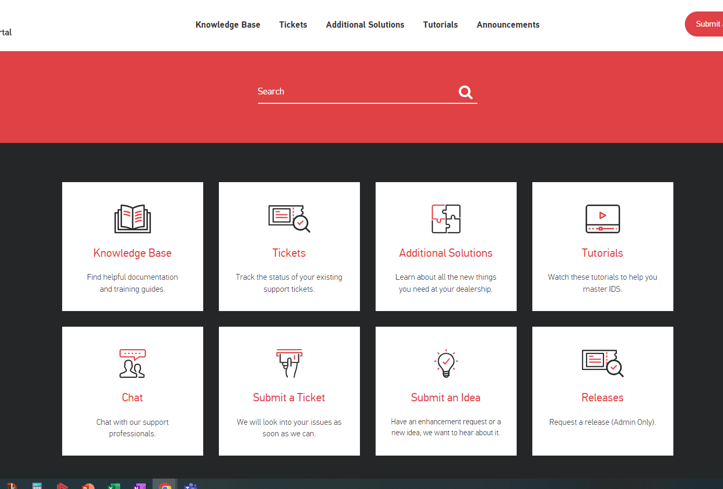
Training
Warranty Department
SmarterU and Service Workbook
MFG training portals
Customer Portal
Techs
New Tech – Day 1 Training, 30-day training, Hand off Training
Intermediate - Tech – Understanding of the portals and the “why”
Expert Tech – PA training and MFG related training (Team PDI’s)
Advisors – Incentivize Warranty

Slide 8
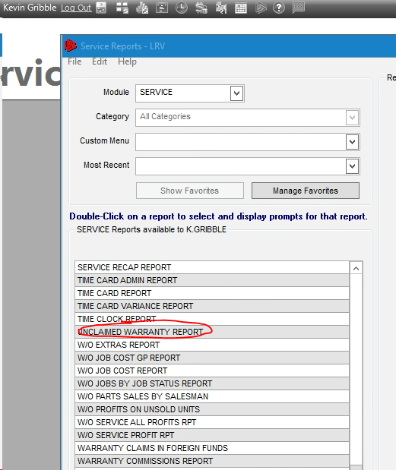
Reporting
Unclaimed Warranty Report
Setting up a benchmark
Aged Receivables Wide
Financial Report Access
Warranty Shortage Report
Leadership Insights
Show Report

Slide 9
Accountability
Reports and how to relay them to ownership and timing
Aged Receivables (Wide) – Weekly, full knowledge of anything over 90 days
Warranty Shortage – Monthly
Check Review – Part of the AR process
Warranty Claim Manager

Slide 10
Parts Return Processes
Parts organization
How do I find a part when it’s used and in warranty
How do I manage large items
Tracking
Documentation and using the system to maintain the record
Where to keep the data
Using that data to make money
Accountability
Techs
Advisors
Warranty

Slide 11
Ownership – Check-in to post purchase
Check in – Warranty should own this process; they know what the MFG needs are
Pre – AUTH – This process shouldn’t be a 1-way communication, but a dialog
Warranty WO’s Closing – Warranty should be involved with the goal of claimable dollars
Claims – This should be done in a timely matter
After Claim – Claiming is only half the battle; follow-up is equally important after a claim is submitted
Basic understanding of AR and being involved in dollars received

Slide 12
Industry Benchmarks
MFG Set Aside Dollars
6% of unit cost is set aside for warranty
MFG’s expect 3% of total cost without internal management escalation
AR of 90 Days
When AR claims hit 90 days there is a 3% recovery rate if the claim is not actively engaged with
10k per tech per month – Goal
Rule of 7
Notes:
Define your sweet spot & build targeted list

Slide 15
Round Table
Canadian Companies
Things you’ve done to build trust
Tech Pay Plans to incentivize warranty
Large Item Warranty parts
Notes:
Define your sweet spot & build targeted list

