Slide 1
System Admin / Accounting Impacts
February 2024

Slide 2
Welcome…Thank you for coming
We appreciate your time and commitment to learning more about your G2 software system. We realize your time is valuable, and we want you to get the most out of these training classes.
We strive to help you discover the most efficient and productive ways to use the software, which would include reports, manage menus, as well as daily, weekly and monthly activities to ensure your data is as accurate and timely as possible.
Please keep your phones on MUTE, we will have time for Questions at the end of the presentation.

Slide 3
Shaunna Tripanier
Professional Services Consultant

Slide 4
Background
I have been with IDS for 20 years. My journey started in the support department in 2003. In 2010, I moved to the professional services team. I enjoy working with new acquisitions and existing customers on a daily basis.

Slide 5
System Admin / Accounting Impacts
System Setup – Accounting Impacts
User Setup
Employee Setup
Employee Time Clock
Manage Favorite Reports by Role
Manage Licenses
E-Sign Setup

Slide 6
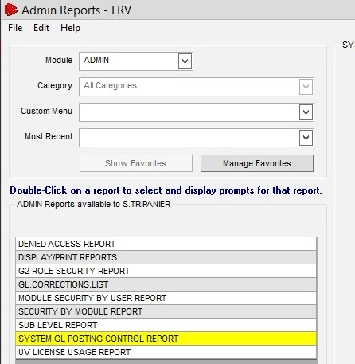
Accessing System Setup
Report
GL Control Report
Admin > Administration Reports> Run Administration Reports> System GL Posting Control Report

Slide 7
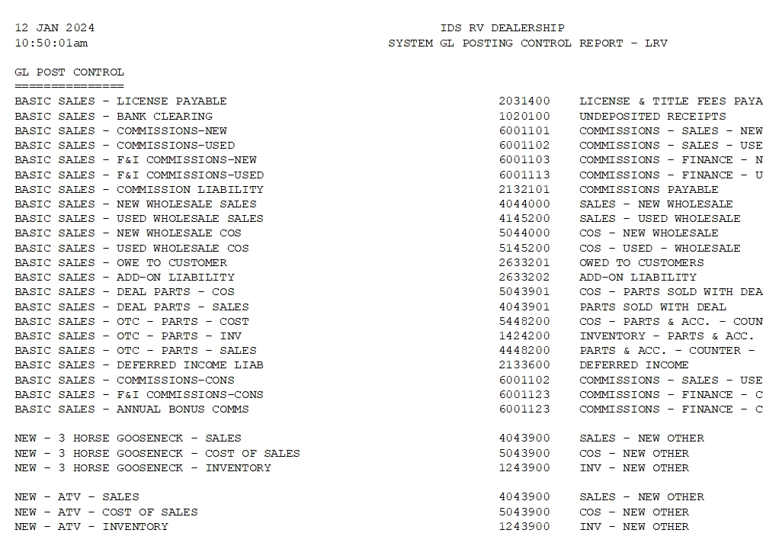
System GL Post Control Report
The Report Details the General Ledger setup for all departments in the system.

Slide 8
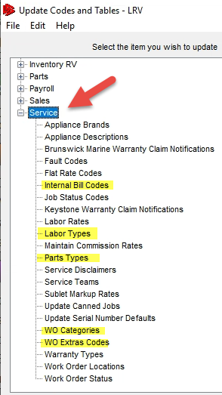
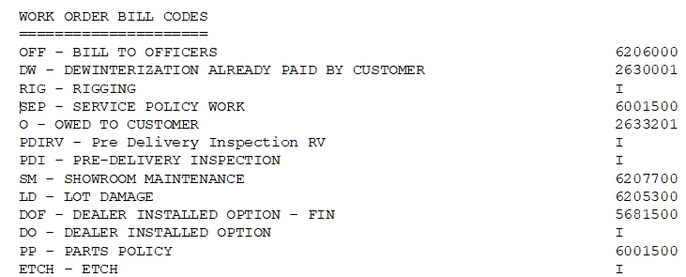
Service Setup Update Codes & Tables
Admin > Setup > Update Codes and Tables > Service
Notes:
Internal Bill Codes, Labour Types, Parts Types,, WO Categories, Wo Extra Codes

Slide 9
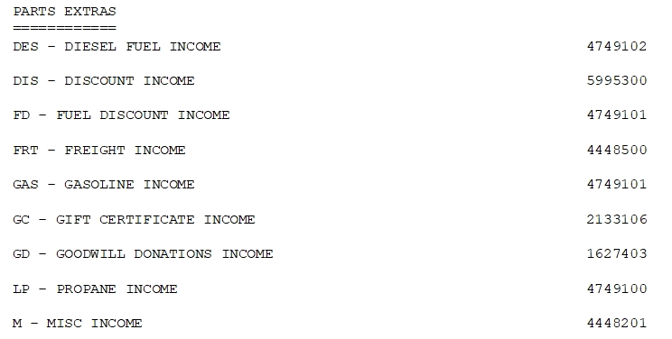
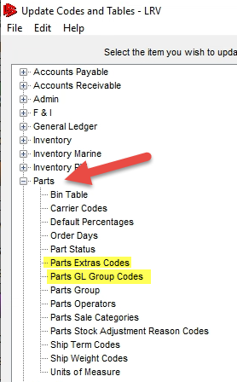
Parts Setup Update Codes & Tables
Admin > Setup > Update Codes and Tables > Parts

Slide 10
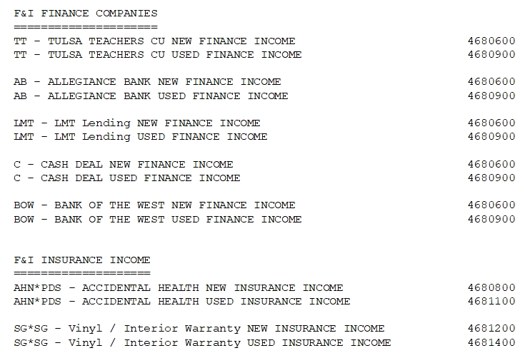
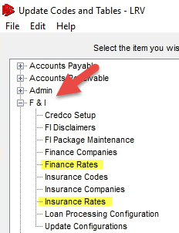
Finance Setup Update Codes & Tables
Admin > Setup > Update Codes and Tables > F&I

Slide 11
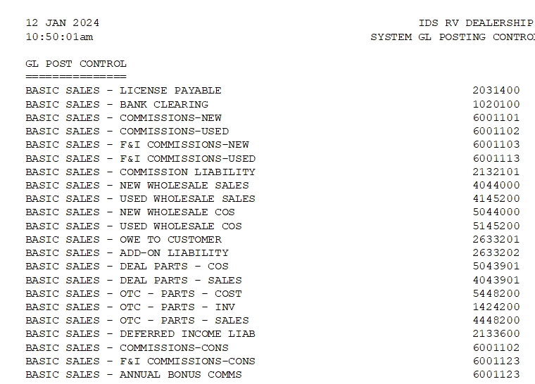
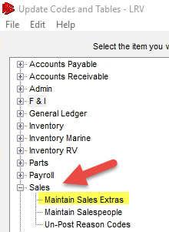
Sales Setup Update Codes & Tables
Admin > Setup > Update Codes and Tables > Sales

Slide 12
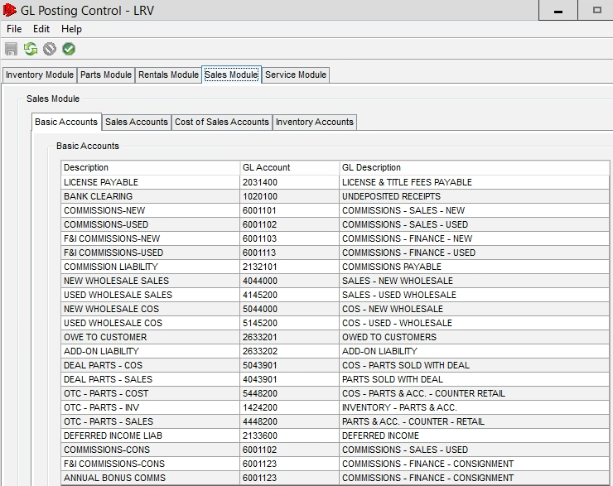
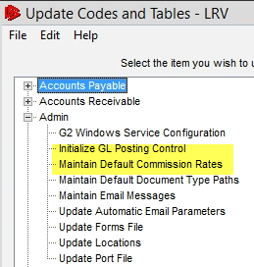
Admin Setup
Update Codes & Tables
Admin > Setup > Update Codes and Tables > Admin

Slide 13
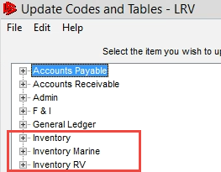
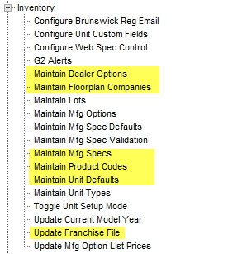
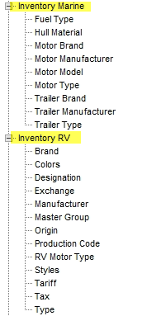
Inventory Setup Update Codes & Tables
Admin > Setup > Update Codes and Tables > Inventory , Marine & RV

Slide 14
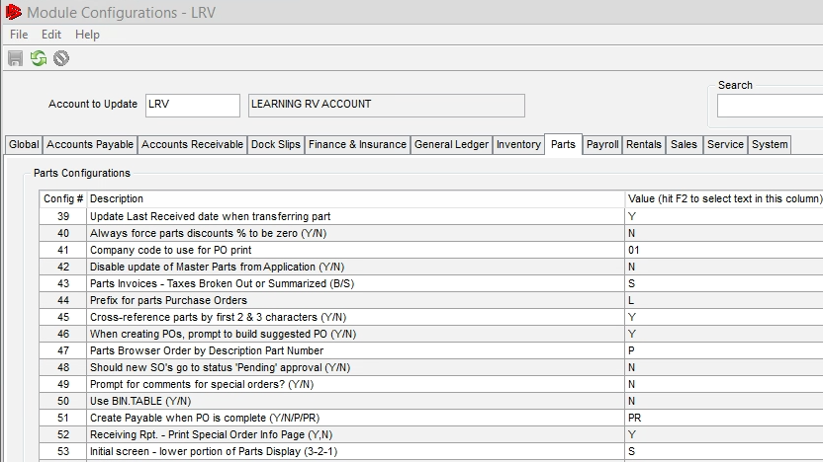
Module Configurations
Admin > Security > Update Module Configurations
It is recommended you sit down with departmental managers and go over the configs for their department.
New Module Configs come out often
Notes:
Parts config 51 is new, PR to create payable for partial receiving of a PO.
Freight amounts to those payables, config 93

Slide 15
New User Setup
Server Setup
Database User Setup
Group Module Security vs Individual Module Security
SMTP
User Locations
Parts Operators
Salesperson
Service Advisor
Mechanic

Slide 16
Server Setup – New User
IDS Cloud Solution or Essentials– Login to the Portal and create a ticket to have the new user setup in Active Directory.
Once the user has been created, you will receive an email back with the username and password.
Onsite Server – Have your Internal IT department setup the new User with a Username and Password in active directory.

Slide 17
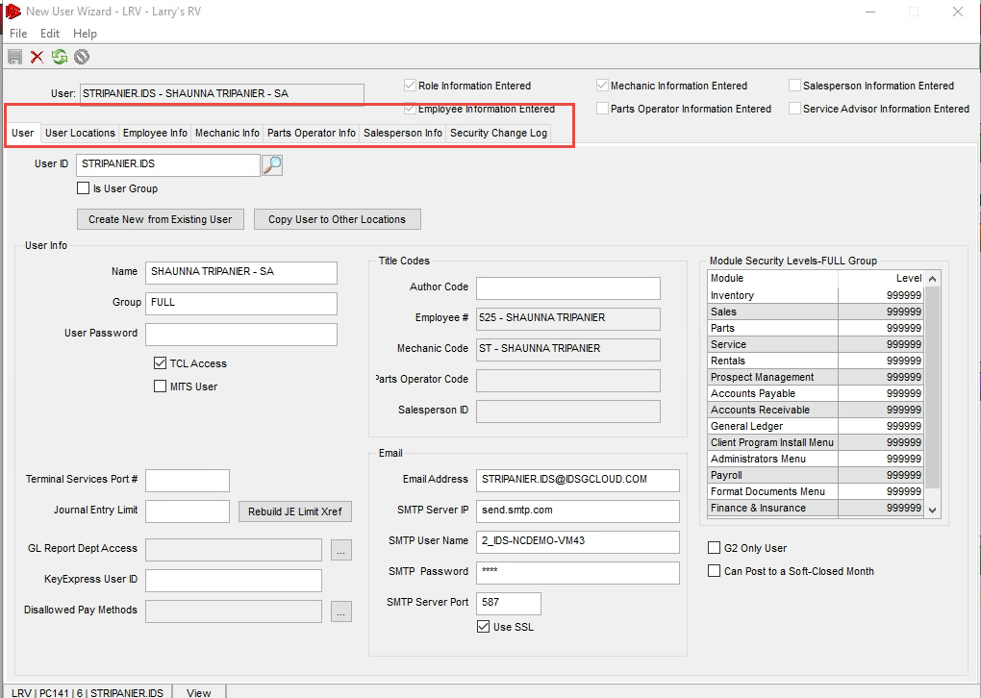
Database
User Setup
Admin > Security > New User Wizard
Enter the User ID , with the same one that was setup in the active directory.
Enter the Users Name
Terminal Services Port# if applicable.
Notes:
Unique to the user, no matter where they login they will keep the same settings, till rec, dashboards, default printers.

Slide 18
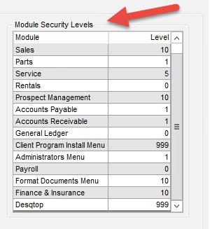
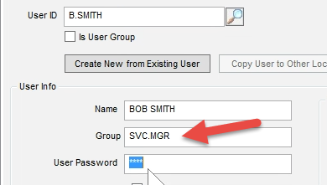
Group Module Security vs Individual Module Security
Group module security allows you to designate security by the dealership role i.e. Service Manager, Parts Manager, Sales Manager, etc. for each module. And allows you to pass this security along to another user with ease.
Individual Module Security allows you to change each individual's department security, without affecting another user. Group Module security is highly recommended.

Slide 19
Not Using Module Security Groups?
Take an existing user i.e Service Manager
Record what they have for their module security
Admin > Security > New User Wizard

Slide 20
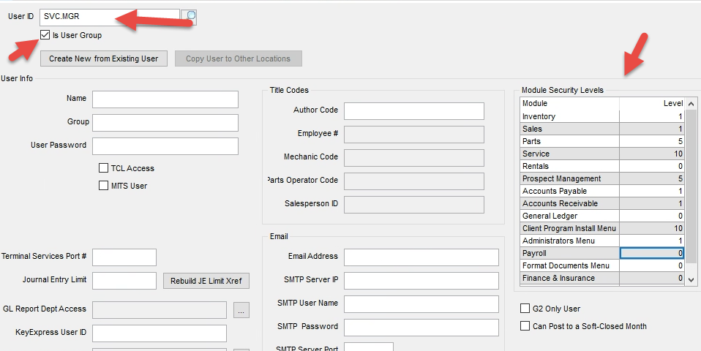
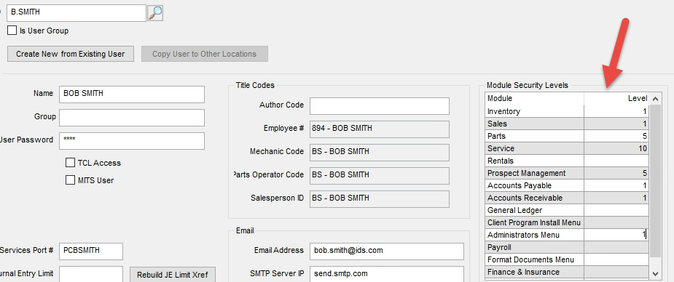
Module Security Groups Cont.

Slide 21
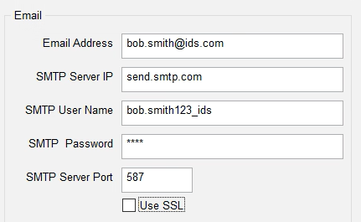
SMTP Settings
Email Information
Setting up the email fields so the user can email from the system in various areas. Now this is dealership specific and generally looking at an existing user will help identify how your account is setup. The email must be unique to the user if using mobile,e-sign and/or 360 products.
Notes:
You use the portal and Chat with our Support team and they can provide that for you.

Slide 22
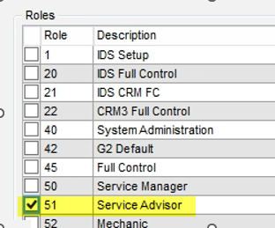
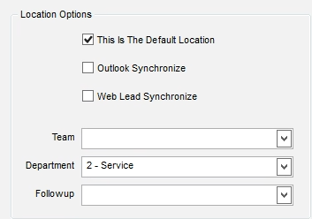
User Locations
Enable the Location for the user Select the Role(s) for the User
Fill out location options

Slide 23
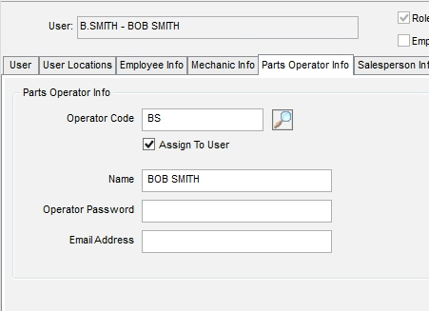
Parts Operator
Enter Operator Code (TAB)
Enter Username
Enter Operator Password (NOT MANDATORY) only do this if you want to password protect them during parts sales.
Enter Email Address , will default from SMTP information on User tab.
Save the Operator, then check assign to user box and save again.

Slide 24
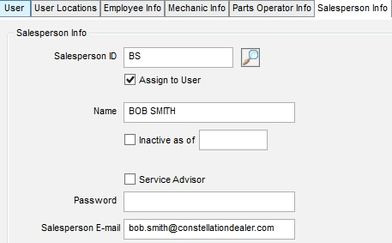
Salesperson
Enter Salesperson code (TAB)
Enter the name of the salesperson
Salesperson Email Address
Save the record
Then check Assign to user and save the record again.

Slide 25
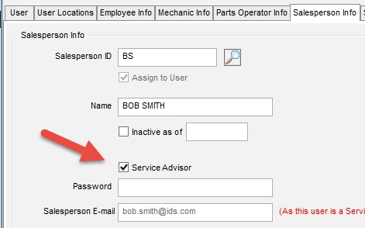
Service Advisor
Set them up as a salesperson, from the previous slide, following all steps.
Check the box that says, service advisor.

Slide 26
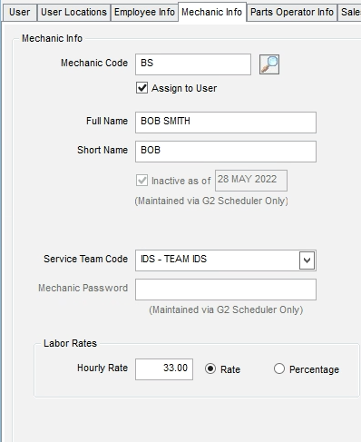
Mechanic
Enter the Mechanic Code (TAB)
Enter the Mechanic’s Name
Enter the Short Name (kiosk display), and it must be unique.
Choose the Service Team
Enter the Hourly Rate or Percentage.
Save
Check Assign to User
Save

Slide 27
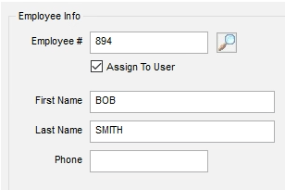
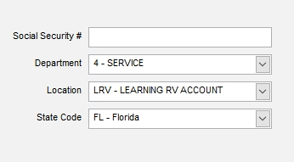
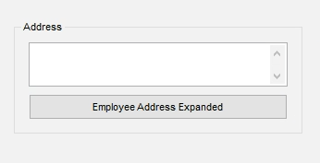
Employee Setup – New User Wizard
Click White piece of paper top right
Name will Default from User tab
Enter Phone, Address, SSN, not mandatory fields.
Choose the Employees Department
Location will default to the one you’re in.
Choose State Code
Save
Assign to User
Save

Slide 28
Employee Setup Cont.
Accounting > Payroll > Maintain Employees
For Use with IDS Time Clock
For use with IDS Mobile Application
Tracking Hires and Termination
Employee Address, Birthday and other information.

Slide 29
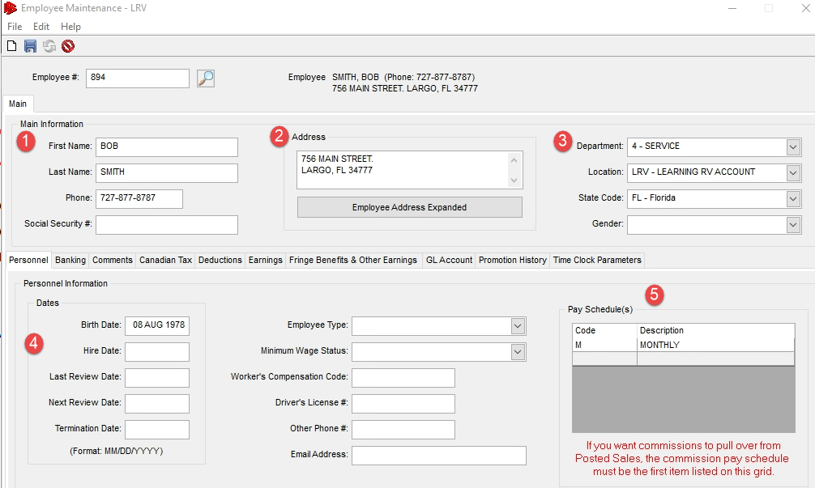
Employee Maintenance Cont.
Accounting > Payroll > Maintain Employees

Slide 30
Time Clock (Non-Technicians)
Clock at the Top of the G2 Navigator

Slide 31
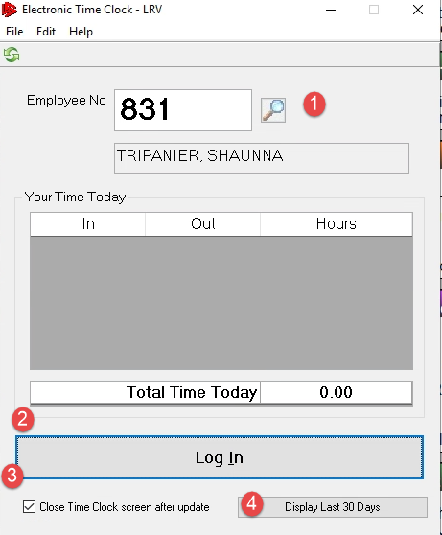
Time Clock Cont.
Search for Employee Number, if unknown.
Log in / Log Out Button
Close Time Clock Screen after Update
Display last 30 Days

Slide 32
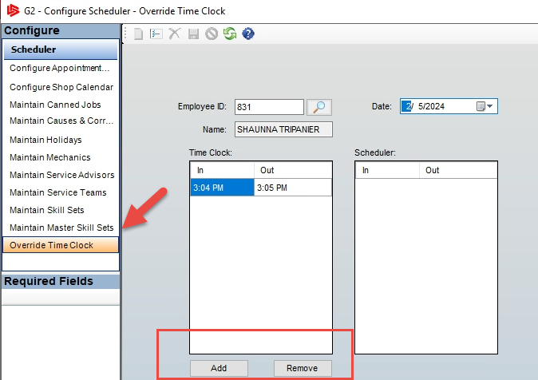
Employee Forget to Clock In or Out?
Admin > Setup > Configure Scheduler > Override Time Clock
Enter Employee Number
Choose Date
Override and change the time clock hours or click the add / remove buttons at the bottom.

Slide 33
Time Clock Hours Report
Service > Service Reports > Run Service Reports > Time Clock Report

Slide 34
Time Clock Report

Slide 35
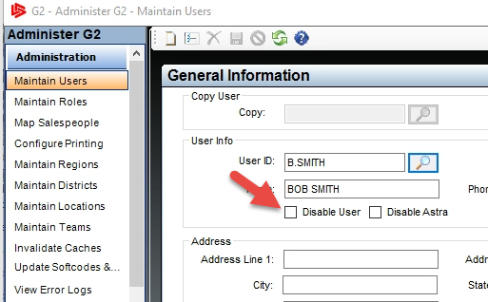
Employee Leaving?
Disable the User in Active Directory.
Enter termination date in Employee Maintenance.
Admin > Security > Administer G2 > Maintain Users Click Disable User
If the Employee owns contacts, you will be prompted to reassign those contacts to another user when saving.
Notes:
Disable will only work at next login, so if they are logged in they will need to log out.

Slide 36
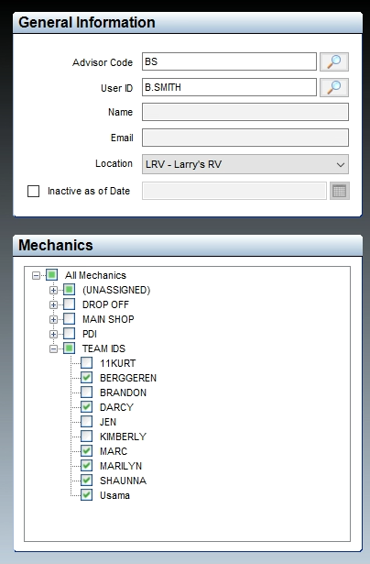
Assigning Mechanics
to Advisors
Admin > Setup > Configure Scheduler >Maintain Service Advisors
Enter code setup in New User Wizard (TAB)
Use the drop down to check the techs that the advisor is allowed to schedule to.
Save

Slide 37
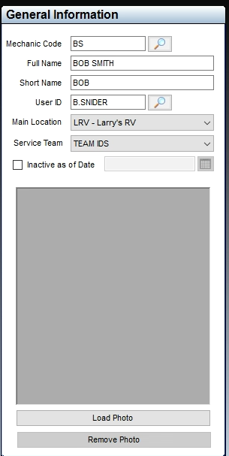
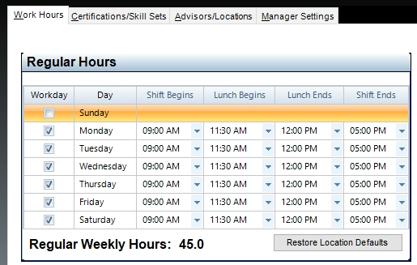
Updating Mechanics
Admin > Setup > Configure Schedule > Maintain Mechanics
Update Service Team
Set to inactive
Upload picture for Kiosk
Update Work Hours
Add Certifications and skill sets
Update Advisors
Update Manager Settings

Slide 38
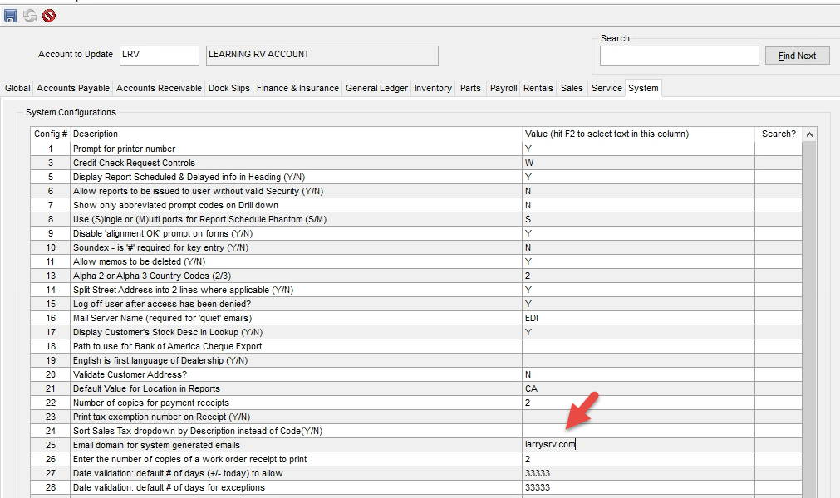
Domain for System Generated Emails
Admin > Security > Update Module Configurations

Slide 39
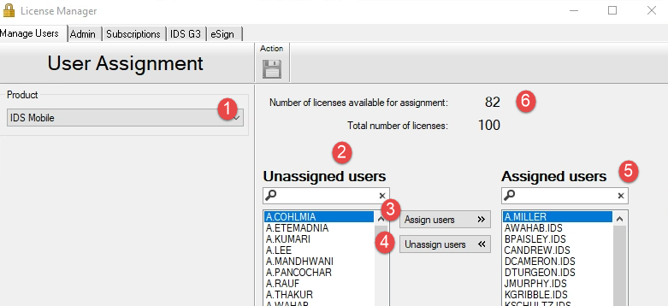
Manage Mobile Licenses
Admin > Security > Manage Licenses

Slide 40
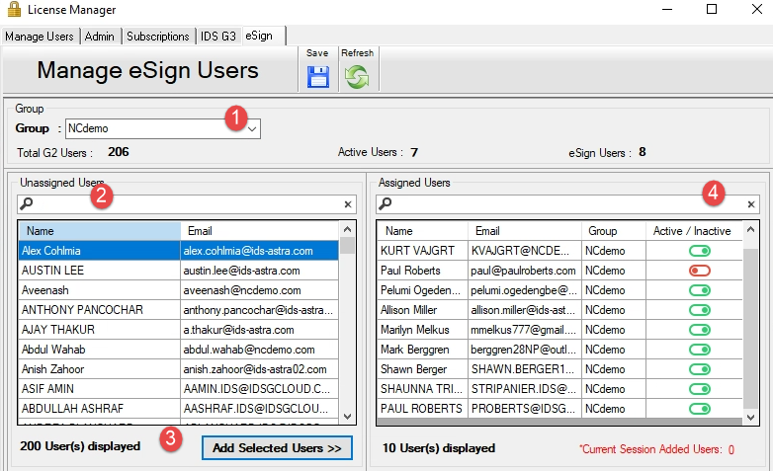
E-Sign Setup
Admin > Security > Manage Licenses > eSign tab
Choose Group = Location
(Do NOT select All)
Search for user you would like to assign
Add Selected Users
Once User is Assigned you can not remove them, only inactivate.
Users in multiple locations? You must assign the for each of the locations.

Slide 41
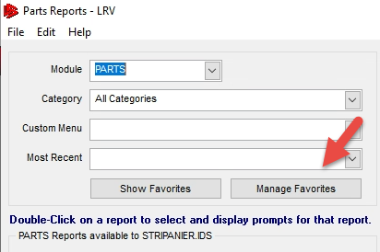
Favorite Reports by Role
From any department, select run reports
Choose Manage Favorites

Slide 42
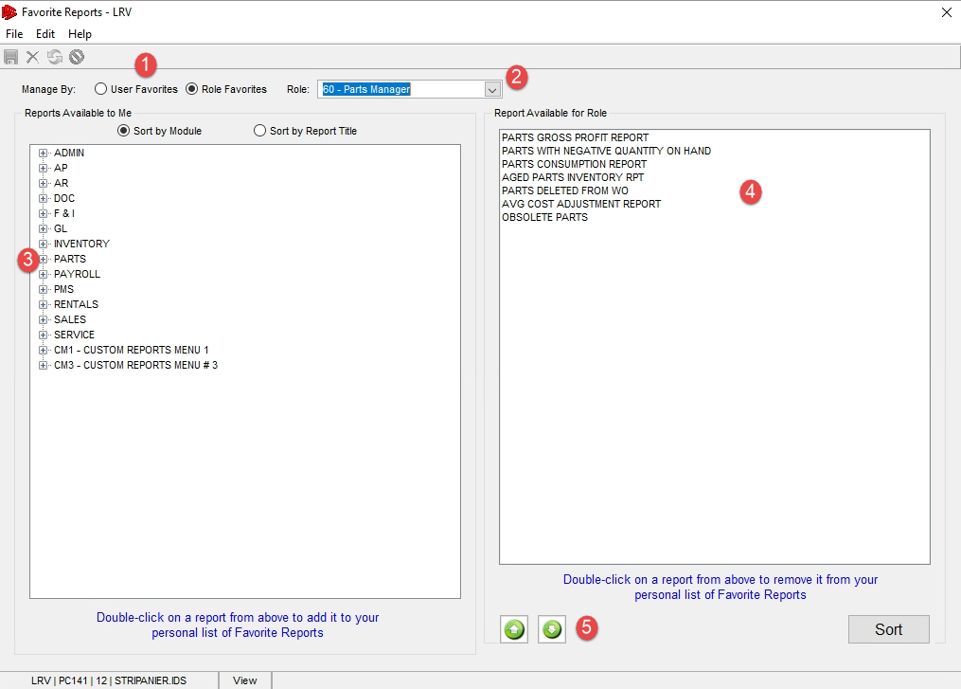
Favorite Reports by Role Cont.
Select Role Favorites
Choose the Role from the drop down
Drop down on the module
Double click on the report to add it to favorites
Move Reports around
Save Changes

Slide 43
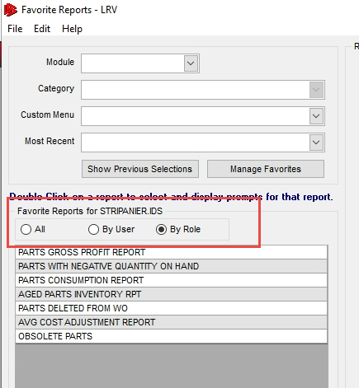
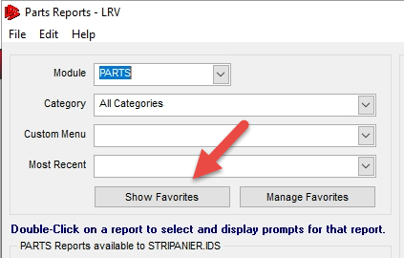
Favorite Reports by Role Cont.
Make sure the user has the role in Admin > Security > New User Wizard> Locations Tab
User logs in and opens up
Reporting
Click Show Favorites
Select All or By Role toggle

Slide 44
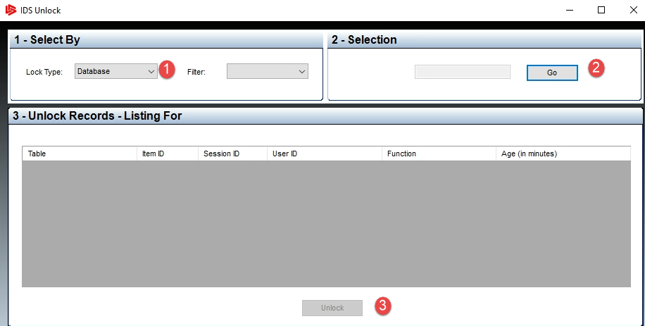
Unlocking a Record
On release 23.14 we have given dealers the ability to unlock records.
Please talk to the user it says is locking the record to ensure they are no actually in the record updating it, but you can now clear the records on your end
Admin > Utilities > Unlock a Record > Database > Go
Find the record lock, choose it and click unlock

Slide 45
New User Setup Guide
NEW USER GUIDE COMPLETE | IDS (Integrated Dealer Systems) Customer Hub (teamsupport.com)

Slide 46
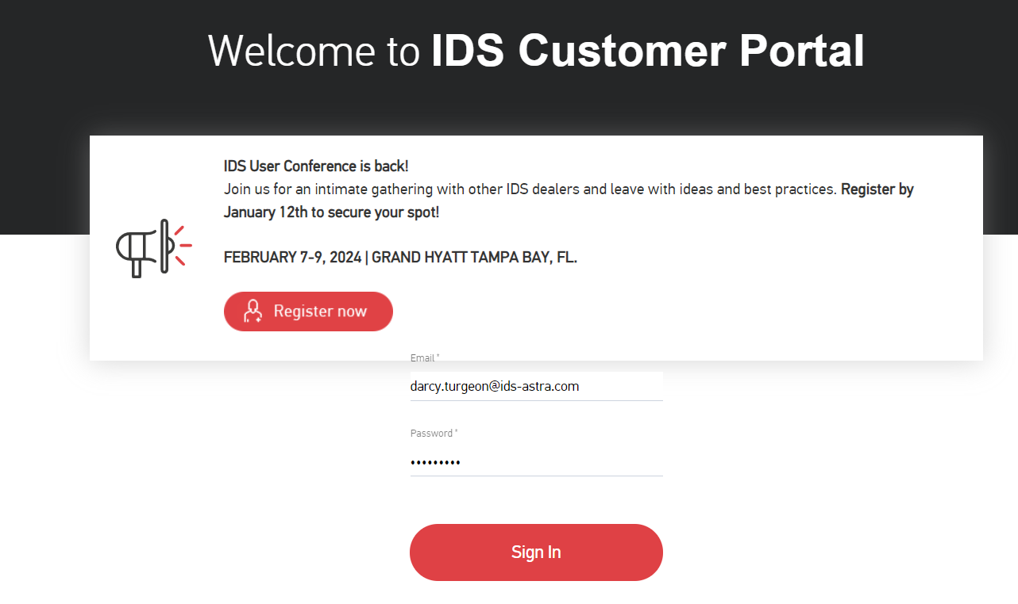
How to get Support Help
The best way to get support is to sign up on the IDS Portal website,
Visit: https://portal.ids-astra.com/login
Here you can register to send in a support ticket and access the vast amount of online reference materials.

Slide 47
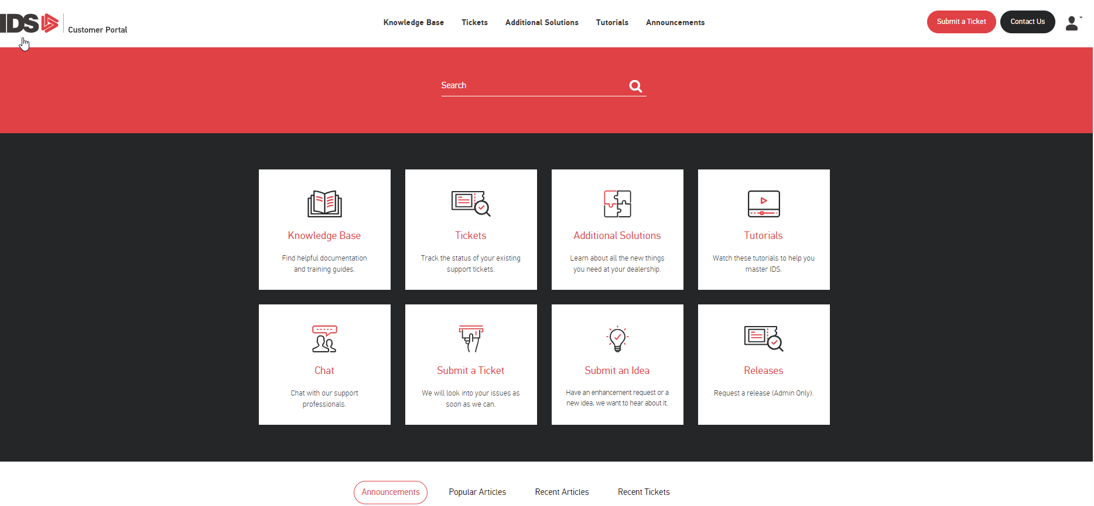
How to get Support Help

Slide 48
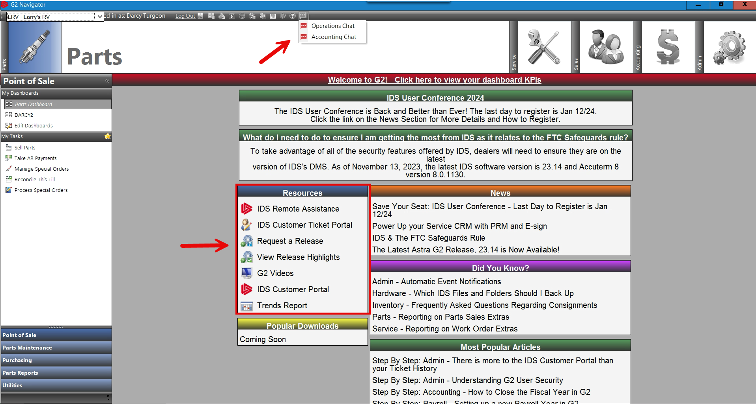
How to get Support Help

