Slide 1
Back to Basics for Sales and Finance
February - 2024

Slide 2
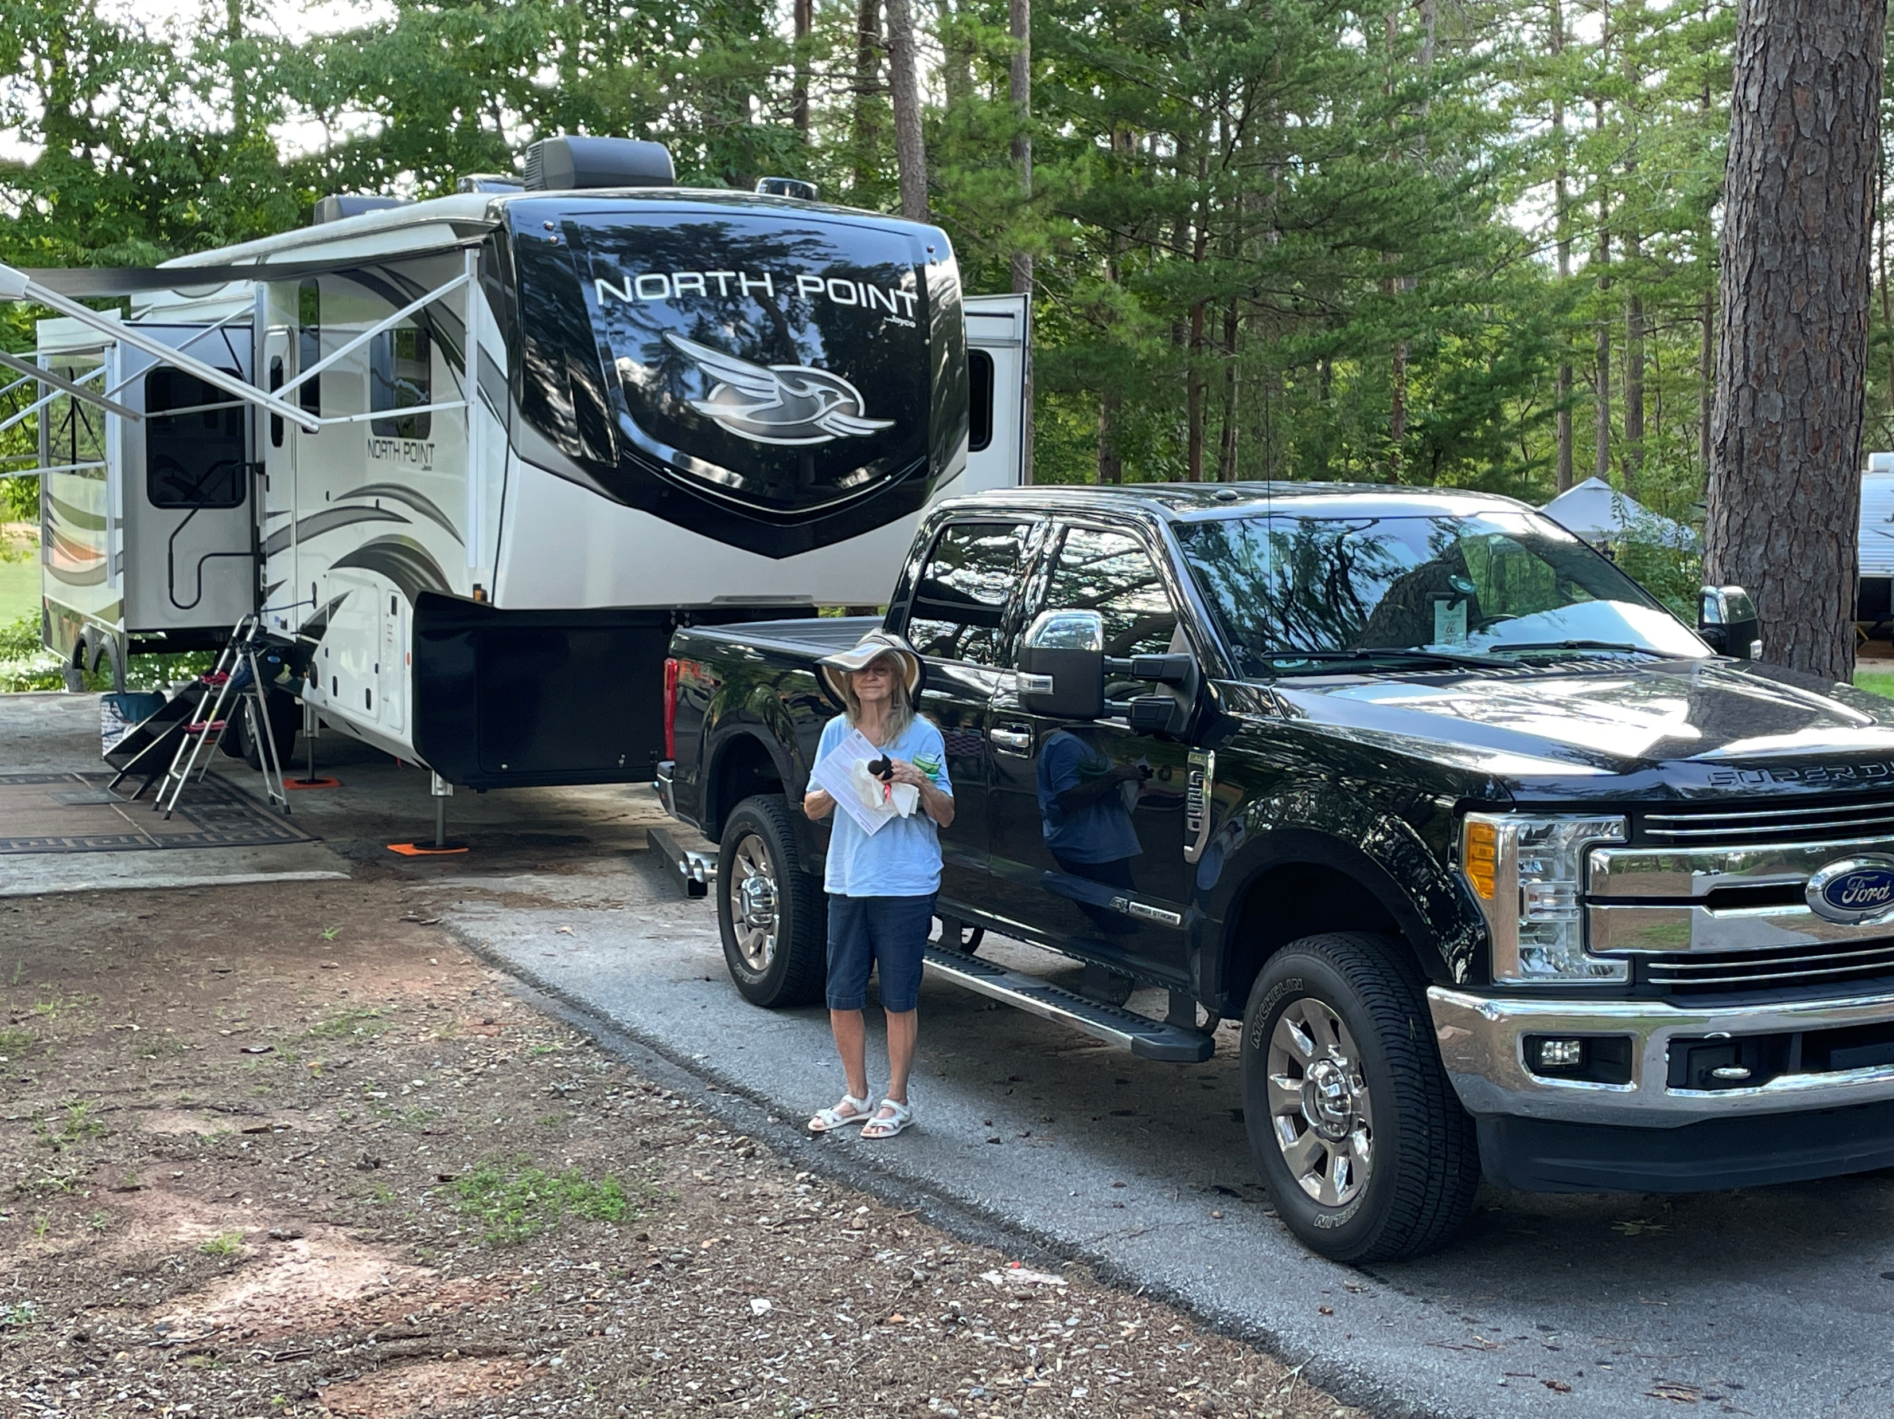
My name is Mark Berggren
Professional Services Account Team
Gray Court, South Carolina
My Background
12 years in the drug & grocery industry with Skaggs & Albertsons.
39 years in the RV & Marine industry.
* 12 years “Leisure Time RV” as a Finance Manager/Assistant Sales mgr.
* 12 years with an IDS marine dealer as their System admin for their southeast region.
* 15 years experience working directly for “Integrated Dealer System” IDS.

Slide 3
Will there be time during these 2 days for any one on one with an IDS representative in regard to these topics ?
YES…. See Kimberly Schultz during any break and she will try arrange a meeting time for you with the appropriate person.

Slide 4
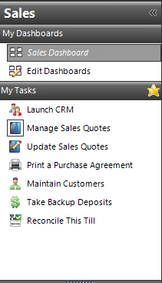
The G2 Main Menu
Let’s start with Manage Sales Quotes

Slide 5
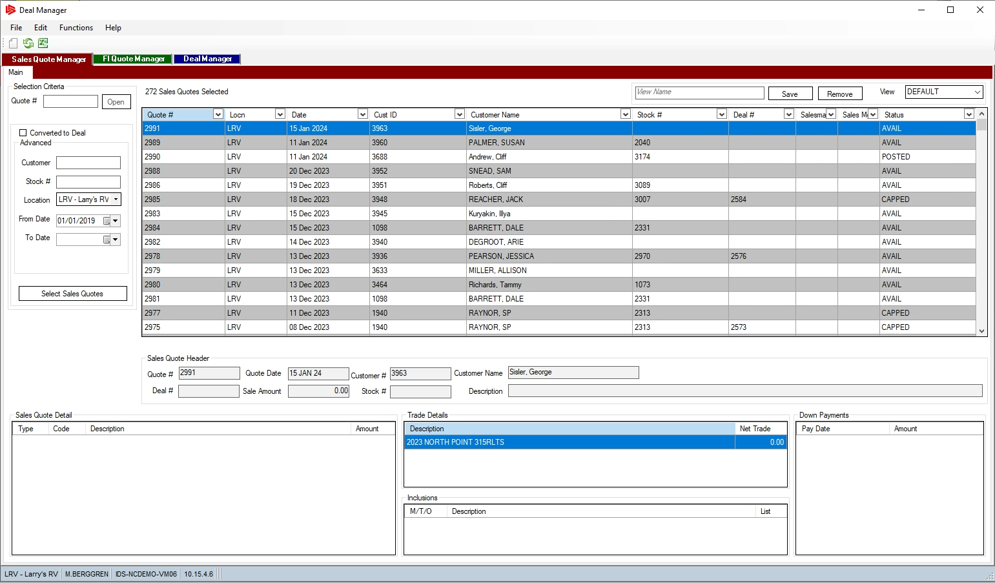
In the Sales Quote Manager.
You can filter by
Salesperson
Customer
Sort by Date
See all quotes on a particular Stock#
Create New Sales Quote
Notes:
Create a New Quote from SQ Manager

Slide 6
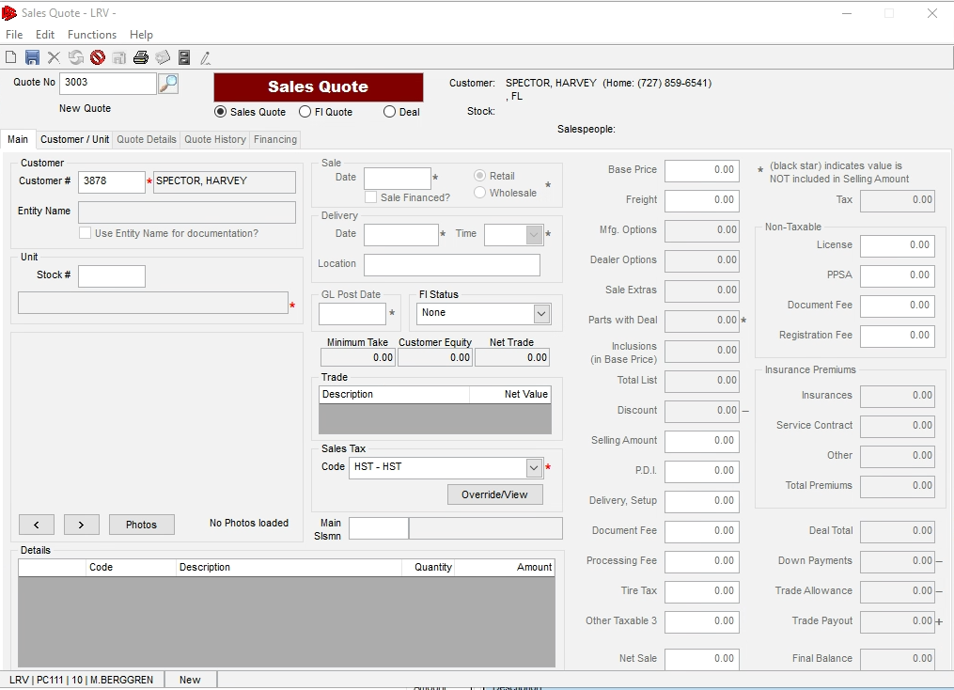
New Sales Quote
* SQ Quote #
Notes:
Press New Quote that add SQ# now enter or find customer

Slide 7
New Sales Quote
Add a Customer #
Now there are 3 ways to add a Unit to a Sales Quote…
Notes:
Press New Quote that add SQ# now enter or find customer

Slide 8
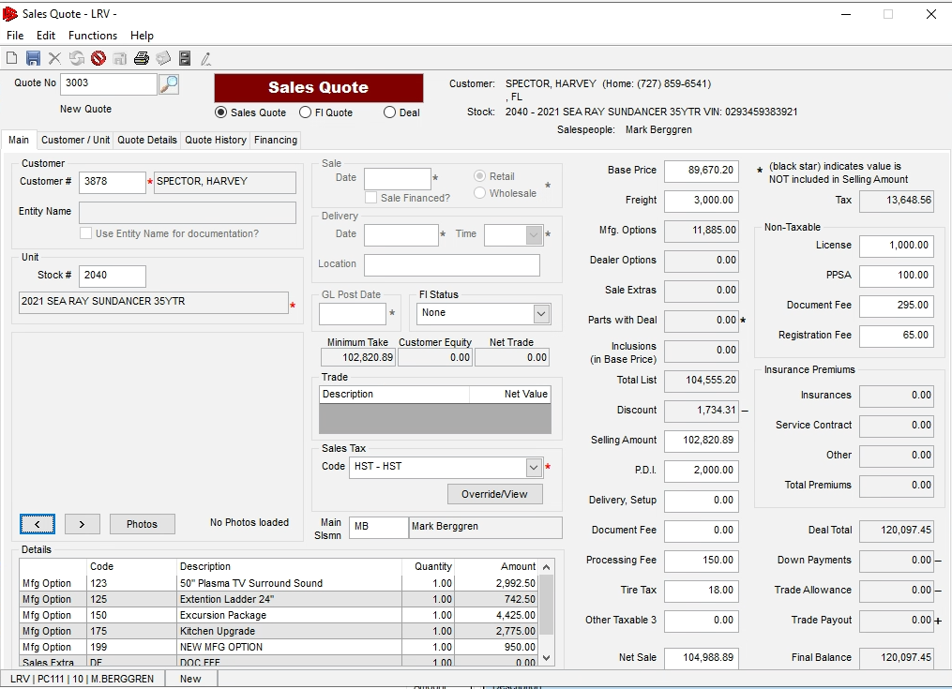
1st way to arrive at the Unit the Sales Quote will be based on..
Pretty Straight forward
* Enter a stock
* Hit tab
* All the numbers default in
Notes:
Go over numbers

Slide 9
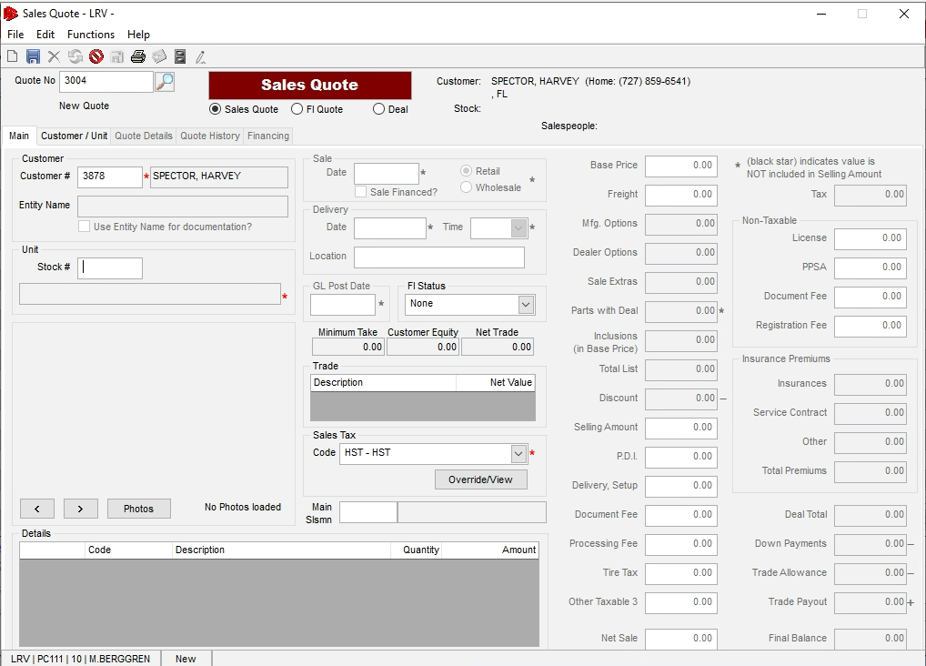
2nd way to arrive at the Unit the Sales Quote will be based on..
Click on Customer/Unit Tab

Slide 10
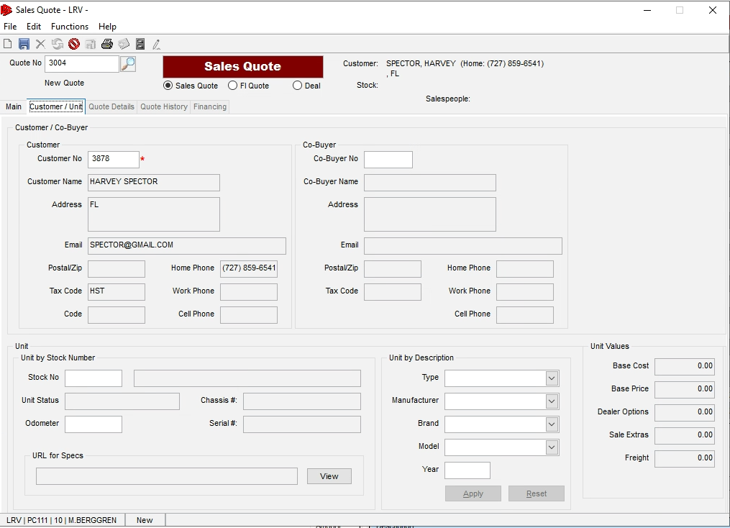
2nd way to arrive at the Unit the Sales Quote will be based on..
Add the Units Description

Slide 11
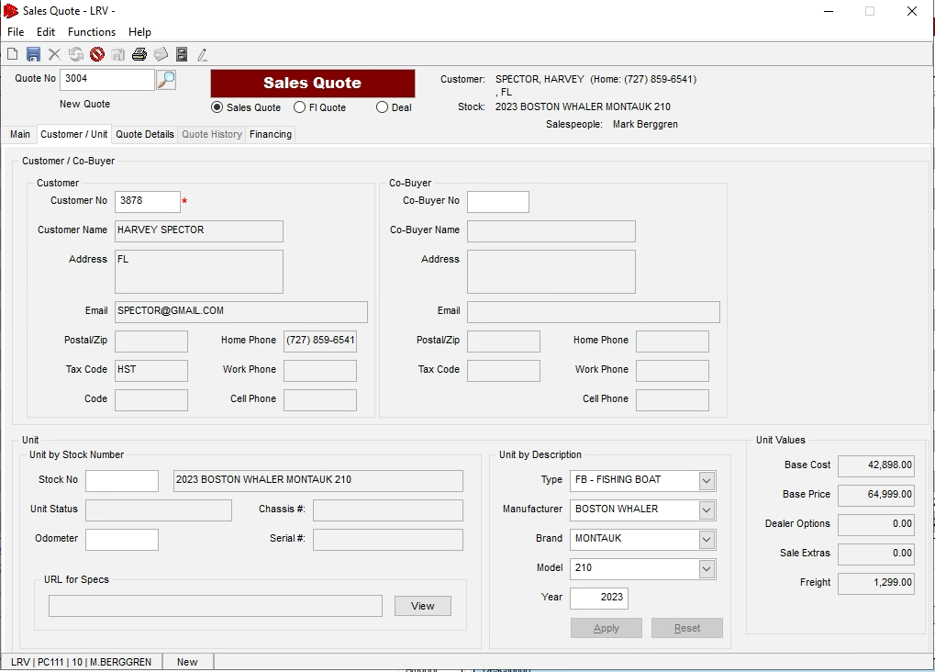
2nd way to arrive at the Unit the Sales Quote will be based on..
Unit Description

Slide 12
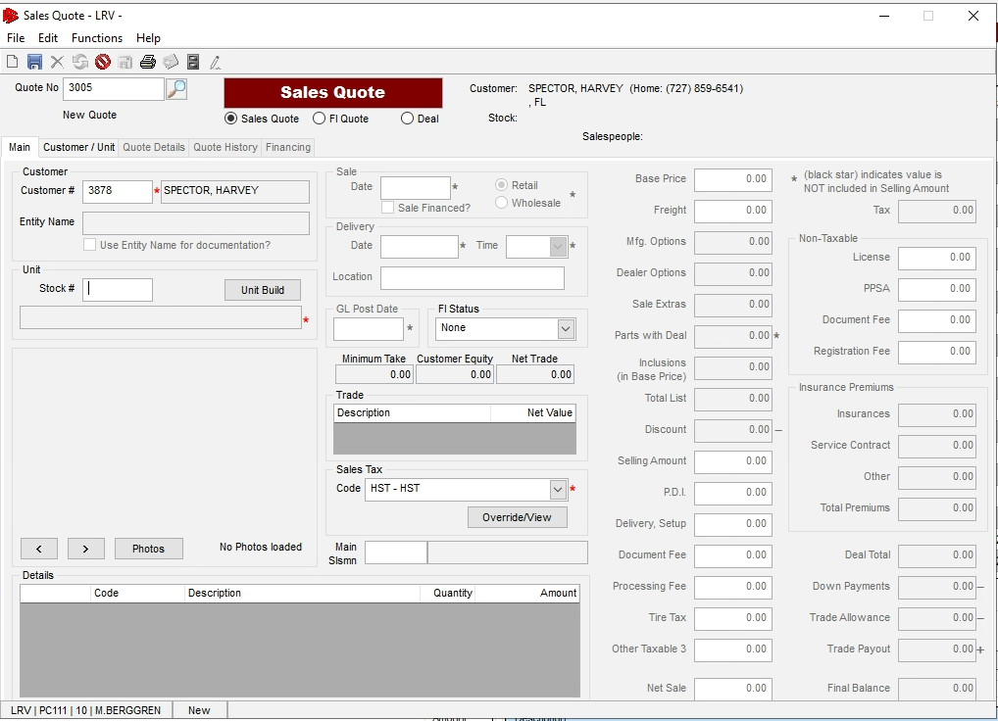
3rd way to arrive at the Unit the Sales Quote should be based on..
3) Using function “Unit Build:

Slide 13
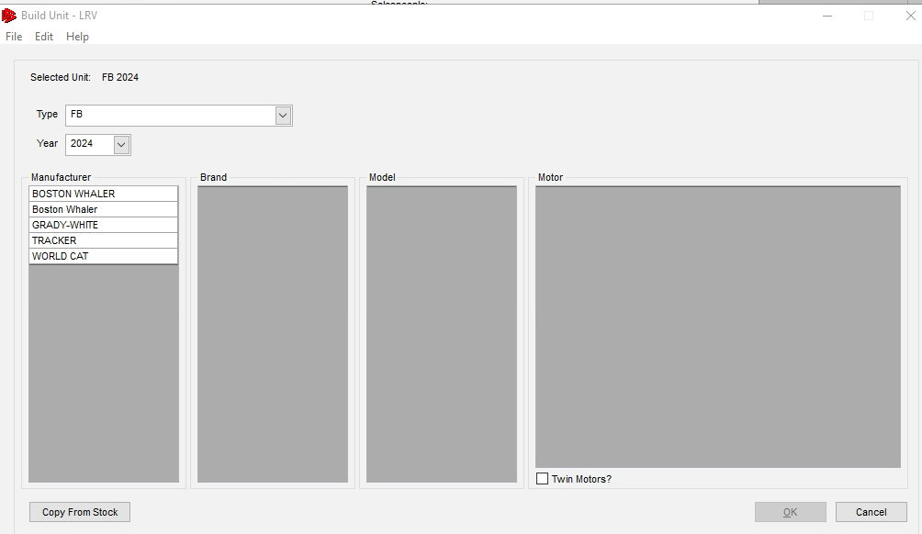
Select
* Type & then Year
To see MFG’s

Slide 14
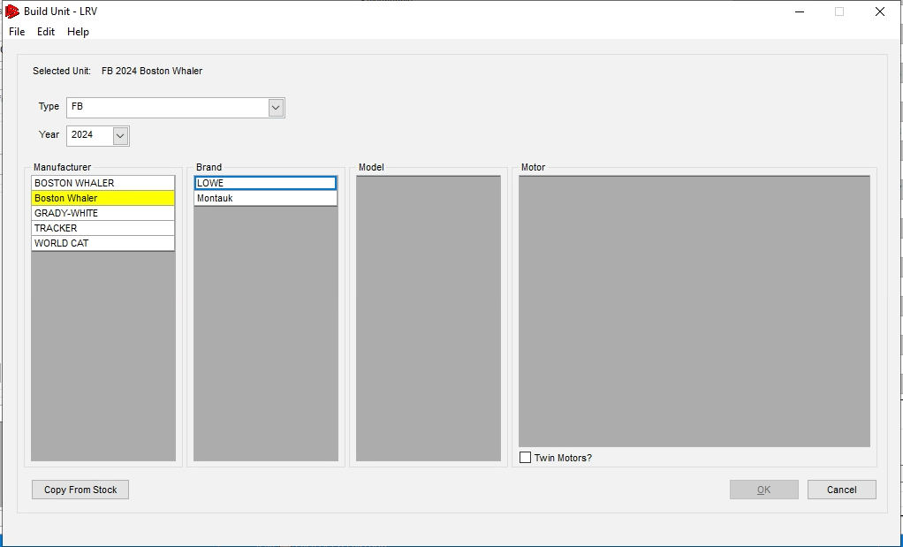
Select
* Manufacturer
To see Brand’s

Slide 15
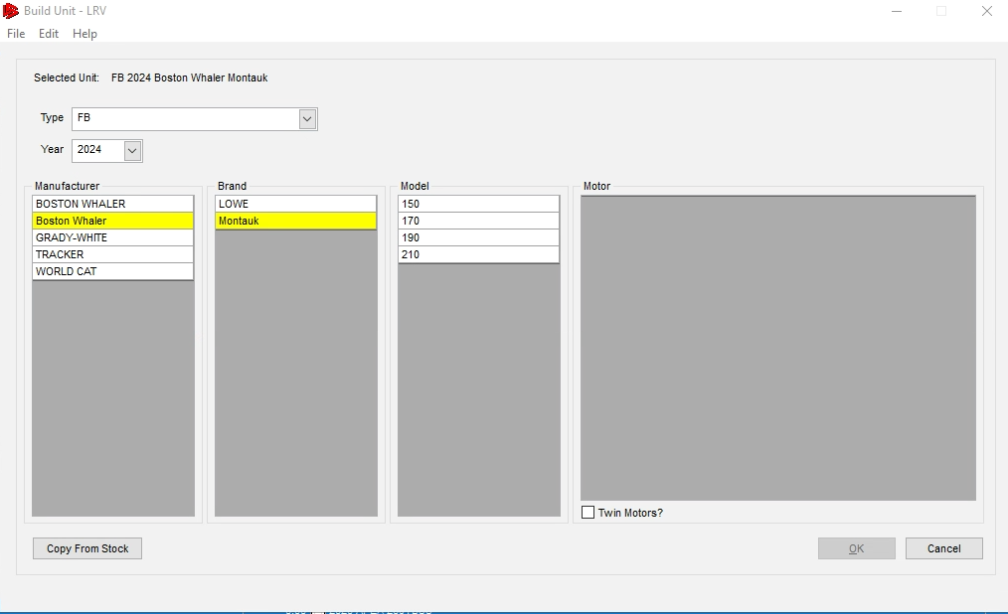
3rd way to arrive at the Unit the Sales Quote will be based on..
Select
* Brand
To see Models

Slide 16
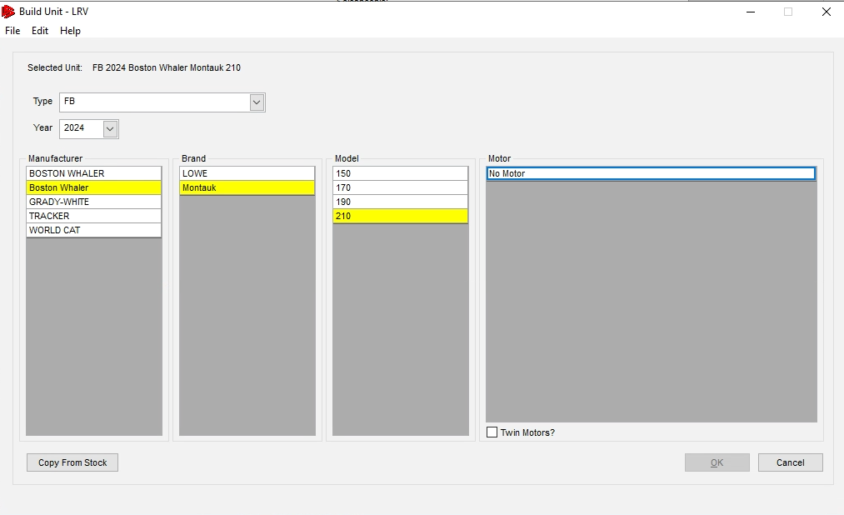
Select
* Models
To see Motor’s

Slide 17
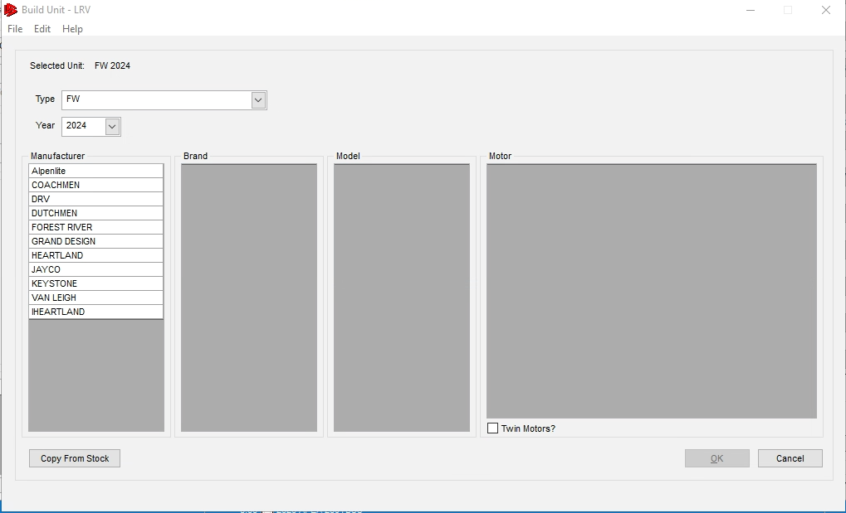
Using function “Unit Build:
Select
* Type
* Year
To see MFG’s
Let’s do the same for RV’s

Slide 18
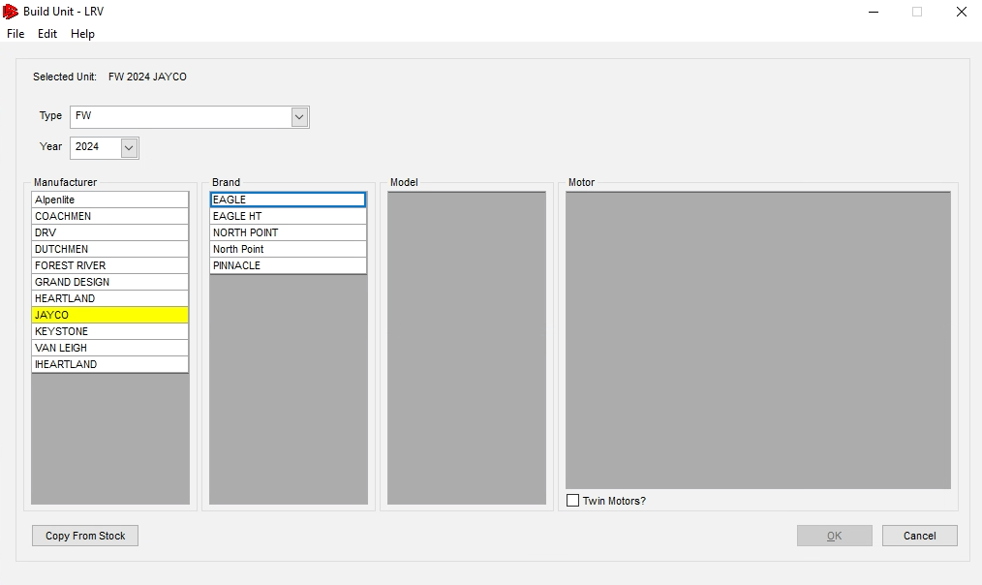
Select
* Manufacturer
To see Brand’s

Slide 19
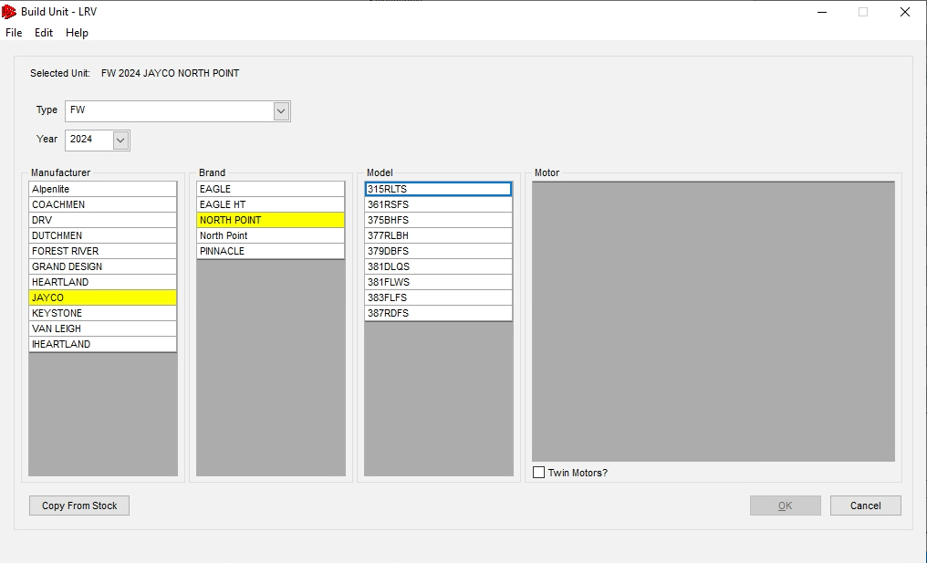
Select
* Brand
To see Models

Slide 20
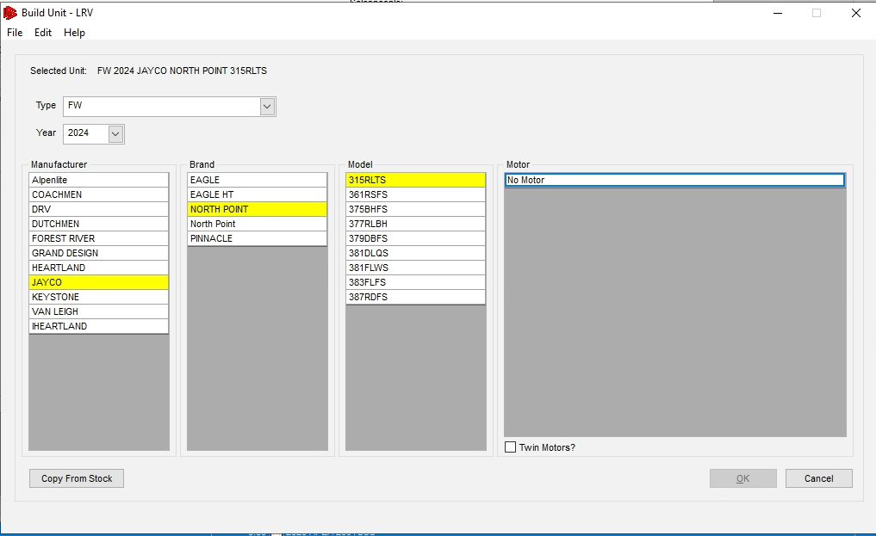
Select
* Models
To see Motor’s

Slide 21
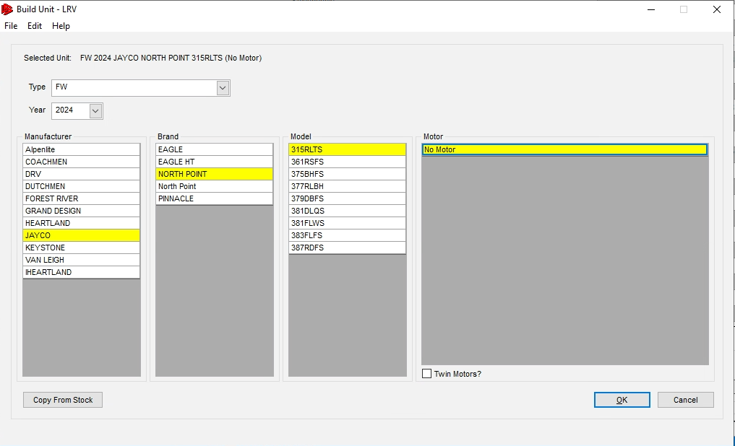
Select
Motor
To click OK

Slide 22
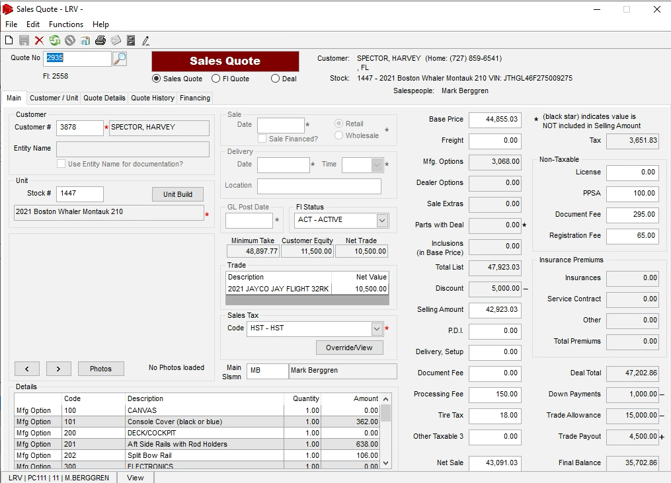
Items to Highlight
Work-a-deal
E-Sign for Sales Quotes
Document Manager
Email Quote
Find previous quotes or units to Quote.
All history tied to customers & Vehicle.
Deale options service operations.
Add trade information around unit desc, acv, allowance, etc.
Let’s look at Sales Quote E-Sign

Slide 23
Items to Highlight
Work-a-deal
E-Sign for Sales Quotes
Document Manager
Email Quote
Find previous quotes or units to Quote.
All history tied to customers & Vehicle.
Deale options service operations.
Add trade information around unit desc, acv, allowance, etc.

Slide 24
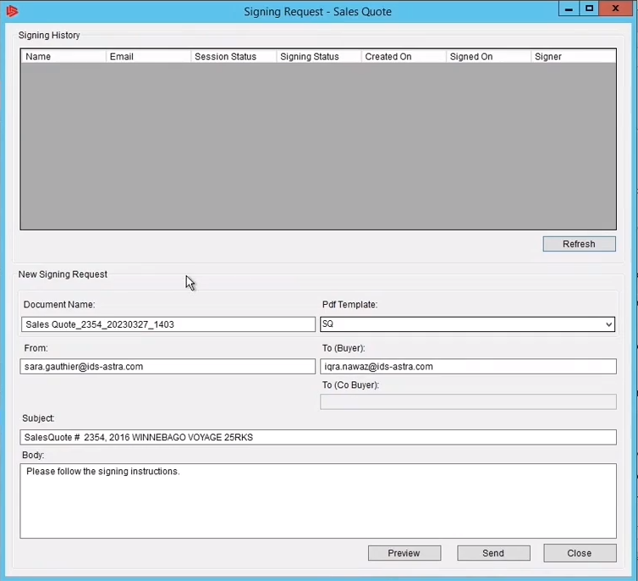
Items to Highlight
Work-a-deal
E-Sign for Sales Quotes
Select send the quote to customer to begin the
e-signing process.

Slide 25
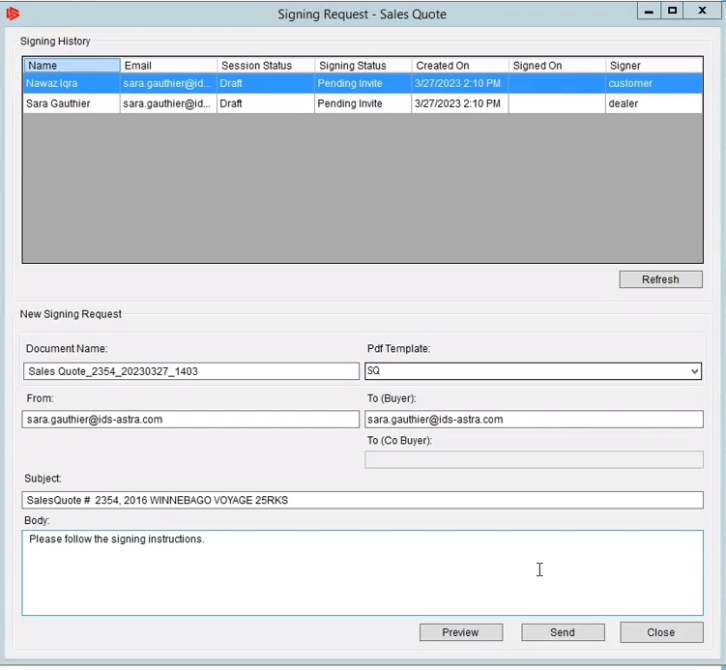
Items to Highlight
Work-a-deal
E-Sign for Sales Quotes
The signing history will update

Slide 26
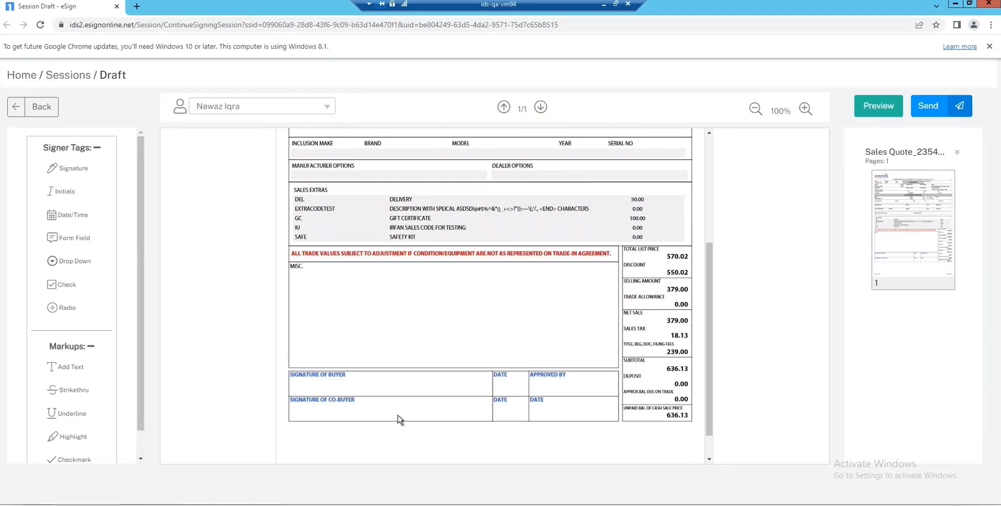
Items to Highlight
Work-a-deal
E-Sign for Sales Quotes
The signing history will update
And
An internet window will open with a draft of the Sales Quote being sent.

Slide 27
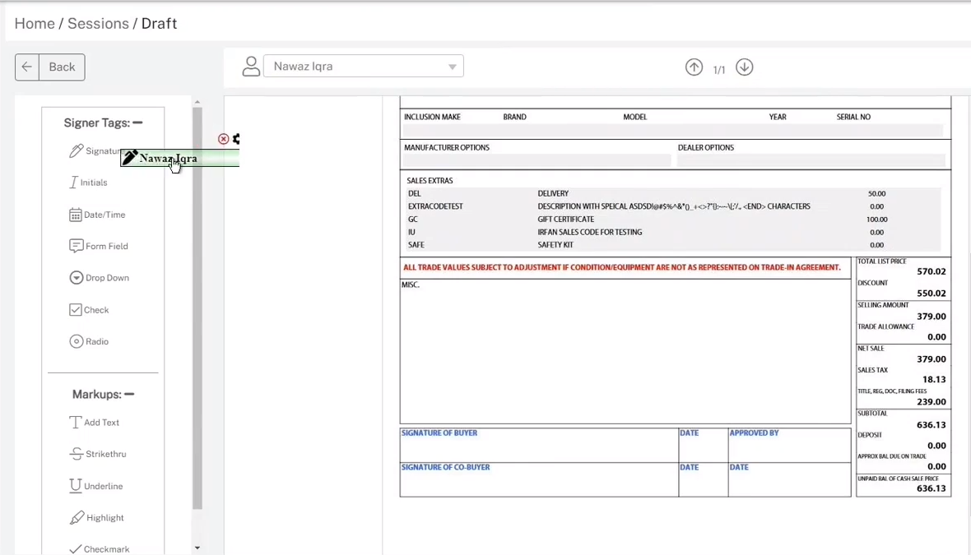
Items to Highlight
Work-a-deal
E-Sign for Sales Quotes
Click on Signature and drag it down to where you want it to appear

Slide 28
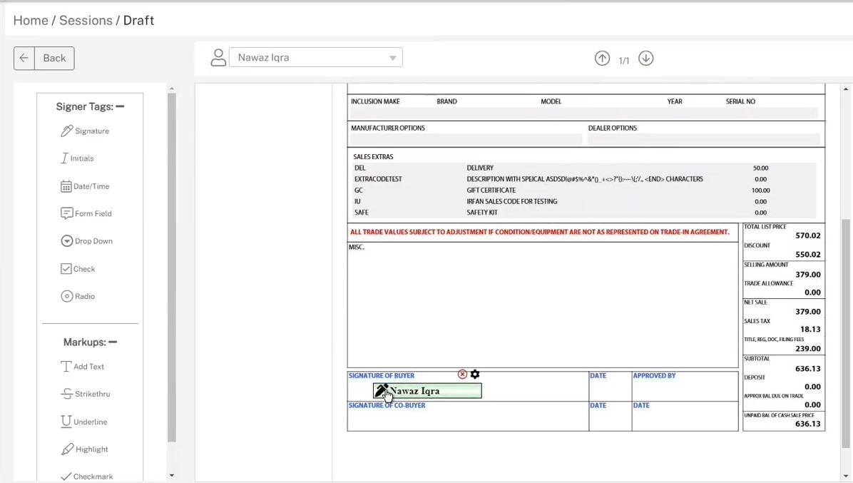
Items to Highlight
Work-a-deal
E-Sign for Sales Quotes
Click on Signature and drag it down to where you want it to appear

Slide 29
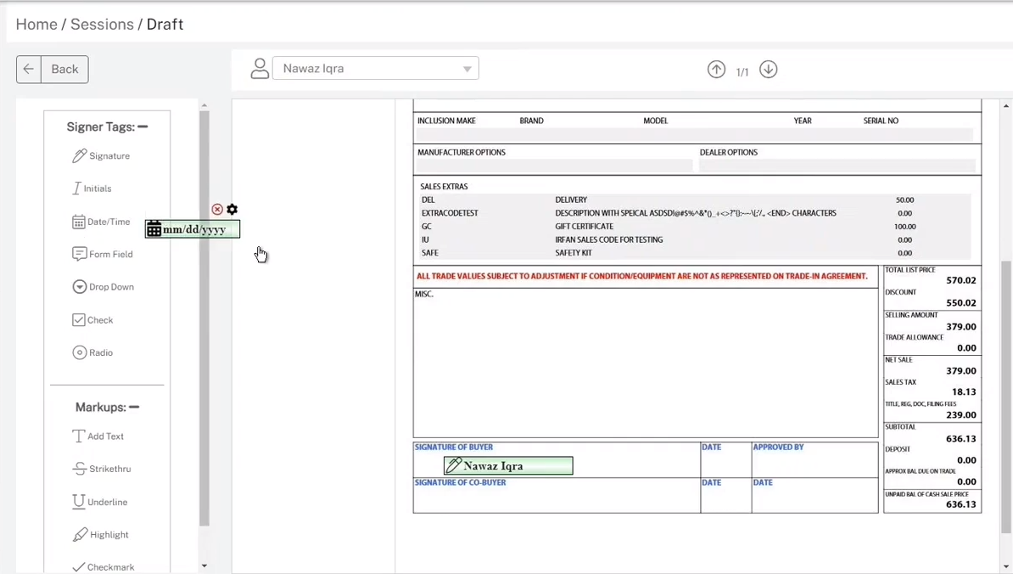
Items to Highlight
Work-a-deal
E-Sign for Sales Quotes
Click on Date/Time and drag it down to where you want it to appear

Slide 30
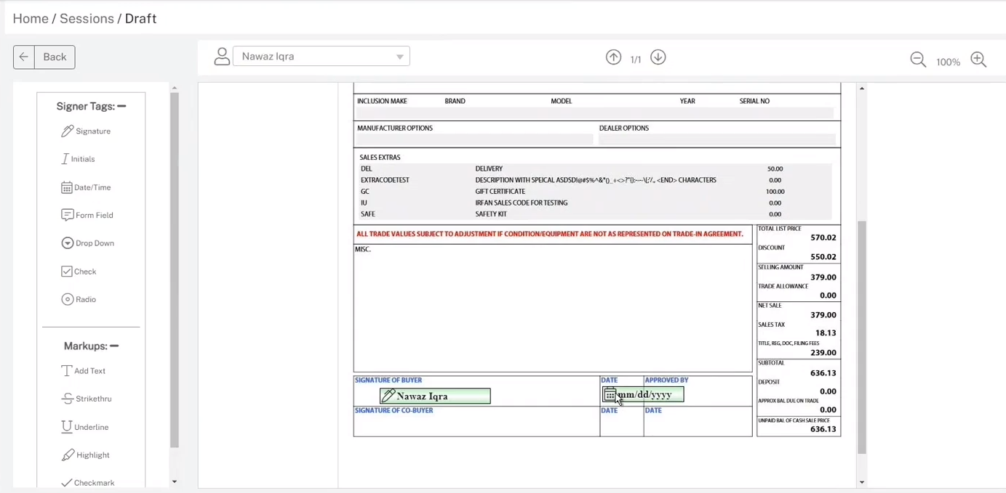
Items to Highlight
Work-a-deal
E-Sign for Sales Quotes
Click on Date/Time and drag it down to where you want it to appear

Slide 31
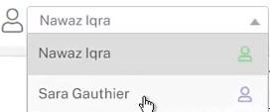
Items to Highlight
Work-a-deal
E-Sign for Sales Quotes
Let’s select someone else to participate in this e-signing

Slide 32
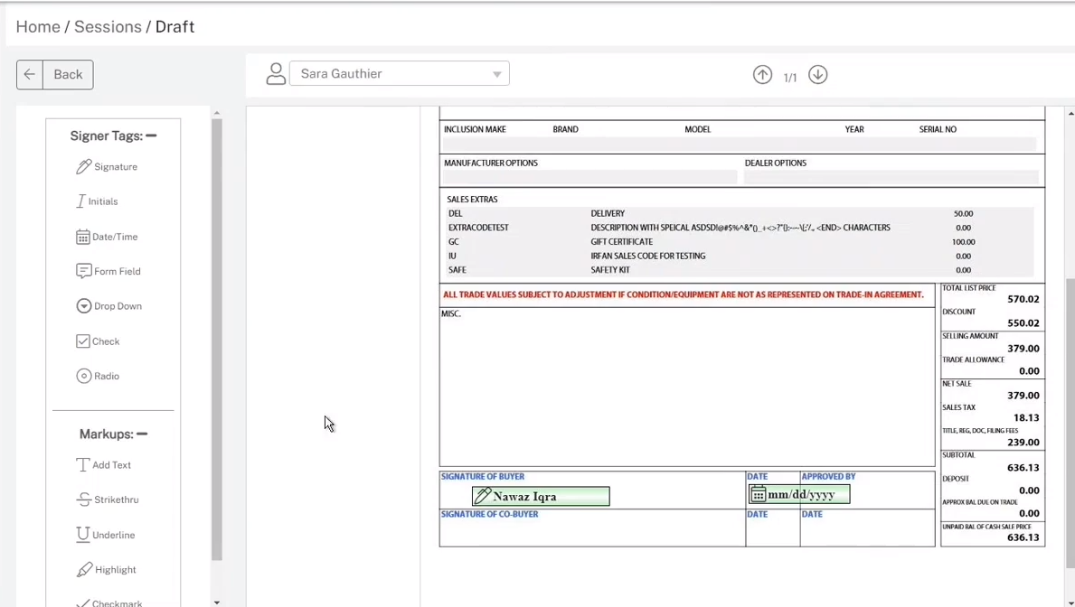
Items to Highlight
Work-a-deal
E-Sign for Sales Quotes
We need her Initials to approve this quote.

Slide 33
Items to Highlight
Work-a-deal
E-Sign for Sales Quotes
Same as before, but this time will drag Initials

Slide 34
Items to Highlight
Work-a-deal
E-Sign for Sales Quotes
And let’s add a date and time for that

Slide 35
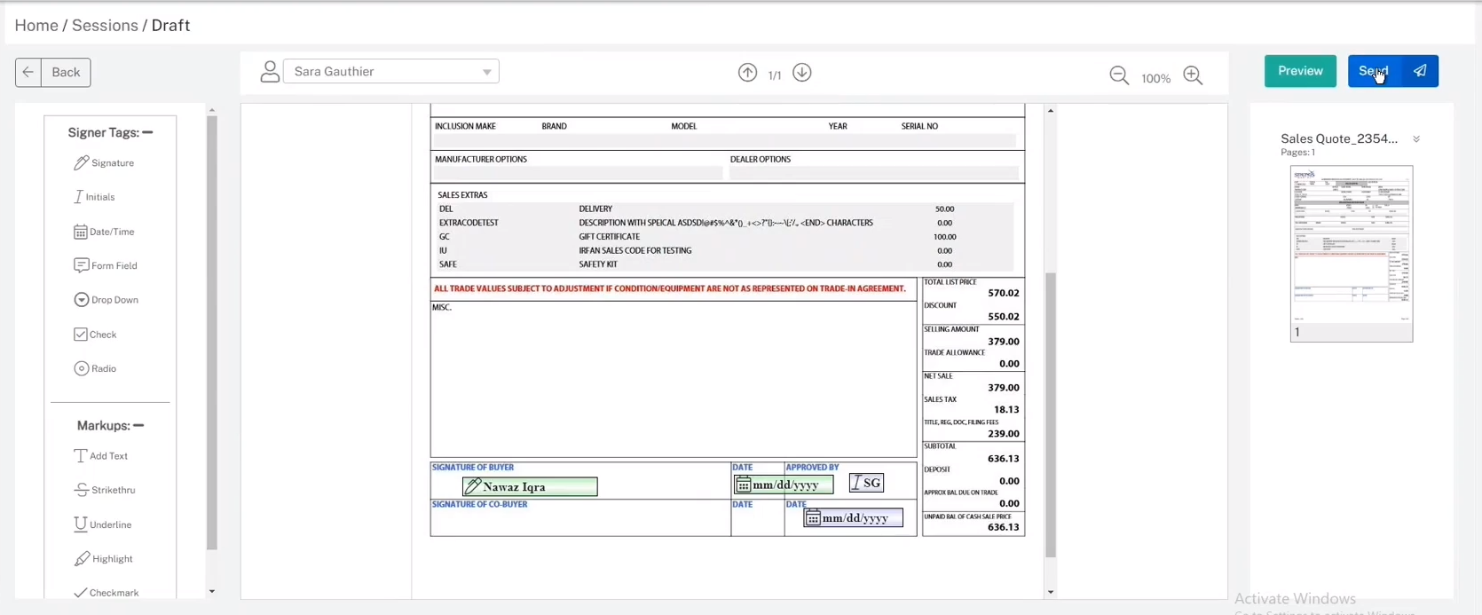
Items to Highlight
Work-a-deal
E-Sign for Sales Quotes
And let’s add a date and time for that
Now the form is complete we can send to the customer

Slide 36
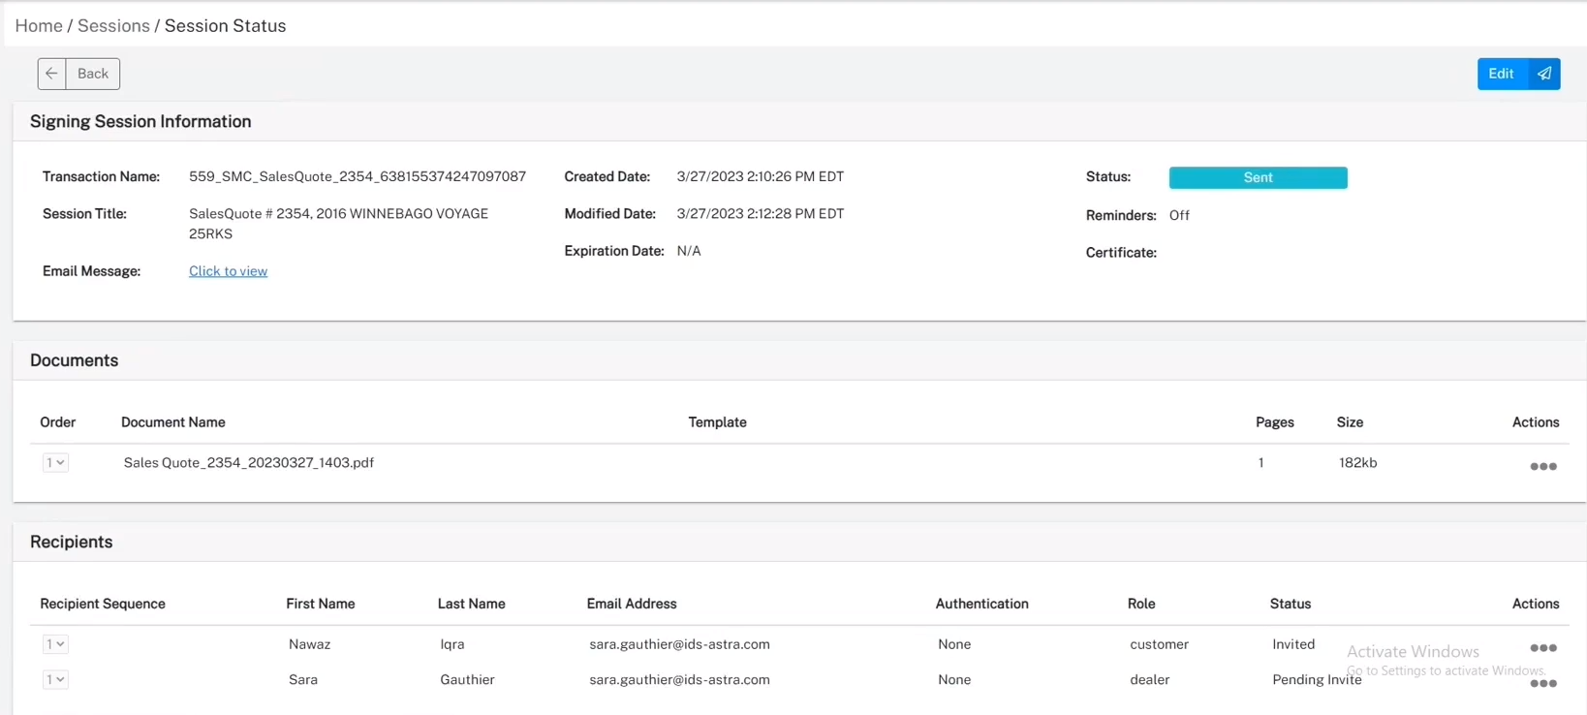
Items to Highlight
Work-a-deal
E-Sign for Sales Quotes
And let’s add a date and time for that
This is the next window to pop up and it is showing a status of “Sent”

Slide 37
Items to Highlight
Work-a-deal
E-Sign for Sales Quotes
And let’s add a date and time for that
Now close the browser and return to your Sales Quote

Slide 38
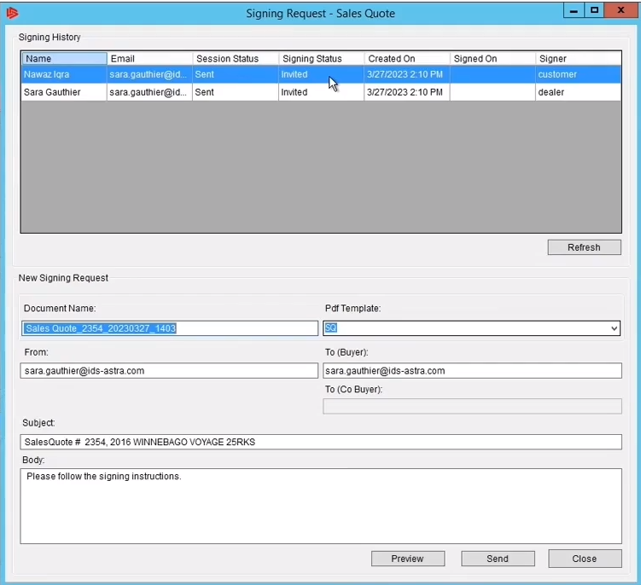
Items to Highlight
Work-a-deal
E-Sign for Sales Quotes
Session Status now shows “Sent”

Slide 39
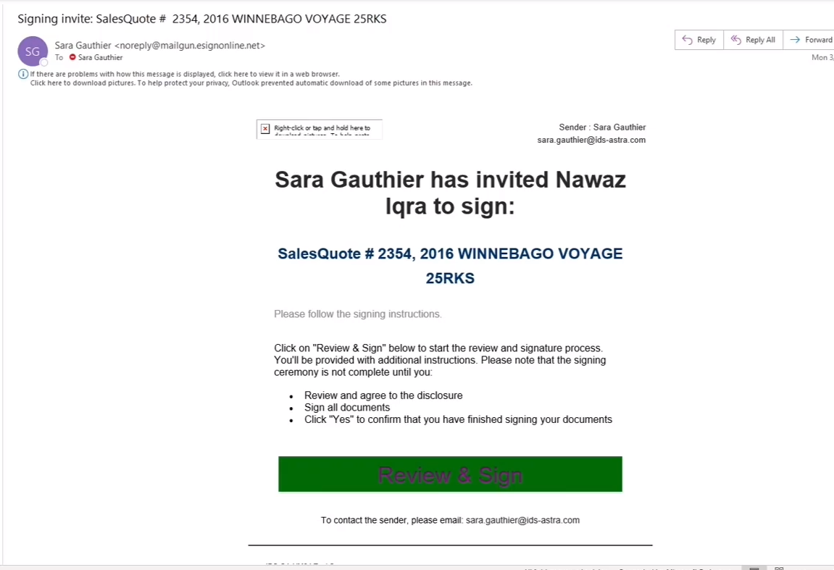
Items to Highlight
Work-a-deal
E-Sign for Sales Quotes
This is an example of the email the customer will receive, they would press “Review & Sign”

Slide 40
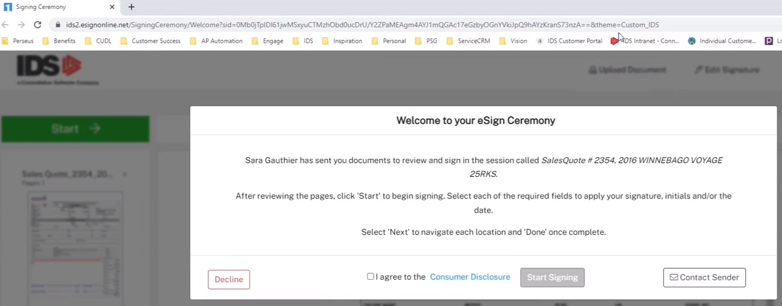
Items to Highlight
Work-a-deal
E-Sign for Sales Quotes
A browser window will open and ask them to agree and “Start Signing”

Slide 41
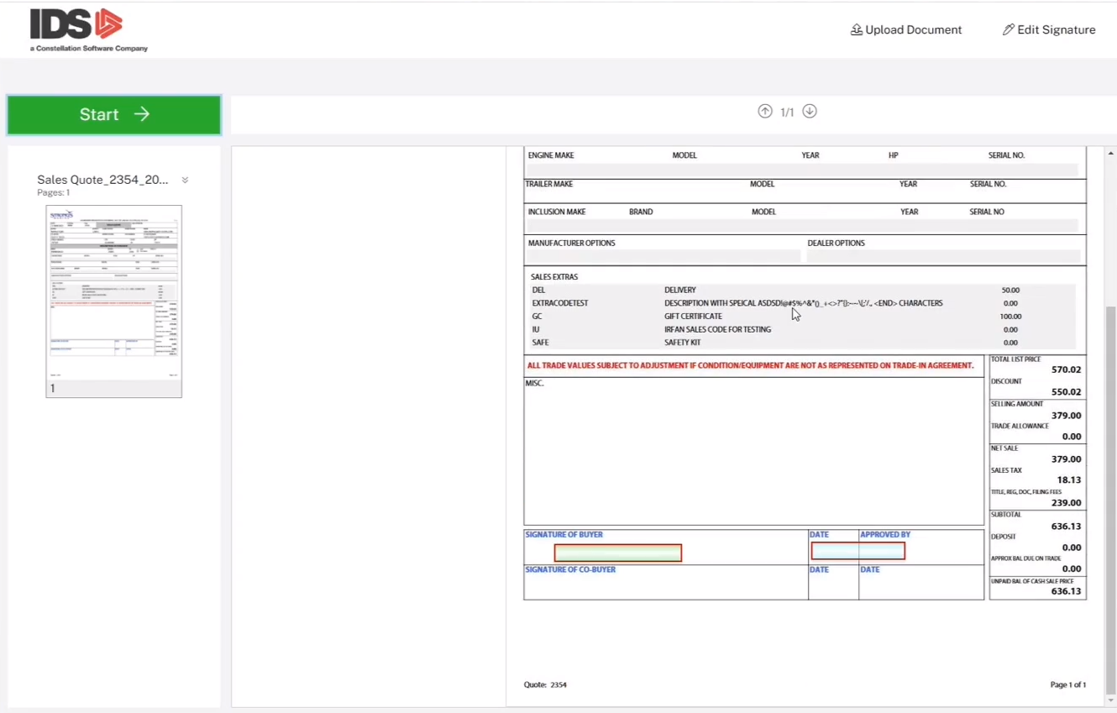
Items to Highlight
Work-a-deal
E-Sign for Sales Quotes
In this example they would click on the signature box and then the date box to insert that information

Slide 42
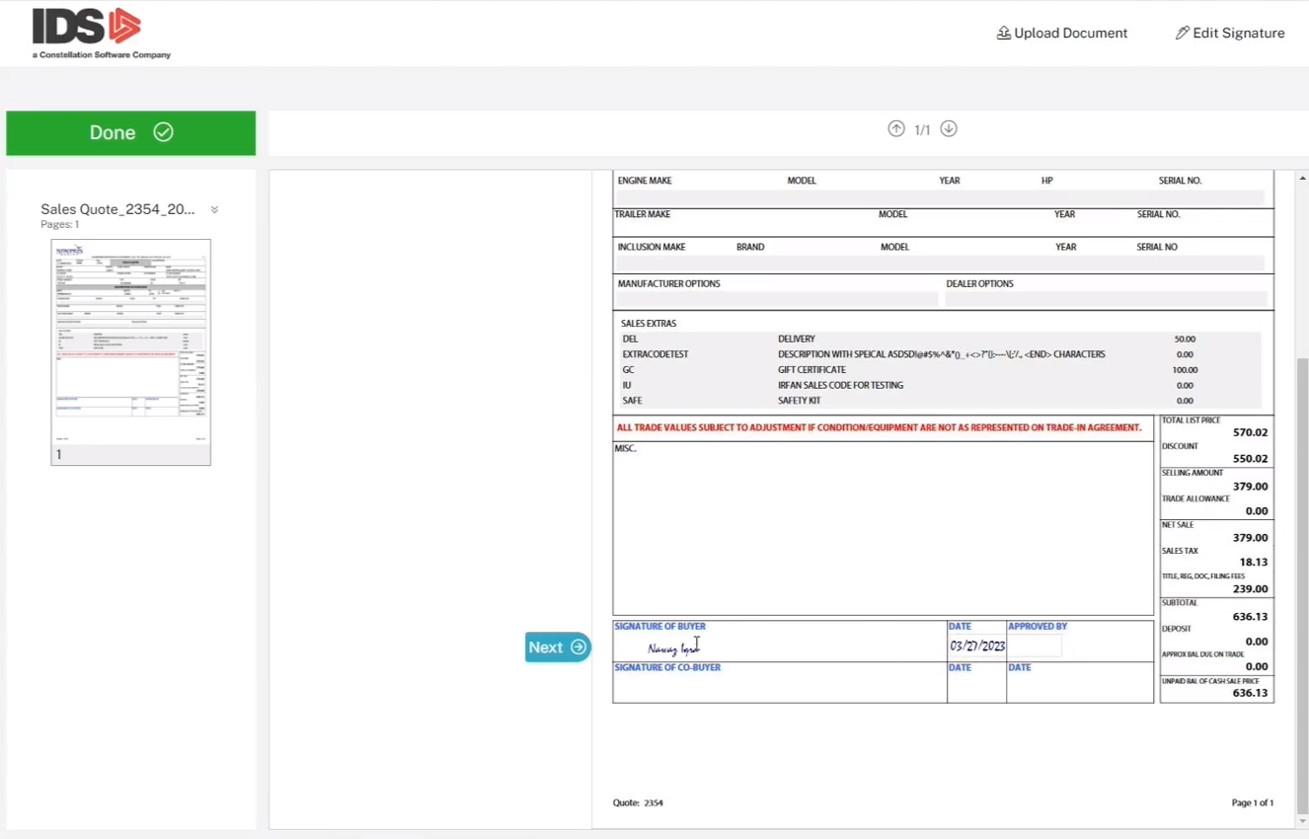
Items to Highlight
Work-a-deal
E-Sign for Sales Quotes
When they click “Next” they will get this conformation request

Slide 43
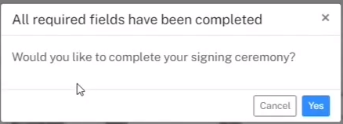
Items to Highlight
Work-a-deal
E-Sign for Sales Quotes
When they click “Next” they will get this conformation request

Slide 44
Items to Highlight
Work-a-deal
E-Sign for Sales Quotes
Congratulations, they are done with “their” portion

Slide 45
Items to Highlight
Work-a-deal
E-Sign for Sales Quotes
Salesperson gets an email that their customer has signed

Slide 46
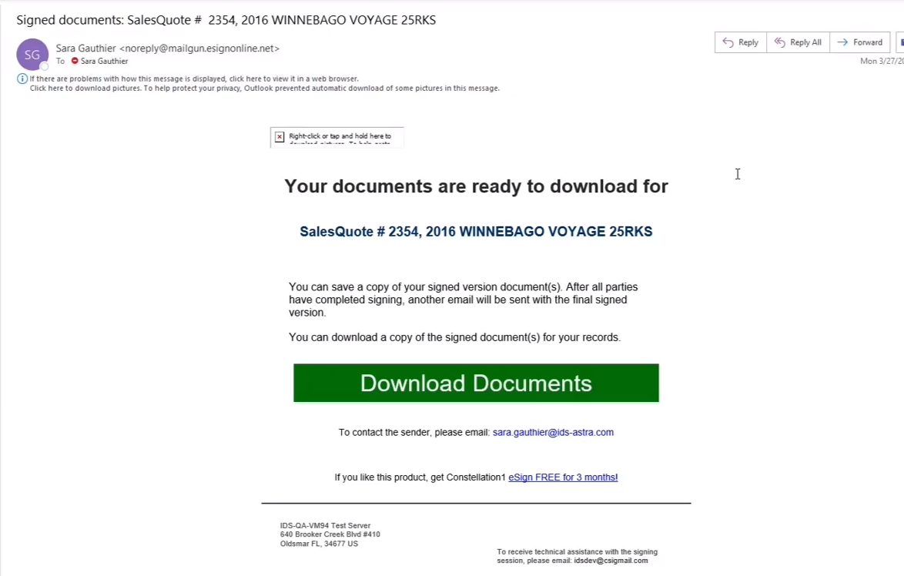
Items to Highlight
Work-a-deal
E-Sign for Sales Quotes
The customer also gets an email and can download what they signed.

Slide 47
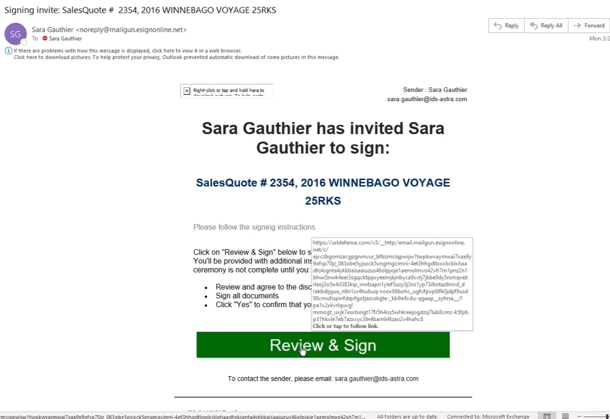
Items to Highlight
Work-a-deal
E-Sign for Sales Quotes
The salesperson gets an email requesting they initial and date they approve the quote.

Slide 48
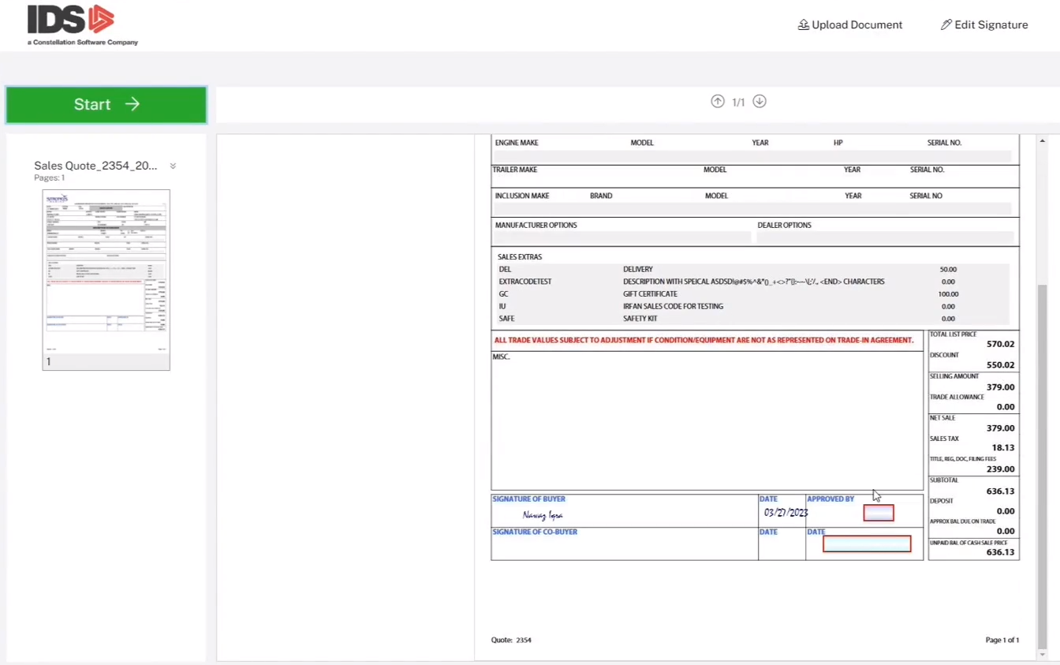
Items to Highlight
Work-a-deal
E-Sign for Sales Quotes
Salesperson would initial and date just like the customer did,

Slide 49
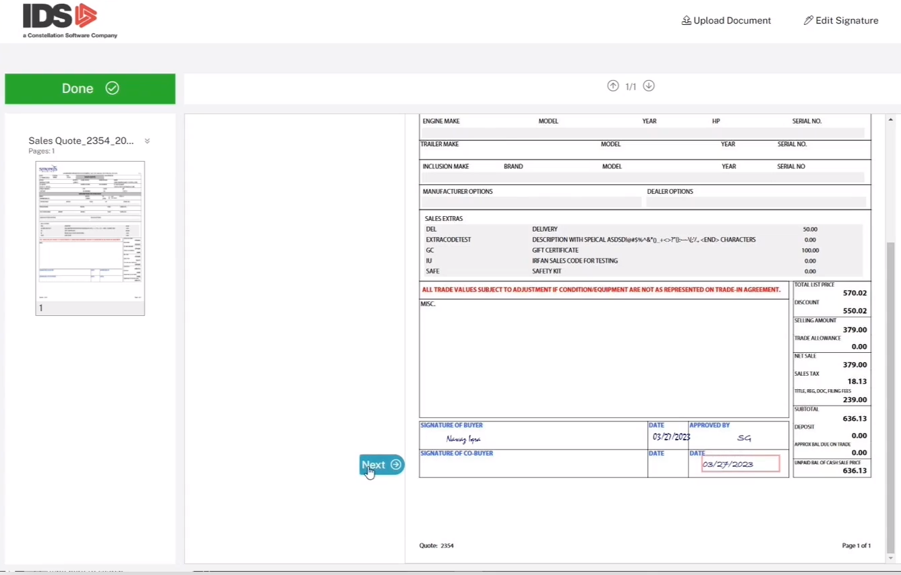
Items to Highlight
Work-a-deal
E-Sign for Sales Quotes
Salesperson would initial and date just like the customer did,

Slide 50
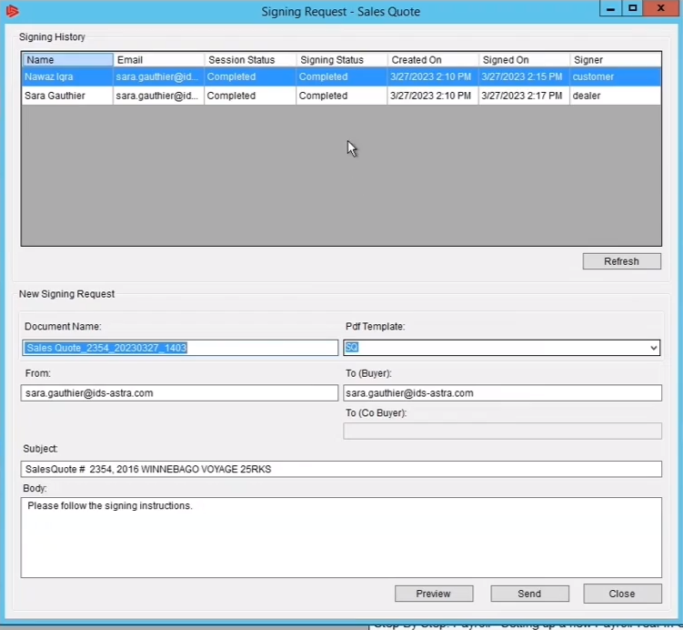
Items to Highlight
Work-a-deal
E-Sign for Sales Quotes
Session Status now shows “Completed”

Slide 51
Items to Highlight
Work-a-deal
E-Sign for Sales Quotes
If you click on the Document Manager

Slide 52
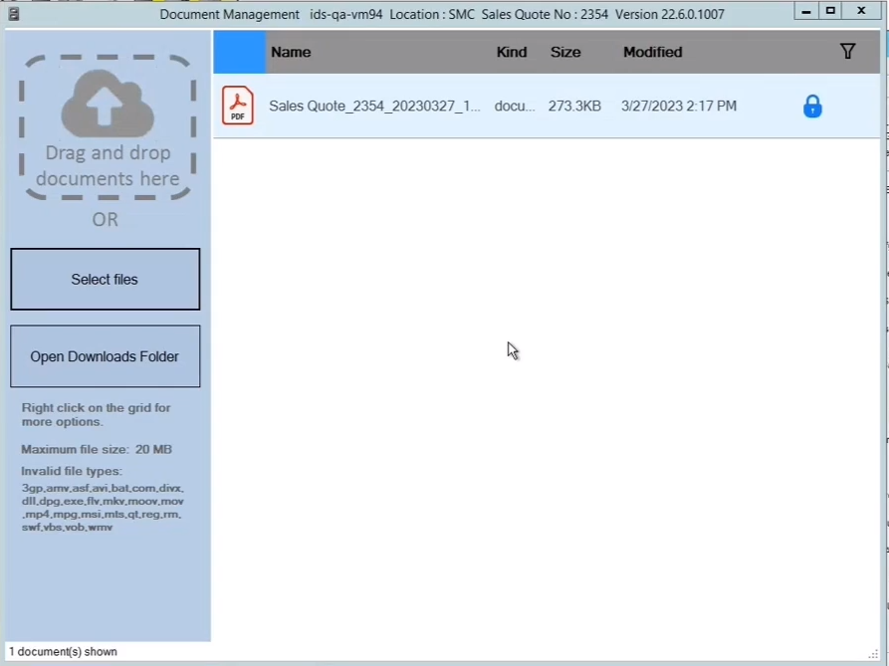
Items to Highlight
Work-a-deal
E-Sign for Sales Quotes
If you click on the Document Manager, you will have your signed document

Slide 53
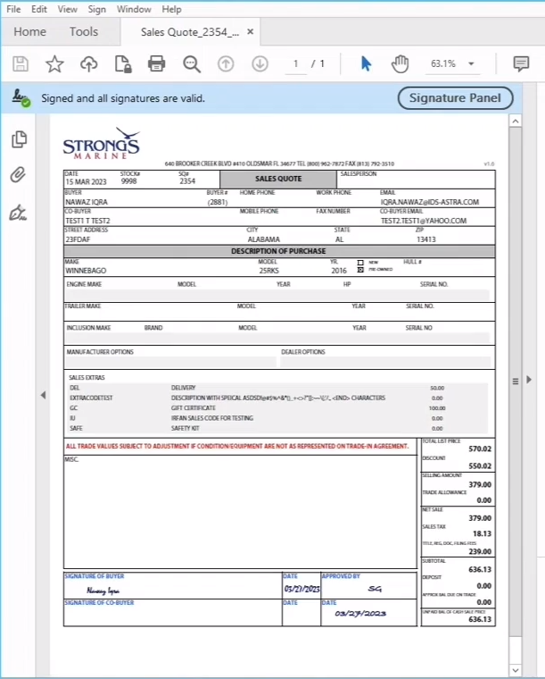
Items to Highlight
Work-a-deal
E-Sign for Sales Quotes
If you click on the Document Manager, you will have your signed document

Slide 54
Email quote

Slide 55
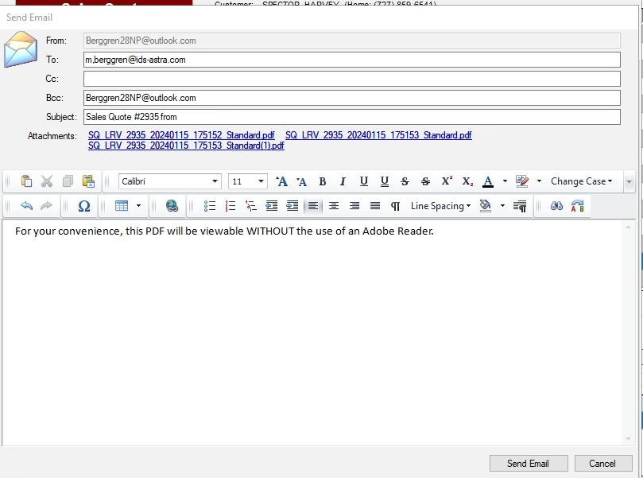
Email quote
You will be presented with a Draft that will be sent, if you are satisfied with the attachments & body of email…..?
Press send
Let’s look at some of the highlights / Information available in a Sales Quote
Notes:
Next slide functions

Slide 56
Quote History
Select Quote History, you will see every quote ever created for this stock #

Slide 57
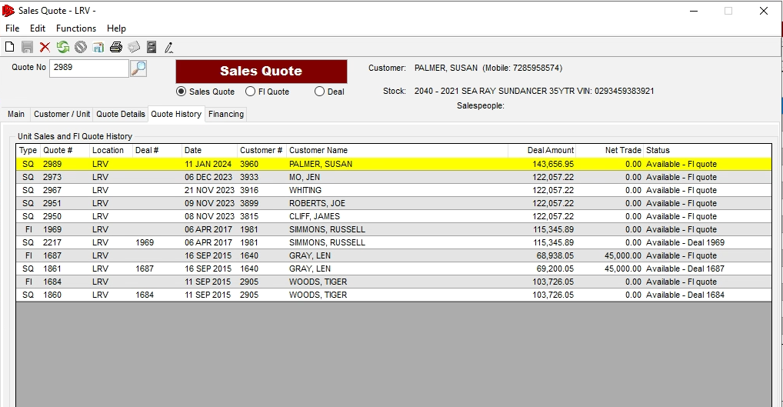
Quote History
Select Quote History, you will see every quote ever created for this stock #
Notes:
Customer History cont

Slide 58
Right click on customer number and choose “Full Edit’
Notes:
Next slide Maintain Customers

Slide 59
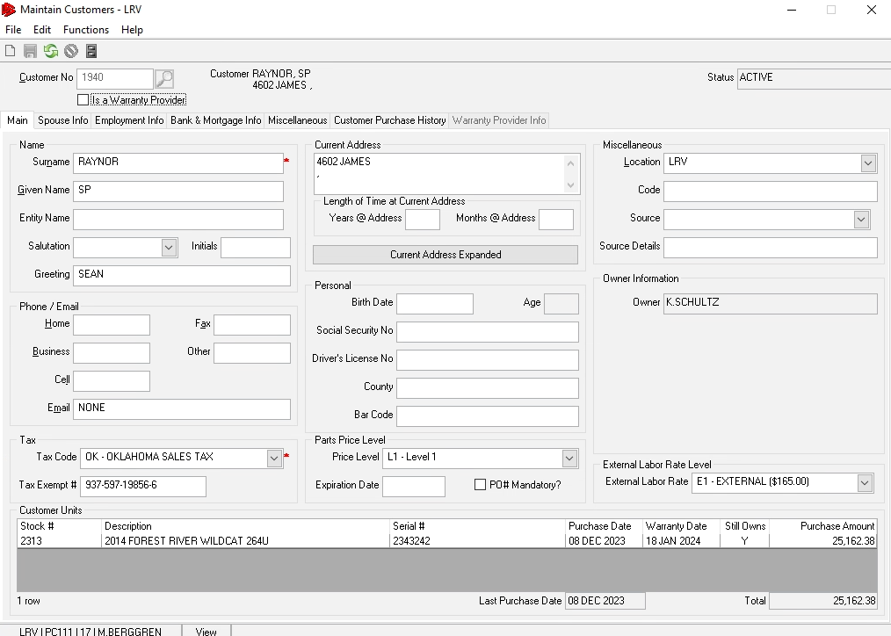
This will open the “Maintain Customer” window

Slide 60
The “Main” tab is details about the Contact

Slide 61
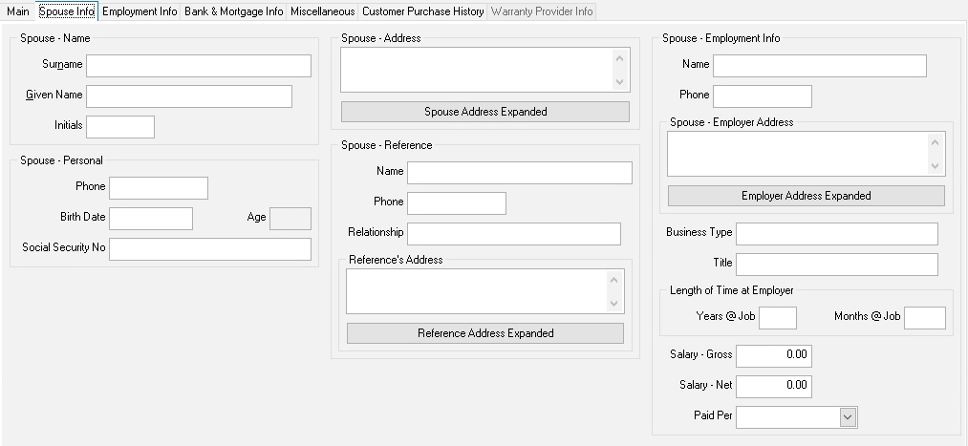
The “Spouse” tab

Slide 62
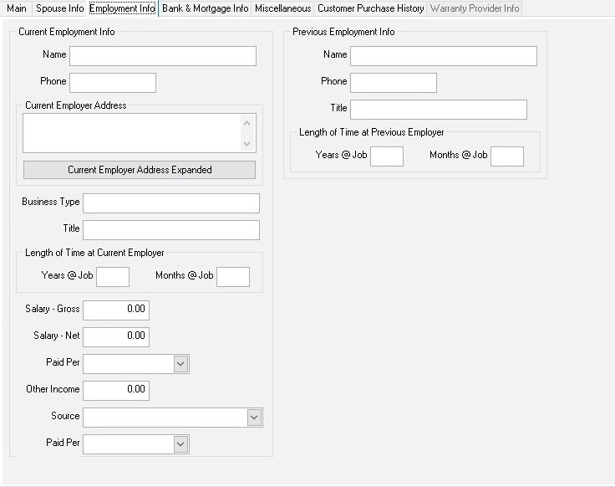
“Employment” info

Slide 63
Bank & Mortgage Info

Slide 64
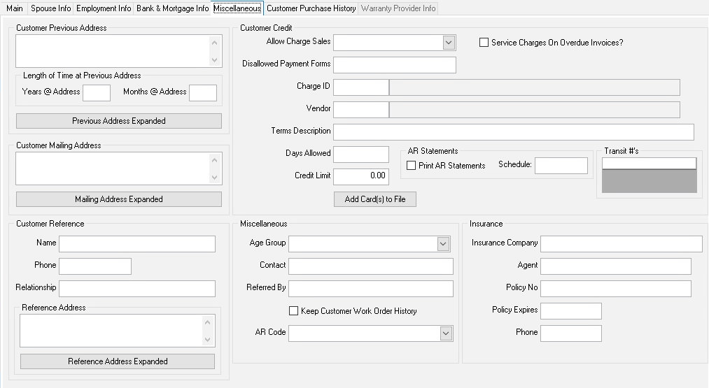
“Misc” Info

Slide 65
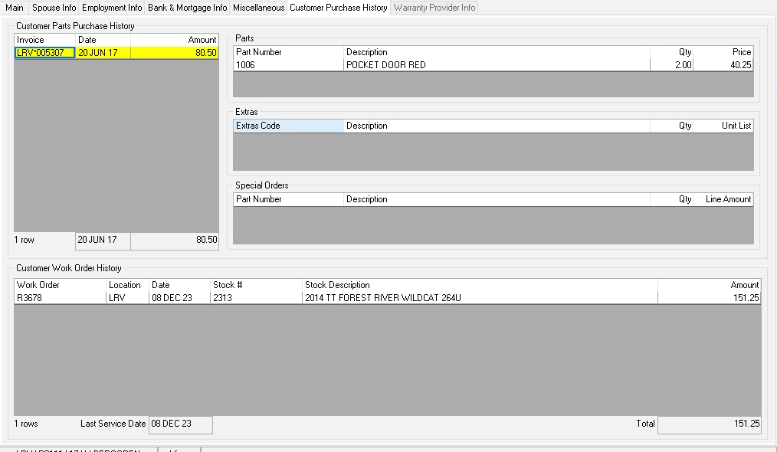
“Purchase” Info
Let’s move to the Quote details tab

Slide 66
“Quote Details”
Is where you see
*Their Trade
*Dealer Options
*Tow Vehicle Info
*Quotes GP
*Quotes Cost
*Units Work Orders
Notes:
Quick talk about each tab

Slide 67
Let's spend some time in the GP tab regarding “Working a Deal”

Slide 68
Say you want a 12.00 % deal instead of a 7.29 %

Slide 69
Just change it to 12.00 % and press tab

Slide 70
You will get a Pop up window asking….
do you want the Sales amount increased to give you that GP %
or
do you want the Trade allowance decreased to give you that GP %

Slide 71
You have adjusted your price and now your GP is 12 %

Slide 72
Say the Customer counters with a “Out the Door” offer of 11,500.00 plus their trade.
What kind of GP would that give you ?
Change the “Total” field to 11,500.00

Slide 73
In this example that reduced the selling price from $26,197.74 to $25,727.77
Resulting in a 10.05 % deal

Slide 74
Summary of the “Gross Profit” tab
Any changes to the highlighted fields, will impact the GP Percent/GP Profit Amt of the deal.

Slide 75
Summary of the “Gross Profit” tab
Any changes to the highlighted fields, will impact the GP Percent/GP Profit Amt of the deal.
Now that you have seen how to Work-A-Deal using the GP Tab, lets look at how to Work-A-Deal using the “Work-a-Deal” Function

Slide 76
Click on Functions
then Work-A-Deal

Slide 77
You have 2 distinct areas to work the deal
Finance Payments
Gross Profit Calculations

Slide 78
Work-A-Deal
Finance Payments
The payments section works like you expect, if the customer asked for a payment of 250.00, then change the Monthly to 250.00

Slide 79
Work-A-Deal
You will now see the “Roll To” window
Select the radio button of what you want adjusted to obtain the desired 250.00 payment and press OK
Is this example I would select “Down payment”

Slide 80
Work-A-Deal
Finance Payments
Now their payment is 250.00 based on them coming up with a $536.70 down payment

Slide 81
Work-A-Deal
Gross Profit Calculations
Pretty much same logic as shown in the GP tab earlier.
Let's change the GP % from 10.05 % to 11.50 %

Slide 82
Work-A-Deal
Gross Profit Calculations
You are being asked, should the Price be increased, or Trade Allowance decreased to get to the desired GP

Slide 83
Work-A-Deal
Gross Profit Calculations
The trade allowance was 16,000.00 and now is 15,652.62 and the GP is 11.50

Slide 84
Work-A-Deal
Summary:
The top box is to work payments
The bottom box is to work GP
No update or changes happen to the quote until you press the
Apply to Quote button

Slide 85
Let’s convert this to a Finance Quote
Click in File

Slide 86
There are 4 different tabs than on the Sales Quote

Slide 87
The DO/WO Comparison tab
Top box shows all the included Dealer Options
The bottom box shows all of the internal work orders.

Slide 88
The Finalize Quote tab
Mandatory Fields in Red.
All others are optional

Slide 89
The Financing tab
Select the Bank or Cash.
These are key fields to explore to see how to use best

Slide 90
FI Package tab for Menu Selling
Have 3 Options and build a 4th on the fly if needed

Slide 91
The Quote Details” tab has some extra sub tabs

Slide 92
Let’s create a Deal, by clicking on File

Slide 93
Pop Quiz…..
What are the 4 Major items happening when a Deal is created ?

Slide 94
Pop Quiz…..
What are the 4 Major items happening when a Deal is created ?
The Unit status is changed to “Sold Available” or “Sold On Order”
You are prompted to create a Sales Work Order
You can receipt a customer deposit into the system
An email notification is sent letting people know a unit has been Sold

Slide 95
Pop Quiz…..
What are the 4 Major items happening when a Deal is created ?
The Unit status is changed to “Sold Available” or “Sold On Order”
You are prompted to create a Sales Work Order
You can receipt a customer deposit into the system
An email notification is sent letting people know a unit has been Sold

Slide 96
Pop Quiz…..
What are the 4 Major items happening when a Deal is created ?
The Unit status is changed to “Sold Available” or “Sold On Order”
You are prompted to create a Sales Work Order
You can receipt a customer deposit into the system
An email notification is sent letting people know a unit has been Sold

Slide 97
Pop Quiz…..
What are the 4 Major items happening when a Deal is created ?
The Unit status is changed to “Sold Available” or “Sold On Order”
You are prompted to create a Sales Work Order
You can receipt a customer deposit into the system
An email notification is sent letting people know a unit has been Sold

Slide 98
Same tabs as FI Quote

Slide 99
Additional “Commissions” tab and additional payment functionality in the Payments/Tax” tab

Slide 100
Must be filled out before unit will post

Slide 101
The “Deal” is where you can receipt in a payment.

Slide 102
The “Deal Manager” “Main” tab is where you can see all your Sold but not delivered units “SA”

Slide 103
The “Deal Manager” “Gross Profit” tab is where you can see all you
Pipeline Profits for “Sold but not delivered units
Or
Your profits on posted units

Slide 104
How to get Support Help
The best way to get support is to sign up on the IDS Portal website,
Visit: https://portal.ids-astra.com/login
Here you can register to send in a support ticket and access the vast amount of online reference materials.

