Slide 1
Keys to Unlocking Efficiency Across Your Dealership
IDS User Conference
February 8, 2024

Slide 2
Allison Miller
Sales Engineer
Notes:
A little bit about me. The majority of my career has been in accounting and administration.
After more than a decade in the telecom industry I joined B. Young RV as their Controller
Helped Bruce sell the business and stayed on as GM for Lazydays

Slide 3
Agenda
Release Updates & Training
Sales, Inventory F&I
New Unit Build
Dealer Options
AppOne Integration
Lead Integration
Parts & Service
Flat rate file import
eSign
Parts Manager
Parts Request Online
Accounting/Back Office
AP Automation
AP Import
Budget Import
GL Import
Charge it Pro Integration
Reporting
Dealer Feedback

Slide 4
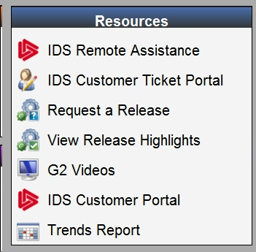
Release Updates
What: Astra/G2 & Service Mobile
When: Twice per year - Spring & Fall
How: Request via G2 Welcome page
Why:
New features
Performance enhancements
Current Versions: 23.14
Notes:
Note: 360 Products update automatically

Slide 5
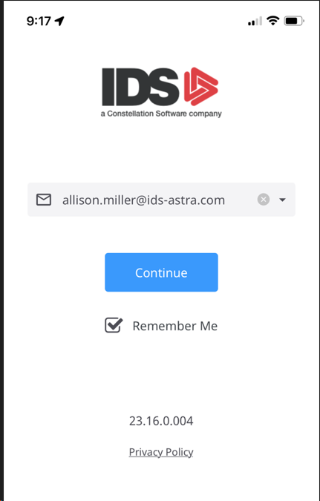
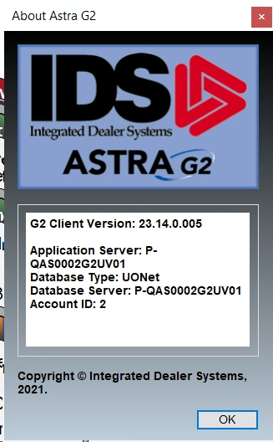
What Version am I on?
Service Mobile:
G2:
Notes:
Note: 360 Products update automatically

Slide 6
The Importance of Ongoing Training
Reduce Skills Gaps
Boost Productivity
Improve Morale
Foster Loyalty
Reduce Turnover
Notes:
All of this contributes to the bottom line

Slide 7
Available Resources
LMS & Online Training Videos for New Hires
Customer Portal
Knowledge Base
Department Workbooks
Ongoing On-Site Training

Slide 8
Sales, Inventory and F&I
Lead Integration & Follow-Up
AppOne/CUDL Integration
New Unit Build
Dealer Options

Slide 9
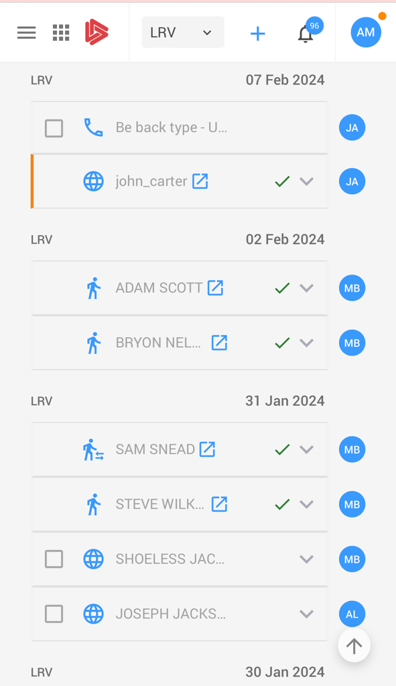
Lead Integration – SalesCRM Online
Import web leads via xml and e-mail from:
Your website
Manufacturer website
RVtrader / Boattrader.com, etc.
Manual or automatic assignments to sales
Push notifications to mobile devices
Notes:
Click to quote

Slide 10
AppOne/CUDL Integrations
Push deal data to AppOne/CUDL
Save 15 minutes per deal on data entry
Reduce errors
Say goodbye to dot matrix printers…
Notes:
Save 15 minutes per deal and increase accuracy

Slide 11
AppOne/CUDL Integrations
G2: F&I Quote→Functions→Loan Processing
Bluescreen: 14-1-1, “LP”
Notes:
Save 15 minutes per deal and increase accuracy
Only applies to US Dealers

Slide 12
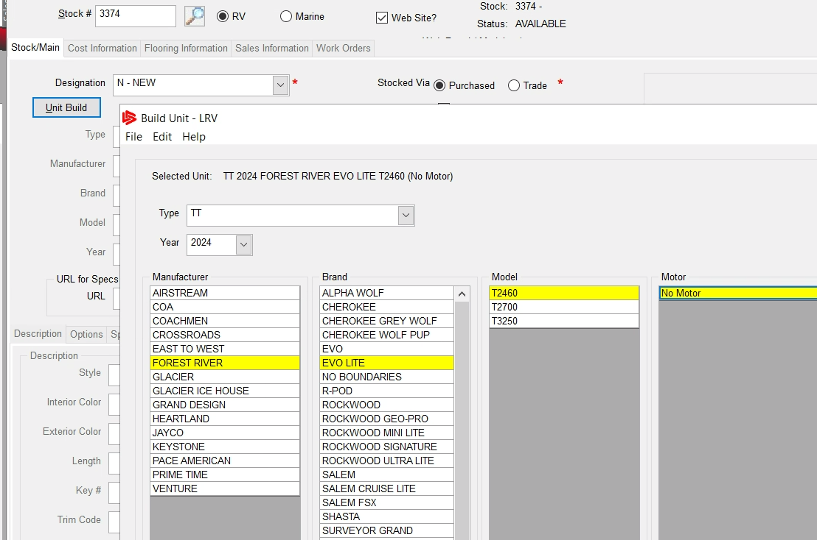
New Unit Build
Decrease data entry time
Increase consistency & accuracy

Slide 13
New Unit Build
Enable/disable:
Inventory module config #24 (new) & 34 (used)
Setup:
Admin→Setup→Update Codes & Table→Inventory→Update Manufacturer Specs
Sales→Utilities→Import Unit Build Data

Slide 14
Dealer Options
Automatically create works order for PDI, accessory installs, etc.
No need to wait for a quote from service for standard items
E-Mail notification to internal advisor
View DO estimate vs actual WO costs

Slide 15
Dealer Options
Setup:
Create/edit: Admin→Setup→Update Codes and Tables→Inventory→Maintain Dealer Options
E-mail: Admin→Setup→Update codes and Tables→Admin→Update Automatic Email Parameters

Slide 16
Parts & Service
Parts Manager
Parts Request Online
Flat Rate File Import
eSign

Slide 17
Parts Manager
View & manage stock levels and obsolete parts
Uses mins & maxes

Slide 18
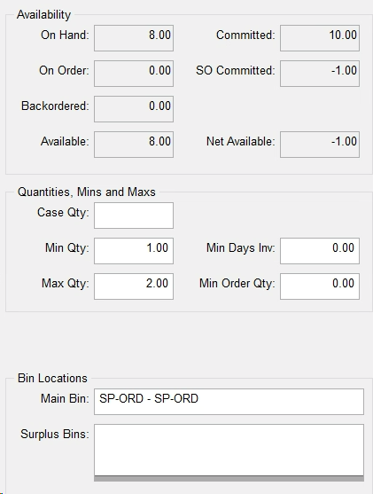
Parts Manager
Update min/max from Parts Maintenance
For a list of current mins & maxes: “Print Vendor Reports”
For historical sales: “Parts Sold by User Report”
Best (min/max & usage):
“Parts Consumption Report”

Slide 19
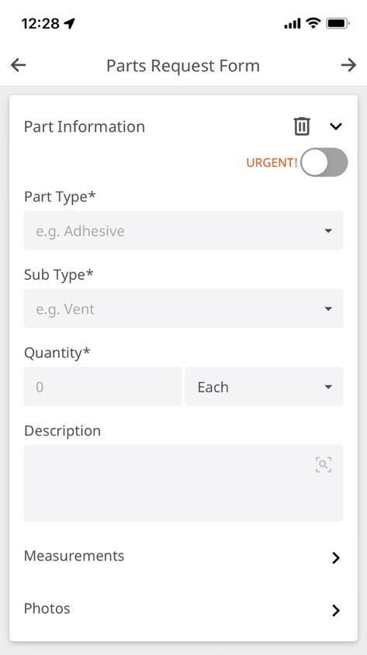
Parts Request Online
Replace paper parts rec sheets – tech submits via Service Mobile
Approval workflow
Automatically add parts to WO when P&A is complete
Measure response times

Slide 20
Flat Rate File Import
Existing:
Service→Utilities→Import Flat Rate Codes
Spader/RVDA, Winnebago, Keystone, Forest River, Mercury, Jayco and K-Z
New:
Custom Import
Functions→ Maintain Other Providers

Slide 21
Flat Rate File Import

Slide 22
eSign
E-mail estimates, work orders, and sales quotes to your customers
Signed docs automatically save to doc manager
Also works from Service Mobile
Create your own templates using the eSign portal
Job line level approvals: Service config #198

Slide 23
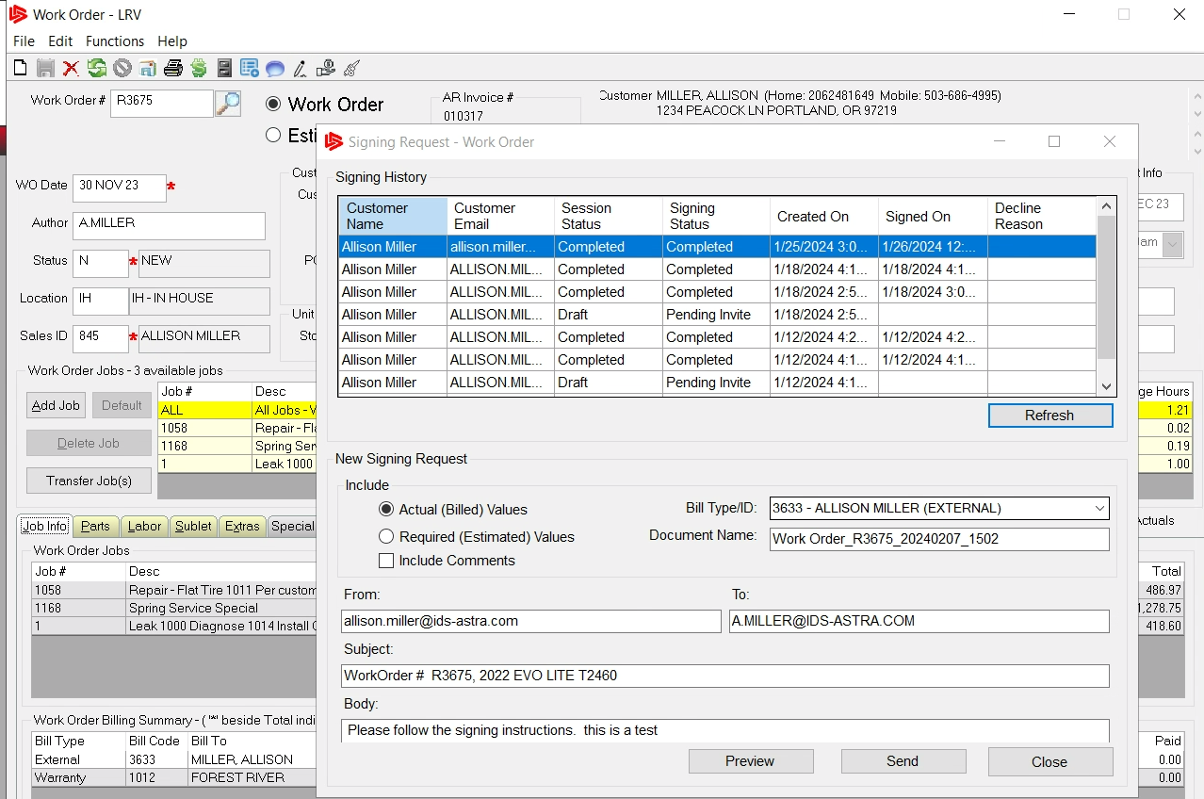
eSign

Slide 24
Accounting & Back Office
AP Automation
Auto post the GL
Imports:
AP
Budgets
GL Transactions
Charge it Pro Integration
Reporting

Slide 25
AP Automation for Parts
Existing G2 functionality
Aligns payable creation with vendor invoices
Enable/Disable: Parts Module config #51
Setup freight account: Parts Module #93

Slide 26
Full AP Automation
3rd Party Integrated Solution
Data is securely and compliantly stored
Securely upload documents
Auto-routing for approvals
Customized review and approval
Bi-directional sync of data with IDS
Robust reporting
Advanced data extraction
Realize an
80%
reduction in human effort

Slide 27
Auto-Post the GL
Reduces the need to manually run the ‘Post GL Transactions’ routine
Can set to a specific increment of time: daily, hourly or as often as every 10 minutes
E-mail request to support@ids-astra.com

Slide 28
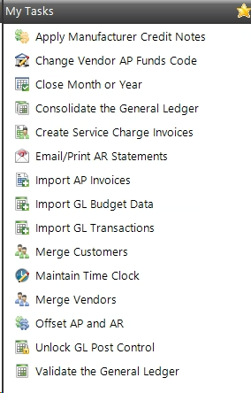
Accounting Imports
Imports:
AP Invoices
Budgets
GL Transactions
Can import multiple locations at a time!
Accounting→Utilities→Import AP Invoice/GL Budget Data/GL Transactions
Notes:
Examples of transactions: CC charges, payroll
Also see JE templates (aka schedules)

Slide 29
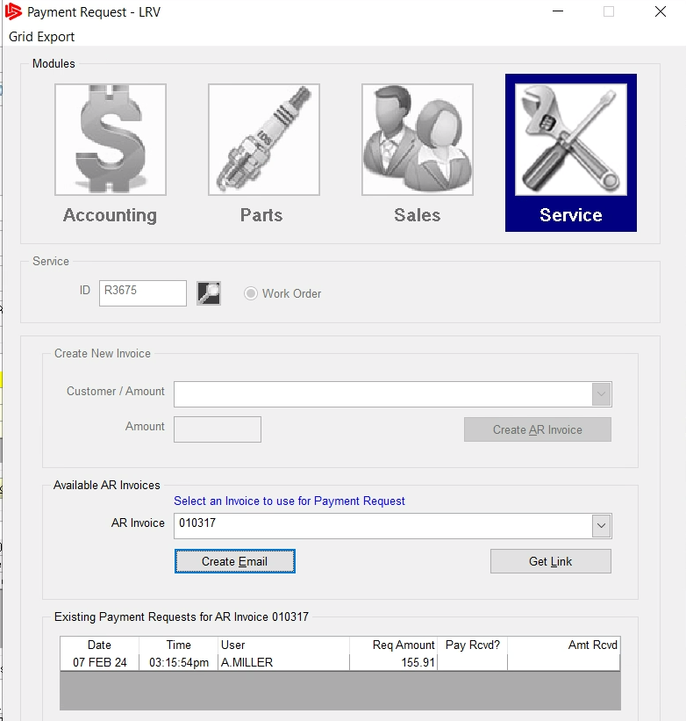
Charge It Pro Integration
Process CC payments & post to IDS
Email or Text payment requests to customers
Securely store credit card info

Slide 30
Reporting with Leadership Insights
Easily accessible
Log into one place to find reports for all departments & locations
Can be done anytime, from anywhere
iOS and Android Apps and software plug-ins available
Easy to review and understand plus drill-down capabilities
Adds efficiency and saves time
Prepared for you
Templated
Data pulled from IDS DMS each night

Slide 31
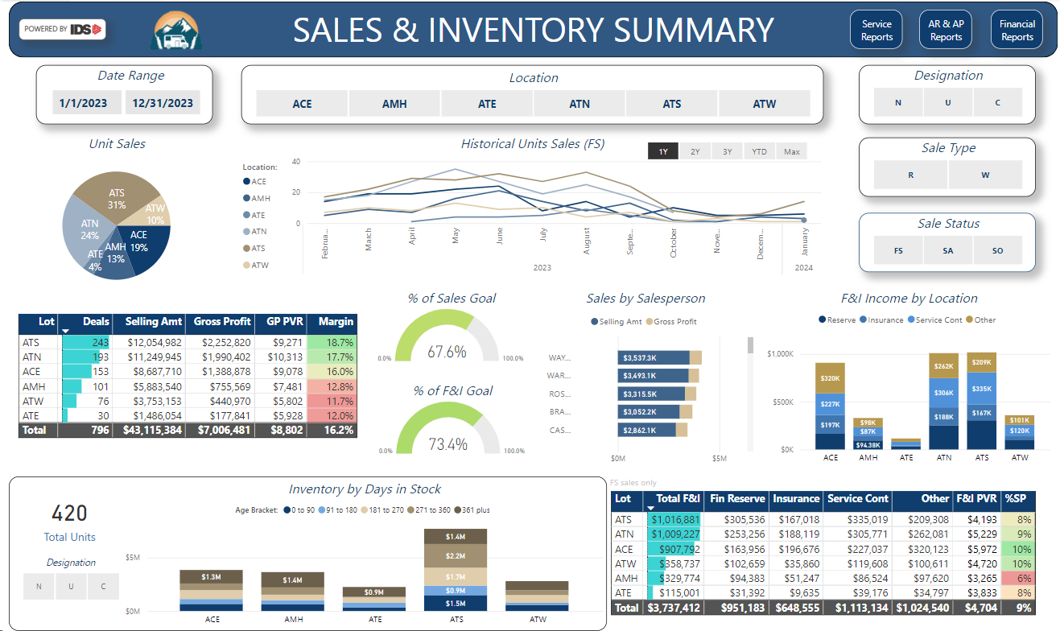

Slide 32
Dealer Feedback
What are your time-saving tricks?
Hot keys: Right click on a menu item and assign an F key

Slide 33
How to get more info
Here at the User Conference
Account Managers: Kevin & Wylie

