Slide 1
Elevating Service Dept Management Through Advanced Reporting
February 2023

Slide 2
Sara Gauthier
Customer Success Coordinator

Slide 3
About Me
Boat dealership job in College
Employed at IDS in the 90’s as a trainer
Full circle back to IDS in 2020 after a career in training and large-scale event management

Slide 4
Elevating Service Department Management through Advanced Reporting
Reporting:
Technician Efficiency
Completed Labor

Slide 5
Why is Technician Efficiency important to your operation?

Slide 6
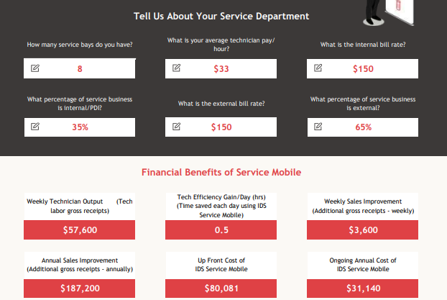
Let’s do some math!
8techs*.5hr=4hrs/day 4hrs*$150=$600/day
$600*6=$3600/wk
$3600*52=$187,200
Notes:
Assumptions – all 8 bays are booked solid for 8 hours daily for 6 days a week
Disregard the “financial benefits of service mobile”, although Service Mobile gives that ½ hour in tech efficiency

Slide 7
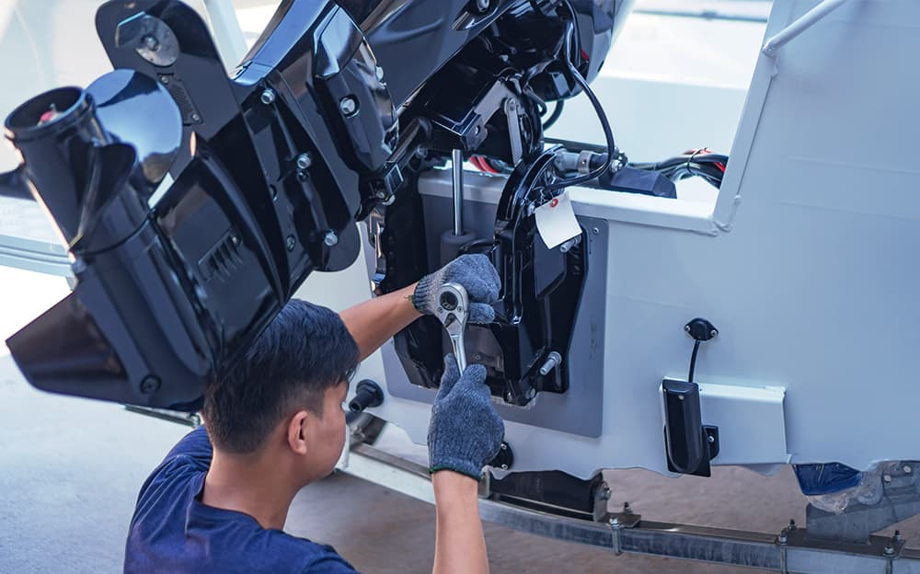
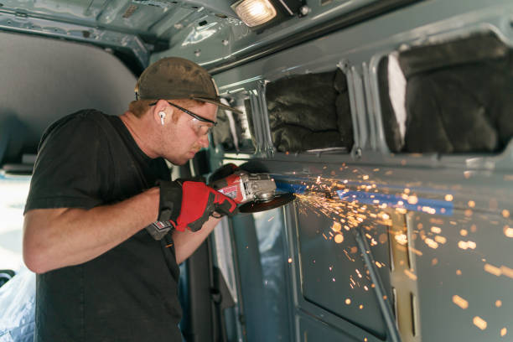
What can impact technician efficiency?
Processes set by management (or lack of)
Advisor communications (or lack of)
Waiting or looking for parts
Warranty approval
Lack of Tech Training
Tech movement
Unit movement
Tech organization
Kiosk for logging hours versus Mobile Device
Paper forms vs electronic devices

Slide 8
Benefits of using Service Mobile and Parts Request Online to improve efficiency
Better time tracking
Update job statuses quickly
Upload Photos
Tech notes
Parts Request Online – no more paper forms
Streamlined communications without tech leaving their bay

Slide 9
Terminology for Technician Efficiency
Premise Time
The time the technician is clocked into the dealership for the day using the time clock feature, ie 8am-5pm w/clock in/out for lunch
Required Time
The amount of time required to complete a job, maybe pre-established by a canned job
Actual Time
The amount of time it took the technician to do the job and mark it as completed - as they clock in/clock out of the job, the time accumulates
Billed Time
The time we are charging $ for
Technician Efficiency
Billed/Actual*100 = Efficiency – reported as a percentage
(*how you calculate efficiency may vary depending on your dealership – some do Billed/Premise)

Slide 10
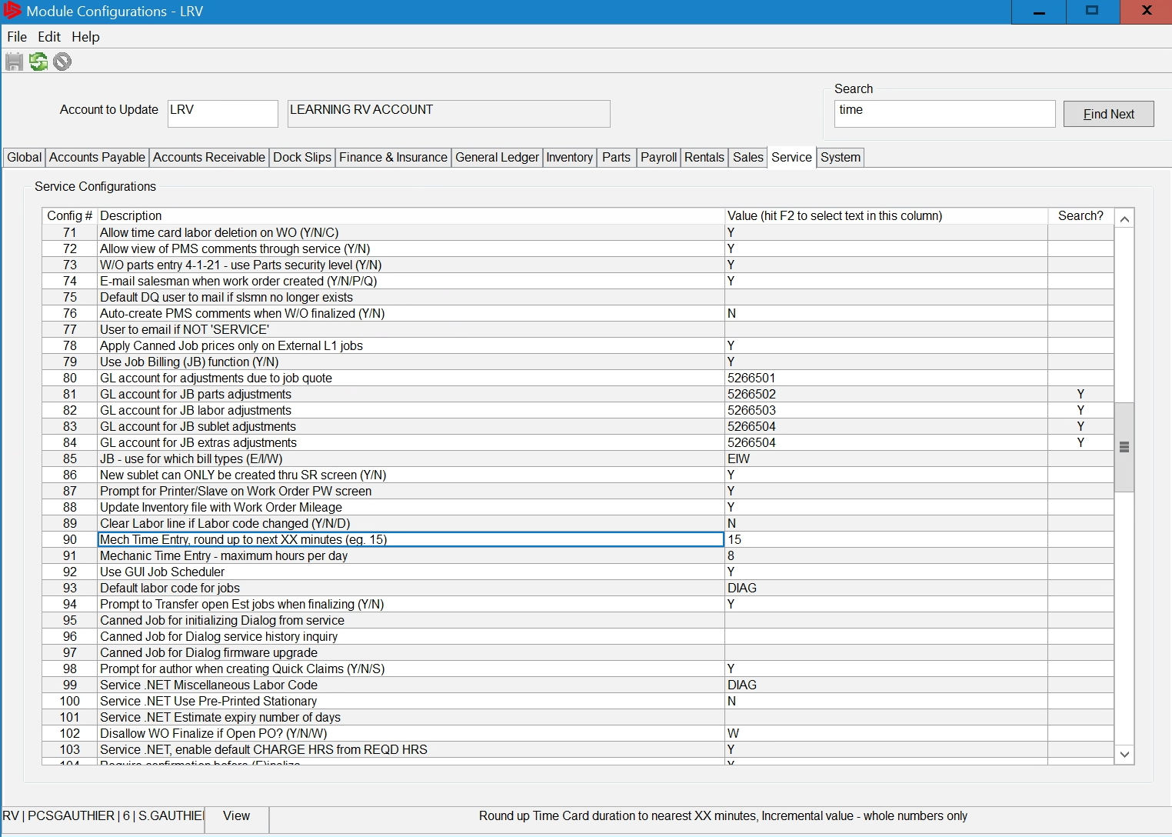
Service Module Configurations
Configurations can impact reporting results
Admin>Setup >Update Module Configurations >Service tab
Recommend an annual review of configs
Tip: use the search box at the top right and click find next to help find configurations
Notes:
Traditional Astra Fans: 11-10

Slide 11
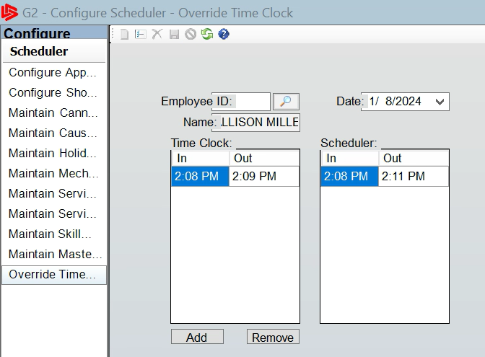
Premise Time – Time Clock
Question: I run a report and premise time is all messed up, how do I fix it?
Admin>Setup>Configure Scheduler>Override Time Clock
Notes:
This slide is hidden, don’t know if I will use or not

Slide 12
G2 Reporting - Efficiency
Service>Service Reports>Run Service Reports
Notes:
Traditional Astra fans: 4-3-2-34 (page 2 of the service reports)

Slide 13
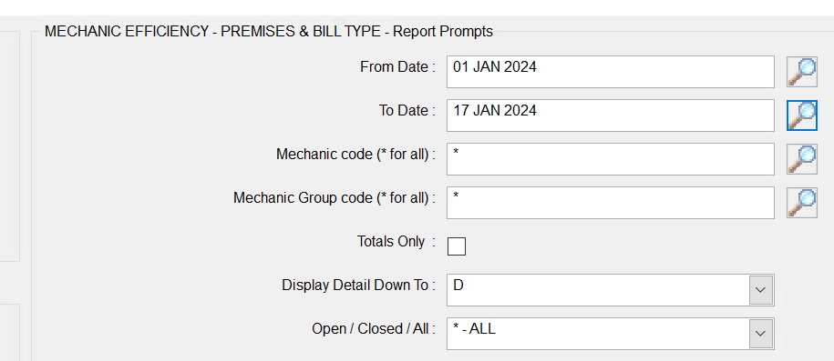
Mechanic Efficiency Premises & Bill Type
Filter Options
Run for specific timeframe
Notes:
Traditional Astra fans: 4-3-2-34-11

Slide 14
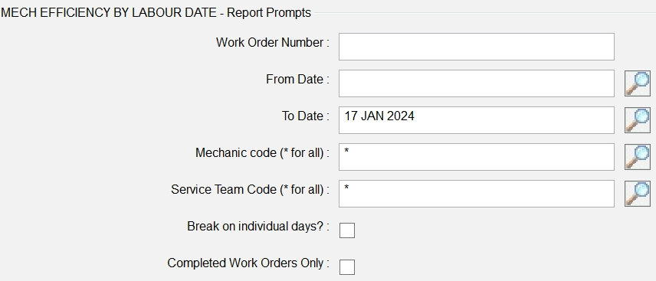
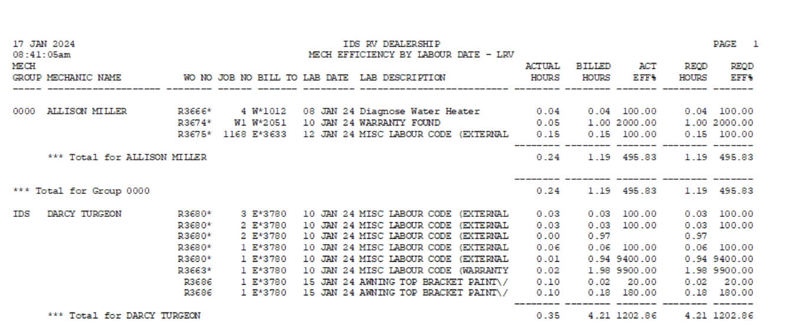
Mechanic Efficiency by Labor Date
Work Order Detail
Notes:
Can be run for completed or in progress
Traditional Astra fans: 4-3-2-34-3

Slide 15
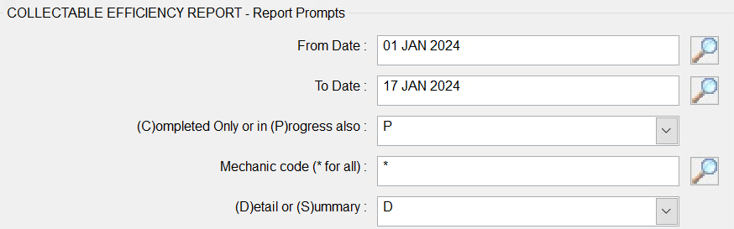
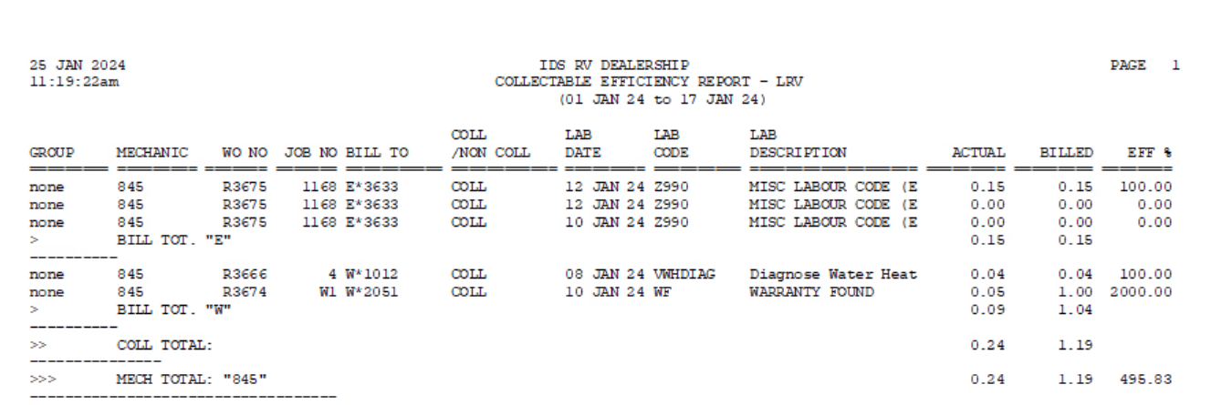
Collectable Efficiency
Work Order Detail
Controlled by Internal Bill Code setup
Notes:
Bluescreen fans 4-3-2-34-4

Slide 16
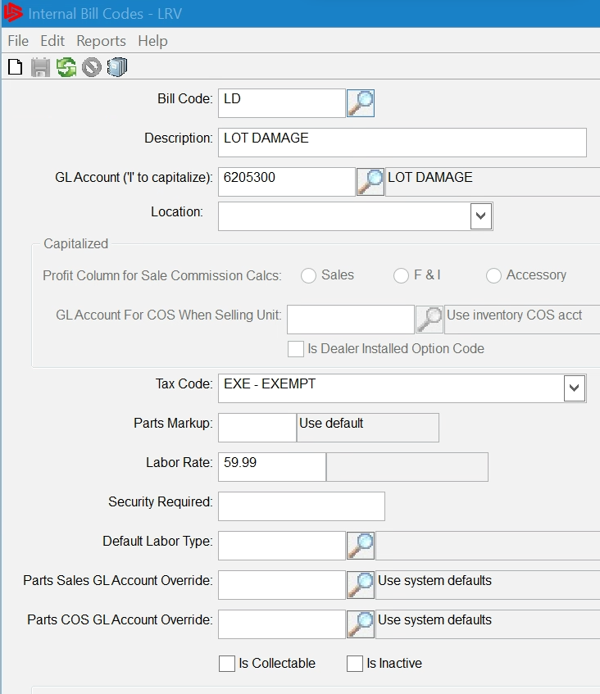
Collectable Efficiency
Work Order Detail
Controlled by Internal Bill Code setup*
*Bill code setup is under Admin>Setup>Update Codes and Tables>Service>Internal Bill Codes

Slide 17
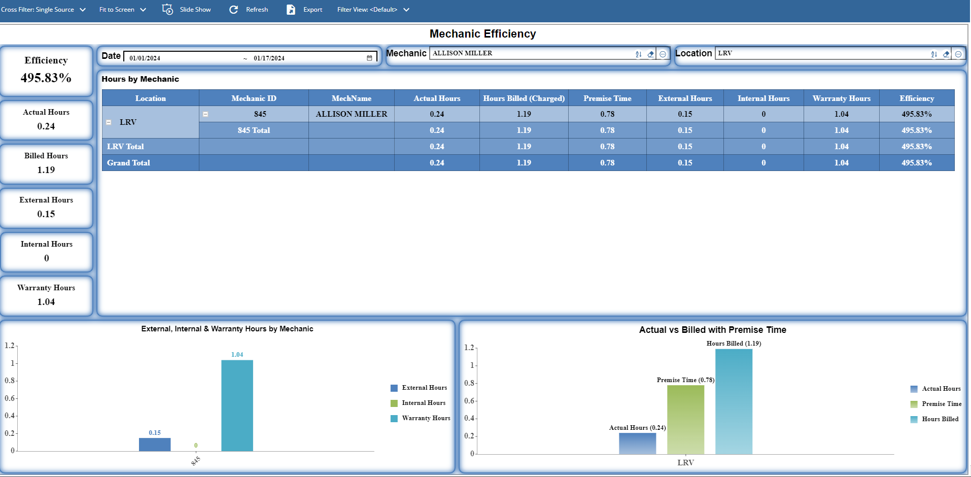
Mechanic Efficiency Dashboard
Parameters of date, mechanic, location
Drillable & interactive
Vision Reporting - Efficiency

Slide 18
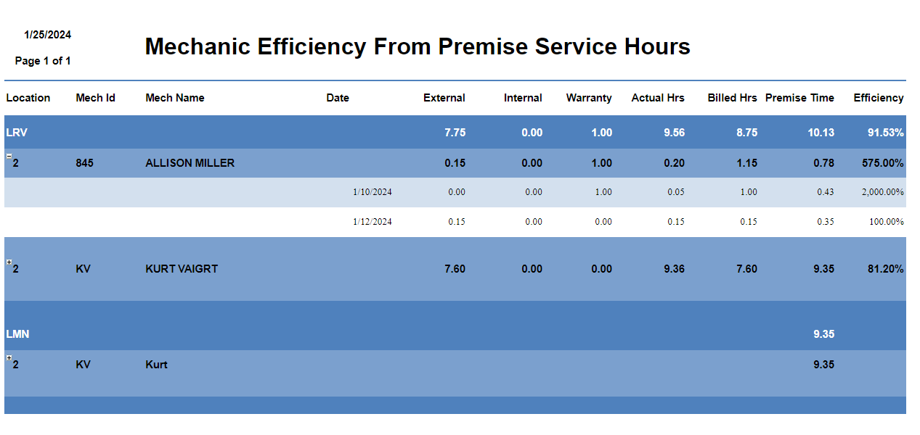
Mechanic Efficiency From Premise Service Hours Report
Date range
Summary, click + for details
Vision Reporting - Efficiency
Notes:
Vision is customizable so you can add columns

Slide 19
Technician Review
Month, Year, Location, Job Bill Type
Drillable, Interactive
Leadership Insights Dashboards

Slide 20
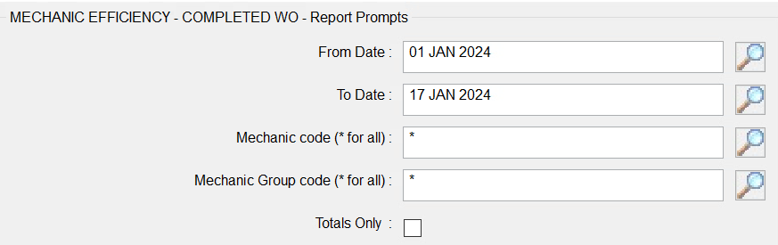
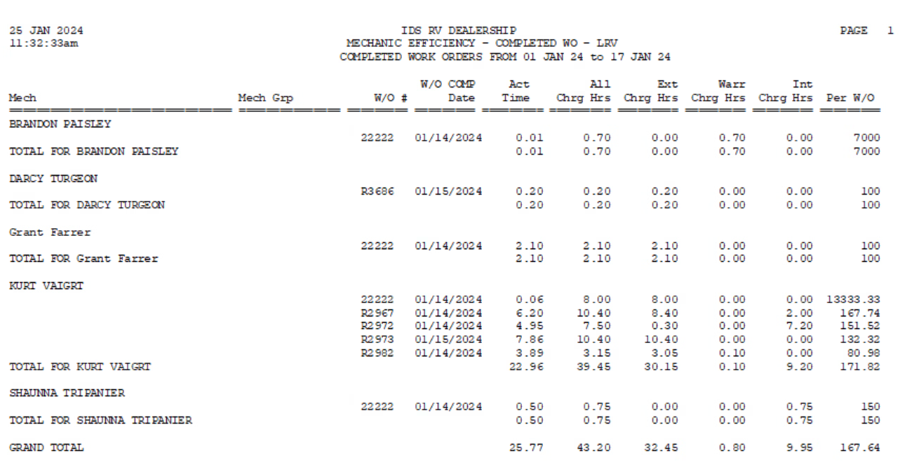
Mechanic Efficiency Completed WO
Work Order #
Completed Labor – G2 Reporting
Notes:
Bluescreen fans: 4-3-2-34-18

Slide 21
Completed Labor – Vision Reporting
Completed Work Order Summary Report
Parameters include start date, end date, author, location

Slide 22
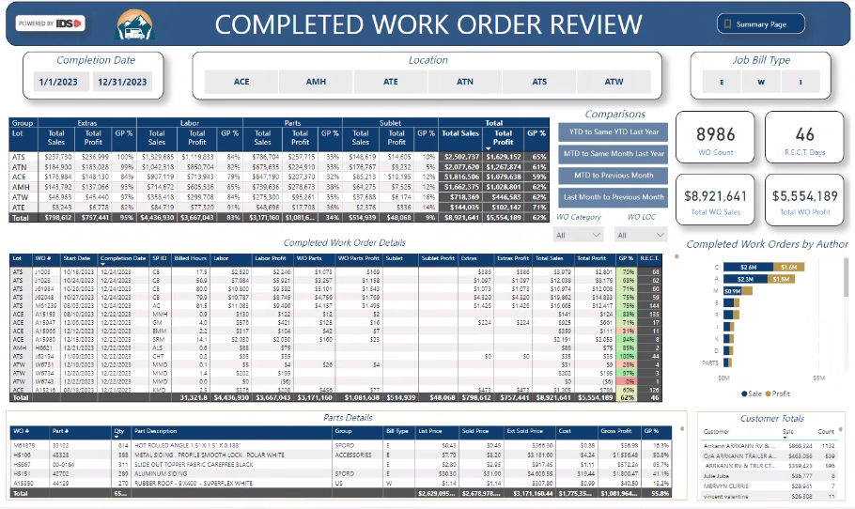
Completed Labor – Leadership Insights
Note:
Can be filtered by WO author, but not by tech

Slide 23
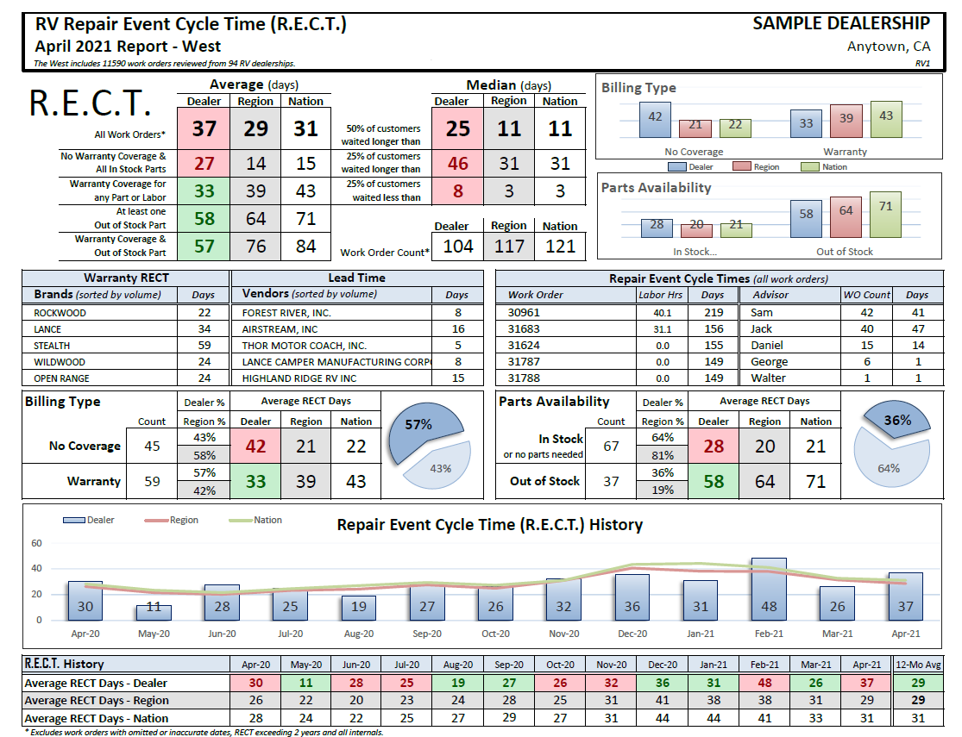
RECT Internal Benchmarking

Slide 24
Tips
Check IDS Module Configurations – a great way to see items you didn’t know were there!
Observe and Listen – shadow a tech for a day – tweak efficiency wherever possible
Utilize RECT Reporting – compare your efficiency along with RECT averages of peers, if techs are 100% efficient, then WHY is your RECT high??
Don’t just see how long it takes overall to complete a Work Order, look for what may be causing any bottlenecks in your repair process
Workflow mapping exercise – evaluate processes from beginning to end –improved customer experience – IDS CAN HELP!
Notes:
Module configs - a great way to see items you didn’t know were there!

Slide 25
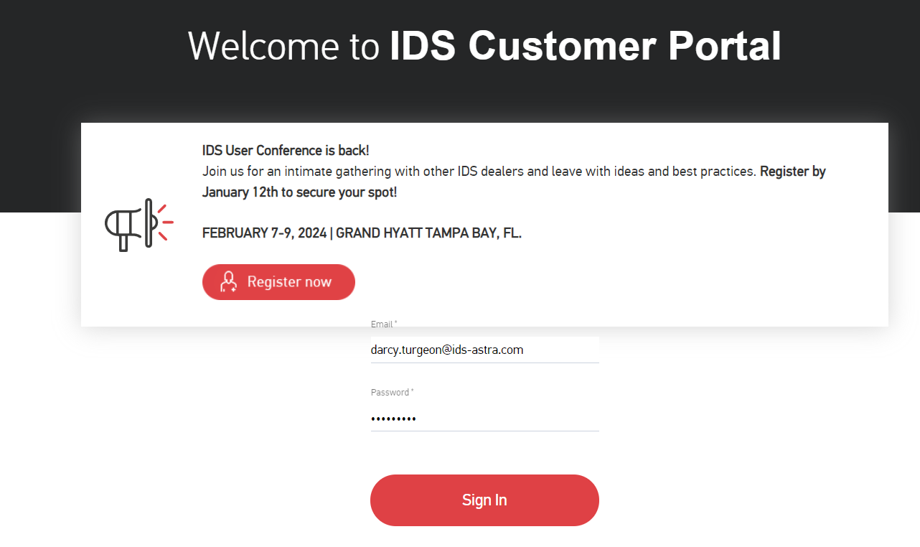
How to Get Help
The best way to get support is to sign up on the IDS Portal website,
Visit: https://portal.ids-astra.com/login
Here you can register to send in a support ticket and access the vast amount of online reference materials.

Slide 26
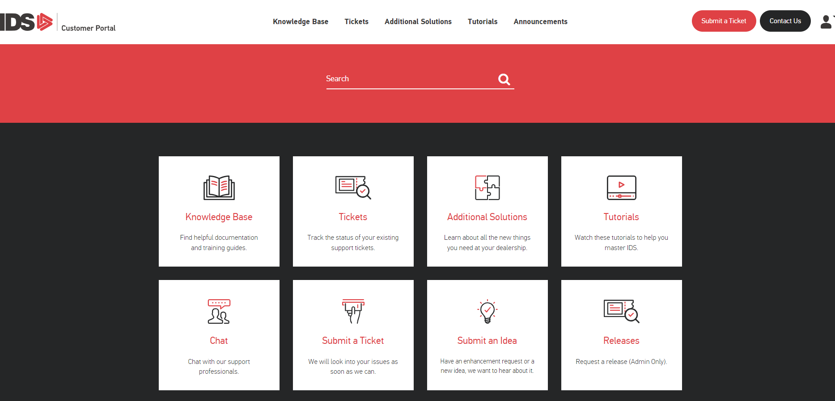
How to Get Help

Slide 27
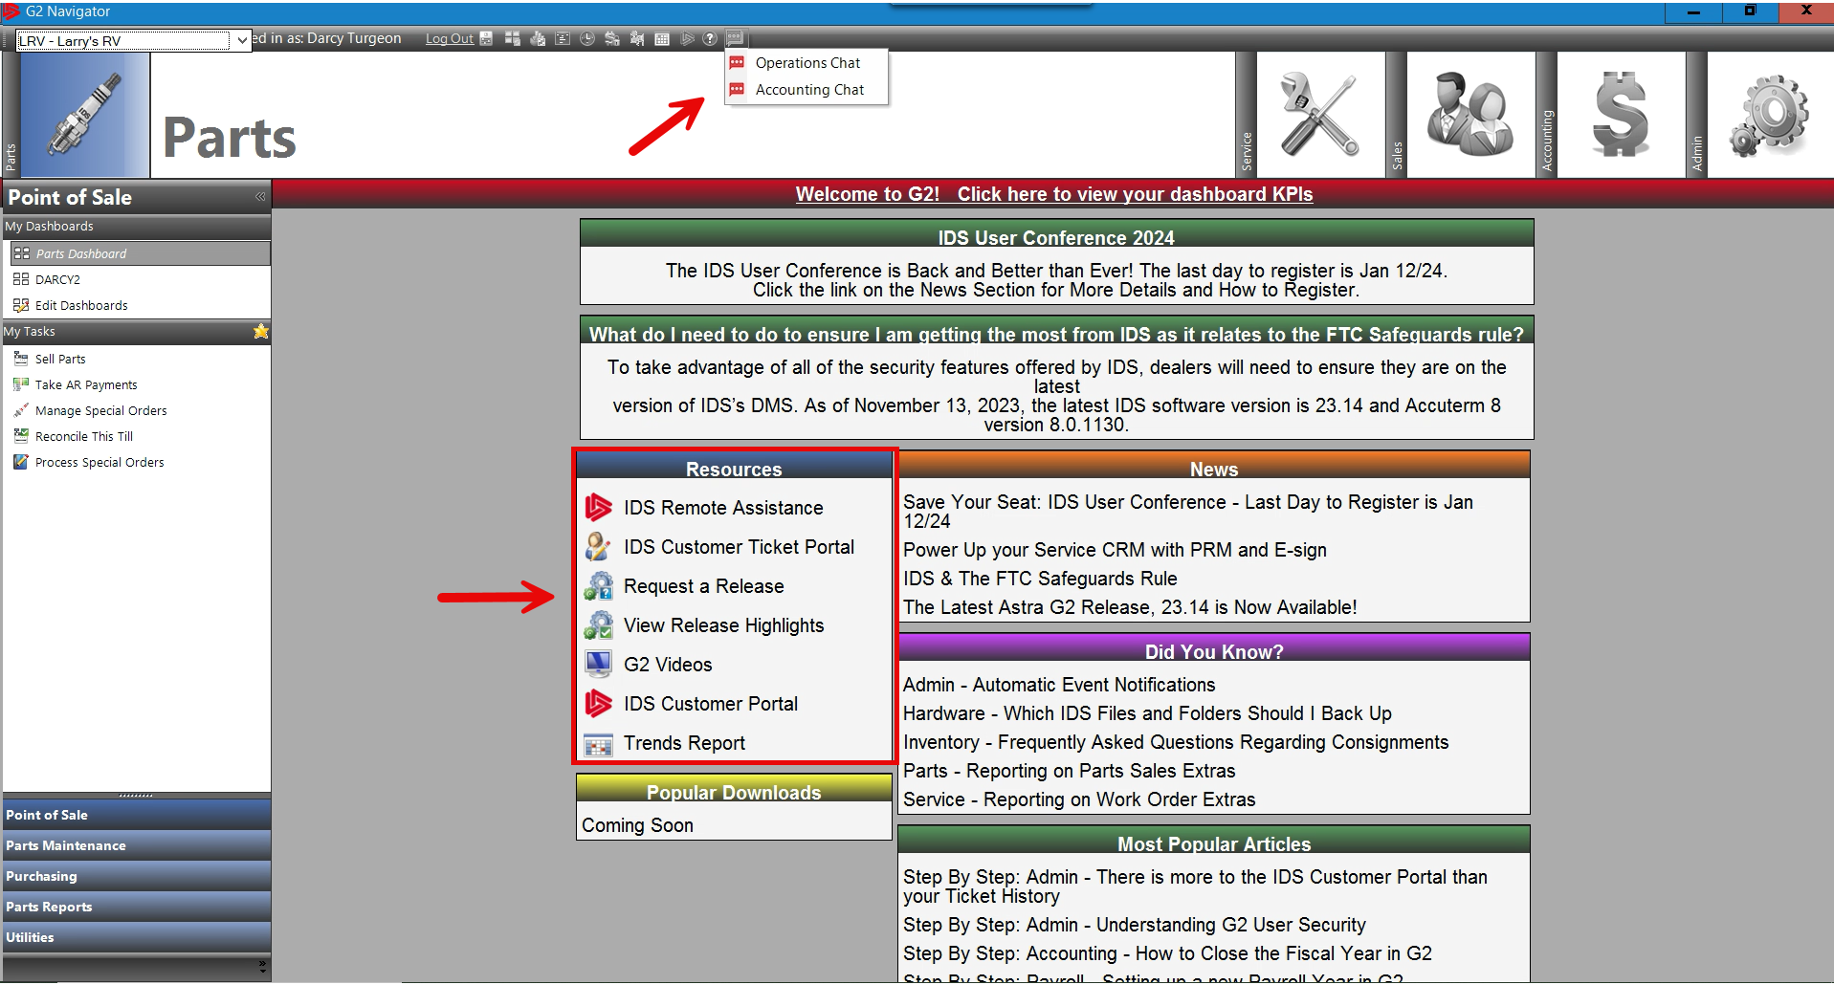
How to Get Help

