Slide 1
Unit Build
February, 2024

Slide 2
Welcome…Thank you for coming
We appreciate your time and commitment to learning more about your G2 software system. We realize your time is valuable, and we want you to get the most out of these training classes.
We strive to help you discover the most efficient and productive ways to use the software, which would include reports, manage menus, as well as daily, weekly and monthly activities to ensure your data is as accurate and timely as possible.
Please keep your phones on MUTE, we will have time for Questions at the end of the presentation.

Slide 3
Darcy Turgeon
Professional Service’s Consultant

Slide 4
Background
25 years in the IT industry with 15 years as an Owner Operator for a full line dealership, with products ranging from small RV’s to a large diesel pushers. My main focus included being the fixed operations manager with support roles in Sales, Marketing and Finance.

Slide 5
Agenda at a Glance
What is Unit Build
Why use Unit Build
Definition of Terms
Module Configurations
Where in IDS do we use Unit Build
How to use Unit Build with Inventory
How to use Unit Build on a Sales Quote
Creating the Unit Build File
Importing the Unit Build File
Adding Units to the Unit Build File
Removing Units from the Unit Build File
Using the Manufacturer Upload to the Unit Build File
Update Codes and Tables
Final Thoughts
How to Get Help
Questions

Slide 6
What is Unit Build?
The Unit Build function is used to create or enter a unit into inventory while increasing accuracy through an automated validation. This allows the user to select only pre-defined Type/Year/Manufacturer/Brand/Model combinations which cuts down on data entry time and user error.

Slide 7
Why use Unit Build?
It’s a Simple and fast way to click and choose your inventory unit into the company’s inventory file and to add an inventory item to any Sales or Finance quote.

Slide 8
Why use Unit Build?
Unit Build eliminates manual entry to reduce the risk of errors and increase accuracy. Using Unit Build will reduce wrong inputs into the build file thus allowing for a more accurate inventory turns reports. example: Zinger Lite and Zinger-Lite are two different models which impact the turns report as two separate models even though they are the same.

Slide 9
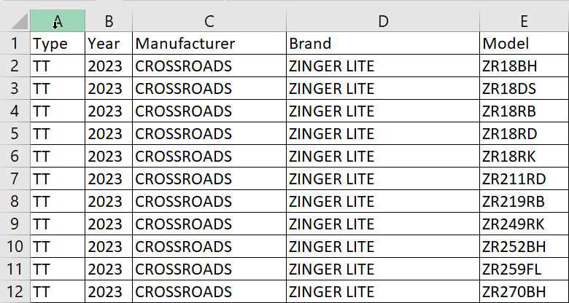
Why use Unit Build?
Using a pre-built table allows us to have a central location to create, modify and remove our inventory on the fly.

Slide 10
Definition of Terms?
RV MANUFACTURER: The term manufacturer in the RV Industry may include the Big 4, Winnebago, Thor, Forest River and Keystone, but not limited to these. There are others, but a majority will fall under these four. There may be times when we need to use the brand when referencing manufacturers. For example, Winnebago acquired Grand Design and maintains their brand so we use the manufacturer in this case as Grand Design, the brand will be the model types like Imagine, Reflection etc..

Slide 11
Definition of Terms?
MARINE MANUFACTURER: - The term manufacturer on the marine side typically is the brand. For instance, Alumacraft would be considered an Alumacraft manufacturer and brand for the purposes of building your tables.
BRAND: The term brand references the model types on the manufacturer’s website. Examples for RV are Zinger Lite, Imagine, Reflection. Examples for Marine are Boston Whaler, Crestliner, Formula. There are many more, this is just a few samples.

Slide 12
Definition of Terms?
MODELS: The term model is referred to as the floorplan associated with the brand on the manufacturer’s website. Examples include 34BH, 25RK or SSI Outboard, 170 Montauk etc..
FLOORPLAN: The term Floorplan is used two ways, firstly the manufacturer uses the term to portray their models as above, secondly Floorplan can also mean financially the location of where unit is funded, often called Bank Flooring.

Slide 13
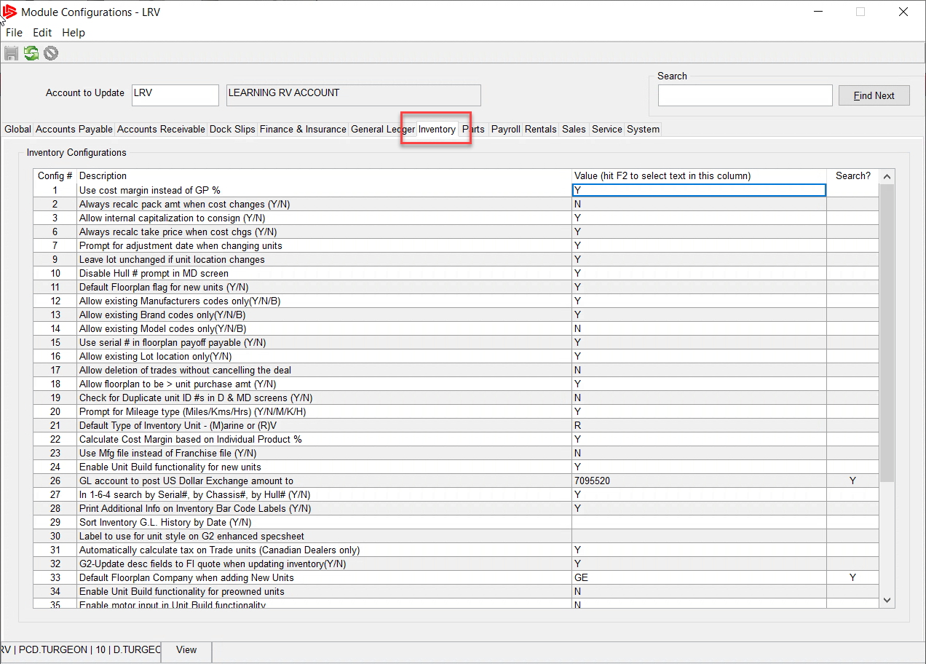
Module Configurations
In order to use Unit Build, we have to make a few adjustments to the module configurations, to make those changes navigate to
Admin>>Setup>>Update Module Configurations and choose the Inventory Tab

Slide 14
Module Configurations
Configuration Number 24: Enable Unit Build functionality for new units
Configurations setting number 24 is used to turn on or off Unit Build.
To turn on unit build set configuration number 24 to Y for Yes.
To turn off Unit Build, remove the Y and leave blank or choose N for No.

Slide 15
Module Configurations
Configuration Number 34: Enable Unit Build functionality for preowned units
Configurations setting number 34 is used to turn on or off unit build for
Used inventory, this setting is normally set to N for No by default. Turning this off will allow the user to create his/her own year, manufacturer and model entry into inventory often referred to as freeform mode.

Slide 16
Module Configurations
Configuration Number 35: Enable motor input in Unit Build functionality
Configurations setting number 35 is used to turn on or off the motor input section of the unit build entry screen. This feature is often used by the marine industry for choosing the various types of interchangeable motors available to the marine unit. RV dealers would choose to keep this feature turned off.

Slide 17
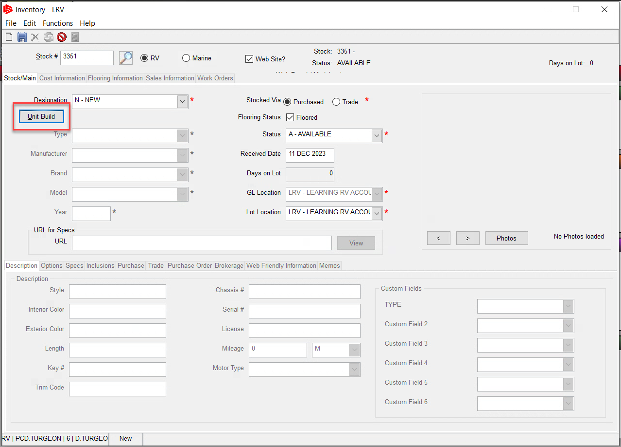
Where do we use Unit Build?
The Unit build feature can be utilized in two locations within the IDS program. The first location is within the unit inventory screen itself, as shown.

Slide 18
Where do we use Unit Build?
Select the designation from the drop-down list.
Choose New, and the unit build button will be activated. Anything else will put you in freeform mode. (Unless you set config 34 to Y, which IDS recommends you do not.)

Slide 19
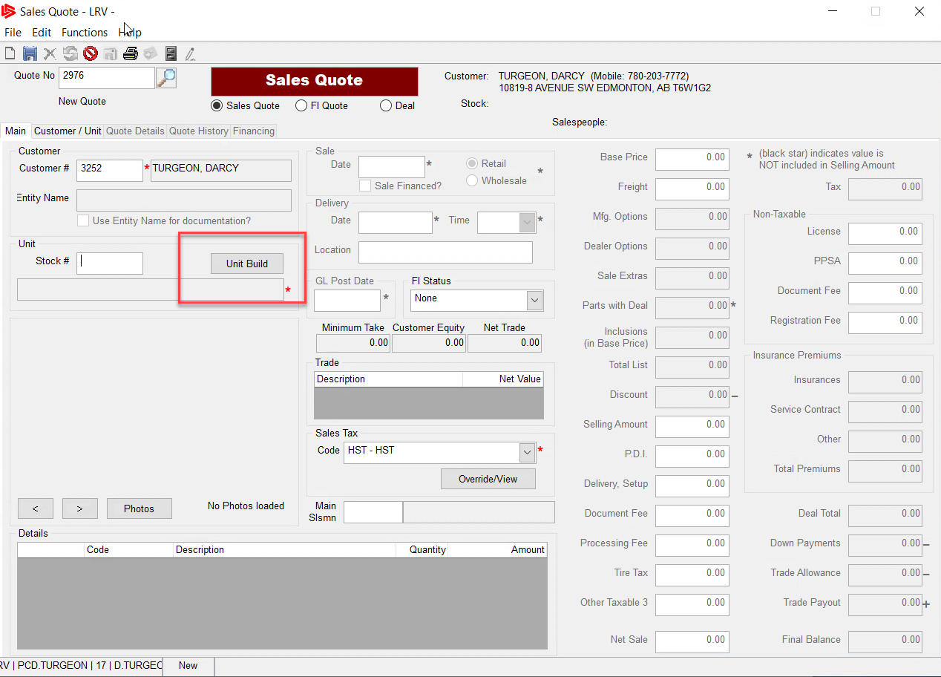
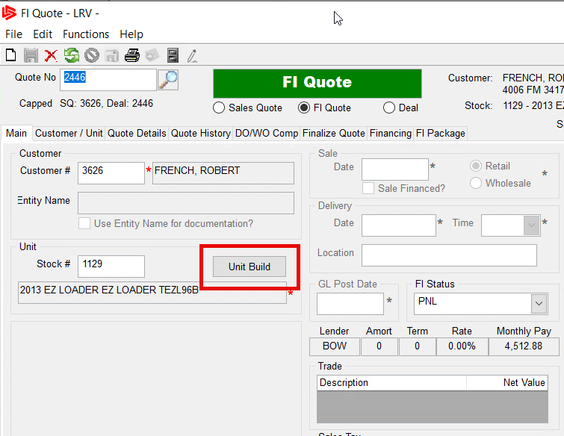
Where do we use Unit Build?
The second locations to use unit build is on the sales quote and the finance quote forms.
Note: Unit build is not available on the Deal Screen and on the finance quotes if the deal has been posted.

Slide 20
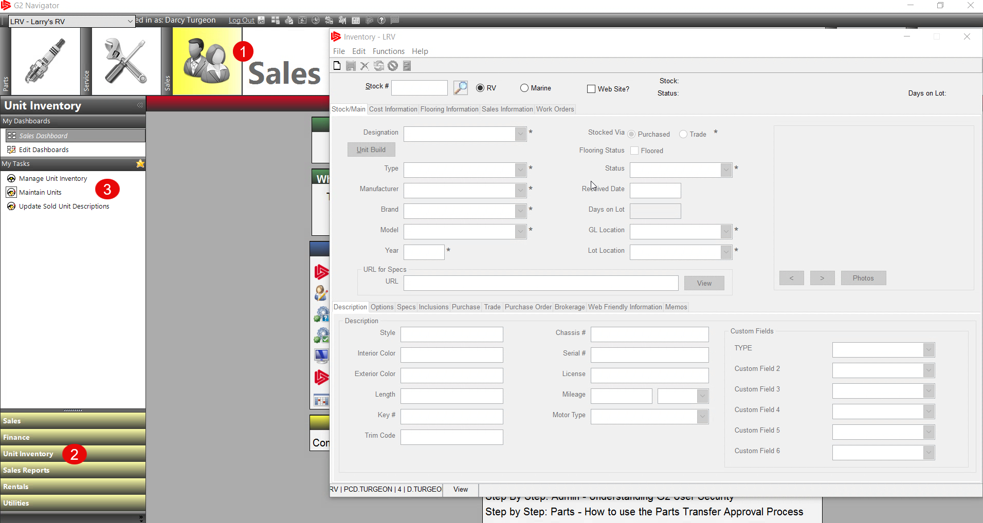
How to use Unit Build with Inventory
To use Unit build in the inventory screen, go to
Sales Module
Unit Inventory Menu
Choose Maintain Units

Slide 21
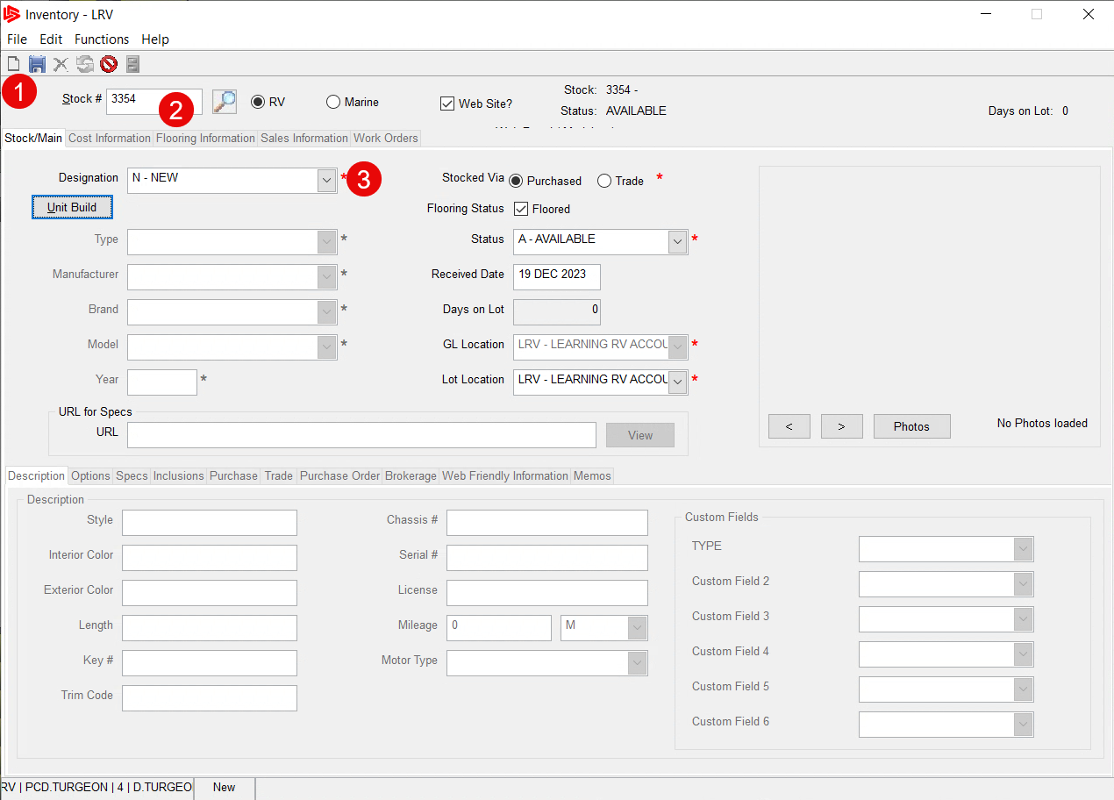
How to use Unit Build with Inventory
Once the Inventory Screen appears, Click on the white piece of paper at the top left to create a new inventory entry.
The next available stock number will automatically be entered into the stock number field.

Slide 22
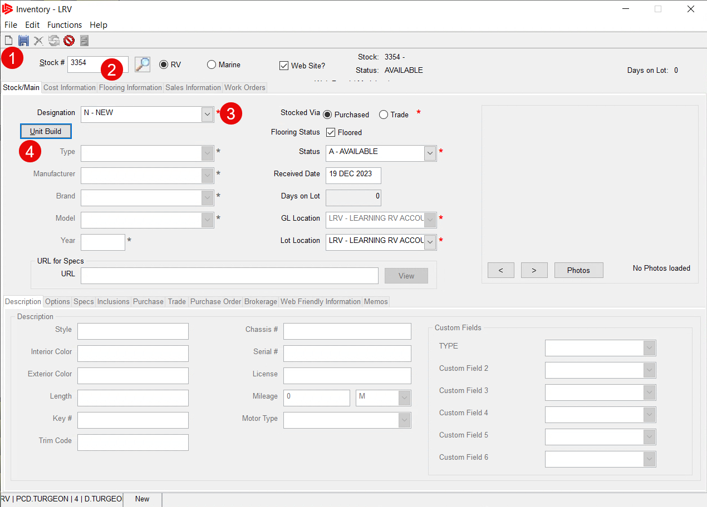
How to use Unit Build with Inventory
Now, click the Designation drop down list and choose New, The unit build button will now Activate
Simply click on the Unit Build Button

Slide 23
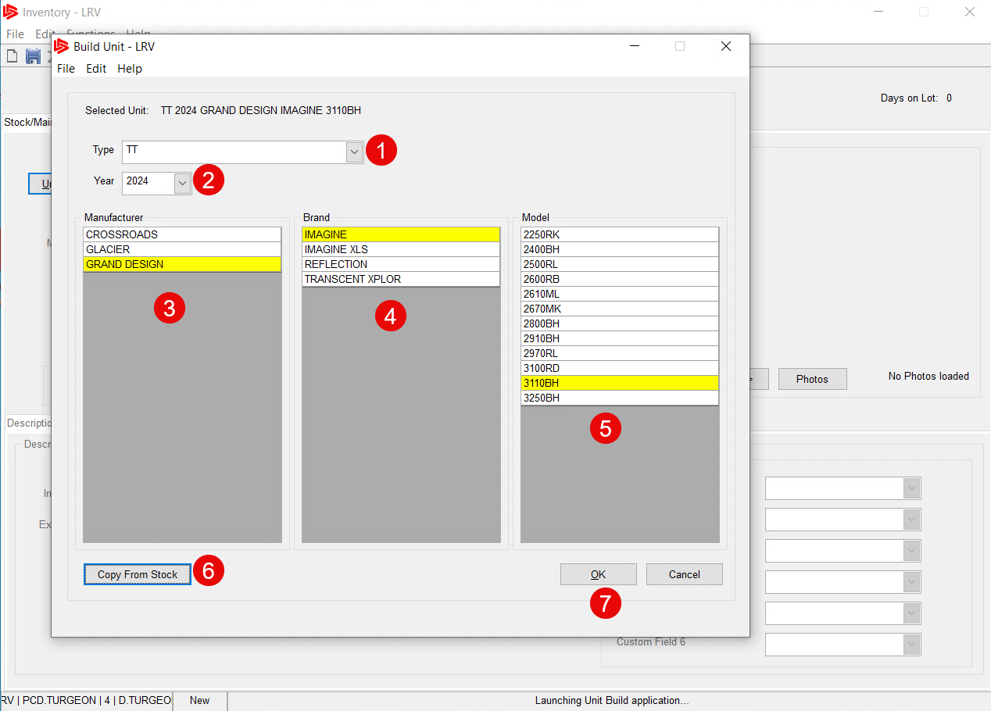
How to use Unit Build with Inventory
The Build Unit Screen will now appear.
Choose the Type from the dropdown list.
Choose the Year from the dropdown list.
Choose a Manufacturer from the populated list.

Slide 24
How to use Unit Build with Inventory
Click on the Brand from the populated list.
Now click on the Model from the list that shows.

Slide 25
How to use Unit Build with Inventory
If you are stocking in multiple units of the same type, year, manufacturer etc. You can do so by clicking on the copy from stock button. This can be done as soon as the build unit screen opens. Either way,
Click OK to load the unit

Slide 26
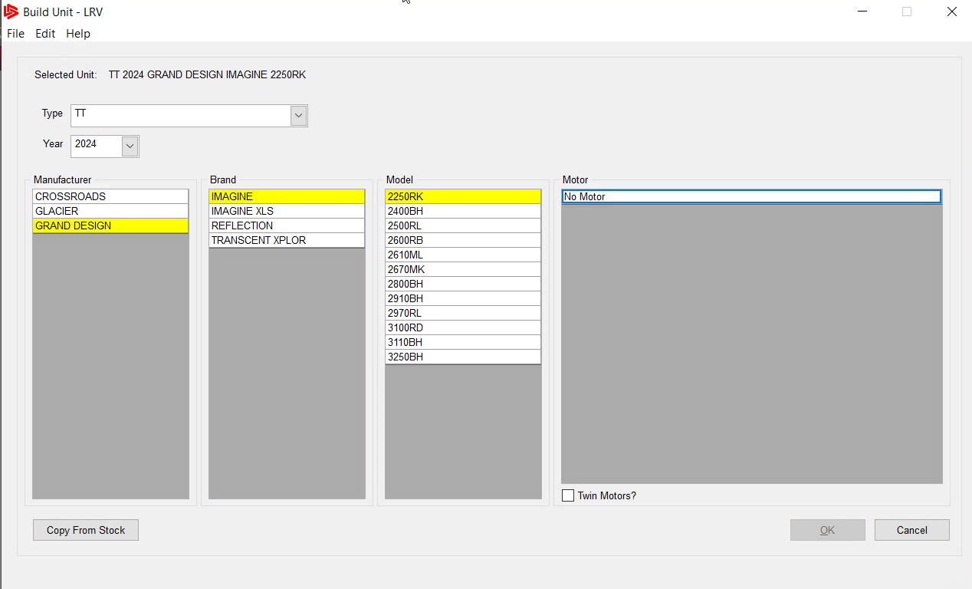
How to use Unit Build with Inventory
If you are Marine Dealer, then you will see a fourth box. This is where you will choose the type of motor for the marine craft you are entering into stock. This feature, can be turned on/off with Module Config Switch 35

Slide 27
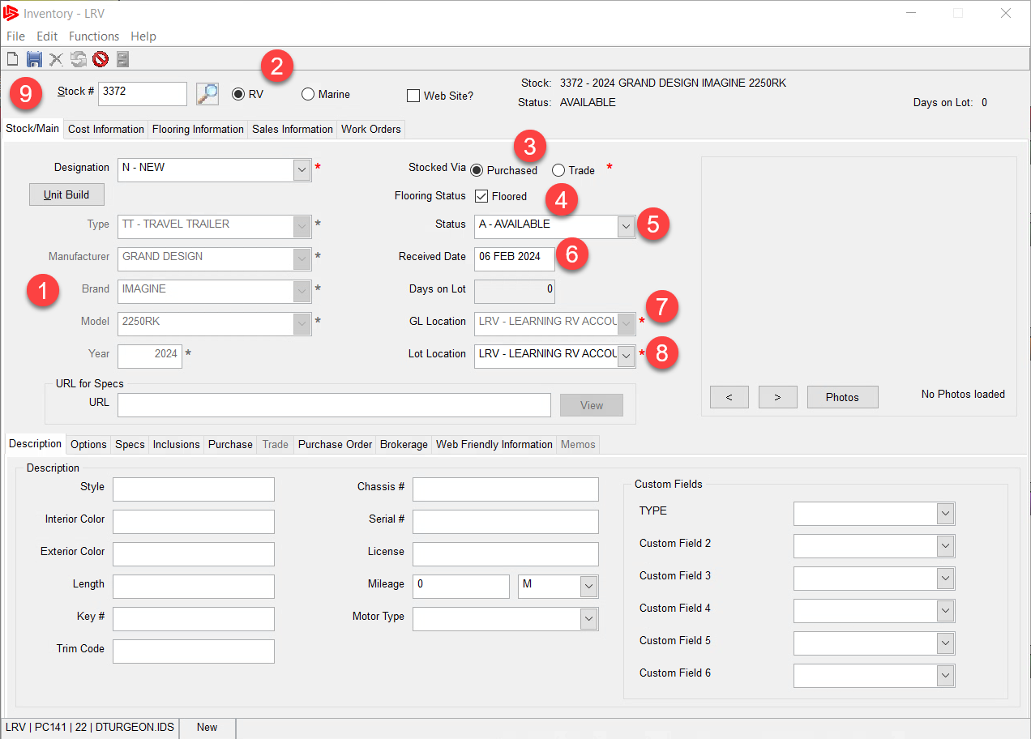
How to use Unit Build with Inventory
The unit will now load and be displayed on the left side of the inventory screen. We now have some housekeeping items that need to be entered before we can save this unit into inventory.

Slide 28
How to use Unit Build with Inventory
If you are an RV dealer then RV will default in, Marine Dealers the Marine will Default in.
The Purchased check box is the default, if you need to change it then you can now.

Slide 29
How to use Unit Build with Inventory
Choose whether the unit is Floored by checking the box.
You can change the status of the unit by the dropdown here.

Slide 30
How to use Unit Build with Inventory
Leave the default date or change it here. This is the date the unit is brought into inventory officially set as Day 0.
The default GL location comes from the franchise file and cannot be changed.

Slide 31
How to use Unit Build with Inventory
If you have multiple lot locations, you can change that here.
Finally, You can now save the unit into inventory by clicking the save button.

Slide 32
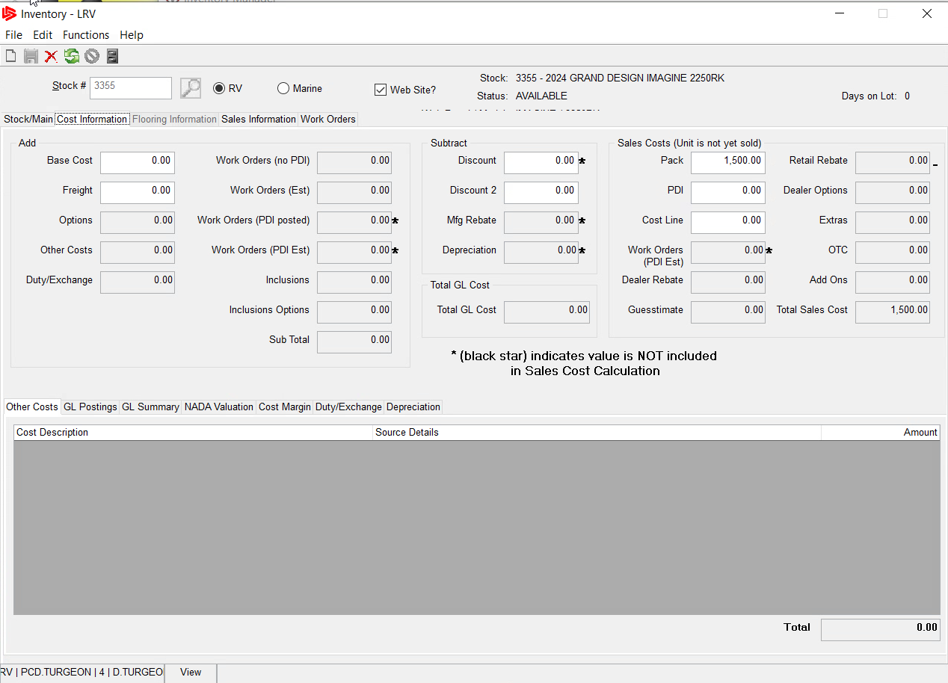
How to use Unit Build with Inventory
The next thing to do is to fill out the Cost Information Tab
For the unit. Filling out the Cost Information Tab is more streamlined if the Unit Build import includes the costs associated to that type of unit.

Slide 33
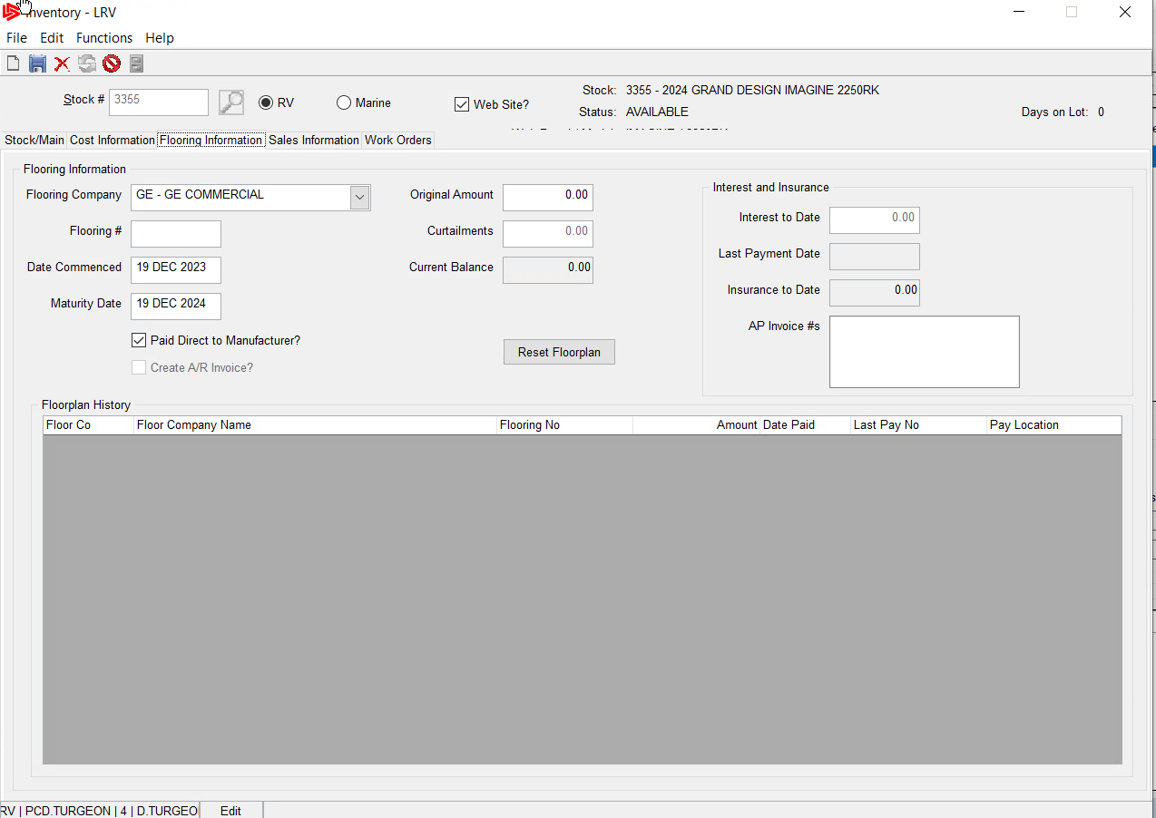
How to use Unit Build with Inventory
If the unit is Floored, then the Flooring Information Tab will need to be filled out, if the unit is not Floored this tab will be greyed out.

Slide 34
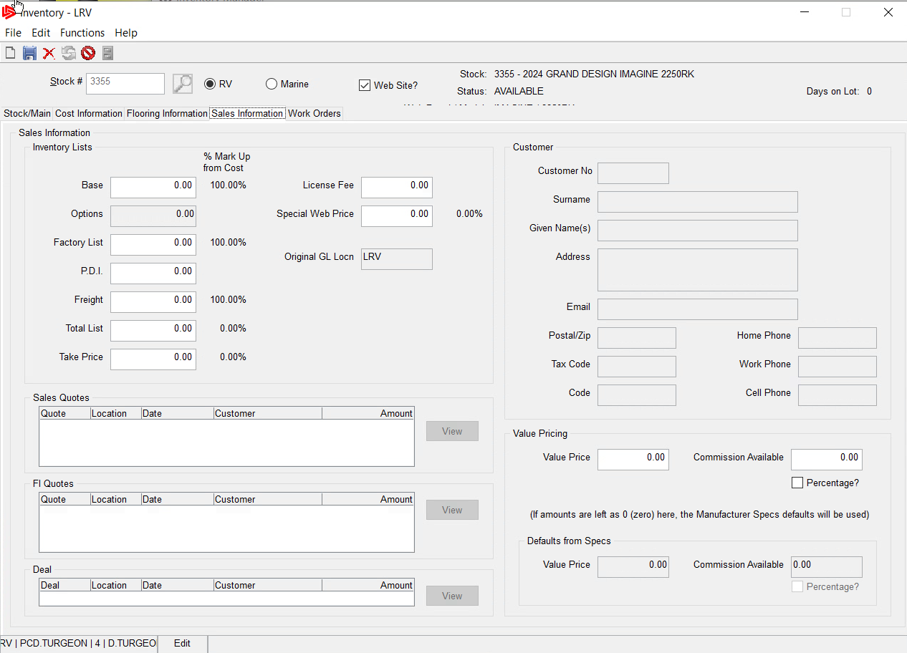
How to use Unit Build with Inventory
Finally, the Sales Information Tab will need to be filled out. If included in the Unit Build Import the List Price and the PDI, the Freight List will all be populated, saving time on manually adding information into these fields.

Slide 35
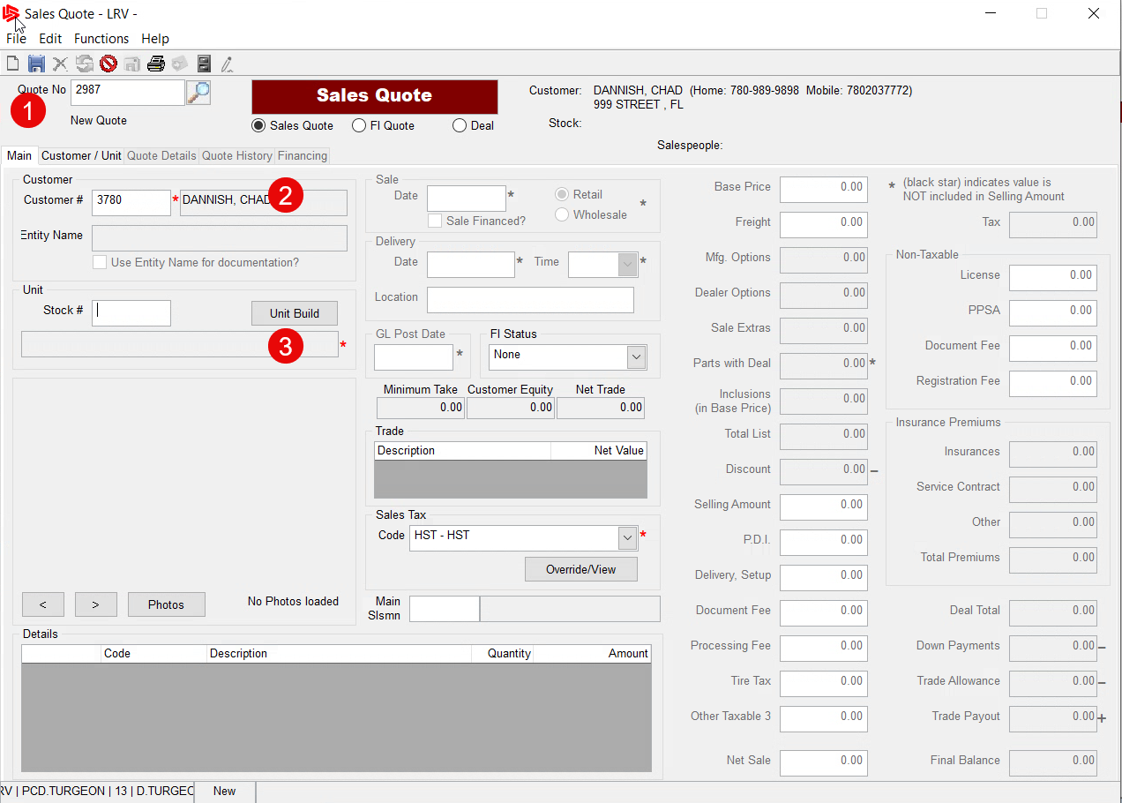
How to use Unit Build on a Sales Quote
The purpose of having the Unit build on a sales quote, is to have the ability to create a quote for a customer for a unit that you have not officially stocked into your inventory.
Click on the New Quote button.

Slide 36
How to use Unit Build on a Sales Quote
Next, if you know the customer number enter it in the field, otherwise choose search. Now the unit build button will activate,
Go ahead and click the unit build button.

Slide 37
How to use Unit Build on a Sales Quote
The Build Unit Screen will now appear.
Choose the Type from the dropdown list.
Choose the Year from the dropdown list.
Choose a Manufacturer from the populated list.

Slide 38
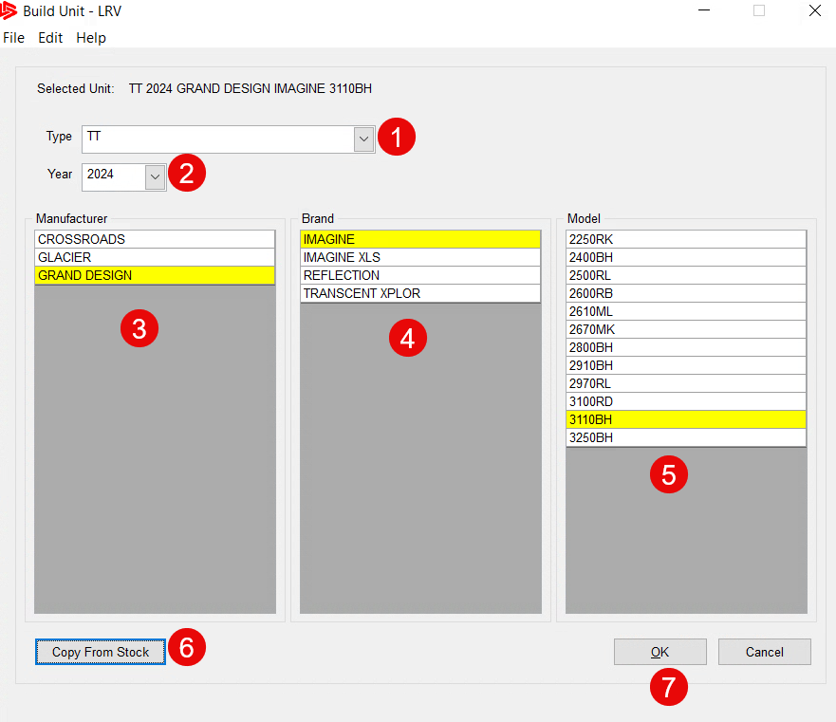
How to use Unit Build on a Sales Quote
Click on the Brand from the populated list.
Now click on the Model from the list that shows.
Click Copy if you have an existing stock number you want to use.
Click OK to load the unit onto the sales quote.

Slide 39
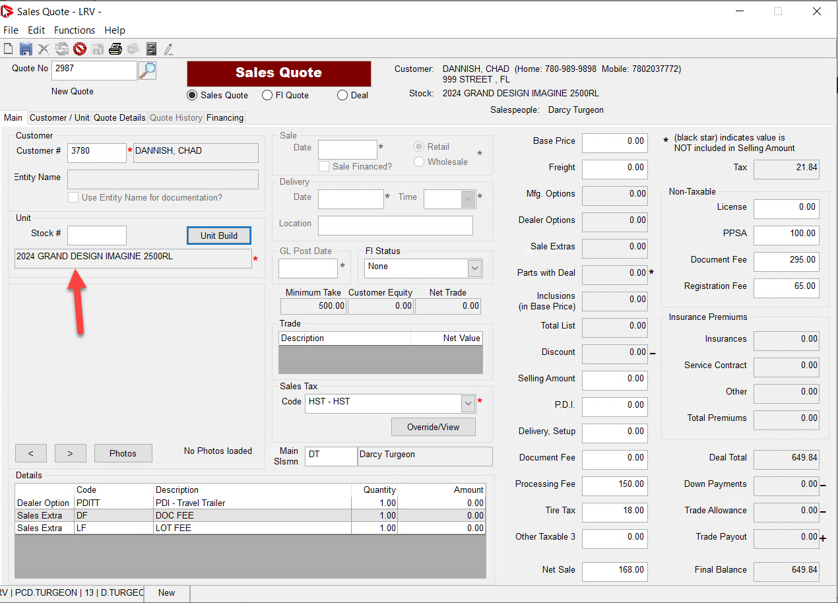
How to use Unit Build on a Sales Quote
Once the unit is loaded on to the Sales Quote, it appears below the stock number field. The unit does not have a stock number because we are just creating a quote on a unit that may or may not exist.

Slide 40
How to use Unit Build on a Sales Quote
All the numbers associated with the quote are zeroed out and will need to be filled in by the salesperson. Unless the build file included some of the pricing.

Slide 41
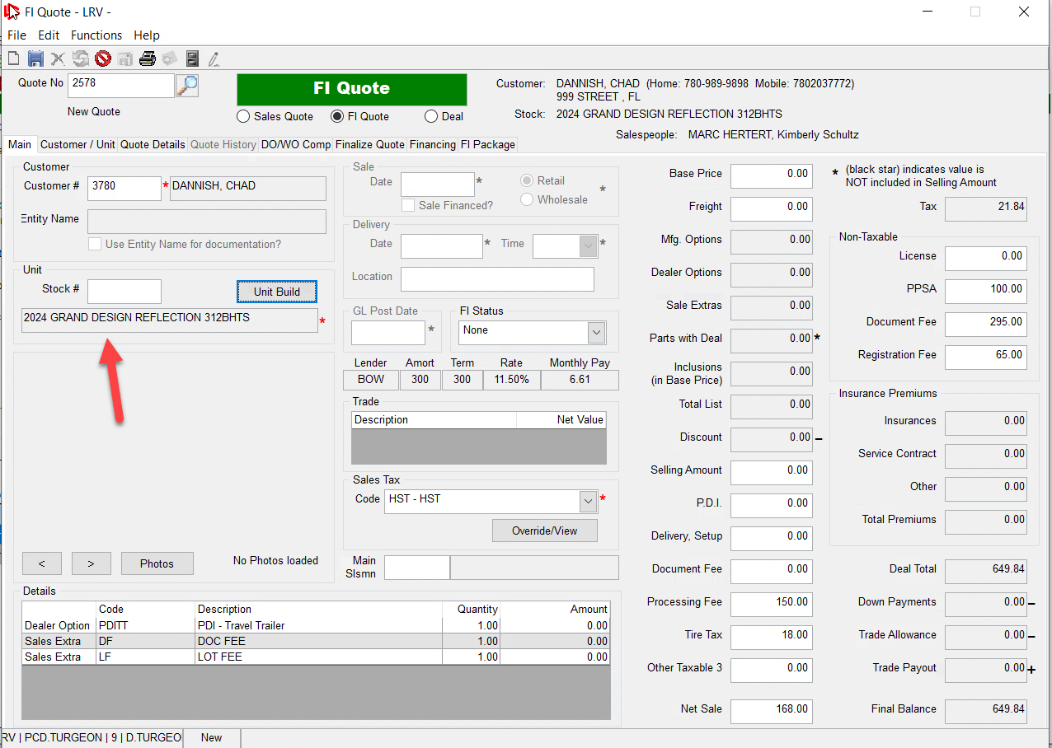
How to use Unit Build on a Sales Quote
This method of creating a sales quote from the unit build file is the same for a finance quote. The exceptions are you cannot use unit build on the deal screen and a stock number is required.

Slide 42
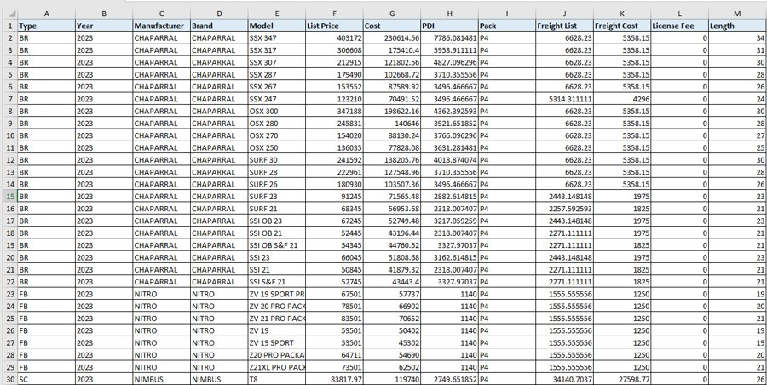
Creating the Unit Build File
The unit build file is created using an Excel spreadsheet. The headers of the file are arranged as shown.
The column headers and the values below them will be mapped to the Unit build file.

Slide 43
Creating the Unit Build File
The minimum we need to import into the unit build file is Type, Year, Manufacturer, Brand and Model.
The additional columns with values/pricing are optional but are often included to reduce the amount of time inputting these values in the inventory screen later.

Slide 44
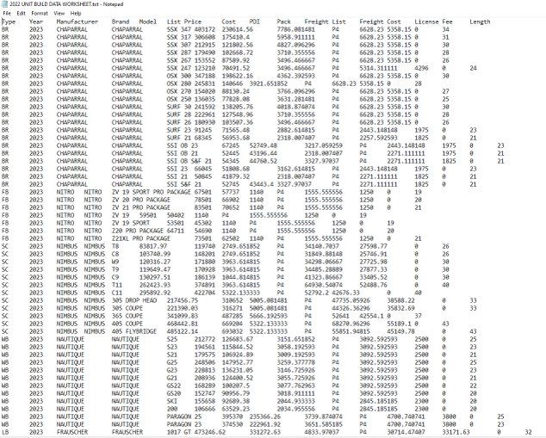
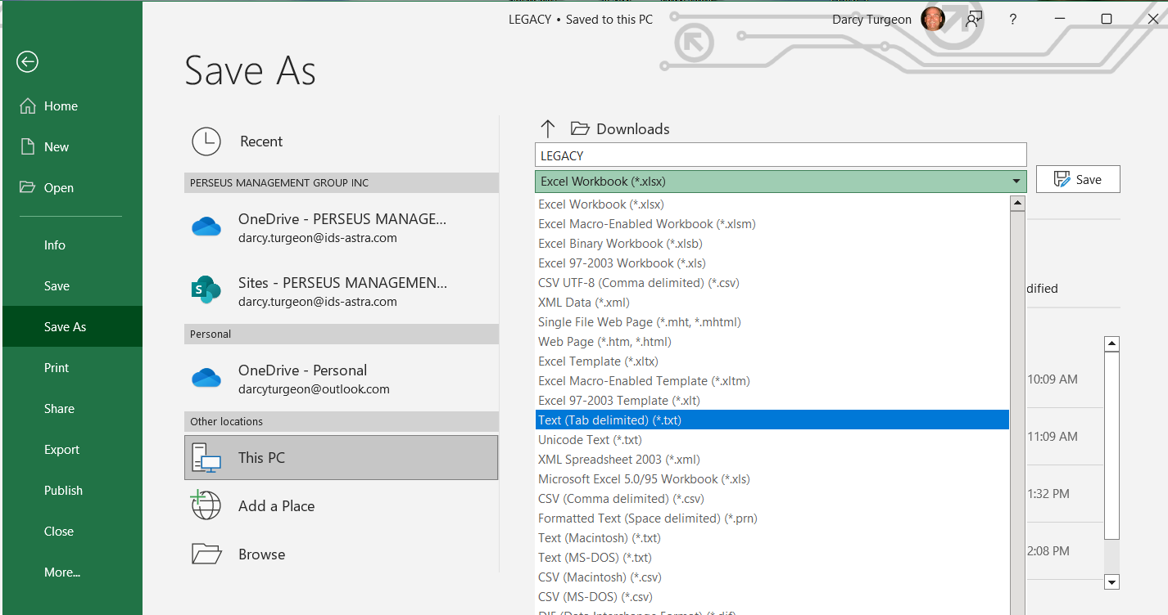
Creating the Unit Build File
Once we have completely filled out the spreadsheet with all the data inputted.
We then save the spreadsheet as a tab delimited .txt file.

Slide 45
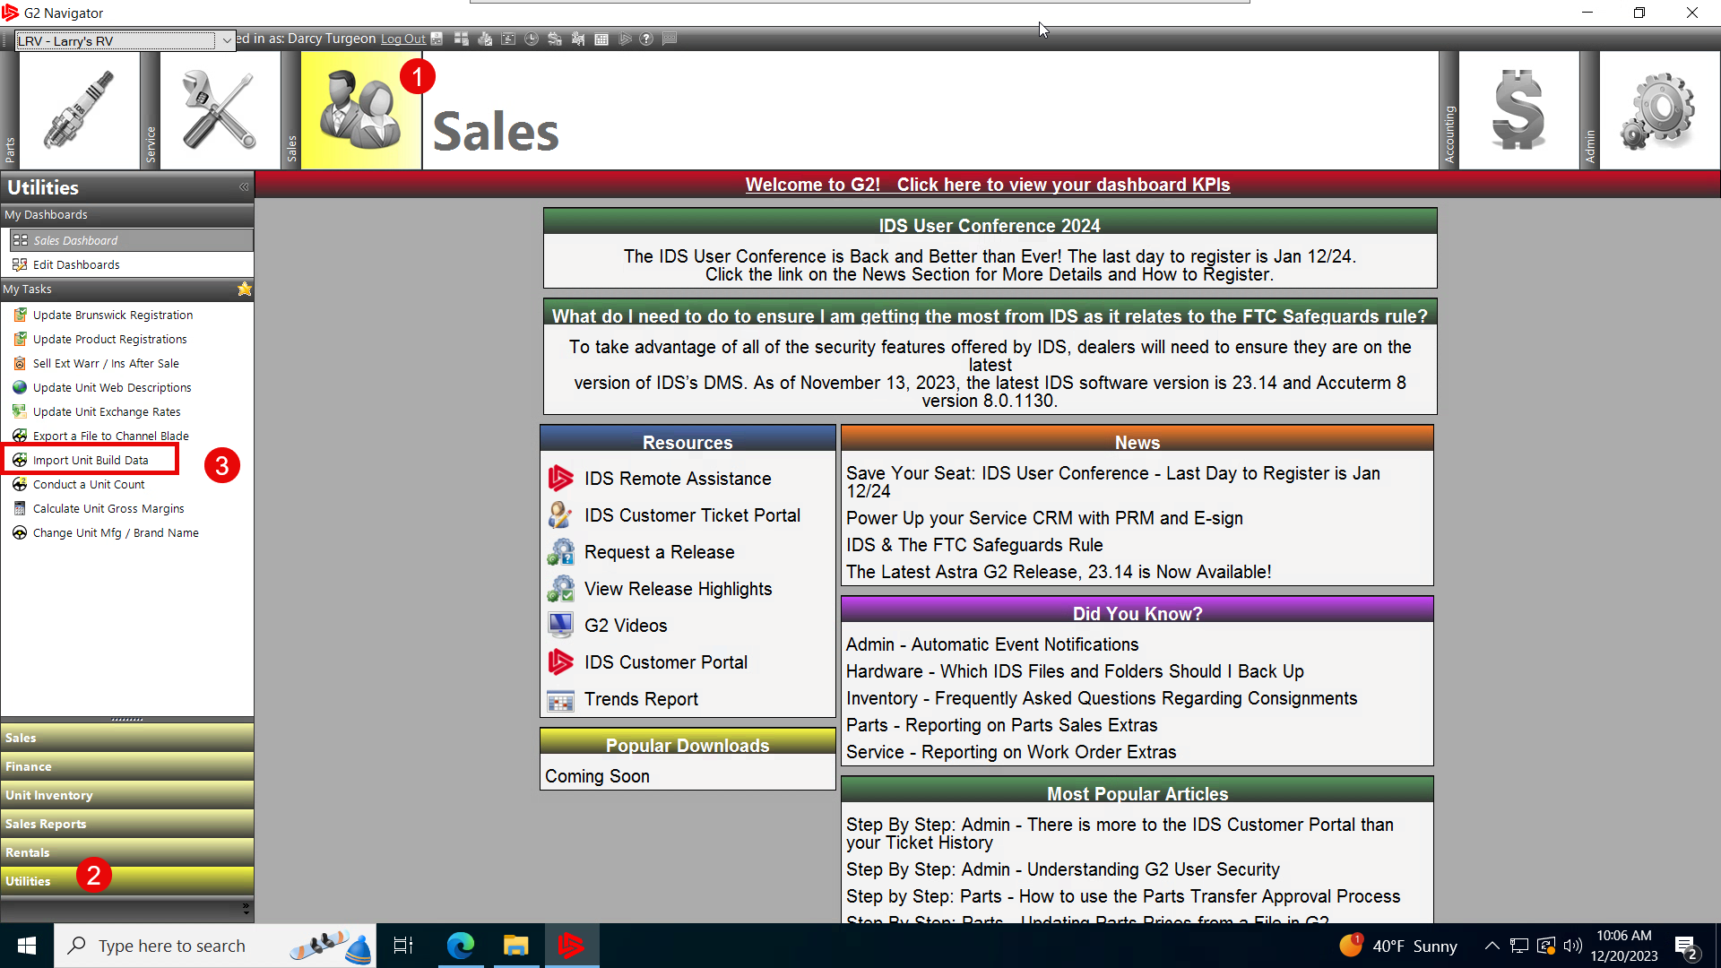
Importing the Unit Build File
To import the Unit build file into IDS
Go to the Sales Module
At the bottom choose the Utilities Sub-menu.
Then click on the menu item Import Unit Build Data

Slide 46
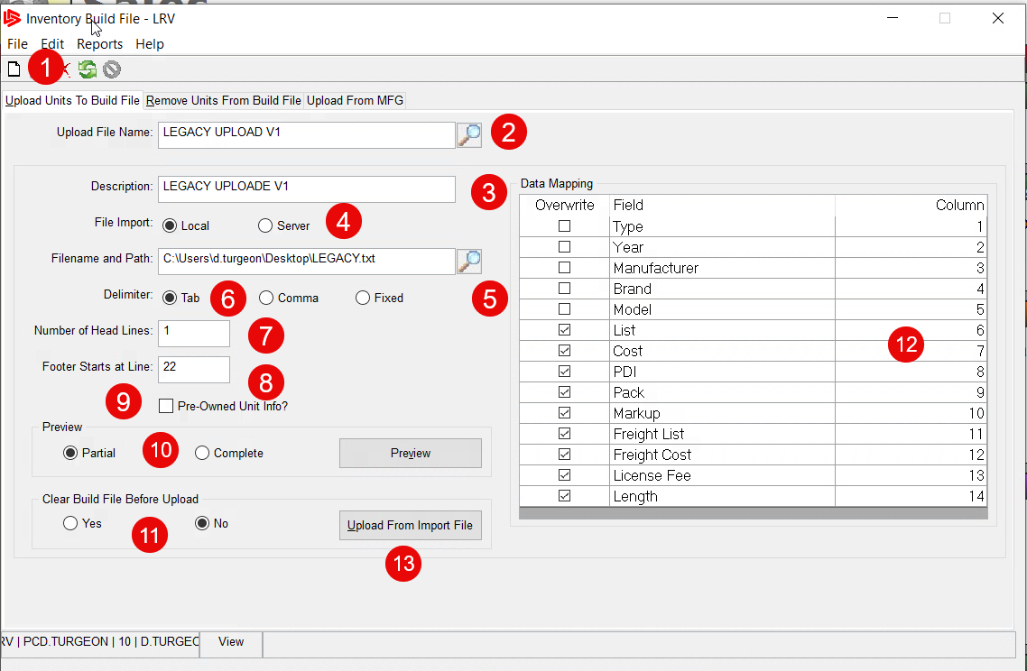
Importing the Unit Build File
When the Inventory build file form appears
click on the white piece of paper in the top left corner to start a new import.
Name the Upload this can be any name you want it can also be recalled and used at a later date.

Slide 47
Importing the Unit Build File
Put a Description in this field, typically it is the same name as the upload File name. Note: You can always recall the Upload file at any time by clicking the search button.

Slide 48
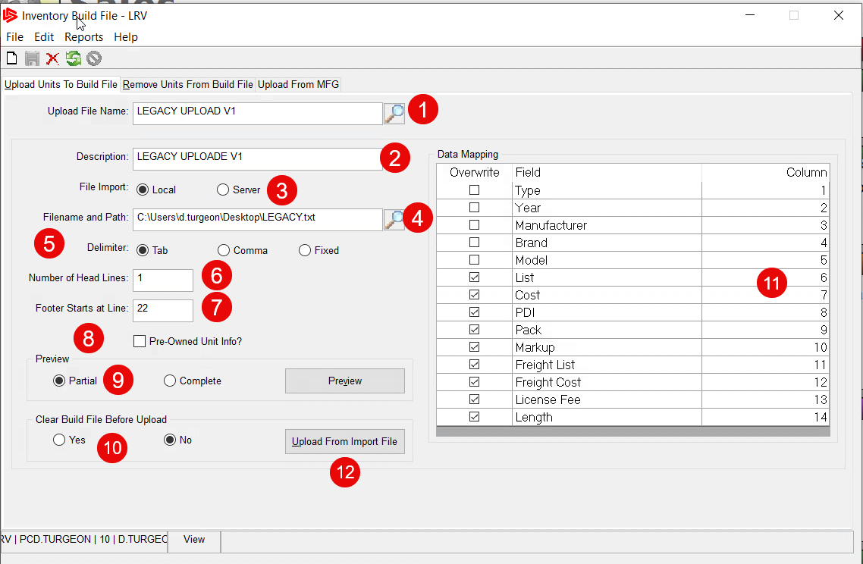
For the number of head lines (6) this should be set to 1 for Row 1. The Footer Starts at Line (7) should be set to the last line of the excel spreadsheet plus 1. Do not check the box for Pre-Owned Unit Info (8).
Importing the Unit Build File
Next choose where the .txt file is located
Click the search button to locate the path of the .txt file
Choose the Tab delimited check box.

Slide 49
Importing the Unit Build File
For the number of head lines this should be set to 1 for Row 1 of the excel spreadsheet.
The Footer Starts at Line should be set to the last row line of the excel spreadsheet plus 1.
Do not check the box for Pre-Owned Unit Info.

Slide 50
Importing the Unit Build File
We want our used inventory to be in freeform mode on unit build, there are just too many manufacturers, brands and models.
We can preview the import by selecting partial or complete.
If you choose Yes to the Clear build file before upload, then only the build file you import will be available. Choosing NO will append the data.

Slide 51
Importing the Unit Build File
We need to map our columns on the right, the column numbers should match the corresponding Excel spreadsheet column numbers. You do not need to check the box in the overwrite column for the first 5 entries these will default in automatically.

Slide 52
Importing the Unit Build File
The columns List, Cost, PDI etc.. Will be checked to overwrite once you save the build file
You have the options to uncheck them
If your build file does not include these fields.
Once you have all the necessary fields mapped, then click on the button Upload from Import File button to upload the Data.

Slide 53
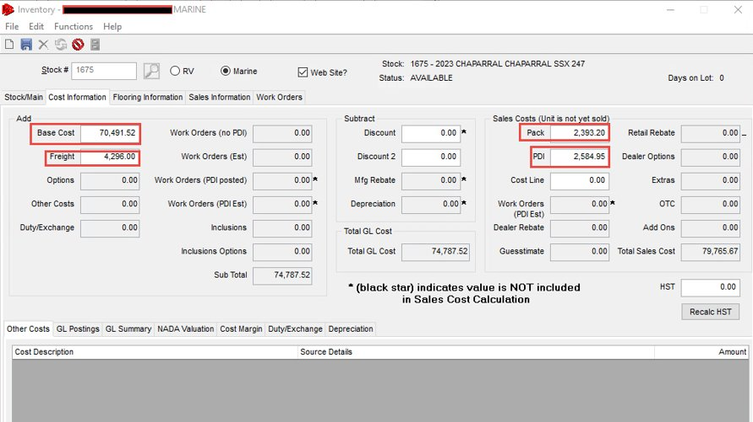
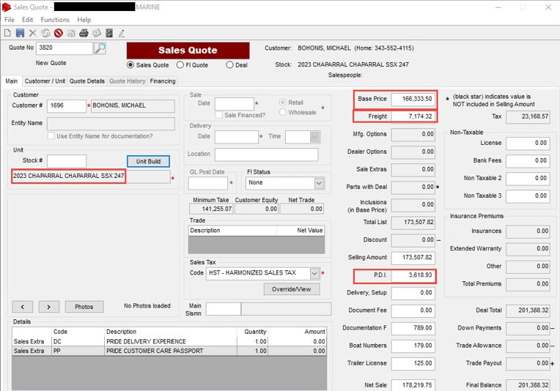
Importing the Unit Build File
After the import if you did include the pricing, it will populate the proper fields in the Inventory and Sales screens, as shown. This method of importing will save time and reduce errors.

Slide 54
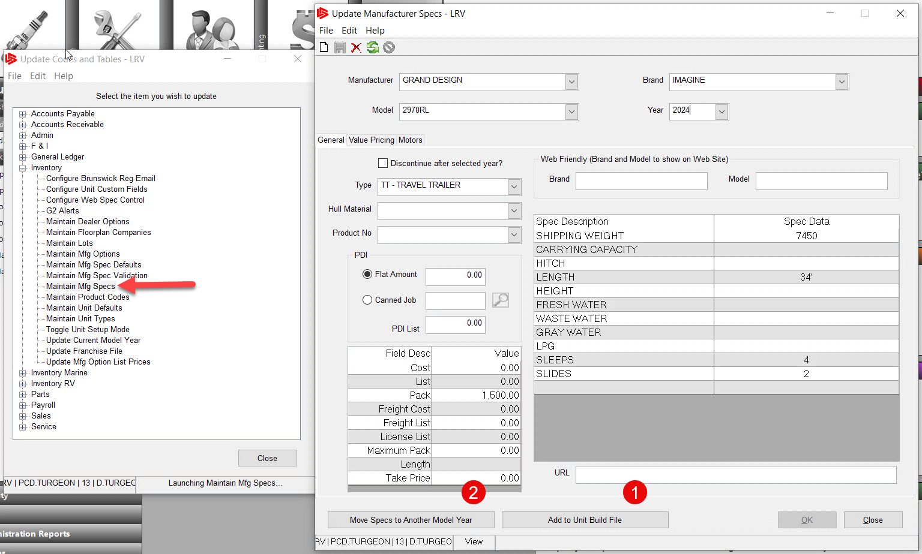
Adding Additional Units to the Unit Build File
To add a new unit to the Unit build. You will go to Admin>>Setup>>Update Codes and Tables>>Inventory>>Maintain Mfg Specs
Input the manufacturer, Brand, Model and Year of the Unit you want to add. Fill out as much information you have available including any pricing and specifications. You also have the option to attach a canned PDI job/price here.

Slide 55
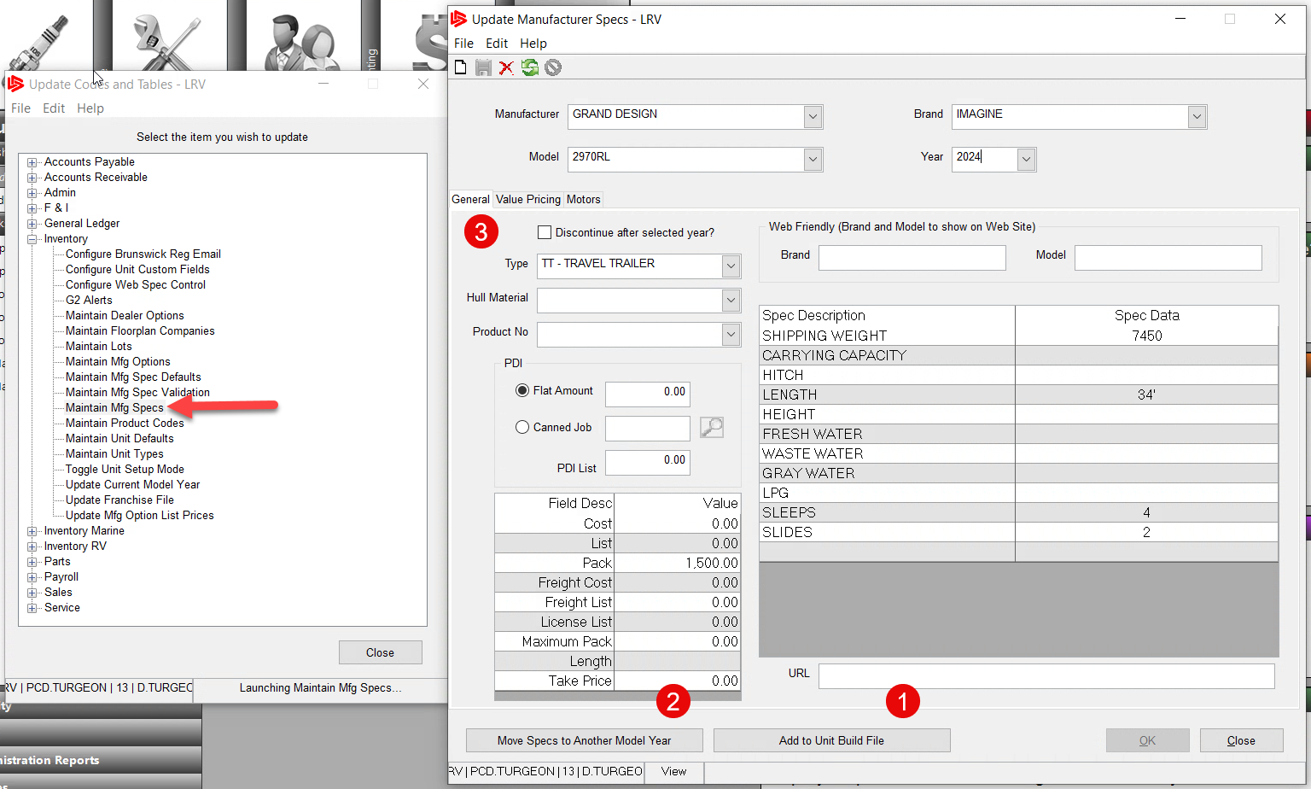
Adding Additional Units to the Unit Build File
Then Click on the Add to Unit build File button.
Here you also have the option to move the unit to a new model year
and to discontinue the unit after the current model Year

Slide 56
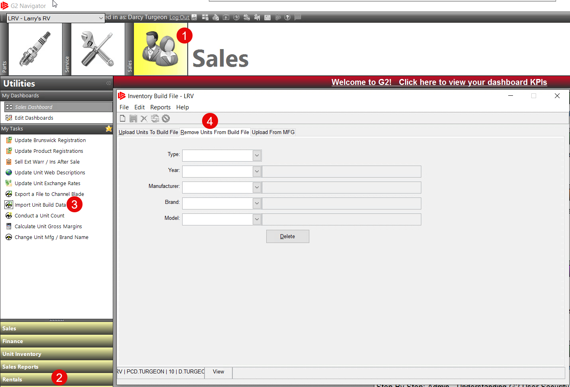
Removing Units from the Unit Build File
To Remove a Unit from the Unit build file. Go to:
Sales Module
Utilities Sub Menu
Import Unit Build Data Menu
And Choose the middle tab, Remove Units from Unit Build

Slide 57
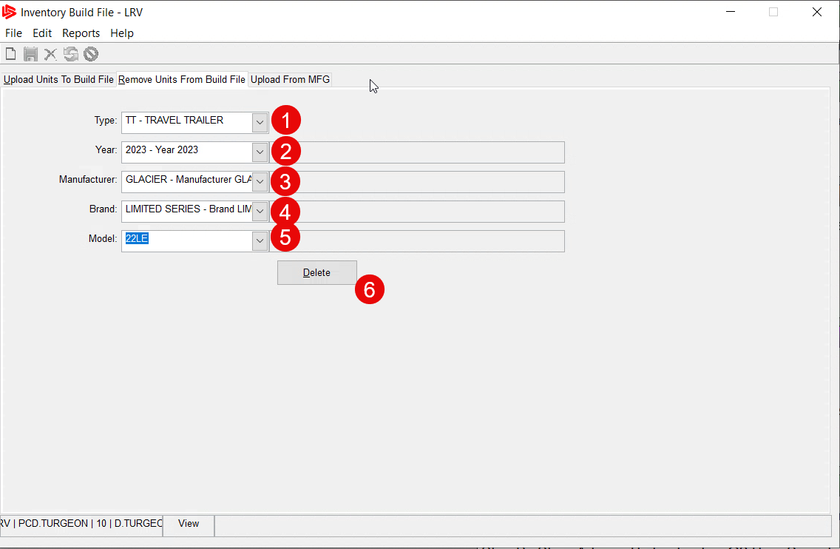
Removing Units from the Unit Build File
Choose the Type of Unit you want to remove
Choose the Year
Choose the Manufacturer
Choose the Brand
Choose the Model
Click Delete to remove the unit(s) from the Build File.

Slide 58
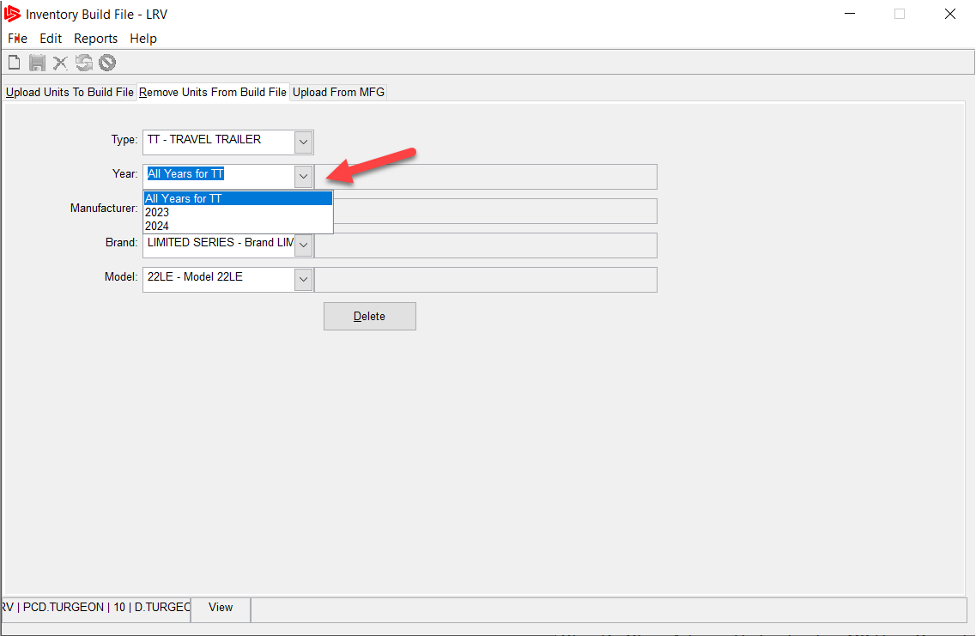
Removing Units from the Unit Build File
Once you select the type of unit all the other choices will allow you to remove units in bulk. For example Choosing 2023 will allow me to remove all TT for the year 2023. Be very careful when using this feature as all units for 2023 will be removed.

Slide 59
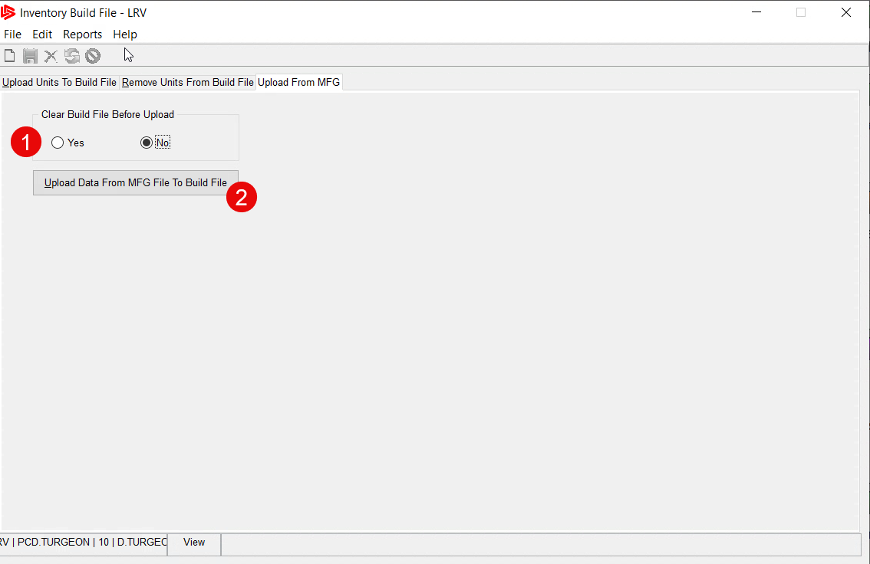
Using the Upload from Manufacturer Feature
The upload from manufacturer tab is used to upload any units already in your inventory and make them available for choosing in the Unit Build screens.
Choose whether to clear the list and only have those units available or choose No to append them
Click the button to upload, there is no confirmation or status it will upload them in the background.

Slide 60
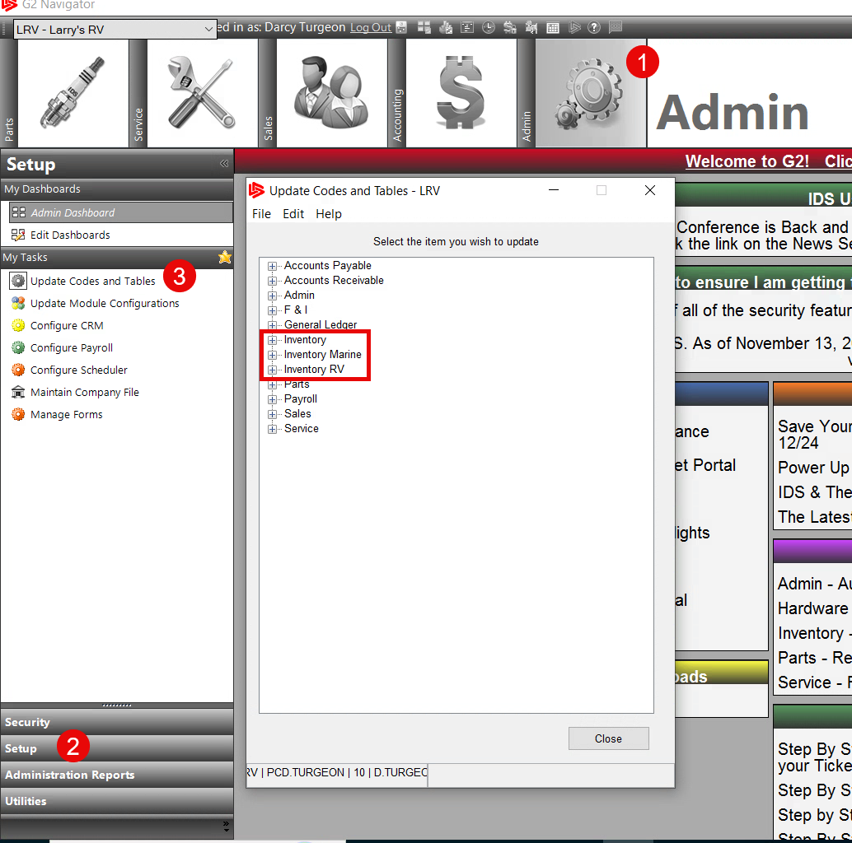
Update Codes and Tables
The update Codes and Tables screens is where the configurations for the Unit Build are located, they can be reached by going to:
Admin Module
Setup Sub-Menu
Update Codes and Tables Menu
The Inventory, Inventory Marine and the Inventory RV are used for the Unit Build Setups.

Slide 61
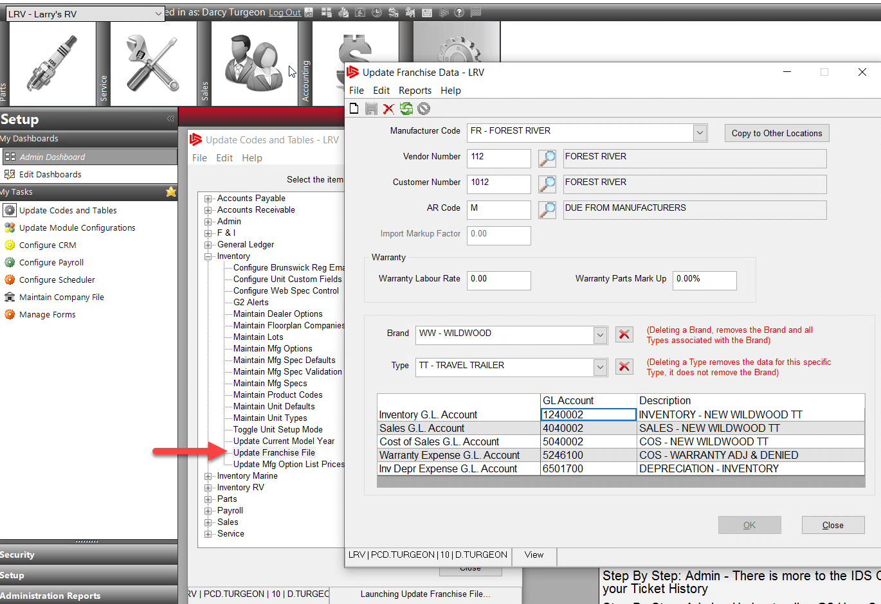
Update Codes and Tables
The Franchise File within the Inventory menu is used to setup the manufacturers and brands you carry and to setup customer and vendor numbers used for AR and AP.
It is also the place you setup the GL Accounts for any transactions that occur with this Manufacturer Brands. If you take on a new Manufacturer you will need to set them up here before you can use Unit Build.

Slide 62
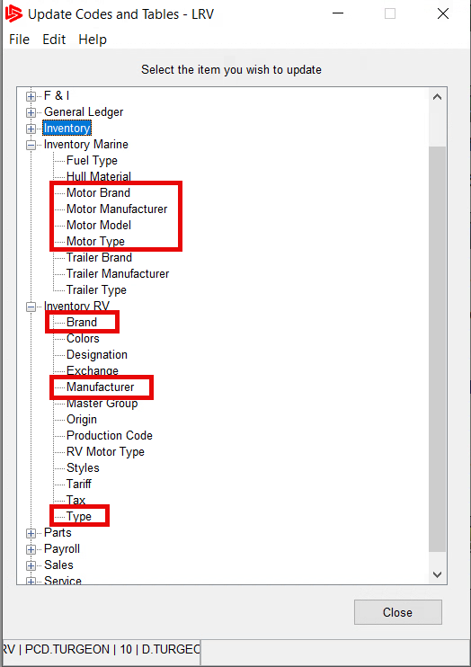
Update Codes and Tables
Within the Inventory RV sub-menu you will need to setup the Brand, Manufacturer and Types. All of which can be created here.
For Marine dealers, you will also use the same locations for your Manufacturer’s, Brand and Types. This is also the place where you can setup your various motor configurations to make them available in the build file under the motor section noted previously.

Slide 63
Final Thoughts
The Excel file is your unit build file, it can be modified anytime and is best kept available for any ongoing additions in the future. It is also a fast way of updating inventory quickly and accurately. Another key point is when you are at shows purchasing units for the new season, use this file to keep track of the purchased units and maintain pricing and PO numbers. This can be done by simply adding more columns to the excel spreadsheet. Remember you only import the stuff that is related to the unit build data.

Slide 64
Final Thoughts
When you proceed with importing unit build on your own using the techniques outlined in this presentation, you will need to contact our support team to help update the indexes within IDS. This cannot be done by the dealer at this time.
The Adding and removing of units from the build file is best done using the excel spreadsheet rather than using the built in forms in the Update Codes and Table. This way it can be done in only a few clicks of the mouse and be accurate.

Slide 65
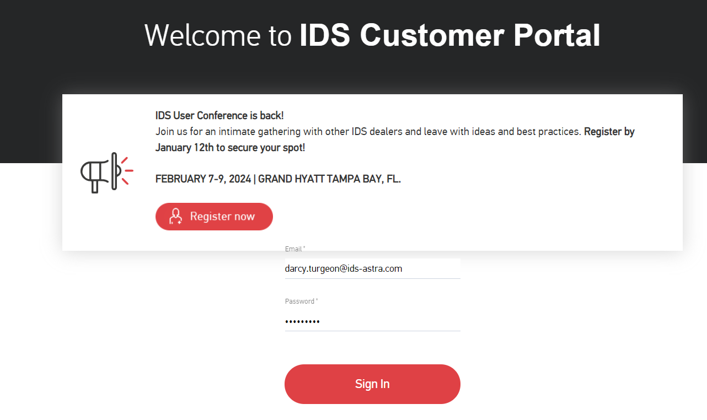
How to get Support Help
The best way to get support is to sign up on the IDS Portal website,
Visit: https://portal.ids-astra.com/login
Here you can register to send in a support ticket and access the vast amount of online reference materials.

Slide 66
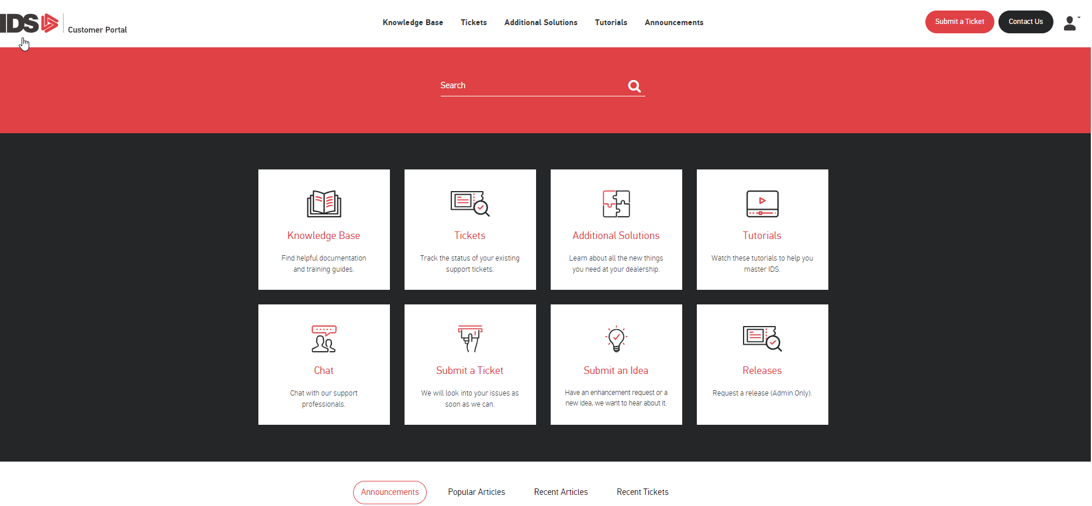
How to get Support Help

Slide 67
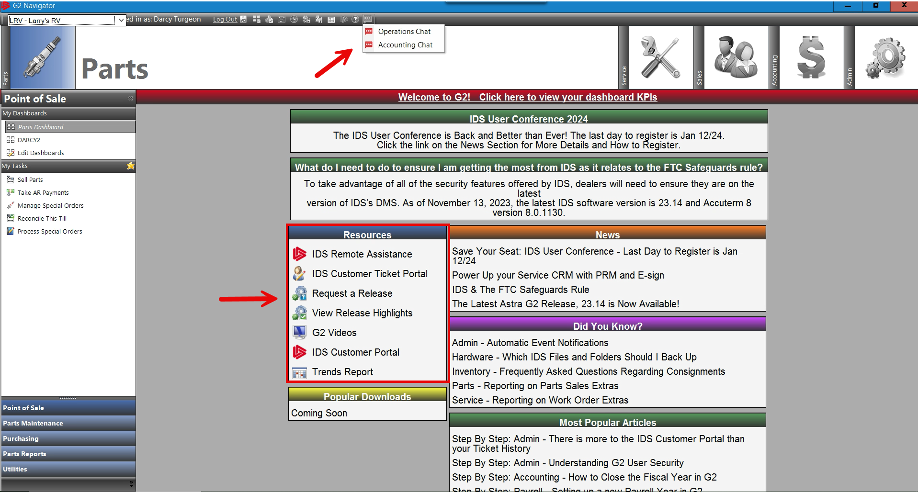
How to get Support Help

