Slide 1
Learning
Networking
And Some Fun ☺
(not necessarily in that order )
Notes:
Insert quote about Education

Slide 2
Frank Tamburrini
General Manager

Slide 3
Thank You!
Notes:
Thank you for taking the time to invest in your business. We all know sales are down and interest rates are cutting into profits. One of the first things that get cut during challenging times is Education when challenging times is when you need education the most. You all know that, that’s why you’re here! Lets focus on things you can control and getting the most out of your IDS solutions.
<Recognize long-time dealers>
<Insert Trailblazer icon>

Slide 4
25+ Year Customers
32 Years
30 Years
29 Years
28 Years
27 Years
26 Years

Slide 5
Getting The Most From Your DMS
Notes:
Tell the story about Controller who changed jobs. Guess how many configs are available? We have 775 configs

Slide 6
Getting The Most Out of The Event
Ask lots of questions
Use the IDS Lab
Talk to your peers
Pick 1 thing and immediately implement it when you get back

Slide 7
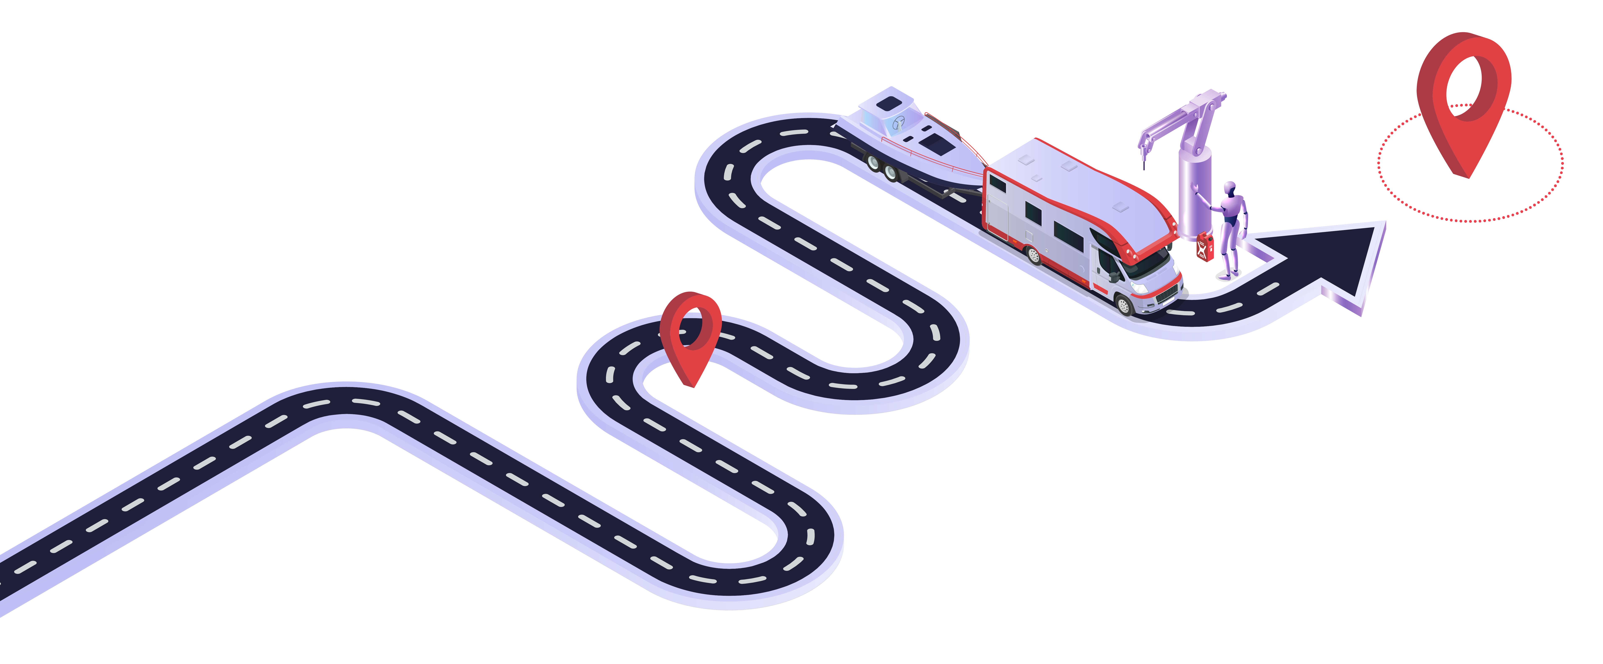
Where is IDS Going?

Slide 9
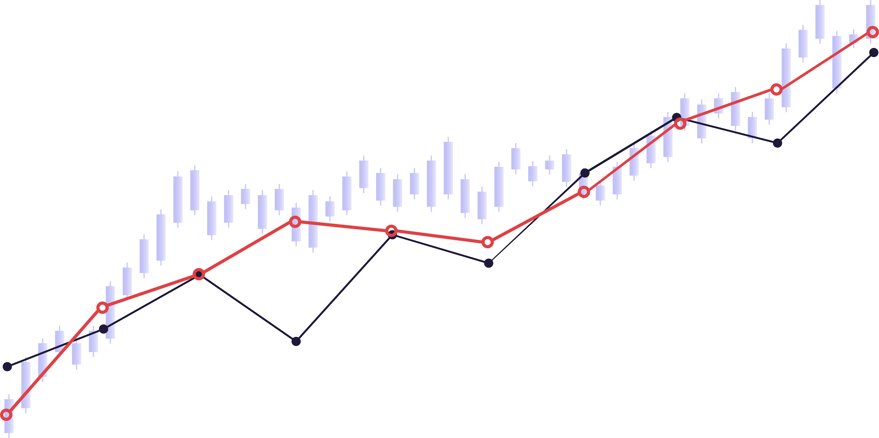
North Star
Company North Star – Most accurately captures the core values you create for your customers.

Slide 10
Where We Are Going
EFFICIENCY
PROFIT
SATISFACTION
Notes:
My job is to bring in top talent to help get us there
-Allison Miller
-Kevin Gribble
-Brandon Paisly
-Matt Richards

Slide 11
What That Means
Investing more into G2 to make you more efficient
Focus on automating repetitive tasks
Working with OEMs and Suppliers
Dealership insights at your fingertips
Using advanced technology where it makes sense

Slide 12
Exploring the Open Road Ahead
Josie Prosdocimo
Director Of Product

Slide 13
Product Mission
As the DMS leader in the RV and Marine Industry, we are the ecosystem that manages the most complex aspects of dealership operations.
Our goal is to provide the necessary connection points to allow our dealers to integrate all points of their business seamlessly.
Help dealers to empower their teams to make better decisions, improve efficiencies and ultimately maximize profitability.

Slide 14
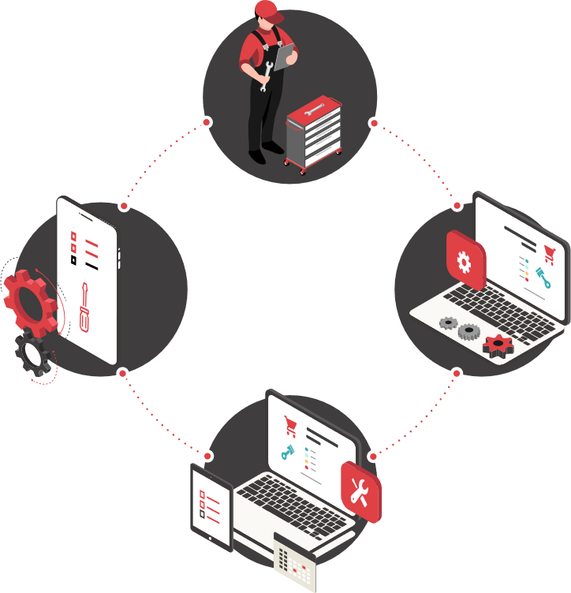
Focus On Your Business
Understand your workflows
Understand end-user needs
Partner to create value focused end-to–end solutions
Provide insights to help dealership leadership make informed decisions

Slide 15
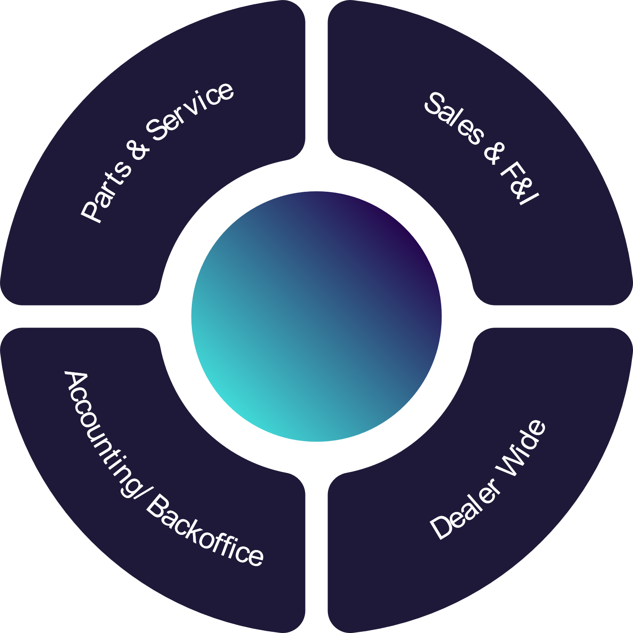
Where We Are Investing?
G2

Slide 16
Core DMS (G2)

Slide 17
Workflow (IDS360)

Slide 18
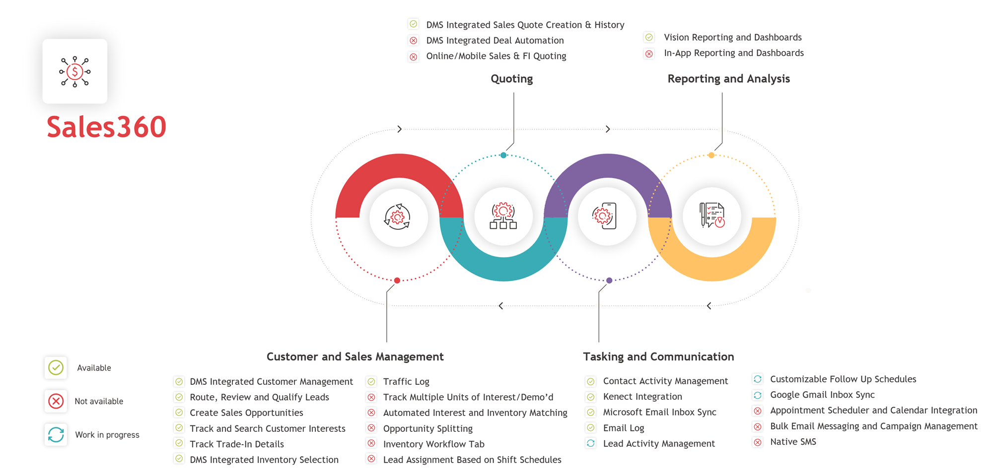

Slide 19
Conversations are Key!
Throughout this conference and beyond, we want to hear from you
Share Thoughts
Ask Questions
Feedback

